Slide 1

Printed Circuit Board Design 101 Using CadSoft Eagle
Bob Coggeshall
bob@cogwheel.com
@BobCoggeshall

Slide 2
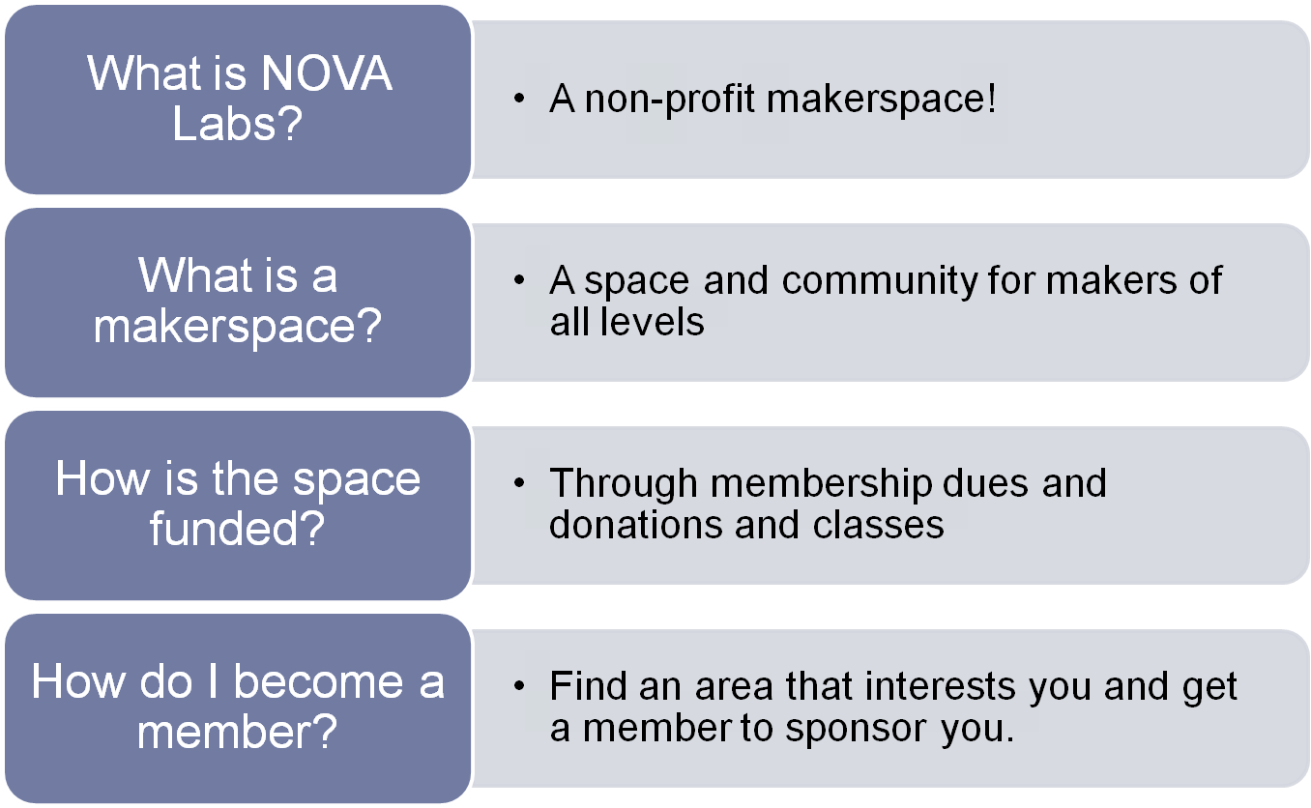
Public Service Announcement
Printed Circuit Board Design 101 Using CadSoft Eagle

Slide 3
Goals and Objectives
Design your first Printed Circuit Board !
Learn PCB Basics
Materials
Terminology
Fabrication
Schematic Capture
Layout Editor
Design Rule-checking
Submit to fab !
Printed Circuit Board Design 101 Using CadSoft Eagle

Slide 4
Format of Class
Verify software and files are installed
PC Board materials and fabrication basics
Hand out Parts
We will all design the same circuit / components
We will try to go step-by-step together.
If you are feeling super-confident, you can make changes but not encouraged.
Printed Circuit Board Design 101 Using CadSoft Eagle

Slide 5
Is your Laptop Ready ?
Instructions: https://goo.gl/557QIx
Eagle CAD 7.x
I’ll be using Eagle CAD 7.2 Free Version
Class Files: https://github.com/cogwheelcircuitworks/IntroToEagleCAD
download zip
Bob: Did you remember to bring a thumb drive ?
Printed Circuit Board Design 101 Using CadSoft Eagle

Slide 6
CAD Soft Eagle & Other EDA Tools
Eagle Pros
  Very stable on all platforms
  Very big parts library
  Very popular
Eagle Cons
  Free Version:
    non-commercial use only, 4”x3”, 2 layers, 1 sheet
Eagle Competitors
  KiCad – FOSS. Rapid uptake, Not complete or stable
  Altium – New cloud-based EDA Tool
Eagle Freeware Non-commercial, 4x3”, 1 sheet, 2 layers | $0
Eagle Light 1 user Same as freeware, but for commercial use | $69
Eagle Hobbyist non-commercial 99 sheets, 6 layers, 160x100mm | $169
Eagle Standard 1 user 99 sheets, 6 layers, 160x100mm | $820
Eagle Professional 999 sheets, 16 layers, 4000x4000mm | $1640
Printed Circuit Board Design 101 Using CadSoft Eagle

Slide 7
Units of Measurement
INCHES | MIL | MM
.001 | 1 | 0.0254
.01 | 10 | 0.254
.1 | 100 | 2.54
1 | 1000 | 25.4
Printed Circuit Board Design 101 Using CadSoft Eagle

Slide 8
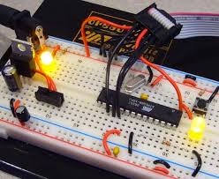
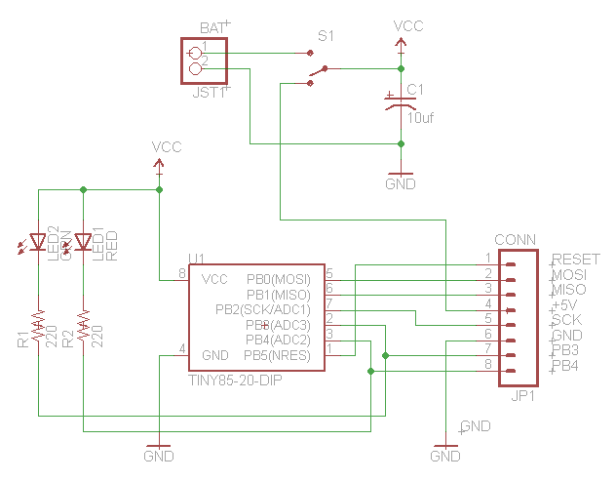
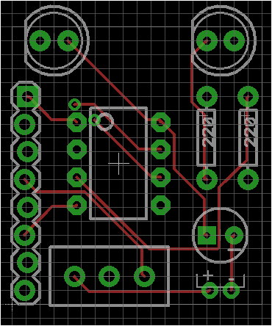
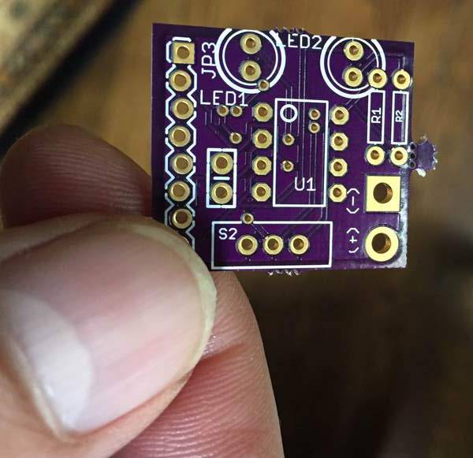
Basic Electronic Design Process
.SCH
.BRD
.GER,.XLN
(FAB)
PROTOTYPE
SCHEMATIC
EDIT
PCB
LAYOUT
STUFF,
TEST, FIND MISTAKES
Prototype stage is sometimes omitted
There will always be bugs
Then there always be changes
Each iteration is called a ‘spin’
Printed Circuit Board Design 101 Using CadSoft Eagle

Slide 9
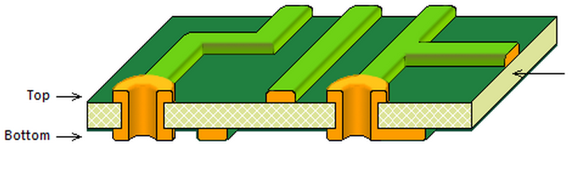
Basic 2-Layer Printed Circuit Board
Drill Holes in FR-4 (woven glass fiber + epoxy resin)
Deposit Copper
Photo-Etch Away Unwanted Copper
Apply Solder Mask (green, purple, red, etc..)
Apply Silkscreen Legending (white, yellow, etc..
Printed Circuit Board Design 101 Using CadSoft Eagle

Slide 10
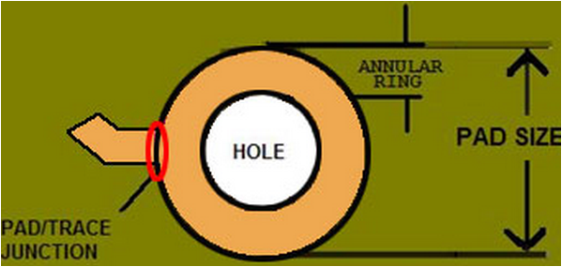
PCB Features : Holes
Unplated
  Mounting Holes
Plated-through Holes (PTH)
  Vias: Plated holes to connect layers
  Pads: Plated holes for device pins ‘through-hole’ PTH
Characteristics
  Drill Size
    Vias: usually fixed. Usually as small as possible
    Oshpark Smallest Drill Size : 13 mil.
    Go a little larger for your vias
  Plating Subtracts from Hole Diameter ~2mil
  Annular Ring
www.sunstone.com
Printed Circuit Board Design 101 Using CadSoft Eagle

Slide 11
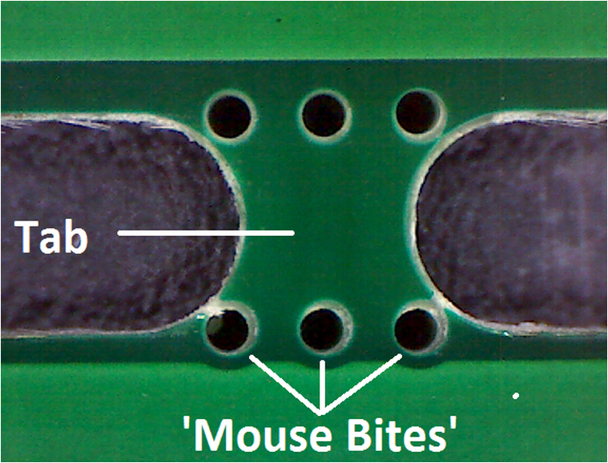
PCB Features: Traces, Board Outline
Traces: Make Connections
Power and Ground should be wider
Oshpark minimum width / space : 6mil / 6 mil
(our default is much larger)
Board Outline
Cut Methods:
  Routed: Can be any shape (within reason)
  V-score: breakable straight line
  Tab-routed: boards are held togeter in panel with perforated ‘tabs’ aka ‘mouse bites’
oshpark uses tab routing
http://www.pcbuniverse.com/
Printed Circuit Board Design 101 Using CadSoft Eagle

Slide 12
PCB Features: Mask & Silkscreen Layers
Masks go on top and bottom of boards
Paste Mask: Defines locations for solder paste for surface mount assembly
Solder Mask: Covers everywhere you don’t want solder to go. Oshpark’s is purple.
Silkscreen: Graphics & Text. Oshpark’s is white
Printed Circuit Board Design 101 Using CadSoft Eagle

Slide 13
Files Needed for Fabrication ?
Layer Information (Gerber Format)
  Top Silkscreen
  Top Soldermask
  Top Copper
  Bottom Copper
  Bottom Soldermask
  Bottom Silkscreen
Drill Information (Excellon Format)
All of the above is in the Eagle .brd file
Oshpark accepts the .brd file. Most fabs don’t
Printed Circuit Board Design 101 Using CadSoft Eagle

Slide 14
Basic Fabrication Limits (mils)
PARAMETER | OSHPARK | EAGLE DEFAULTS
MIN TRACE WIDTH | 6 | 8
MIN TRACE CLEARANCE | 6 | 8
MINIMUM DRILL SIZE | 13 | 24
You don’t need to mess with these
Just be aware of them for now
Printed Circuit Board Design 101 Using CadSoft Eagle

Slide 15
EagleCAD UI COMPONENTS
CONTROL PANEL
SCHEMATIC CAPTURE
PCB LAYOUT
TO FAB:
.ger, .xln
(netlist)
PROJ.SCH
PROJ.BRD
LIBRARY
EDITOR
.LBR
We won’t be covering the Library Editor ☹
Printed Circuit Board Design 101 Using CadSoft Eagle

Slide 16
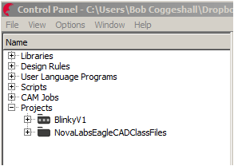
EagleCAD Control Panel – Create Project
Do This:
  [ ] Options->Directories
  Find your $HOME/../Projects/myeagle/
  [ ] In the file explorer Find Projects/NovaLabsEagleCADClassFiles/
Make Sure you can access the class files directory
Do this:
  [ ] Highlight Projects/
  [ ] File -> New -> Project -> BlinkyV1
Printed Circuit Board Design 101 Using CadSoft Eagle

Slide 17
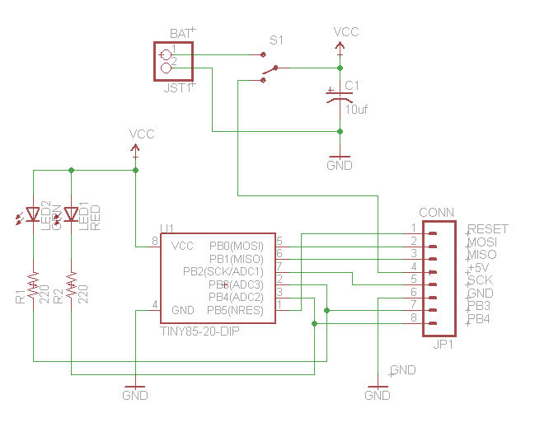
What we will be building
Atmel ATTiny processor
(2) LEDs
(2) Resistors
Switch
Capacitor
Connection for battery
Connection for in-circuit programming / expansion
Printed Circuit Board Design 101 Using CadSoft Eagle

Slide 18
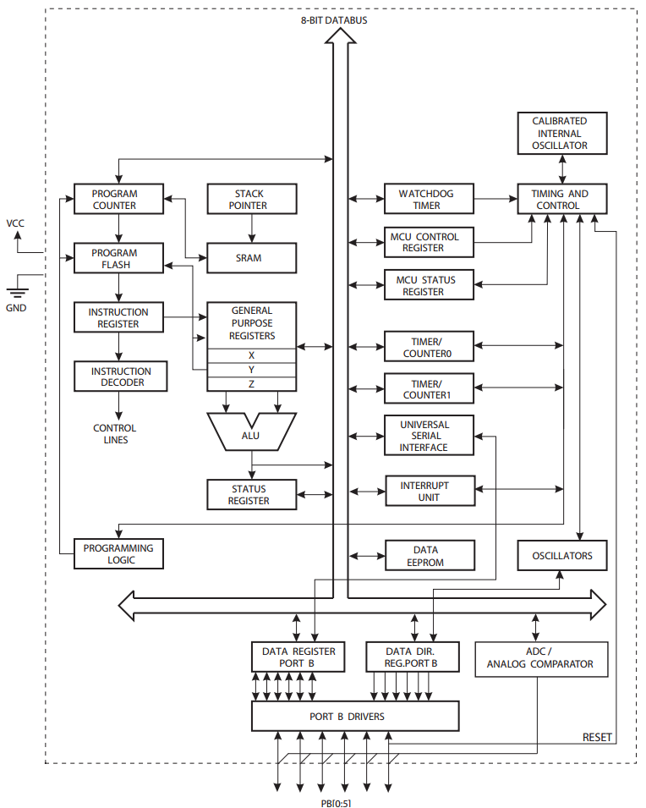
ATTiny Block Diagram
Printed Circuit Board Design 101 Using CadSoft Eagle

Slide 19
Our Bill of Materials
QTY | MFR | MFRPN | DESCRIPTION | DIST
1 | Atmel | ATTINY85-20PU-ND | IC MCU 8BIT 8KB FLASH 8DIP | DK | $1.38
1 | TE Connectivity | 1825115-1 | SWITCH SLIDE SPDT 250MA 125V .5mil spacing | DK | $0.74
1 | Jameco Reliapro | 216081 | Battery Holder 2-AA Wires | JC | $0.69
1 | Jameco Valuepro | 6000-8DW-R | 8-Pin IC Socket Dual Wipe Low Profile | JC | $0.74
1 | Jameco Valuepro | 7000-1X40SG-R | Connector Unshrouded Header 40 Position 2.54mm Straight Thru-Hole | JC | $0.12
1 | Jameco Valuepro | R10/25A | @ CAP,RADIAL10uF,25V,20%,85C 5 x 11 x 5mm (10) | JC | $0.19
1 | Jameco Valuepro | RL50-PR543 | LED Ultra Red Water Clr T1 3/4 | JC | $0.29
2 | Jameco Valuepro | UT5HW3-4D-URC3-4861-R | LED White T-1 3/4 7000mcd 30 Deg Viewing Angle | JC | $2.00
2 | Jameco Valuepro | CF1/4W101JRC | Resistor Carbon Film 100 Ohm 1/4 Watt | JC | $0.18
 |  |  |  |  | $6.33
Also the PCB From Oshpark.. ~$5.00 DK = Digikey, JC = Jameco
Printed Circuit Board Design 101 Using CadSoft Eagle

Slide 20
Create an empty schematic (.sch)
Do this in Control Panel:
  [ ] Select Projects/BlinkyV1/
  [ ] Right-Mouse -> New -> Schematic -> BlinkyV1
  You’ll be thrown into the schematic editor..
  In schematic editor:
  [ ] Save As BlinkyV1
Printed Circuit Board Design 101 Using CadSoft Eagle

Slide 21
Schematic Editor Basics
  Familiarize Yourself With
    [ ] Titlebar Commands
    [ ] Side bar Commands
    [ ] Command Window
  There are usually 2 or 3 ways to do things
  Turn the Grid on:
    [ ] Click on the Grid Icon or...
    [ ] Do a View->Grid or ...
    [ ] Type grid on in the command window
Printed Circuit Board Design 101 Using CadSoft Eagle

Slide 22
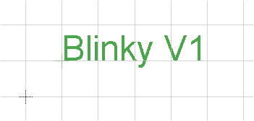
Zoom, Find Origin, Add Some Text
  [ ] Zoom Out
  [ ] Zoom In
  [ ] Zoom Fit
  [ ] Click on the “T” at left
  [ ] Click Somewhere, Start the text command
  End Command <esc><esc> or
  Click on (i) in command bar
  Or right-mouse->properties
  ** commands are sticky **
  ** some commands are multi-state **
  Use >DRAWING_NAME for file name
  Use >LAST_DATE_TIME for date
Printed Circuit Board Design 101 Using CadSoft Eagle

Slide 23
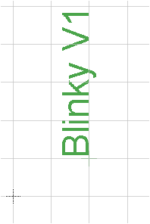
Move
[ ] Find the origin of the Text
[ ] Click The Move Icon
[ ] Click near the origin of the text
[ ] Move the mouse
[ ] Click Again
[ ] Try clicking right-mouse
[ ] How many ways are there to start the Move command ? Pick your favorite
Printed Circuit Board Design 101 Using CadSoft Eagle

Slide 24
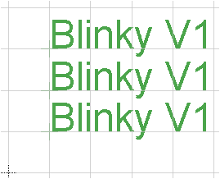
Copy, Delete, Undo
[ ] Start the copy command
[ ] Click on text
[ ] Move the mouse
[ ] Click again
[ ] Start Delete Command
[ ] Click on Text
[ ] Run Undo Command
Printed Circuit Board Design 101 Using CadSoft Eagle

Slide 25
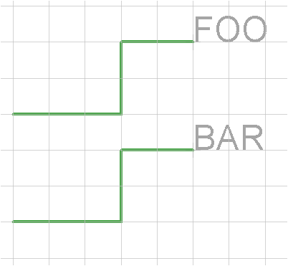
Wires, Labels, Names
[ ] Start Wire Command
[ ] Click Start point, Click End Point, Click Again
[ ] Mouse Over Wire
[ ] (Right-Mouse) Label
[ ] Click to position
[ ] Mouse over Wire
[ ] Click Name
[ ] Enter Name
Printed Circuit Board Design 101 Using CadSoft Eagle

Slide 26
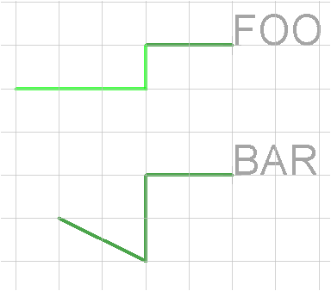
Moving Wires
[ ] Mouse over end point
[ ] Right-Mouse->Move
[ ] Move end point, Click
[ ] Mouse over middle
of a segment
[ ] Right-Mouse->Move
[ ] Move Segment, Click
Printed Circuit Board Design 101 Using CadSoft Eagle

Slide 27
Moving Groups
[ ] Click Group
[ ] Click+Drag Corners
[ ] Click Move
[ ] Right-Mouse: Move Group
[ ] Click again to position
KEYBOARD SHORTCUTS
[ ] In command window:
assign
Create some keyboard shortcuts :
assign f1 group
assign f2 move
Printed Circuit Board Design 101 Using CadSoft Eagle

Slide 28
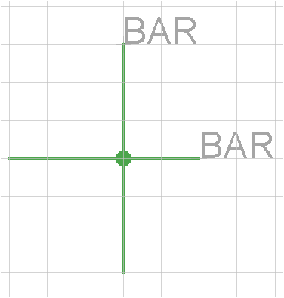
Joints
[ ] Make the two segments cross
[ ] Click Joint
[ ] Click on Intersection
[ ] Decide on a Name
Printed Circuit Board Design 101 Using CadSoft Eagle

Slide 29
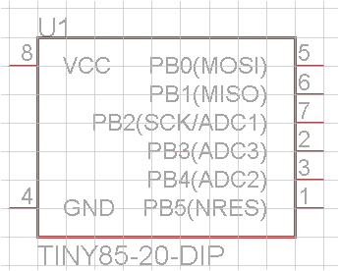
Attaching Libraries, Adding Components
[ ] In Control Panel, Navigate to NovaEagleCADClass.lbr
[ ] Right-Mouse->USE
[ ] In Schematic Editor, Click on Add
[ ] Expand NovaEagleCADClass
[ ] Click TINY85-20-DIP
Printed Circuit Board Design 101 Using CadSoft Eagle

Slide 30
THIS IS THE PART WHERE PARTS GET HANDED OUT
Printed Circuit Board Design 101 Using CadSoft Eagle

Slide 31
Add The Components
[x] Microcontroller: TINY85-20-DIP
[ ] Resistors Resistor -> Axial-0.3 x2
[ ] Leds LED -> 5mm x2
[ ] Connector : MO8 -> M08LOCK
[ ] Battery Connector: JST_2PIN -> JST-PH-2-THM-RA
[ ] Ground Symbol: GND
[ ] Capacitor :10UF-25V-20%
[ ] Switch SWITCH-SPDT->SWITCH-SPDT_3.2MM
[ ] Power Symbol VCC
Printed Circuit Board Design 101 Using CadSoft Eagle

Slide 32
Schematic Layout Tips
Undo (^Z) is your friend
Moving wire ends to join does not work
Wiggle part to make sure it is connected to wire
Moving attached groups works in one axis
RUN ERC WHEN DONE !
Printed Circuit Board Design 101 Using CadSoft Eagle

Slide 33
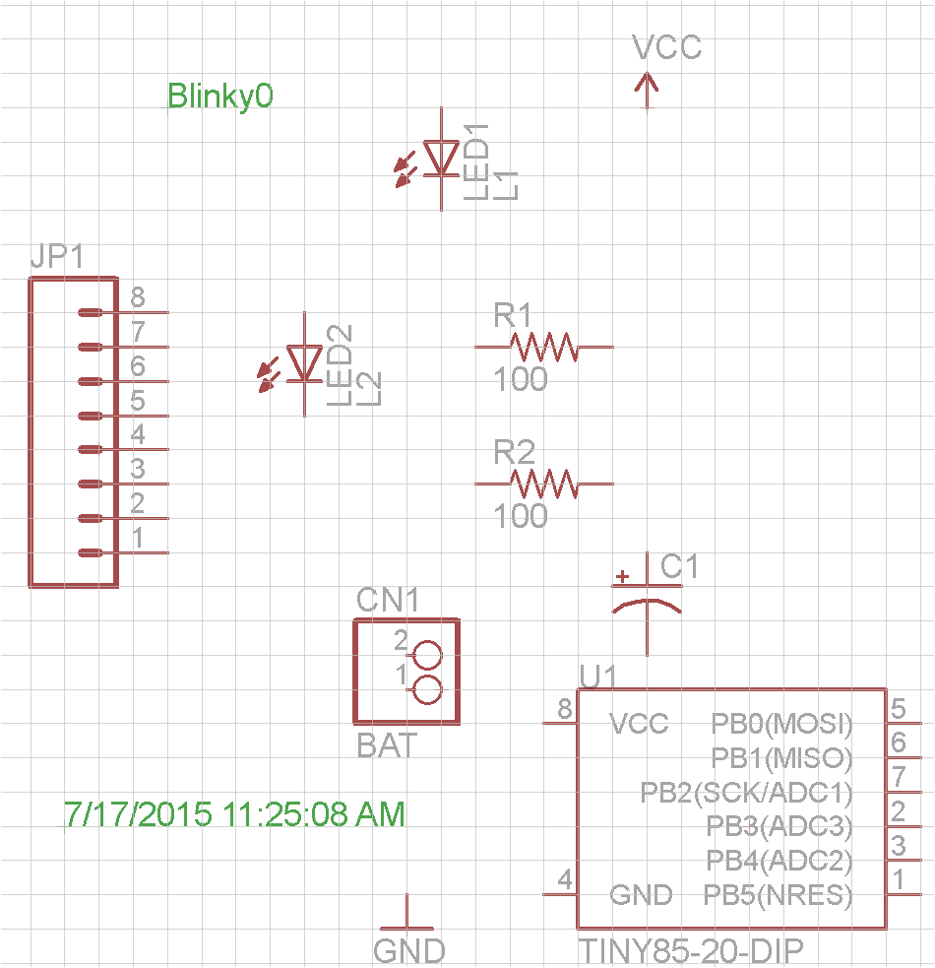
Wire ‘em up !
Before:
Printed Circuit Board Design 101 Using CadSoft Eagle

Slide 34
Wire ‘em up !
After
Printed Circuit Board Design 101 Using CadSoft Eagle

Slide 35
*Times UP*
If you haven’t finished your schematic in class, don’t worry.
Make a new project and place blinky-sch-done.sch from the ClassFiles Directory in it
Printed Circuit Board Design 101 Using CadSoft Eagle

Slide 36
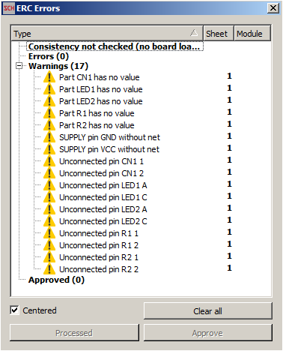
ERC – Electrical Rule Check
Tools -> ERC
Printed Circuit Board Design 101 Using CadSoft Eagle

Slide 37
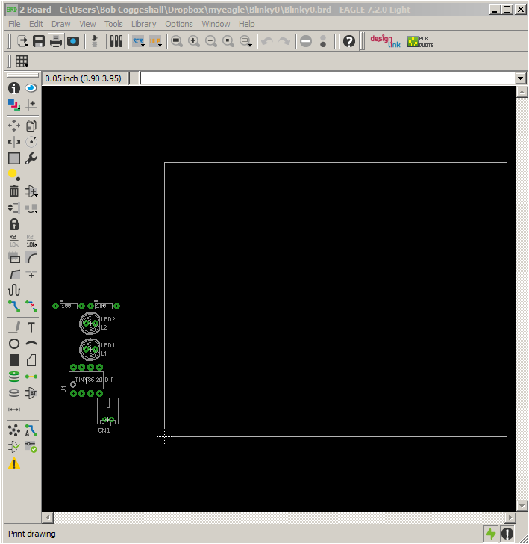
Start PCB Layout Editor
[ ] File->Switch To Board
PCB and Layout
are connected
Always open both
[ ] Practice switching
between the two
You now have matching
.sch and a .brd files
Printed Circuit Board Design 101 Using CadSoft Eagle

Slide 38
Layout Editor Keyboard Shortcuts
Load Keyboard Shortcuts in NovaLabsEagleCADClassFiles/
[ ] File->Execute Script->KeyboardShortCuts.scr
Cut out KeyboardShortCuts.doc to use as a cheat sheet
F1 | group
F2 | move
F7 | display all
F8 | display ratsnest
CTRL-F8 | hide ratsnest
F9 | display top layers
CTRL-F9 | hide top layers
F10 | display bottom layers
CTRL-F10 | hide bottom layers
F11 | show top silkscreen
CTL-F11 | hide top silkscreen
F12 | show bottom silkscreen
CTL-F12 | hide bottom silkscreen
Printed Circuit Board Design 101 Using CadSoft Eagle

Slide 39
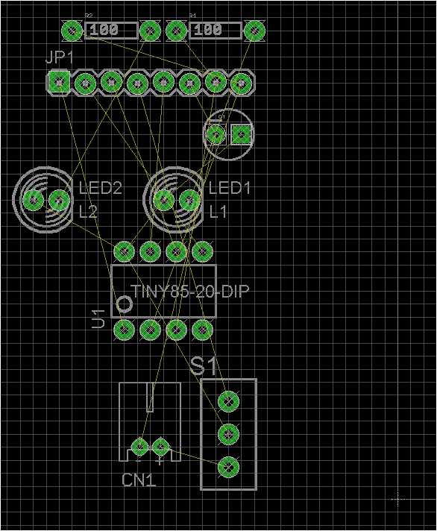
PCB Layout Editor - Intro
[ ] Turn Grid On, Display all
[ ] Note: Origin, Unrouted
(aka “Ratsnest”)
[ ] Try Zoom In Zoom Out
[ ] Try Move
[ ] Try:
Select All (or F7)
View->Layer Settings
Rats On (F8) Rats Off (CTRL-F8)
View->Layer Settings
Printed Circuit Board Design 101 Using CadSoft Eagle

Slide 40
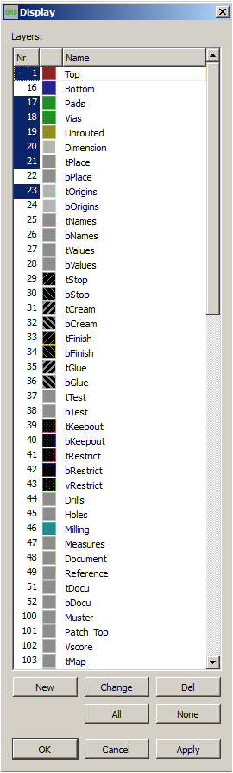
PCB Layout Editor – More Exploration
[ ] Turn on Unrouted and
Top Layer (F8, F9)
[ ] View->Layer Settings
Printed Circuit Board Design 101 Using CadSoft Eagle

Slide 41
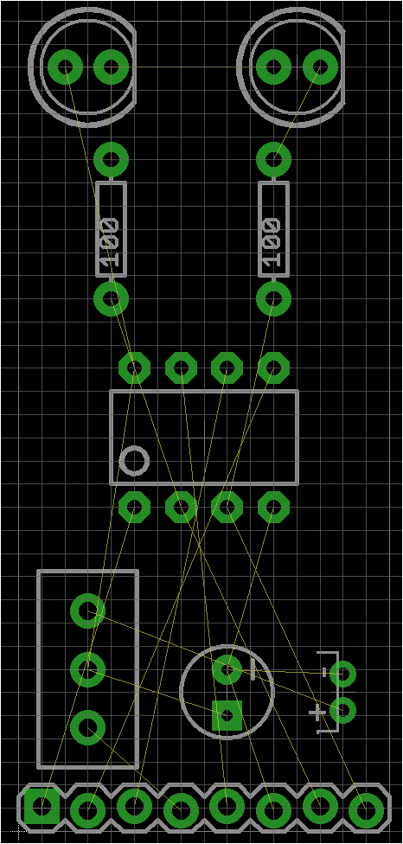
Position Parts
[ ] Start moving things onto board
Zoom, Move, and Group work
the same as in schematic capture
[ ] Move Board Outline Last
Printed Circuit Board Design 101 Using CadSoft Eagle

Slide 42
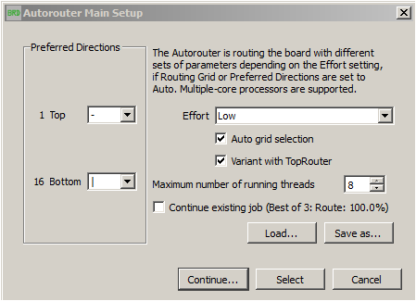
Run the Auto-Router
[ ] Tools -> Autorouter
Printed Circuit Board Design 101 Using CadSoft Eagle

Slide 43
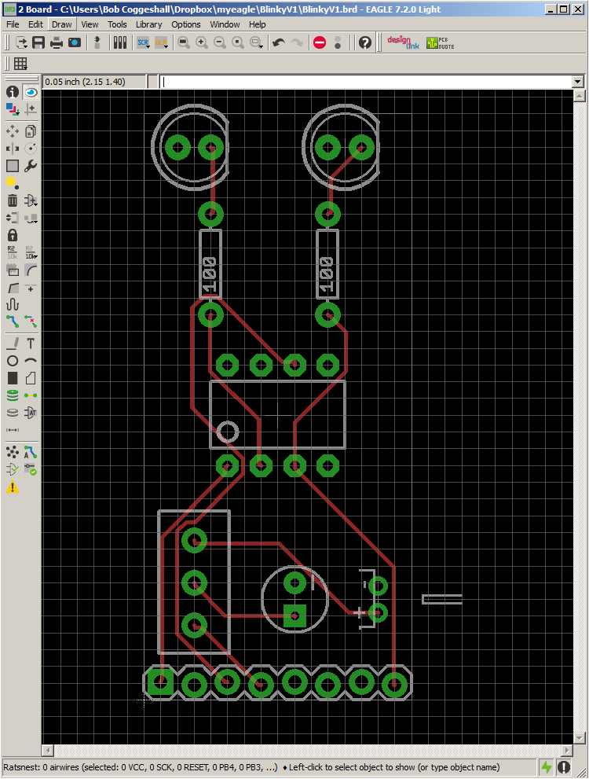
Check that it was 100% Routed
[ ] In command Window:
Rats *
Should say
0 airwires
Printed Circuit Board Design 101 Using CadSoft Eagle

Slide 44
Rip-up, Run auto-route again, Run ERC
[ ] Display all (F7)
[ ] Select all
[ ] Ripup, Right-mouse Ripup group
[ ] Run ERC. Should say ‘No Errors/warnings’
Printed Circuit Board Design 101 Using CadSoft Eagle

Slide 45
Edit Silkscreen
[ ] Select All
[ ] Smash, Right-mouse -> Smash Group
Allows you to move text around independent
Parts...
[ ] Display Top Silk (F11)
[ ] Move text around to suit
[ ] Fix size with ‘change size’
Printed Circuit Board Design 101 Using CadSoft Eagle

Slide 46
Add some additional Text on Bottom
[ ] Understand the ‘view layer’ vs. ‘layer’ command
[ ] Understand Silkscreen is Names layer + Place layer
[ ] Add polarity indication for capacitor
[ ] Add polarity indication for battery
[ ] Add pin 1 marker for header
Add stuff on the bottom
[ ] Layer
Printed Circuit Board Design 101 Using CadSoft Eagle

Slide 47
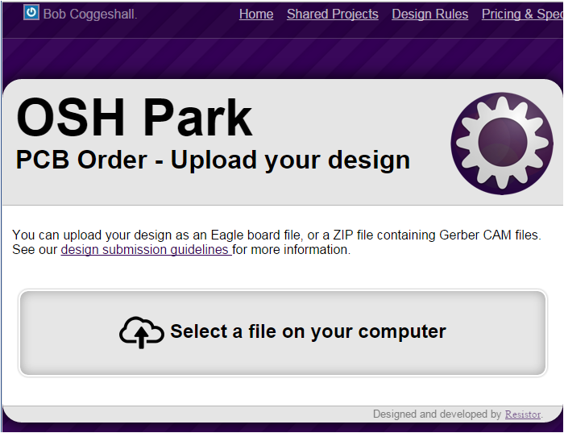
Submit To Oshpark
Drag and drop your .brd file
Printed Circuit Board Design 101 Using CadSoft Eagle

Slide 48
Gerber and Drill Previewers
Offline Windows/Linux:
Gerbv: http://gerbv.sourceforge.net/
Online:
webgerber http://mayhewlabs.com/3dpcb
Printed Circuit Board Design 101 Using CadSoft Eagle

Slide 49
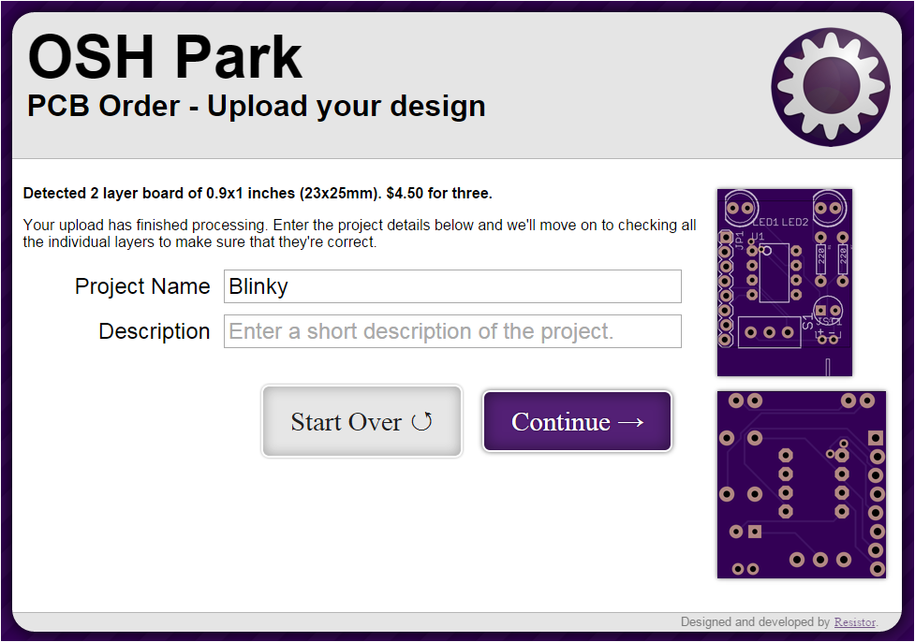
Submit to oshpark con’t
oshpark previewer sometimes make little mistakes w/outline
Printed Circuit Board Design 101 Using CadSoft Eagle

Slide 50
Things we didn’t do that we should have
[ ] Never trust part libraries
[ ] Always preview your gerbers and drill files
[ ] Never auto-route everything
[ ] Never trust default design rules
Printed Circuit Board Design 101 Using CadSoft Eagle

Slide 51
Going forward
Stuff and Build your Boards !
Email me how you did !
Explore existing designs on Sparkfun and Adafruit
Load Sparkfun and Adafruit Libraries
Revise your design to do something else !
Printed Circuit Board Design 101 Using CadSoft Eagle

