Slide 1
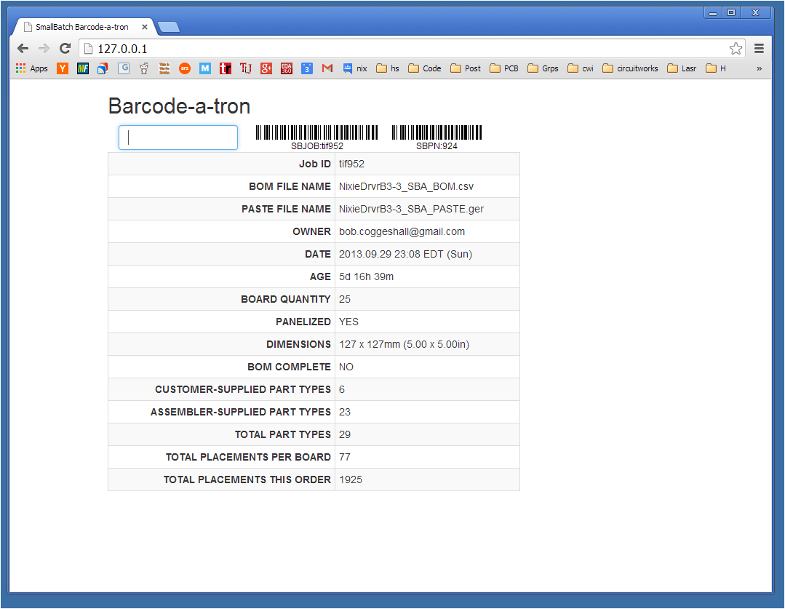
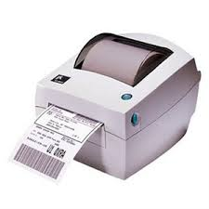
SERVER (LAMP)
wordpress ajax API
json
WAN
LAN
http POST
BROWSER
http GET
LOCAL SERVER
(FLASK )
.html, .js, .css
barcode.js
form.html
http_barcodes.py
sb_aj_query.py
kitlabels.py
ajax http POST
json
acrobat
barcode printer

