Slide 1
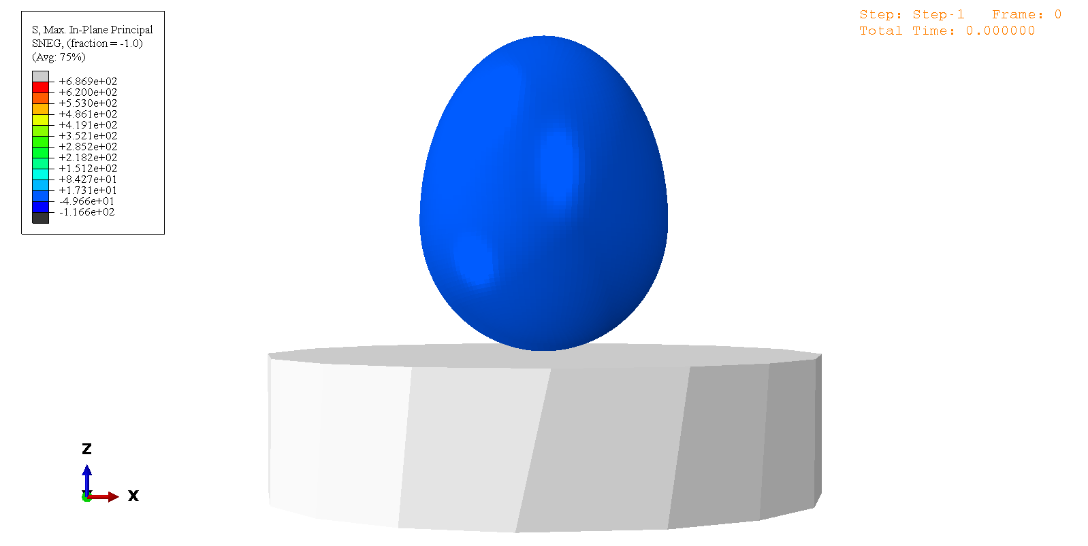
Time-history animation showing the maximum principal stress contours (in MPa) on the deformed shape of a vertically oriented egg dropped from a height of 200 mm

Slide 2
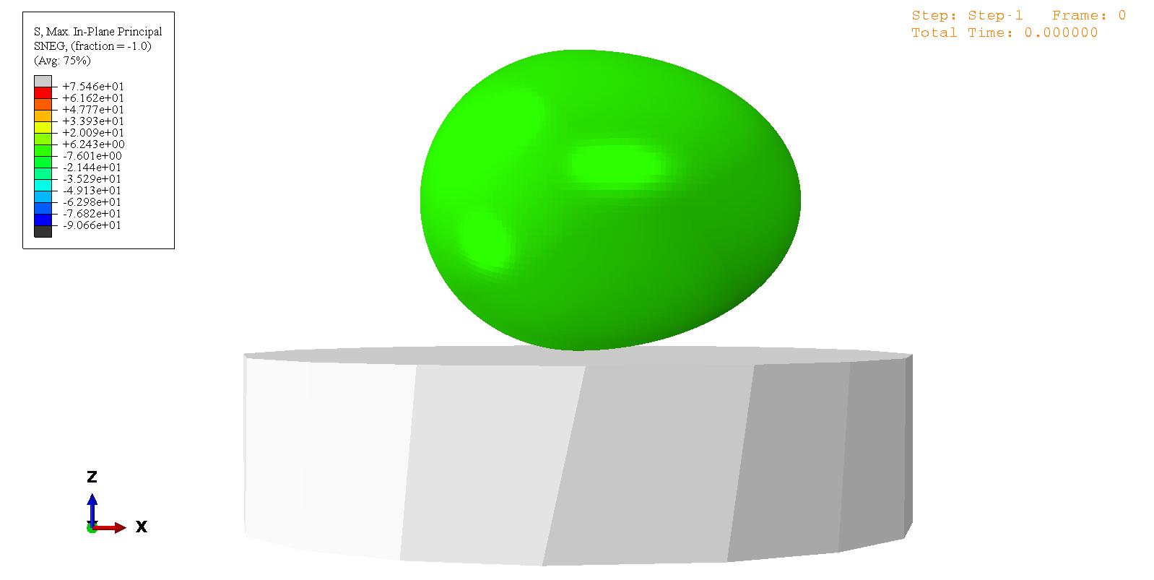
Time-history animation showing the maximum principal stress contours (in MPa) on the deformed shape of a horizontally oriented egg dropped from a height of 200 mm.

