Slide 1
Predicting Workaholics

Slide 2

Who cares if someone likes to work?
Getting work done is important
Developing relationships and being a team player is important
Balance is Key

Slide 3

We Need to Quantify Workaholism
Recruiters filter through many upon many resumes a day
Being able to filter candidates based on how workaholic they are would be valuable

Slide 4
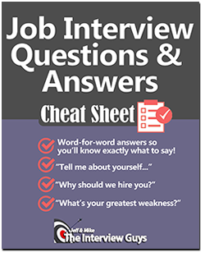
But How?
Can’t directly ask candidates – they will know what the company is looking for.
Instead ask other questions that can help gage their characteristics.

Slide 5

Objectively Defining Workaholism
1 – Postpones doing work whenever possible.
2 – Doesn’t like doing work but will do work when needed reluctantly
3- Balances work with other interactions
4- Enjoys doing work but recognizes other needs
5- Will push off other needs in order to work.

Slide 6

What We Have
A survey taken by young adults containing
Their background – where they group up (rural vs urban) number of siblings…
Their interests (movies, music…)
Their hobbies (shopping, browsing the internet)
How Workaholic they are

Slide 7

Our Job
Identify key features that can help indicate whether a person is workaholic or not.
Create a model to predict how workaholic on a scale of 1 to 5 a person is.

Slide 8
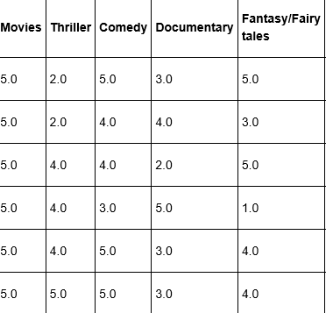
Data Wrangling
Imported the data-set
Mapped words like “very” and “somewhat” to ratings out of 5
Filled missing values with the mean
Filtered out overly specific columns, keeping 34 features to analyze.
Checked that all values were between 1 and 5
Subset of Data used from Movies Interests

Slide 9
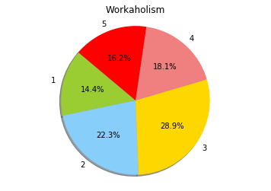
Workaholism Distribution
Most people are in the middle – that is having a rating of 3
30 percent fall out in the extremes – 16 percent have a rating of 5 and 14.4 have a rating of 1.

Slide 10
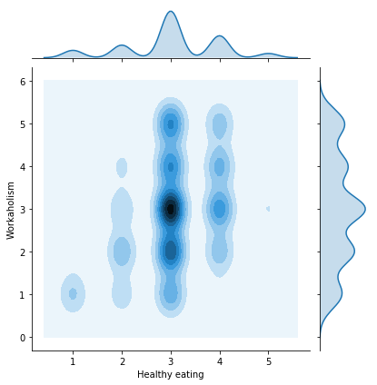
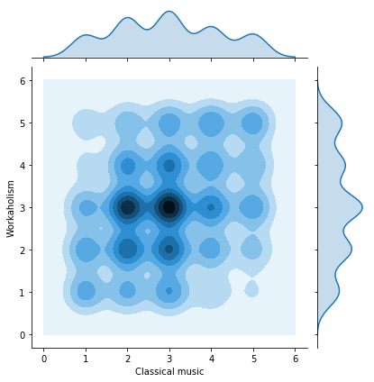
Finding Correlations Through Plots
People who eat don’t eat healthy tend not to be workaholic
People who like Classical Music tend to be more workaholic

Slide 11
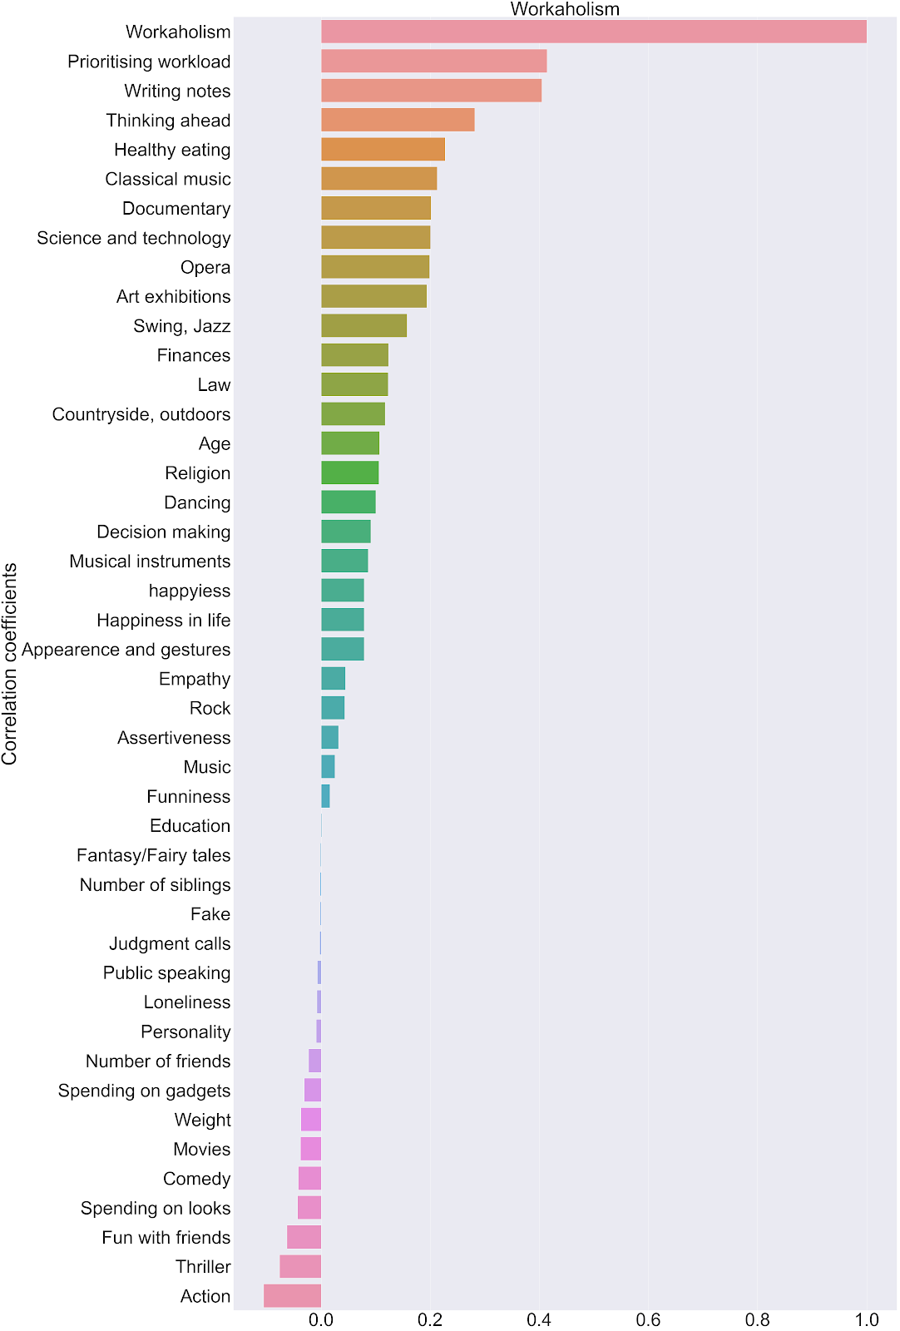
Pearson Correlations
‘Prioritizing Workload’ and ‘Writing Notes’ have the strongest correlations while ‘Action Movies’ has the weakest.
Most of the features are not closely correlated
.

Slide 12
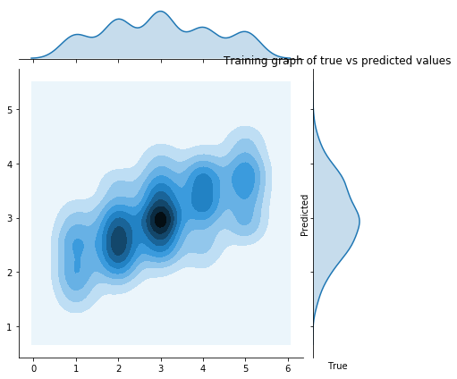
Creating our Ridge Regression Model
Split into test set and training set
Regularized by comparing the cross-validation scores with different values of alpha
Alpha values picked through trial and error
Model’s prediction on training data

Slide 13
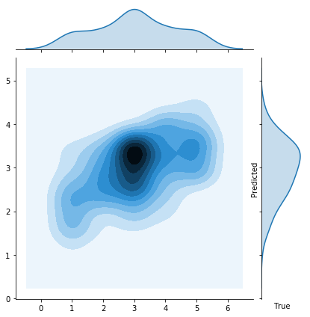
Analysis
The model tends not to give values in the extreme.
The mean deviation is around 1 in either direction
We can use the model to semi accurately rate how workaholic a person is.
Model’s prediction on test data

Slide 14
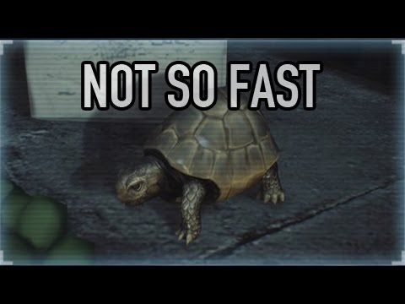
Caution
Our MSE is too high to give an actual prediction of whether a person belongs in the 1,2,3,4,5 range
Our model therefore should NOT be used in order to filter candidates.

Slide 15

At the same time…
Our model will become more accurate given more data.
Our model can be used to give a rough approximation of how workaholic a person is.
This project did identify what features are correlated to workaholism through the Pearson Coefficients.

Slide 16

Further study…
Use a data-set from people of varying ages
Look at the other features
Use metrics like how much people work instead of surveys

