Slide 1


At the bottom of the list you can see the average amount of prize points you achieved so far.
At the end, you will get a cent for each 4 prize points (25 cents for 100 prize points).
The bonus is 20 cents minus the average ranking.
In this case, the bonus will be:
20 – 3.2 = 16.8 cents
If the candidate is rejected, he cannot be hired later on, and we move on to interview the next candidate for the current position.
For each position, you have 10 different candidates. Your (and the HR executive’s) interest is to hire highly qualified candidate.
This is a screenshot of the game after rejecting 5 candidates for the manager position (and interviewing the sixth).
After a candidate is interviewed, a decision must be taken of whether to hire the candidate or reject him
The candidates are interviewed one by one by the HR executive, and each candidate has a rank, relative to all the previous candidates.
Filling a Position –
Summary
The ranking is determined by the relative position of the candidate, compared to all the candidates that were interviewed by now for the current position.
The current candidate is ranked 4 out of 6 candidates interviewed thus far
In case we hire a candidate, we can see the real rankings of the interviewed candidates, including the hired candidate
As the HR executive interviews a new candidate, he needs to decide whether to hire him or not. Once a candidate has been rejected, he cannot be hired later (cannot be recalled).
4 candidates remained
Then, the ranking of the candidate is determined.
We can also see the real rankings of the candidates that we didn’t interview
In the training mode, you need to make the decision to accept/reject each candidate with the thumbs buttons
Choose
The rankings of the hired candidates are saved in the positions list.
Make a decision:
Accept
Reject
You won’t see each interview, only the result of the interviews – the hired candidate’s rank.
In the game, you won’t see the whole process of interviewing, only a summary of the process.
You will see the hired candidate for the position.
Please note that the HR executive still interviews the candidates as described in the instructions.
Choose Accept or Reject
This is the list of the remaining candidates. Each position has initially 10 candidates
After a candidate is hired, you need to pick uniform for him.
Then we move on to the next position
Each worker hired will get you prize points according to her ranking. #1 ranked will get you 100 points, #2 will get you 90 points, and so on.
In the right column of the table, you can see the number of prize points achieved for each worker.
This is the list of the positions we need to fill
This is the current position we are interviewing candidates for.

Slide 2
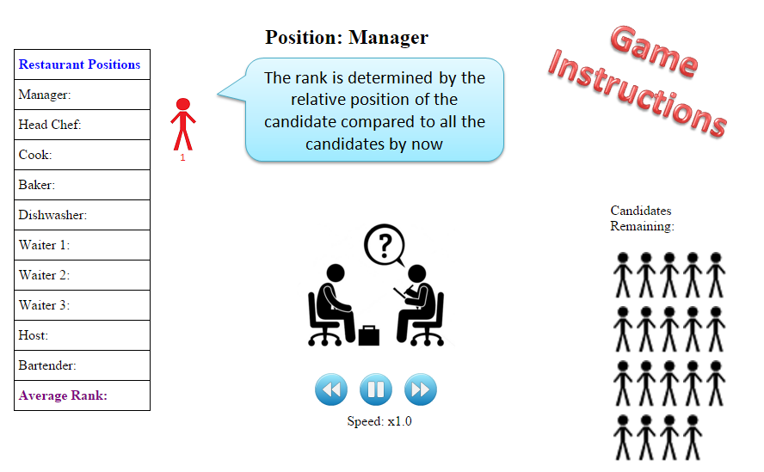
Game
Instructions

