Slide 1
Stable Diffusion Fine Tuning
Abhi Lad

Slide 2
Basics
System: GCP High Mem (26 GB) Nvidia T4 instance
Primary library: huggingface diffusers
Note: Special training routine or evaluation code has not been incorporated in diffusers code due to limited time and trivial nature of the assigned task. We use the available training scripts with our data to fine-tune the models.

Slide 3

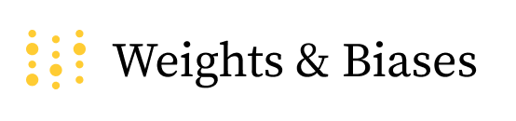
Ideal Training Approach
Custom Loss based on CLIP score
HF Captions Dataset
Custom Training Loop in Diffusers
HF Diffusers Model
Hyperparameter Sweep

Slide 4
Approaches Utilized
Base fine-tuning approaches
Text-to-image | Dreambooth
Train prompt-image pairs, possibly including multiple concepts Demo: https://huggingface.co/abhilad98/abhi_thumbsup | Train on a single new concept with few examples with a generic class prompt Demo: https://huggingface.co/abhilad98/db_abhi
Training enhancements
LoRA
Prevents catastrophic forgetting Significantly smaller model, useful for saving multiple concepts Enables training on smaller memory GPUs

Slide 5
Training steps
Text-to-image
Captioned 120 images and created hf compatible dataset : link
Trained sd-2 on thumbs up + Abhi images with LoRA and appropriate hyperparameters
WandB logs: link
Dreambooth
Trained sd-2 on thumbs up images first
WandB logs: link
Used thumbs up trained model to fine-tune on 7 Abhi images using LoRA
WandB logs: link

Slide 6
Insights on Approaches
 | Text-to-image | Dreambooth
Pro | Single step training on thumbs up and personal images Can learn nuances on prompts and generate specific outputs | Does not require prompts for all the images Works with small number of training images Better qualitative results on personal images
Con | Requires prompts for all images Requires large number of images for each concept | Can only train 1 concept at a time, requiring multiple training steps to learn complex prompts

Slide 7
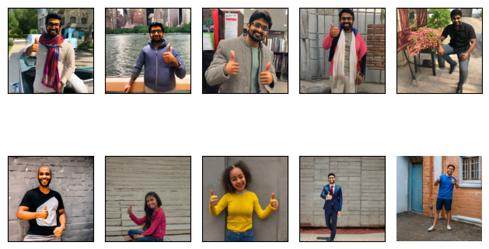
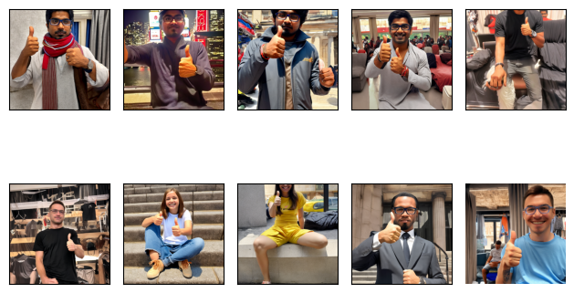
Qualitative Results
Evaluation Notebook: link
Text-to-image results
Dreambooth results

Slide 8
Quantitative Results and Observations
Text-to-image | Dreambooth
CLIP score: 32.99 | CLIP score: 30.77
CLIP scores will vary on each run due to stochastic nature of the generative models
CLIP scores are also dependant on how generic the prompts are
Text-to-image has kept person in center of frame, whereas in dreambooth the subject is often cut out
Dreambooth has better images of subject Abhi

Slide 9
Some known issues
Dreambooth fine-tuning without LoRA will result in catastrophic forgetting of the pretrained models
Text-to-train does not perform well on generating Abhi images since it has limited samples and tries to train on specific prompts
Dreambooth LoRA training script has a bug which prevents resuming training from checkpoint. So, our dreambooth training looks like: db -> db_lora instead of db_lora -> db_lora
Dreambooth thumbs up images also messes up the existing knowledge without using the lora training approach as can been seen on WandB.

Slide 10
Deploying at Scale
Using text-to-image on scale is difficult as it needs captions for each image which may be infeasible
Also, if we want model to learn an overarching concept like thumbs up, then we don’t need fine grained captions
Getting sufficient images of such a concept on scale is easier
Instead of making a general purpose model, we will make task specific model since we can use LoRA to reduce the final model size
Then we use 2 stage Dreambooth based training

Slide 11
Deploying at Scale
2 stage Dreambooth training
First fine-tuning base model on overarching concept like thumbs up
Save as new model (large model size, will forget original task but better at new concept)
Save as LoRA model (small model size, since it can be reconstructed from base model)
Then fine-tune the concept trained model on an individual person (personalization) using LoRA
This step should be last as models forget faces quickly as not enough data is present

Slide 12
Feel free to ask for GCP instance permission to replicate the results

