Slide 1



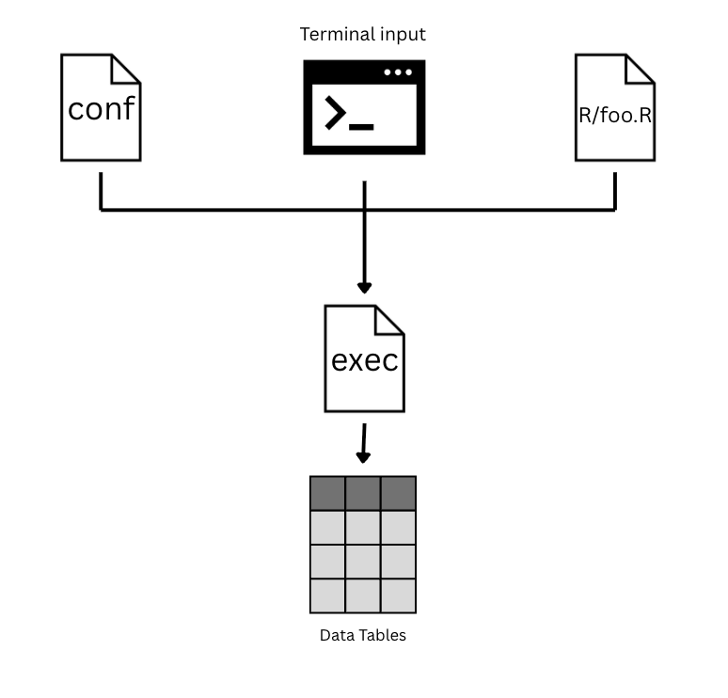








Sentiment Analysis: : CHEAT SHEET
About
Data Extraction
Exec Workflow
/pykumu
Executables provide access to kaiaulu's functions through a command line interface. This allows server side execution which is useful for constant refreshes.
Sailuh
Main
<>Code
/kaiaulu
pytetrad
Main
kaiaulu/exec
R
R
exec
README.MD
Project Config Setup
conf
git.R
/kaiaulu_react
exec
jira.R
The first part of running any vignette is setting up your project configuration file (examples in conf/kaiaulu).
ghevents.R
/sentiment_classifier
Required Fields
filter:
...
mailing_list:
...
issue_tracker:
...
tool:
...
/process_mining
Other Tools and Projects
Server Side Execution
The monitoring system utilizes Cron jobs to call refresh scripts every x minutes (E.g., 60 minutes). The refresher script is called regularly to ensure that local data is always up to date without manual intervention.
Sailuh tools such as pykumu rely on kaiaulu executables to download and refresh data. Kaiaulu executable are also made to provide kaiaulu's functions to users, tools, and projects outside of the sailuh ecosystem.
60 mins
Project
/exec
/conf
You should also specify the required external tools in tools.yml:
Project Activity
Tools Config Setup
Required Fields
perceval:
Data Tables
Kaiāulu
CC BY SA Gerald Huff, Carlos Paradis, Haotian Zhang • Kaiaulu package version 0.0.0.9700 (in development) • Updated: 2025-12

Slide 2
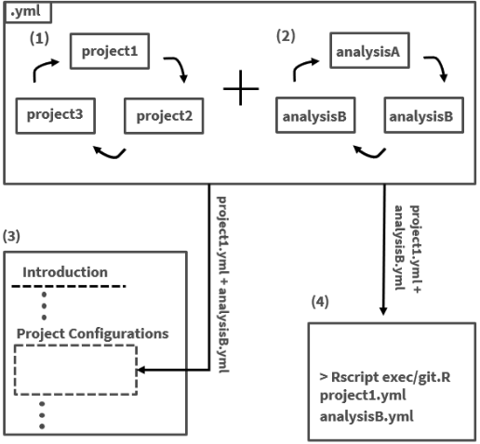

Kaiaulu Executables: : CHEAT SHEET
About
Data Extraction
Exec Workflow
Executables provide access to kaiaulu's functions through a command line interface. This allows server side execution which is useful for data refreshes.
Sailuh tools such as pykumu rely on kaiaulu executables to download and refresh data. Kaiaulu executable are also made to provide kaiaulu's functions to users, tools, and projects outside of the sailuh ecosystem.
Executables require project configuration files in order to find information about the project such as where the project git data is located locally. The project configuration file is inputted as an argument with the exec command in the command line.
Sailuh
Project Config Setup
/pykumu
The first part of running any vignette is setting up your project configuration file (examples in conf/kaiaulu).
/kaiaulu
Required Fields
filter:
...
mailing_list:
...
issue_tracker:
...
tool:
...
/conf
>
/exec/git.R
/exec
/kaiaulu_react
/R
/sentiment_classifier
/process_mining
Server Side Execution
Data Tables
Other Tools and Projects
Cron jobs can be used to call refresh scripts every x minutes (E.g., 60 minutes). The refresher script is called regularly to ensure that local data is always up to date without manual intervention.
60 mins
Project
/exec
/conf
You should also specify the required external tools in tools.yml:
Project Activity
Tools Config Setup
Required Fields
perceval:
Data Tables
Kaiāulu
CC BY SA Gerald Huff, Carlos Paradis, Haotian Zhang • Kaiaulu package version 0.0.0.9700 (in development) • Updated: 2025-12

Slide 3
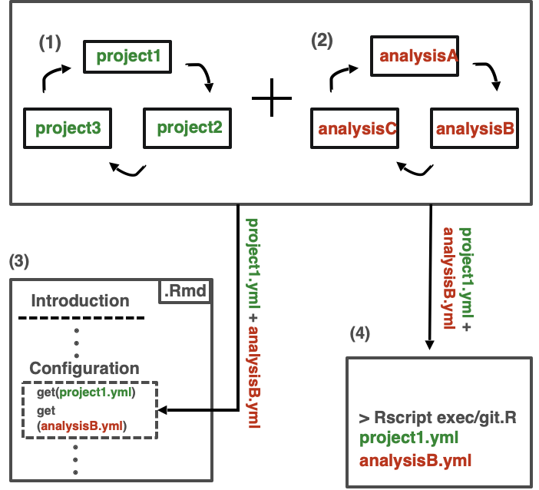

Kaiaulu Executables: : CHEAT SHEET
About
Data Extraction
Exec Workflow
Sailuh tools such as pykumu rely on kaiaulu executables to download and refresh data. Kaiaulu executable are also made to provide kaiaulu's functions to users, tools, and projects outside of the sailuh ecosystem.
Executables require project configuration files in order to find information about the project such as where the project git data is located locally. The project configuration file is inputted as an argument with the exec command in the command line.
Executables provide access to kaiaulu's functions through a command line interface. This allows server side execution and use of Kaiaulu capabilities without knowledge of R.
Server Side Execution
Sailuh
Cron jobs can be used to call refresh scripts every x minutes (E.g., 60 minutes). The refresher script is called regularly to ensure that local data is always up to date without manual intervention.
/kaiaulu
/R
>
/exec
60 mins
/conf
Project Config Setup
The first part of running any vignette is setting up your project configuration file (examples in conf/kaiaulu).
Project
/exec
/conf
Required Fields
mailing_list:
...
issue_tracker:
...
Project Activity
/pykumu
/kaiaulu_react
/sentiment_classifier
Analysis Setup
An analysis file is also required to specify filters and parameters
Data Tables
/process_mining
Required Fields
filters:
...
parameters:
...
Data Extraction
Kaiaulu executables provide data from sources such as mailing lists, issue comments, and issue logs.
Tools Config Setup
Other Tools and Projects
The required external tools are specified in tools.yml:
Required Fields
perceval:
depends:
Kaiāulu
CC BY SA Gerald Huff, Carlos Paradis, Haotian Zhang • Kaiaulu package version 0.0.0.9700 (in development) • Updated: 2025-12

Slide 4
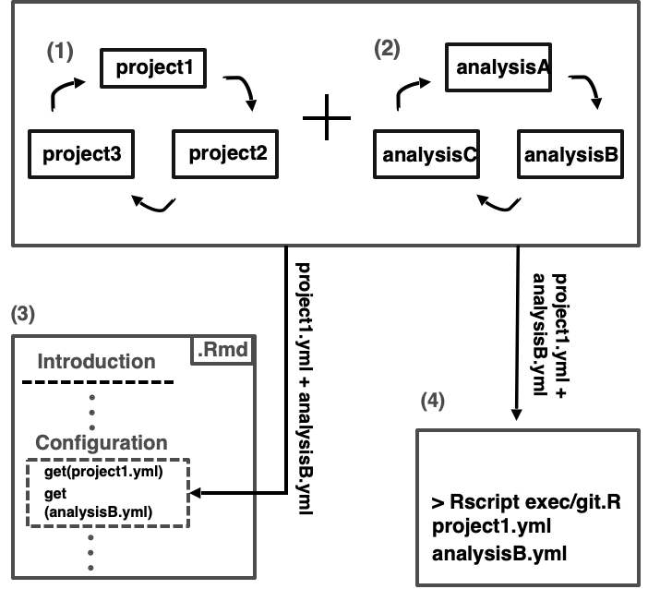


Kaiaulu Executables: : CHEAT SHEET
About
Data Extraction
Exec Workflow
Executables require project configuration files in order to find information about the project such as where the project git data is located locally. The project configuration file is inputted as an argument with the exec command in the command line.
Executables provide access to kaiaulu's functions through a command line interface. This allows server side execution and use of Kaiaulu capabilities without knowledge of R.
Sailuh tools such as pykumu rely on kaiaulu executables to download and refresh data. Kaiaulu executable are also made to provide kaiaulu's functions to users, tools, and projects outside of the sailuh ecosystem.
Server Side Execution
Sailuh
Cron jobs can be used to call refresh scripts every x minutes (E.g., 60 minutes). The refresher script is called regularly to ensure that local data is always up to date without manual intervention.
/kaiaulu
/R
60 mins
/exec
/conf
Project Config Setup
Project
/exec
/conf
The first part of running any vignette is setting up your project configuration file (examples in conf/kaiaulu).
Project Activity
GitHub
Required Fields
mailing_list:
...
issue_tracker:
...
/pykumu
/kaiaulu_react
Jira
Data Tables
/sentiment_classifier
Analysis Setup
Mail
An analysis file is also required to specify filters and parameters
/process_mining
Required Fields
filters:
...
analysis
...
Data Extraction
Kaiaulu executables provide data from sources such as mailing lists, Jira issues, and GitHub issues.
Tools Config Setup
Other Tools and Projects
The required external tools must be specified in tools.yml:
Required Fields
perceval:
depends:
Kaiāulu
CC BY SA Gerald Huff, Carlos Paradis, Haotian Zhang • Kaiaulu package version 0.0.0.9700 (in development) • Updated: 2025-12

Slide 5
Kaiaulu Executables: : CHEAT SHEET
About
Data Extraction
Server Side Execution
Executables provide access to Kaiaulu's functions through a command line interface. This allows server side execution and use of Kaiaulu capabilities without knowledge of R.
Sailuh tools such as pykumu rely on kaiaulu executables to download and refresh data. Kaiaulu executable are also made to provide kaiaulu's functions to users, tools, and projects outside of the sailuh ecosystem.
Cron jobs can be used to call refresh scripts every x minutes (E.g., 60 minutes). The refresher script is called regularly to ensure that local data is always up to date without manual intervention.
Project Config Setup
The first part of running any vignette is setting up your project configuration file (examples in conf/kaiaulu).
Sailuh
Required Fields
mailing_list: ...
issue_tracker: ...
60 mins
/kaiaulu
Analysis Setup
/conf
/R
Project
/exec
/conf
An analysis file is also required to specify filters and parameters
Project Activity
Required Fields
Filters: ...
Analysis: ...
Tools Config Setup
/exec
The required external tools must be specified in tools.yml:
Data Tables
Required Fields
perceval: ...
depends: ...
GitHub
/pykumu
Exec Workflow
/kaiaulu_react
Data Extraction
Executables require project configuration files in order to find information about the project. The project configuration file is inputted as an argument with the exec command in the command line.
Kaiaulu executables provide data from sources such as mailing lists, Jira issues, and GitHub issues. Kaiaulu's functions in Kaiaulu/R parse, analyze, and filter raw data from these sources and output them in usable forms such as csv's
Jira
/sentiment_classifier
/process_mining
Mail
Other Tools and Projects
Kaiāulu
CC BY SA Gerald Huff, Carlos Paradis, Haotian Zhang • Kaiaulu package version 0.0.0.9700 (in development) • Updated: 2025-12

Slide 6
Kaiaulu Executables: : CHEAT SHEET
About
Data Extraction
Server Side Execution
Executables provide access to Kaiaulu's functions through a command line interface. This allows server side execution and use of Kaiaulu capabilities without knowledge of R.
Sailuh tools such as pykumu rely on kaiaulu executables to download and refresh data. Kaiaulu executable are also made to provide kaiaulu's functions to users, tools, and projects outside of the sailuh ecosystem.
Cron jobs can be used to call refresh scripts every x minutes (E.g., 60 minutes). The refresher script is called regularly to ensure that local data is always up to date without manual intervention.
Project Config Setup
The first part of running any vignette is setting up your project configuration file (examples in conf/kaiaulu).
Sailuh
Required Fields
mailing_list: ...
issue_tracker: ...
60 mins
/kaiaulu
Analysis Setup
/conf
/R
Project
/exec
/conf
An analysis file is also required to specify filters and parameters
Project Activity
Required Fields
Filters: ...
Analysis: ...
Tools Config Setup
/exec
The required external tools must be specified in tools.yml:
Data Tables
Required Fields
perceval: ...
depends: ...
/pykumu
Exec Workflow
/kaiaulu_react
Data Extraction
Executables require configuration files in order to find information about the project. The configuration file is inputted as an argument with the exec command in the command line.
Kaiaulu executables provide data from sources such as mailing lists, Jira issues, and GitHub issues. Kaiaulu's functions in Kaiaulu/R parse, analyze, and filter raw data from these sources and output them in usable forms such as csv's
/sentiment_classifier
/process_mining
GitHub
Raw Data
Other Tools and Projects
Mail
Jira
Kaiāulu
CC BY SA Gerald Huff, Carlos Paradis, Haotian Zhang • Kaiaulu package version 0.0.0.9700 (in development) • Updated: 2025-12

Slide 7

Kaiaulu Executables: : CHEAT SHEET
About
Data Extraction
Server Side Execution
Executables provide access to Kaiaulu's functions through a command line interface. This allows server side execution and use of Kaiaulu capabilities without knowledge of R.
Sailuh tools such as pykumu rely on kaiaulu executables to download and refresh data. Kaiaulu executable are also made to provide kaiaulu's functions to users, tools, and projects outside of the sailuh ecosystem.
Cron jobs can be used to call refresh scripts every x minutes (E.g., 60 minutes). The refresher script is called regularly to ensure that local data is always up to date without manual intervention.
Project Config Setup
The first part of running any vignette is setting up your project configuration file (examples in conf/kaiaulu).
Sailuh
Required Fields
mailing_list: ...
issue_tracker: ...
60 mins
/kaiaulu
Analysis Setup
/conf
/R
Project
/exec
/conf
An analysis file is also required to specify filters and parameters
Project Activity
Required Fields
Filters: ...
Analysis: ...
/exec
Tools Config Setup
The required external tools must be specified in tools.yml:
Data Tables
Required Fields
perceval: ...
depends: ...
/pykumu
Exec Workflow
/kaiaulu_react
Data Extraction
Executables require configuration files to find information about the project, analysis parameters and tools needed. The project and analysis config are also used by notebooks in Kaiaulu.
Kaiaulu executables provide data from sources such as mailing lists, Jira issues, and GitHub issues. Kaiaulu's functions in Kaiaulu/R parse, analyze, and filter raw data from these sources and output them in usable forms such as csv's
/sentiment_classifier
/process_mining
Executable Documentation
Executable help docs follow a standard which provides users a quick understanding of all of the capabilities of the executable.
GitHub
Raw Data
USAGE: Specifies command line syntax
DESCRIPTION: Overview of executable's purpose COMMANDS: Defines each command's functionality ARGUMENTS: Specifies required parameters OPTIONS: Describes optional flags
Other Tools and Projects
Mail
Jira
Kaiāulu
CC BY SA Gerald Huff, Carlos Paradis, Haotian Zhang • Kaiaulu package version 0.0.0.9700 (in development) • Updated: 2025-12

Slide 8

Kaiaulu Executables: : CHEAT SHEET
About
Data Extraction
Server Side Execution
Executables provide access to Kaiaulu's functions through a command line interface. This allows server side execution and use of Kaiaulu capabilities without knowledge of R.
Sailuh tools such as pykumu rely on kaiaulu executables to download and refresh data. Kaiaulu executables are also made to provide kaiaulu's functions to users, tools, and projects outside of the sailuh ecosystem.
Cron jobs can be used to call refresh scripts every x minutes (E.g., 60 minutes). The refresher script is called regularly to ensure that local data is always up to date without manual intervention.
Project Config Setup
Sailuh
The first part of running any vignette is setting up your project configuration file (examples in conf/kaiaulu).
Required Fields
mailing_list: ...
issue_tracker: ...
Sailuh/kaiaulu
60 mins
Analysis Config Setup
Project
exec/*.R
/conf
An analysis file is also required to specify filters and parameters
project.yml
analysis.yml
Project Activity
Required Fields
Filters: ...
Analysis: ...
Tools Config Setup
Sailuh/pykumu
The required external tools must be specified in tools.yml:
Sailuh/kaiaulu_react
Data Tables
Required Fields
perceval: ...
depends: ...
exec/*.R
Sailuh/sentiment_classifier
Exec Workflow
Executables require configuration files to find information about the project, analysis parameters and tools needed. The project and analysis config are also used by notebooks in Kaiaulu.
Sailuh/process_mining
(1)
project1
(2)
analysisA
project3
project2
analysisC
analysisB
Other Tools and Projects
Mail
Jira
GitHub
(3)
project1.yml + analysisB.yml
project1.yml + analysisB.yml
Why executables?
Introduction
.Rmd
(4)
...
Kaiaulu executables provide data from sources such as Mail, JIRA, and GitHub. Kaiaulu's functions in Kaiaulu/R parse, analyze, and filter raw data from these sources and output them in usable forms such as csv's
Executables remove the need to manually write R scripts, fetch data, or manage complex workflows. Instead of handling APIs, parsing data, and chaining steps manually, Kaiaulu executables do this from configuration files . This allows you to focus on defining your analysis rather than implementing it.
Configuration
> Rscript exec/*.R project1.yml
analysisB.yml
get(project1.yml)
get (analysisB.yml)
Kaiāulu
CC BY SA Gerald Huff, Carlos Paradis, Haotian Zhang • Kaiaulu package version 0.0.0.9700 (in development) • Updated: 2025-12

Slide 9
Kaiaulu Executables: : CHEAT SHEET
About
Data Extraction
Data Extraction
Executables provide access to Kaiaulu's functions through a command line interface. This allows server side execution and use of Kaiaulu capabilities without knowledge of R.
Sailuh tools such as pykumu rely on kaiaulu executables to download and refresh data. Kaiaulu executables are also made to provide kaiaulu's functions to users, tools, and projects outside of the sailuh ecosystem.
Kaiaulu executables provide data from sources such as Mail, JIRA, and GitHub. Kaiaulu's functions in Kaiaulu/R parse, analyze, and filter raw data from these sources and output them in usable forms such as csv's
Project Config Setup
Sailuh
The first part of running any vignette is setting up your project configuration file (examples in conf/kaiaulu).
Required Fields
mailing_list: ...
issue_tracker: ...
Sailuh/kaiaulu
Server Side Execution
Cron jobs can be used to call refresh scripts every x minutes (E.g., 60 minutes). The refresher script is called regularly to ensure that local data is always up to date without manual intervention.
Analysis Config Setup
An analysis file is also required to specify filters and parameters
project.yml
analysis.yml
Required Fields
Filters: ...
Analysis: ...
Tools Config Setup
Sailuh/pykumu
60 mins
The required external tools must be specified in tools.yml:
Sailuh/kaiaulu_react
Required Fields
perceval: ...
depends: ...
Project
exec/*.R
/conf
Sailuh/sentiment_classifier
Project Activity
Exec Workflow
exec/*.R
Executables require configuration files to find information about the project, analysis parameters and tools needed. The project and analysis config are also used by notebooks in Kaiaulu.
Sailuh/process_mining
(1)
project1
(2)
analysisA
Data Tables
project3
project2
analysisC
analysisB
Other Tools and Projects
Mail
Jira
GitHub
(3)
project1.yml + analysisB.yml
project1.yml + analysisB.yml
Why executables?
Introduction
.Rmd
...
Interchangable Configurations
Executables remove the need to manually write R scripts, fetch data, or manage complex workflows. Instead of handling APIs and parsing data manually, Kaiaulu executables do this using configuration files. This allows you to focus on defining your analysis rather than implementing it.
(4)
Any project.yml files (1) can be combined with any analysis.yml files (2). This allows users to run the same analysis on multiple projects or run different analyses on the same project, reducing duplication of configuration sections.
Configuration
> Rscript exec/*.R project1.yml
analysisB.yml
get(project1.yml)
get (analysisB.yml)
Kaiāulu
CC BY SA Cohen Ruport, Carlos Paradis, • Kaiaulu package version 0.0.0.9700 (in development) • Updated: 2026-4

Slide 10
Kaiaulu Executables: : CHEAT SHEET
About
Interchangable Configurations
Server Side Execution
Executables provide access to Kaiaulu's functions through a command line interface. This allows other tools to build on Kaiaulu capabilities or use it server-side.
Any project.yml files (1) can be combined with any analysis.yml files (2). This allows users to run the same analysis on multiple projects or run different analyses on the same project, reducing duplication of configuration sections.
Cron jobs can be used to call refresh scripts every x minutes (E.g., 60 minutes). The refresher script is called regularly to ensure that local data is always up to date without manual intervention.
Project Config Setup
Data Extraction
The first part of running any vignette is setting up your project configuration file (examples in conf/kaiaulu).
Sailuh tools such as pykumu rely on kaiaulu executables to download and refresh data. Kaiaulu executables are also made to provide kaiaulu's functions to users, tools, and projects outside of the sailuh ecosystem.
Required Fields
mailing_list: ...
issue_tracker: ...
60 mins
Sailuh
Analysis Config Setup
Project
exec/*.R
/conf
Sailuh/kaiaulu
Project Activity
An analysis file is also required to specify filters and parameters
Required Fields
Filters: ...
Analysis: ...
Mail
Jira
GitHub
Tools Config Setup
project.yml
analysis.yml
The required external tools must be specified in tools.yml:
Data Tables
Required Fields
perceval: ...
Exec Workflow
Data Pipelines
Executables require configuration files to find information about the project, analysis parameters and tools needed. The project and analysis config are also used by notebooks in Kaiaulu.
exec/*.R
Executables remove the need to manually write R scripts, fetch data, or manage complex workflows. Instead of handling APIs and parsing data manually, Kaiaulu executables do this using configuration files. Executables can also be chained together to construct more complex pipelines.
(1)
project1
(2)
analysisA
Sailuh/pykumu
Sailuh/sentiment_classifier
project3
project2
analysisC
analysisB
Sailuh/kaiaulu_react
Sailuh/process_mining
(3)
project1.yml + analysisB.yml
project1.yml + analysisB.yml
.
Introduction
.Rmd
...
...
.
(4)
.
Configuration
> Rscript exec/*.R
project1.yml
analysisB.yml
Other Tools
get(project1.yml)
get (analysisB.yml)
Kaiaulu executables provide data from sources such as Mail, JIRA, and GitHub.
Kaiāulu
CC BY SA Cohen Ruport, Carlos Paradis, • Kaiaulu package version 0.0.0.9700 (in development) • Updated: 2026-4

Slide 11
Kaiaulu Executables: : CHEAT SHEET
About
Interchangable Configurations
Server Side Execution
Executables provide access to Kaiaulu's functions through a command line interface. This allows other tools to build on Kaiaulu capabilities or use it server-side.
Any project.yml files (1) can be combined with any analysis.yml files (2). This allows users to run the same analysis on multiple projects or run different analyses on the same project, reducing duplication of configuration sections. See Configuration (.yml) cheatsheet for more information.
Cron jobs can be used to call refresh scripts every x minutes (E.g., 60 minutes). The refresher script is called regularly to ensure that local data is always up to date without manual intervention.
Project Config Setup
The first part of running any vignette is setting up your project configuration file (examples in conf/kaiaulu).
Data Extraction
Required Fields
mailing_list: ...
issue_tracker: ...
Sailuh tools such as pykumu rely on kaiaulu executables to download and refresh data. Kaiaulu executables are also made to provide kaiaulu's functions to users, tools, and projects outside of the sailuh ecosystem.
60 mins
Analysis Config Setup
Sailuh
Project
exec/*.R
/conf
An analysis file is also required to specify filters and parameters
Sailuh/kaiaulu
Project Activity
Required Fields
Filters: ...
Analysis: ...
Mail
Jira
GitHub
Tools Config Setup
project.yml
analysis.yml
The required external tools must be specified in tools.yml:
Data Tables
Required Fields
perceval: ...
Exec Workflow
Data Pipelines
Executables require configuration files to find information about the project, analysis parameters and tools needed. The project and analysis config are also used by notebooks in Kaiaulu.
exec/*.R
Executables remove the need to manually write R scripts, fetch data, or manage complex workflows. Instead of handling APIs and parsing data manually, Kaiaulu executables do this using configuration files. Executables can also be chained together to construct more complex pipelines.
(1)
project1
(2)
analysisA
project3
project2
analysisC
analysisB
Sailuh/pykumu
Sailuh/process_mining
(3)
project1.yml + analysisB.yml
project1.yml + analysisB.yml
Sailuh/kaiaulu_react
Sailuh/sentiment_classifier
Introduction
.Rmd
...
.
(4)
...
.
Configuration
.
get(project1.yml)
get (analysisB.yml)
> Rscript exec/*.R
project1.yml
analysisB.yml
Other Tools
Kaiaulu executables provide data from sources such as Mail, JIRA, and GitHub.
Kaiāulu
CC BY SA Cohen Ruport, Carlos Paradis, • Kaiaulu package version 0.0.0.9700 (in development) • Updated: 2026-4

Slide 12
Kaiaulu Executables: : CHEAT SHEET
About
Interchangable Configurations
Server Side Execution
Executables provide access to Kaiaulu's functions through a command line interface. This allows other tools to build on Kaiaulu capabilities or use it server-side.
Any project.yml files (1) can be combined with any analysis.yml files (2). This allows users to run the same analysis on multiple projects or run different analyses on the same project, reducing duplication of configuration sections. See Configuration (.yml) cheatsheet for more information.
Cron jobs can be used to call refresh scripts every x minutes (E.g., 60 minutes). The refresher script is called regularly to ensure that local data is always up to date without manual intervention.
Project Config Setup
The first part of running any vignette is setting up your project configuration file (examples in conf/kaiaulu).
Data Extraction
Required Fields
mailing_list: ...
issue_tracker: ...
Sailuh tools such as pykumu rely on kaiaulu executables to download and refresh data. Kaiaulu executables are also made to provide kaiaulu's functions to users, tools, and projects outside of the sailuh ecosystem.
60 mins
Analysis Config Setup
Sailuh
Project
exec/*.R
/conf
An analysis file is also required to specify filters and parameters
Sailuh/kaiaulu
Project Activity
Required Fields
Filters: ...
Analysis: ...
Mail
Jira
GitHub
Tools Config Setup
project.yml
analysis.yml
The required external tools must be specified in tools.yml:
Data Tables
Required Fields
perceval: ...
Exec Workflow
Data Pipelines
Executables require configuration files to find information about the project, analysis parameters and tools needed. The project and analysis config are also used by notebooks in Kaiaulu.
exec/*.R
Executables remove the need to manually write R scripts, fetch data, or manage complex workflows. Instead of handling APIs and parsing data manually, Kaiaulu executables do this using configuration files. Executables can also be chained together to construct more complex pipelines.
(1)
project1
(2)
analysisA
project3
project2
analysisC
analysisB
Sailuh/pykumu
Sailuh/process_mining
(3)
project1.yml + analysisB.yml
project1.yml + analysisB.yml
Sailuh/kaiaulu_react
Sailuh/sentiment_classifier
Introduction
.Rmd
...
.
(4)
...
.
Configuration
.
get(project1.yml)
get (analysisB.yml)
> Rscript exec/*.R
project1.yml
analysisB.yml
Other Tools
Kaiaulu executables provide data from sources such as Mail, JIRA, and GitHub.
Kaiāulu
CC BY SA Cohen Ruport, Carlos Paradis, • Kaiaulu package version 0.0.0.9700 (in development) • Updated: 2026-4

Slide 13

Kaiaulu Executables: : CHEAT SHEET
About
Interchangeable Configurations
Server Side Execution
Executables provide access to Kaiaulu's functions through a command line interface. This allows other tools to build on Kaiaulu capabilities or use it server-side.
Any project.yml files (1) can be combined with any analysis.yml files (2). This allows users to run the same analysis on multiple projects or run different analyses on the same project, reducing duplication of configuration sections. See Configuration (.yml) cheatsheet for more information.
Cron jobs can be used to call refresh scripts every x minutes (E.g., 60 minutes). The refresher script is called regularly to ensure that local data is always up to date without manual intervention.
Project Config Setup
Data Extraction
The first part of running any vignette is setting up your project configuration file (examples in /conf).
Sailuh tools such as pykumu rely on kaiaulu executables to download and refresh data. Kaiaulu executables are also made to provide kaiaulu's functions to users, tools, and projects outside of the sailuh ecosystem.
Required Fields
mailing_list: ...
issue_tracker: ...
60 mins
Sailuh
Analysis Config Setup
Project
exec/*.R
/conf
An analysis file is also required to specify filters and parameters
Sailuh/kaiaulu
Project Activity
Required Fields
Filters: ...
Analysis: ...
Mail
Jira
GitHub
Tools Config Setup
project.yml
analysis.yml
The required external tools must be specified in tools.yml:
Data Tables
Required Fields
perceval: ...
Exec Configuration
Data Pipelines
Executables require configuration files to find information about the project, analysis parameters and tools needed. The project and analysis config are also used by notebooks in Kaiaulu.
exec/*.R
Executables remove the need to manually write R scripts, fetch data, or manage complex workflows. Instead of handling APIs and parsing data manually, Kaiaulu executables do this using configuration files. Executables can also be chained together to construct more complex pipelines.
(1)
project1
(2)
analysisA
project3
project2
analysisC
analysisB
Sailuh/pykumu
Sailuh/process_mining
(3)
project1.yml + analysisB.yml
project1.yml + analysisB.yml
Sailuh/kaiaulu_react
Sailuh/sentiment_classifier
Introduction
.Rmd
...
(4)
...
Configuration
> Rscript exec/*.R
project1.yml
analysisB.yml
. . .
get(project1.yml)
get (analysisB.yml)
Other Tools
Kaiaulu executables provide data from sources such as Mail, JIRA, and GitHub.
Kaiāulu
CC BY SA Cohen Ruport, Carlos Paradis, • Kaiaulu package version 0.0.0.9700 (in development) • Updated: 2026-4

Slide 14
Kaiaulu Executables: : CHEAT SHEET
About
Interchangeable Configurations
Server Side Execution
Executables provide access to Kaiaulu's functions through a command line interface. This allows other tools to build on Kaiaulu capabilities or use it server-side.
Any project.yml files (1) can be combined with any analysis.yml files (2). This allows users to run the same analysis on multiple projects or run different analyses on the same project, reducing duplication of configuration sections. See Configuration (.yml) cheatsheet for more information.
Cron jobs can be used to call refresh scripts every x minutes (E.g., 60 minutes). The refresher script is called regularly to ensure that local data is always up to date without manual intervention.
Project Config Setup
Data Extraction
The first part of running any vignette is setting up your project configuration file (examples in /conf).
Sailuh tools such as pykumu rely on kaiaulu executables to download and refresh data. Kaiaulu executables are also made to provide kaiaulu's functions to users, tools, and projects outside of the sailuh ecosystem.
Required Fields
mailing_list: ...
issue_tracker: ...
60 mins
Sailuh
Analysis Config Setup
Project
exec/*.R
/conf
An analysis file is also required to specify filters and parameters
Sailuh/kaiaulu
Project Activity
Required Fields
filters: ...
analysis: ...
Mail
Jira
GitHub
Tools Config Setup
project.yml
analysis.yml
The required external tools must be specified in tools.yml:
Data Tables
Required Fields
perceval: ...
Exec Configuration
Data Pipelines
Executables require configuration files to find information about the project, analysis parameters and tools needed. The project and analysis config are also used by notebooks in Kaiaulu.
exec/*.R
Executables remove the need to manually write R scripts, fetch data, or manage complex workflows. Instead of handling APIs and parsing data manually, Kaiaulu executables do this using configuration files. Executables can also be chained together to construct more complex pipelines.
(1)
project1
(2)
analysisA
project3
project2
analysisC
analysisB
Sailuh/pykumu
Sailuh/process_mining
(3)
project1.yml + analysisB.yml
project1.yml + analysisB.yml
Sailuh/kaiaulu_react
Sailuh/sentiment_classifier
Introduction
.Rmd
...
(4)
...
Configuration
> Rscript exec/*.R
project1.yml
analysisB.yml
. . .
get(project1.yml)
get (analysisB.yml)
Other Tools
Kaiaulu executables provide data from sources such as Mail, JIRA, and GitHub.
Kaiāulu
CC BY SA Cohen Ruport, Carlos Paradis, • Kaiaulu package version 0.0.0.9700 (in development) • Updated: 2026-4

Slide 15
Kaiaulu Executables: : CHEAT SHEET
About
Interchangeable Configurations
Server Side Execution
Executables provide access to Kaiaulu's functions through a command line interface. This allows other tools to build on Kaiaulu capabilities or use it server-side.
Any project.yml files (1) can be combined with any analysis.yml files (2). This allows users to run the same analysis on multiple projects or run different analyses on the same project, reducing duplication of configuration sections. See Configuration (.yml) cheatsheet for more information.
Cron jobs can be used to call executable download scripts every x minutes (E.g., 60 minutes) using the refresher API. This can be combined to the sailuh/kaiaulu_react to monitor project health or create data warehouses.
Project Config Setup
Data Extraction
The first part of running any vignette is setting up your project configuration file (examples in /conf).
Sailuh tools in tools.yml rely on kaiaulu executables to download and refresh data. Kaiaulu executables also expose capabilities to other tools outside of the sailuh ecosystem.
Required Fields
mailing_list: ...
issue_tracker: ...
60 mins
Sailuh
Analysis Config Setup
Project
exec/*.R
/conf
An analysis file is also required to specify filters and parameters.
Sailuh/kaiaulu
Project Activity
Required Fields
filters: ...
analysis: ...
Mail
Jira
GitHub
Tools Config Setup
project.yml
analysis.yml
The required external tools must be specified in tools.yml.
Data Tables
Required Fields
perceval: ...
Exec Configuration
Data Pipelines
Executables require configuration files to find information about the project, analysis parameters and tools needed. The project and analysis config are also used by notebooks in Kaiaulu.
exec/*.R
Executables can also be chained together to construct more complex pipelines. By using different combinations of project.yml and analysis.yml files, this can facilitate extending data pipelines, much like chaining commands in bash.
(1)
project1
(2)
analysisA
project3
project2
analysisC
analysisB
Sailuh/pykumu
Sailuh/process_mining
(3)
project1.yml + analysisB.yml
project1.yml + analysisB.yml
Sailuh/kaiaulu_react
Sailuh/sentiment_classifier
Introduction
.Rmd
...
(4)
...
Configuration
> Rscript exec/*.R
project1.yml
analysisB.yml
. . .
get(project1.yml)
get (analysisB.yml)
Other Tools
Kaiaulu executables provide data from sources such as Mail, JIRA, GitHub, and other analyses, including social smells.
Kaiāulu
CC BY SA Cohen Ruport, Carlos Paradis, • Kaiaulu package version 0.0.0.9700 (in development) • Updated: 2026-4

