Slide 1
Colorado University Decision Diagram
Course Material
TA’s Email: tina19990717@gmail.com
TA: Ting-Yun Hsiao
Advisor: Juinn-Dar Huang, Ph.D.
May 2 , 2022

Slide 2
Outline
CUDD Intro
WebGraphviz Intro

Slide 3
Colorado University Decision Diagram(CUDD)
A library for BDD

Slide 4
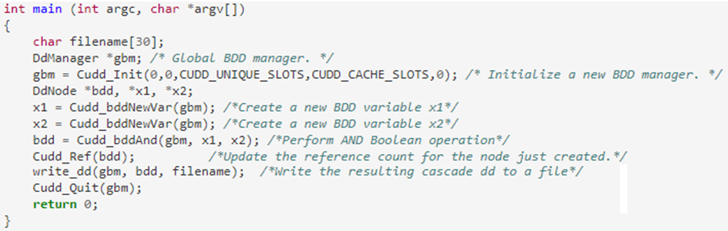
BDD for the AND Boolean function

Slide 5
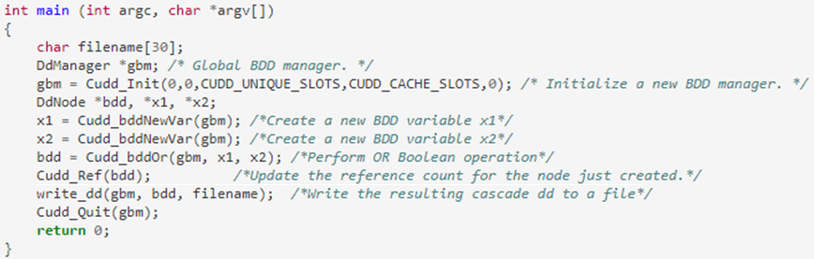
BDD for the OR Boolean function

Slide 6
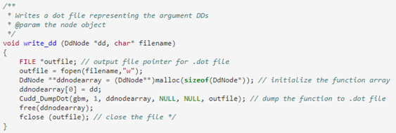
Dumpfile

Slide 7
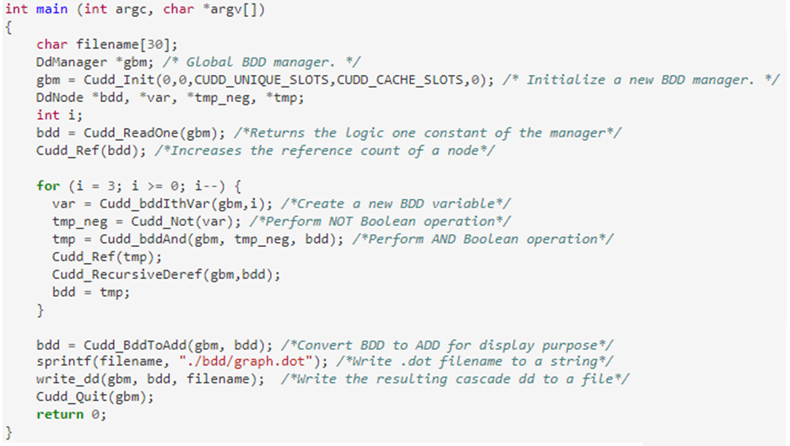
BDD for Boolean function f= x0’x1’x2’x3’

Slide 8
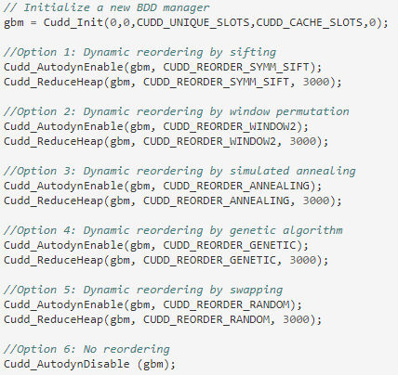
Variable Reordering

Slide 9
CUDD function reference
http://web.mit.edu/sage/export/tmp/y/usr/share/doc/polybori/cudd/cuddAllDet.html
https://www.cs.rice.edu/~lm30/RSynth/CUDD/cudd/doc/cuddAllFile.html
http://www.cs.cmu.edu/~emc/15817-s05/bdd-example.c
https://davidkebo.com/cudd
http://www.ece.ubc.ca/~eddieh/abc_dox/de/d7d/cuddReorder_8c.html#a02a5a86dfb8ebc7726d6cf56b6a7eec1

Slide 10
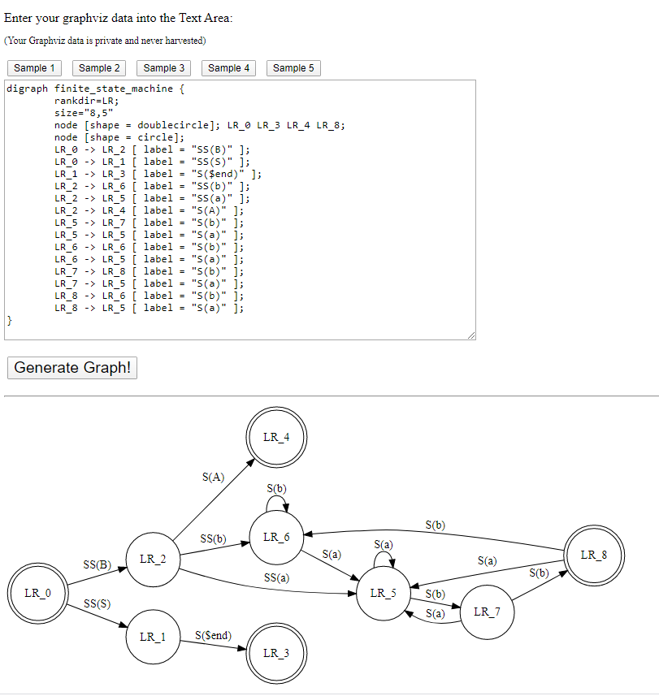
WebGraphviz
http://www.webgraphviz.com/

Slide 11
Thank you

