Slide 1
Introduction to Path Delay Fault And A Sat-Based Path-Delay-Fault ATPG Solver
VLSI Testing LAB: ED612
陳亮廷 a123tim123.ee06@nycu.edu.tw

Slide 2
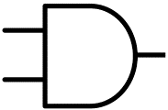

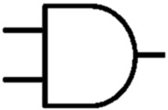
Path Delay Fault
Any path with a total delay exceeding the clock interval is called a "path fault."
One major problem in finding delay faults is the number of possible paths in a circuit under test (CUT). The number of total paths can grow exponentially with circuit size.
A
4 paths in the circuit:
A → E → G
B → E → G
C → F → G
D → F → G
B
E
C
G
D
F

Slide 3
Path-Delay-Fault ATPG
A path-delay-fault ATPG generates a vector pair (v1,v2) that can distinguish between the correct circuit behavior and the faulty circuit behavior caused by defects.
2 phases of ATPG:
Fault Activation: Creates a transition (either rising or falling) at the beginning of the target path.
Fault Propagation: Propagates the corresponding transition to primary output through the target path.
A
On-input: A, E, G
Off-input: B, F
B
1
Output of ATPG: (v1, v2)
Ex. 0111，1111
E
C
3
G
Target path
D
2
F

Slide 4
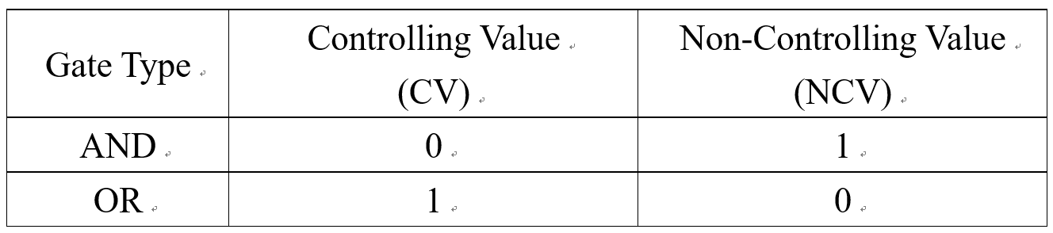
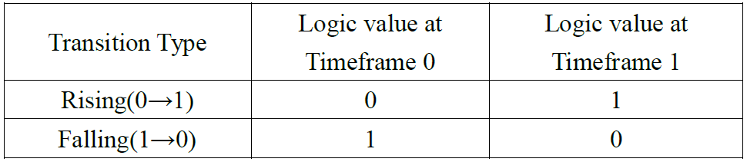
Some Terms in Path-Delay-Fault ATPG
On-input & off-input
Controlling Values & Non-Controlling Values
Timeframe
On-input: A, E, G
Off-input: B, F
A
B
1
E
C
3
G
Target path
D
2
F

Slide 5
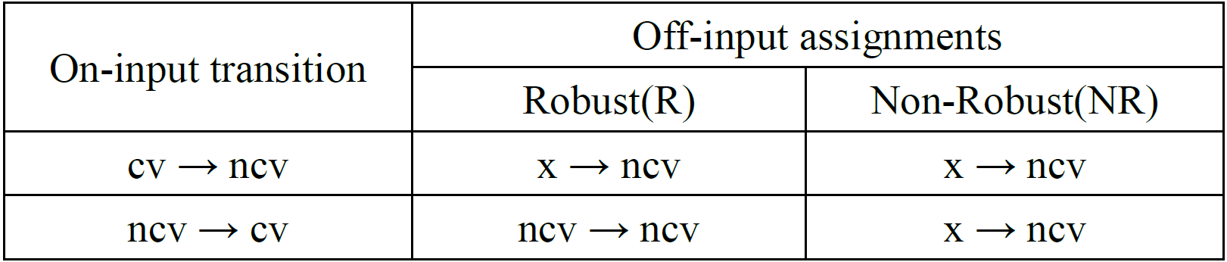
Test Quality for A Path
A test pattern (v1,v2) of a path P can be classified as Robust or Non-Robust based on the transition states on the on-inputs and off-inputs.
On-input: A, E, G
Off-input: B, F
Output of ATPG:
(v1, v2)
R: 1111，0111
NR: 1XXX，0111
A
B
1
E
C
3
G
Target path
D
2
F

Slide 6
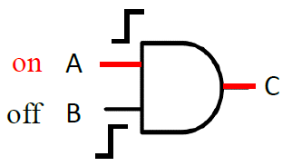
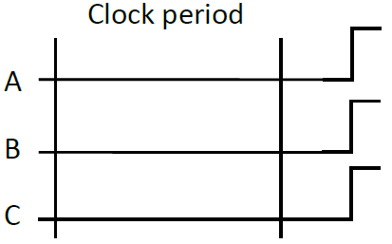
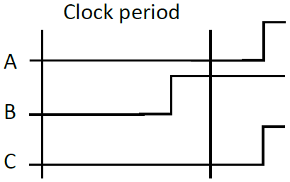
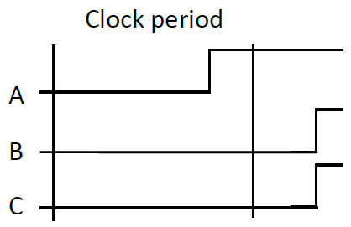
Robust Test
Both inputs have delay fault
Success
Only on-input has delay fault
Success
Only off-input has delay fault
Success

Slide 7
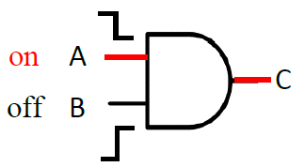
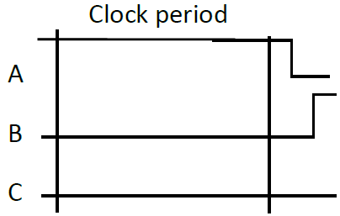
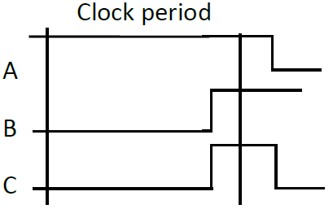
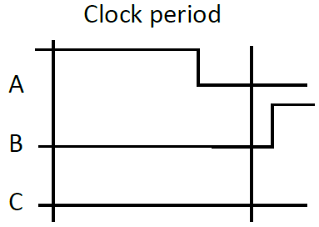
Non-Robust Test
Both inputs have delay fault
Fail
Only on-input has delay fault
Success
Only off-input has delay fault
Fail

Slide 8
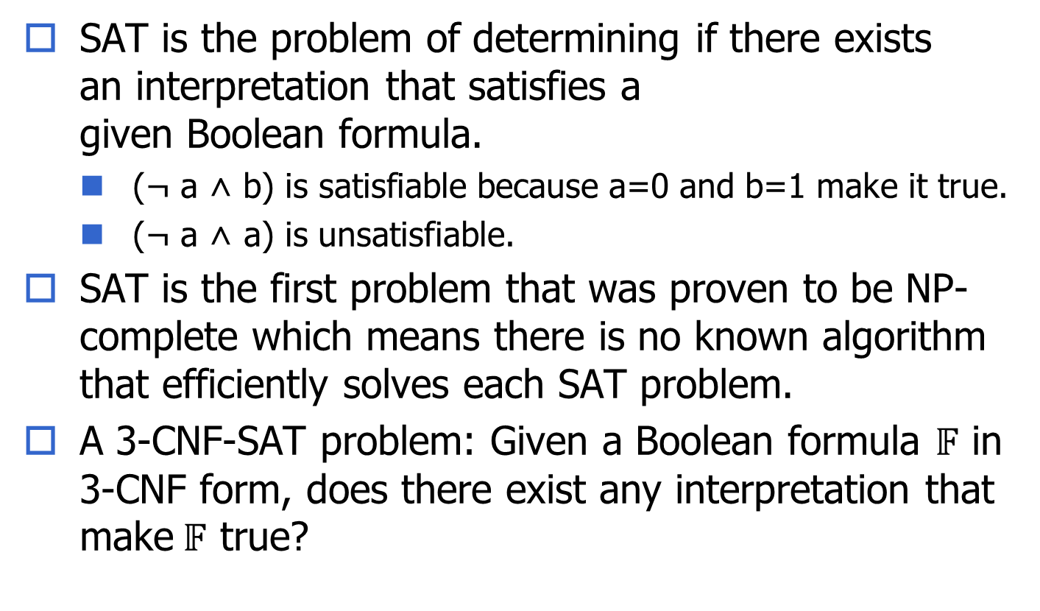
Boolean Satisfiability (SAT) Problem
SAT is the problem of determining if there exists an interpretation that satisfies a given Boolean formula.
(¬ a ˄ b) is satisfiable because a=0 and b=1 make it true.
(¬ a ˄ a) is unsatisfiable.
SAT is the first problem that was proven to be NP-complete which means there is no known algorithm that efficiently solves each SAT problem.
A 3-CNF-SAT problem: Given a Boolean formula $𝔽$ in 3-CNF form, does there exist any interpretation that make$𝔽$ true?

Slide 9
Conjunctive Normal Form (CNF)
A literal is either a Boolean variable or the negation of a Boolean variable.
x, ¬ y
A clause is a disjunction of literals.
( x ˅ y ˅ ¬ z)
A Boolean formula is in Conjunctive Normal Form if it is a conjunction of clauses (or a single clause).
( x ˅ y ˅ ¬ z ˅ w ˅ ¬ u) ˄ (¬ y ˅ z) ˄ (¬ x)
( x ˅ y ˅ ¬ z ˅ w ˅ ¬ u)
3-CNF: a conjunction of clauses where each clause contains exactly 3 literals/at most 3 literals.
( x ˅ y ˅ ¬ z) ˄ (¬ y ˅ z) ˄ (¬ x)

Slide 10
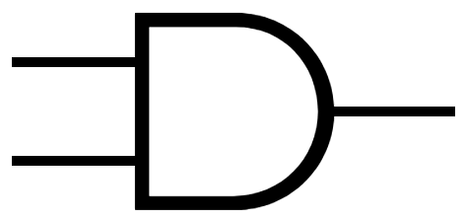

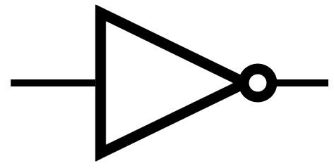
Tseytin Transformation
Tseytin transformation takes as input an arbitrary combinatorial logic circuit and produces a Boolean formula in conjunctive normal form (CNF), which can be solved by a CNF-SAT solver.
Gate type | Operation | CNF expressions
 | c = a · b | (¬a ˅ ¬b ˅ c) ˄ (a ˅ ¬c) ˄ (b ˅ ¬c)
 | c = a + b | (a ˅ b ˅ ¬c) ˄ (¬a ˅ c) ˄ (¬b ˅ c)
 | c = -a | (¬a ˅ ¬c) ˄ (a ˅ c)
a
c
b
a
c
b
a
c

Slide 11
SAT-Based Path-Delay-Fault ATPG
A given combination circuit + a given PDF.
Do Fault Activation & Fault Propagation = Building a Boolean formula in CNF to feed into the SAT solver.
Problem definition: Can we find a test vector pair to detect the transition delay fault rising on path A → E → G ?
If the SAT problem is solved, a test vector pair(v1, v2) is successively found and the PDF is detected.
A
Combinatorial circuit in CNF
B
E
C
G
Target path
D
F
For non-robust test:
1st timeframe: (¬A ˅ ¬B ˅ E) ˄ (A ˅ ¬E) ˄ (B ˅ ¬E) ˄ ….. ˄ ¬A
2nd timeframe: (¬A ˅ ¬B ˅ E) ˄ (A ˅ ¬E) ˄ (B ˅ ¬E) ˄ ….. ˄ A ˄ B ˄ F

Slide 12
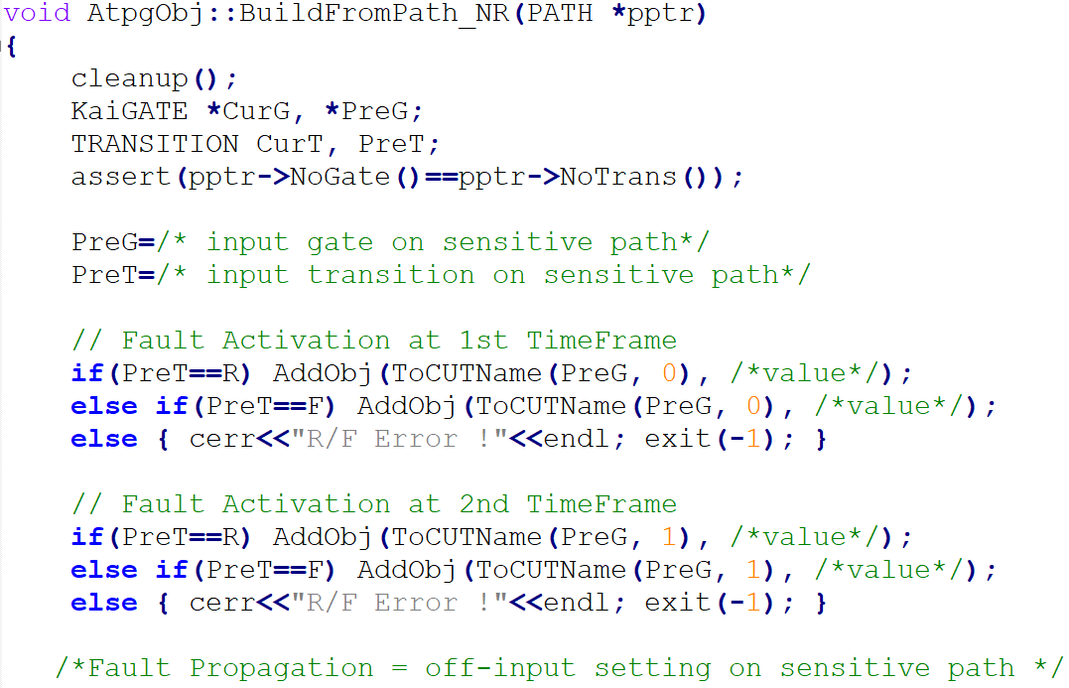
What you need to do in HW4
In kai_objective.cpp
Add more clauses to the original combinational circuit CNF by using AddObj(ToCUTName(gate ptr, timeframe), logic value)
0 or 1
0 or 1
Target path
Find PI gate ptr and the transition state of the PI on target path
Fault Activation
Fault Propagation

Slide 13
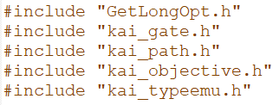
More hints
Go to the following files to understand the data structure of this program.
E.g. In kai_path.h:
E.g. In kai_gate.h:
Only AND, NAND, OR, NOR gates need to be considered.

