Slide 1
Progress Report
Student:何祁恩
Advisor: Prof. 賴伯承, Yuhao Fang
2021/10/13

Slide 2
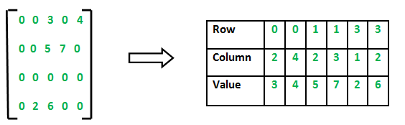
Coding Part
Code sparse matrix multiplication and transpose.
To decrease the memory use, I only store the non-zero term value and its row and column into the struct.

Slide 3
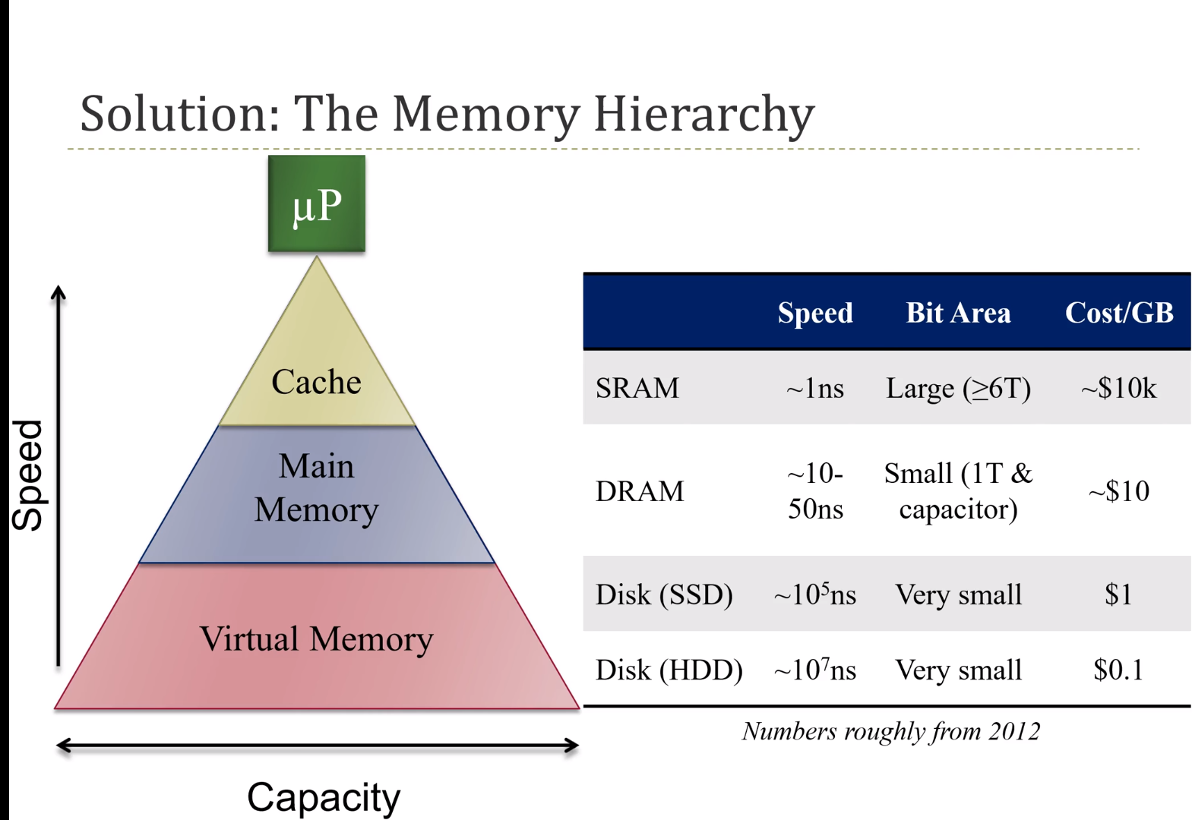
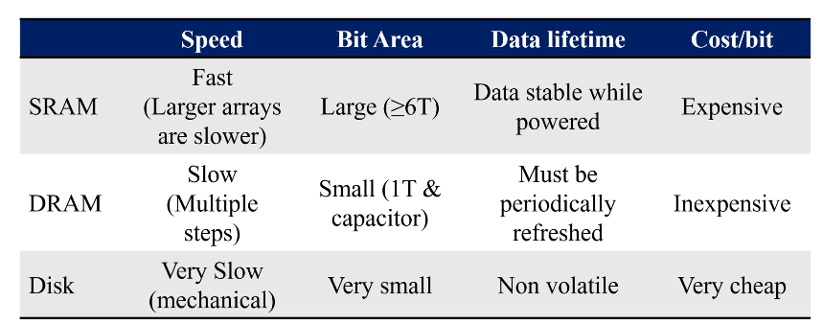
Computer Organization Part
Fast cheap big capacity trade off: memory hierarchy
Fast cache near microprocessor, the slower the speed to access the memory, the further distance to the microprocessor.

Slide 4
Computer Organization Part
DRAM
Know what exactly how to access the memory read and write the data
Cell + Binary decoder + Multiplexer + Demultiplexer to read and write the data

Slide 5
Computer Organization Part
Spatial Locality:
If used data recently, likely to use data close to it soon.
Temporal Locality:
After compile the code to assembly code, if instruction used recently, likely to use it soon.

Slide 6
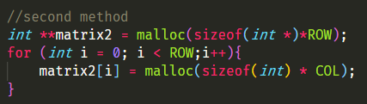

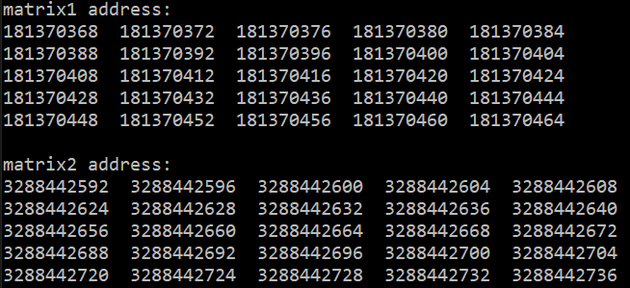
Locality
Two method to construct the 2d-array(matrix):
The address of the element :
The address in both method in same row are continuous, and non-continuous in same column.
And there is something different between the red circle side.

Slide 7
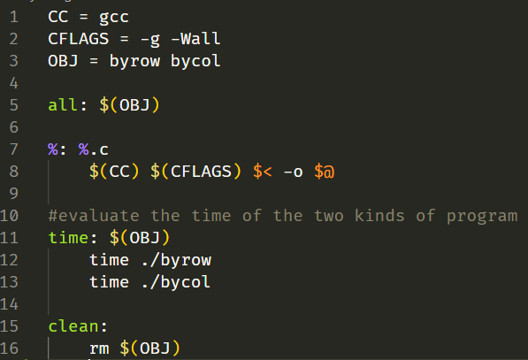
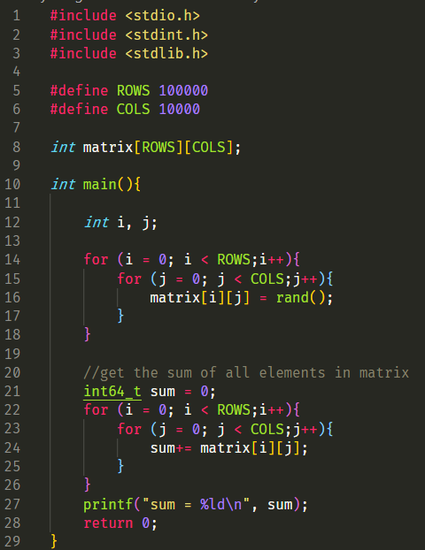
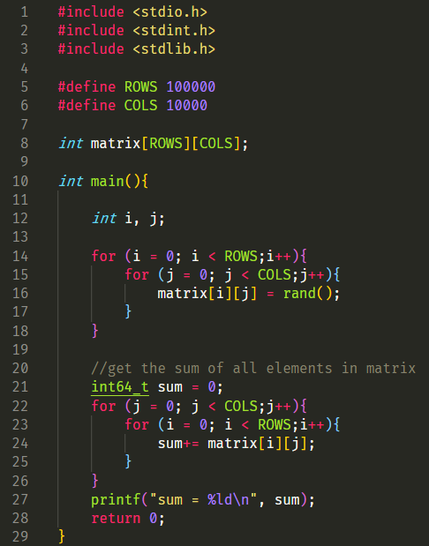
Locality
Makefile setup
Measure the executed time
byrow.c
bycol.c
The only difference is the method to get the sum of the matrix elements. (red circle)

Slide 8
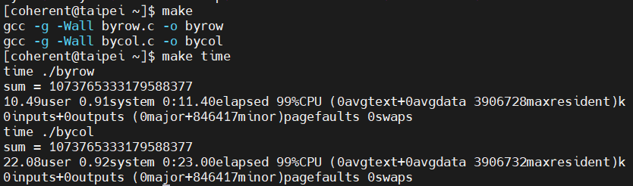
Locality
2X executed time due to spatial locality.

