Slide 1
Introduction to Algorithms
Lab2 Routing
2022/11/23 Professor: Hung-Ming Chen
Sheng-Guo Huang

Slide 2
Outline
Introduction
Input
Output
Grading
Submission
Notice

Slide 3
Introduction
Objection
Minimum spanning tree

Slide 4
Introduction
Routing is a big issue in back-end EDA. We hope to connect all gates in the design correctly and minimize the cost.
There are a variety of concerns during routing process. However, to simplify the problem, we only consider the distance as cost, which shows in equation (1).
In this Lab, we want you to perform the net routing task, which means you need to connect all given pins with smallest cost.
Manhattan distance: |𝒙𝟏−𝒙𝟐|+|𝒚𝟏−𝒚𝟐| −(𝟏)

Slide 5
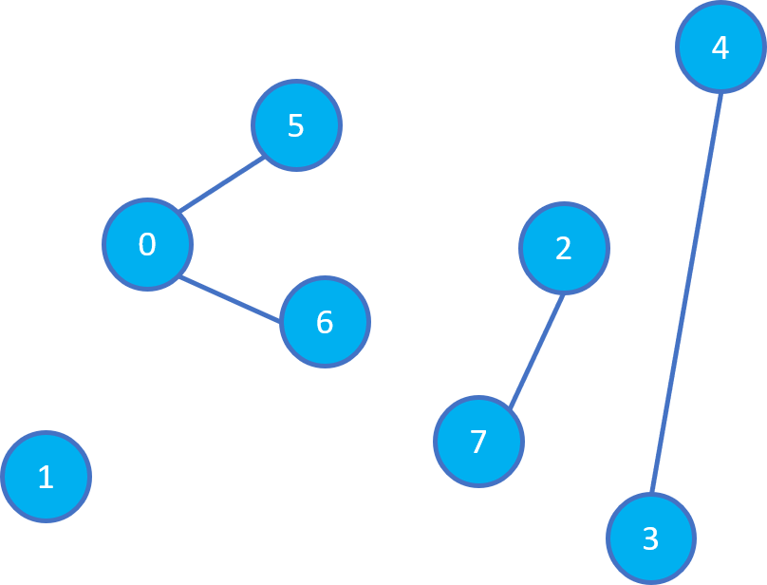
Input, Output format
Example (input)
8 // number of pins
10 60 // coordinate(x, y) of pin 0
0 5 // 1
74 55 // 2
100 0 // 3
113 113 // 4
35 94 // 5
41 47 // 6
63 13 // 7
0 5 // existed routing segment
0 6
3 4
2 7

Slide 6
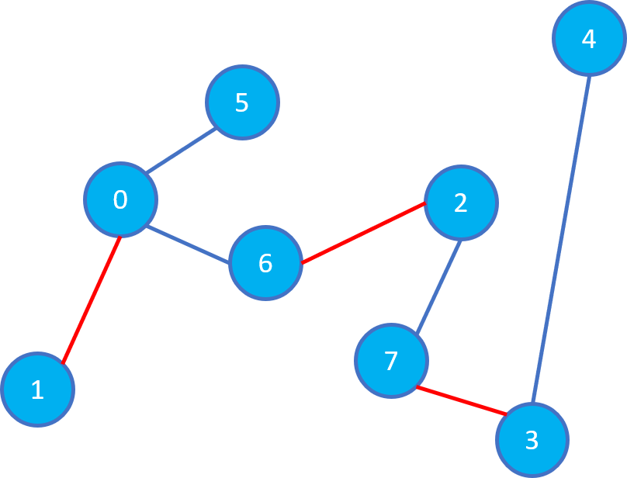
Input, Output format
Example (output)
156 // minimal cost
0 1 // added routing segment between pin 0 and pin 1
2 6
3 7

Slide 7
Input, Output format
Input example
8 // number of pins
10 60 // coordinate(x, y) of pin 0
First line represents n(the number of the pins).
Then, it will give n lines representing the coordinate of each pin.
Last, it will give the existing routing segments.

Slide 8
Input, Output format
Output example
156 // minimal cost
0 1 // added routing segment between pin 0 and pin 1
First you should output minimal cost
Then, output m lines which represent the added routing segments.
(m: number of added routing segments)
Pin order is not matter each line such as “1 0” in the second line is OK!

Slide 9
Specification
Notice
All the coordinate in input file are integer.

Slide 10
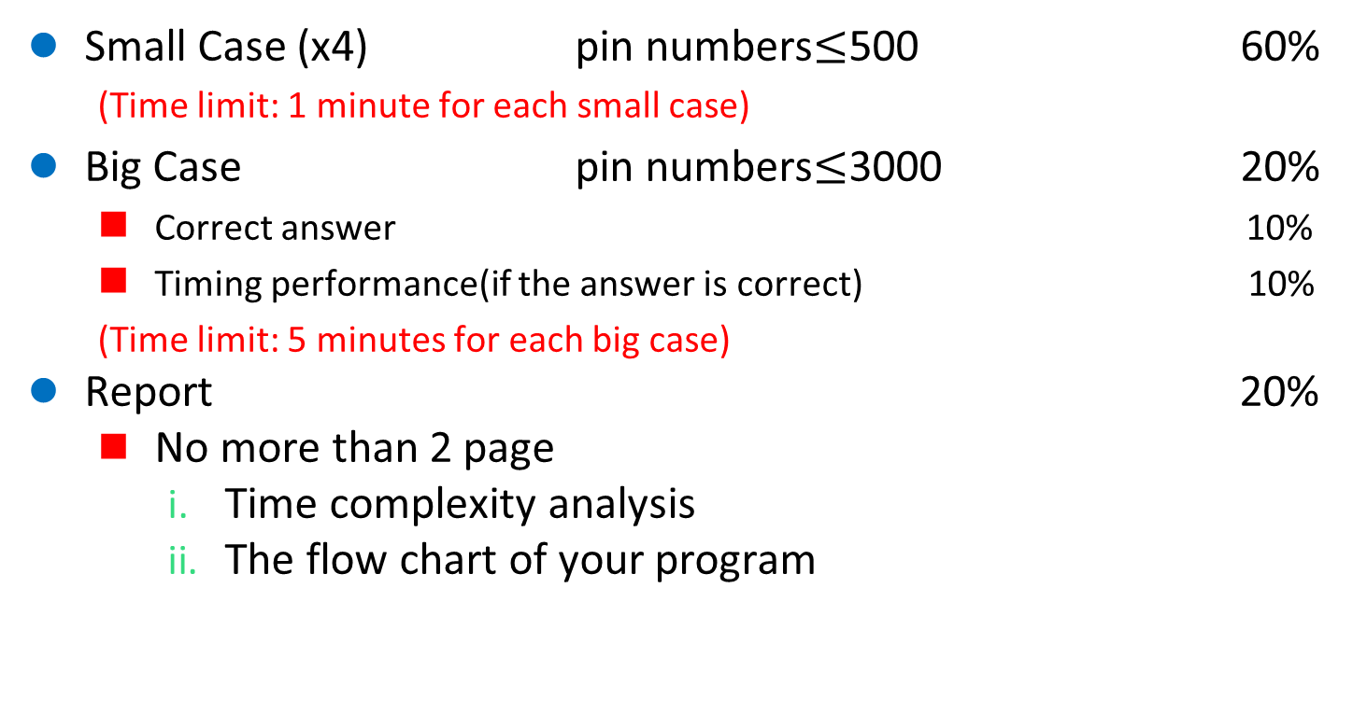
Grading
Small Case (x4) pin numbers$≤$500 60%
(Time limit: 1 minute for each small case)
Big Case pin numbers$≤$3000 20%
Correct answer 10%
Timing performance(if the answer is correct) 10%
(Time limit: 5 minutes for each big case)
Report 20%
No more than 2 page
Time complexity analysis
The flow chart of your program

Slide 11
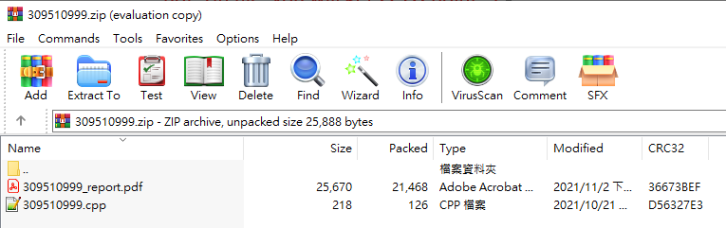
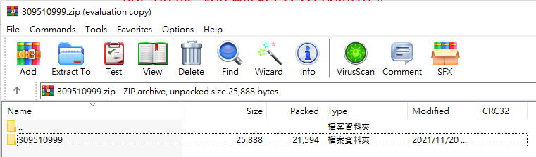
Submission
<student_id>.zip (example: 109511999.zip)
Including source code and report
Source code: <student_id>.cpp (example: 109511999.cpp)
Report: <student_id>_report.pdf (example: 109511999_report.pdf)
Naming error: -5% per file
zip format



Slide 12
Notice
Please make sure your code is available on our linux server.
Please use argc and argv to read input and output files.
Do not print anything on the terminal!
Please check the output format!
Compile procedure: g++ -std=C++11 <student_ID>.cpp -o Lab2
Execution procedure: ./Lab2 [input] [output]
Example: ./Lab2 case1.txt output.txt
You MUST WRITE YOUR OWN CODE. Plagiarism is not allowed!!!

Slide 13
Thank you for listening.

