Slide 1
ModelSim install

Slide 2
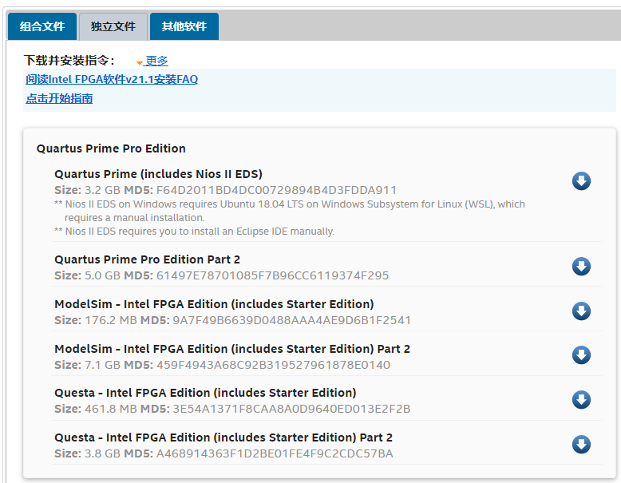
https://fpgasoftware.intel.com/21.1/?edition=pro&platform=windows&fbclid=IwAR1yYGX-GqoRiQj6-nHtoPQFtYL5Pz1k1I-xZd0RdiYL7kPIUkeraf4lXNo

Slide 3
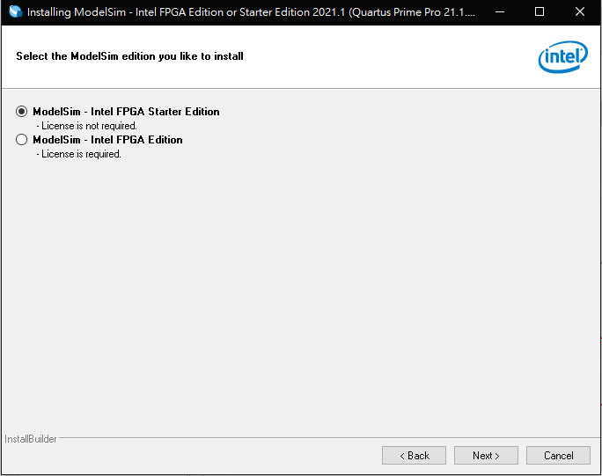
Choose starter edition

Slide 4
ModelSim Operation

Slide 5
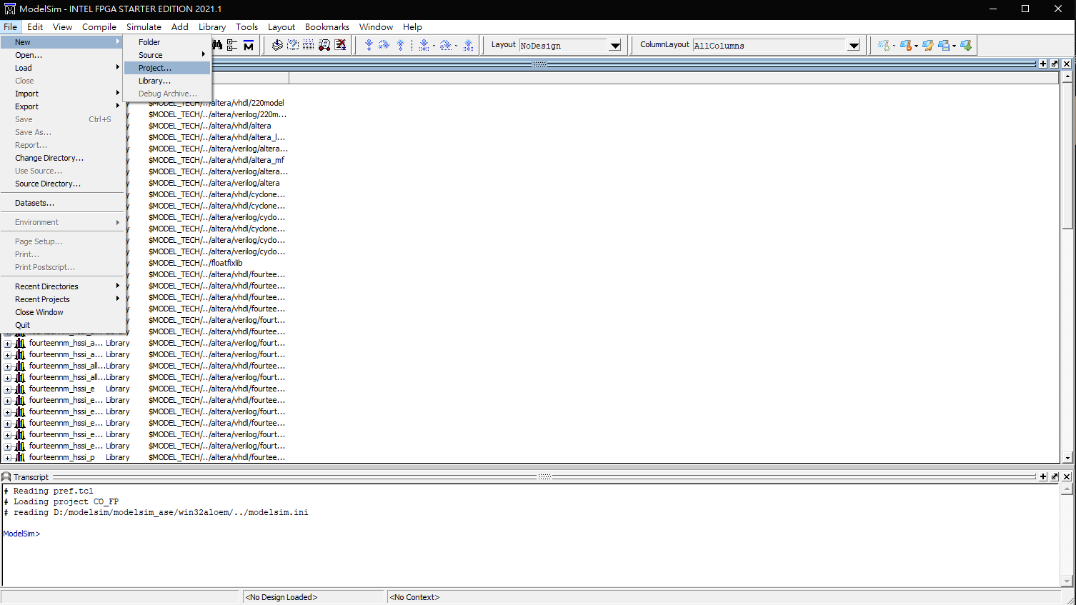
Create new project

Slide 6
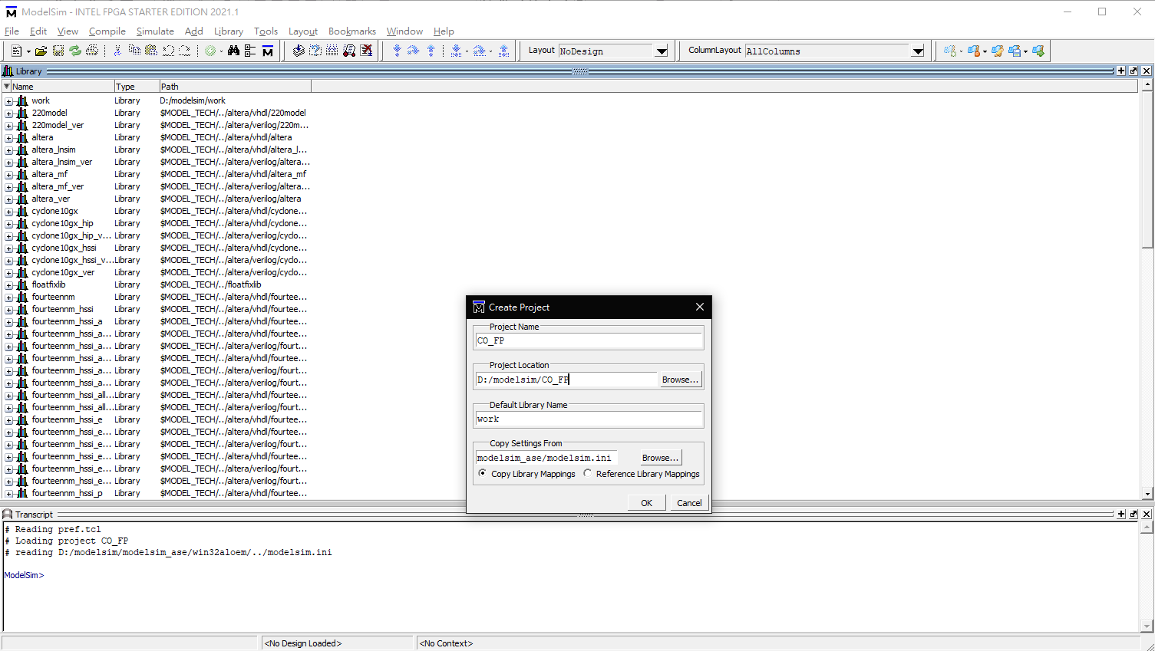
1
2
3

Slide 7
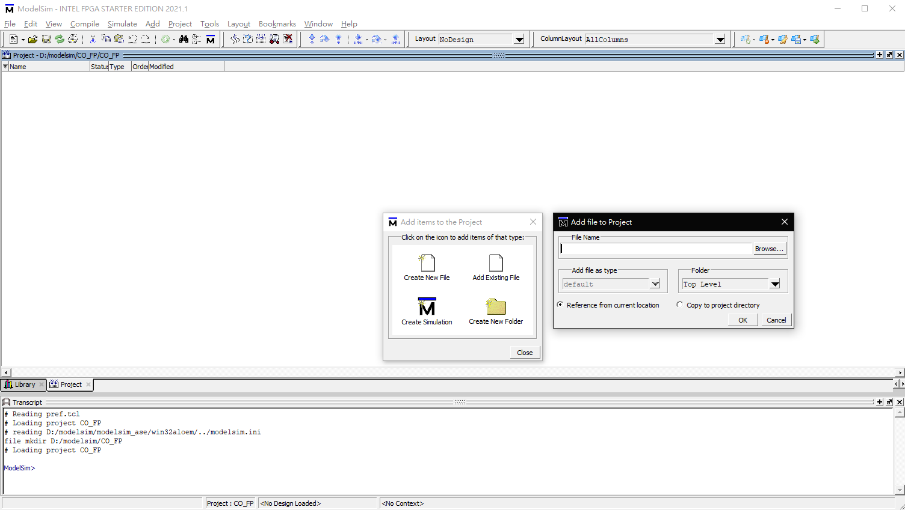

Slide 8
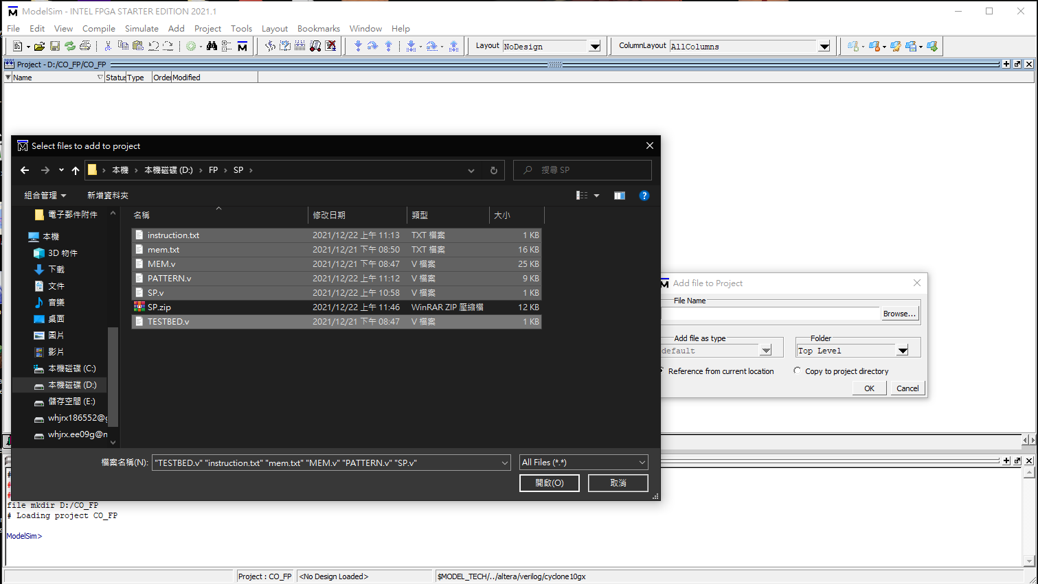

Slide 9
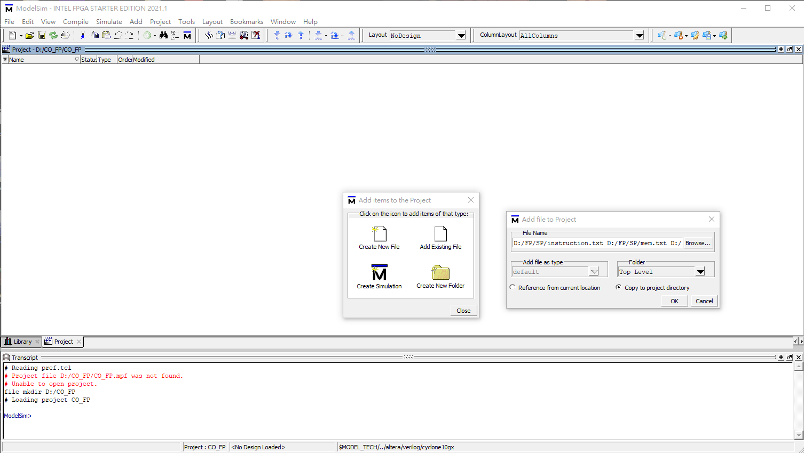

Slide 10
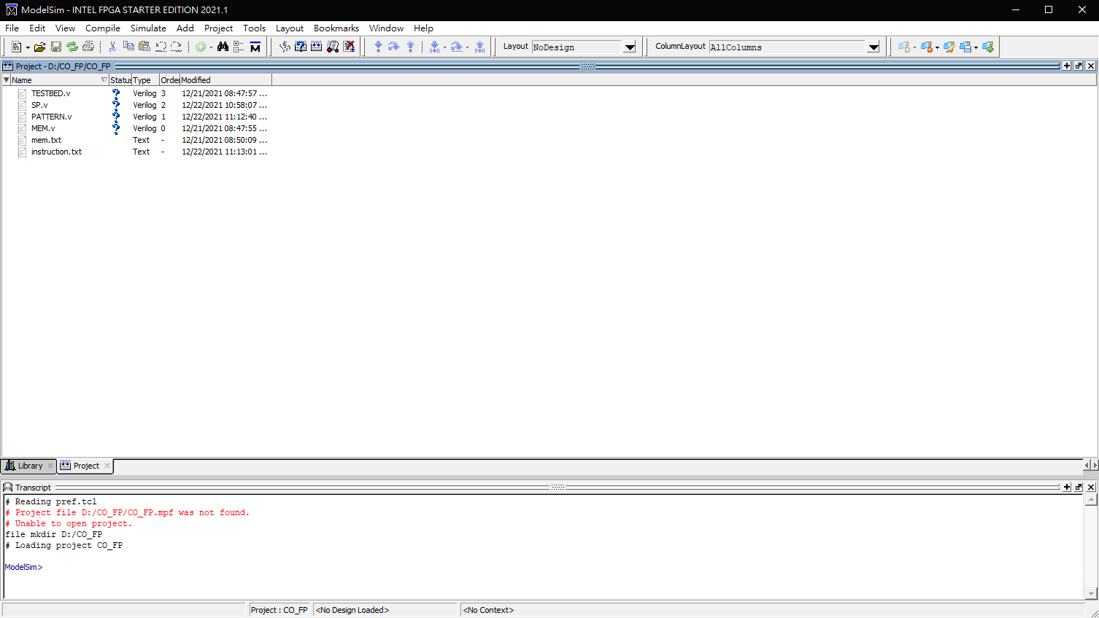
Compile all

Slide 11
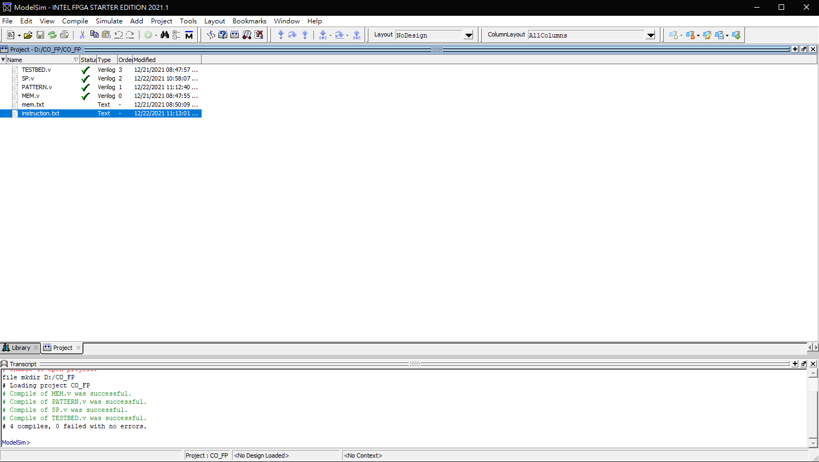

Slide 12
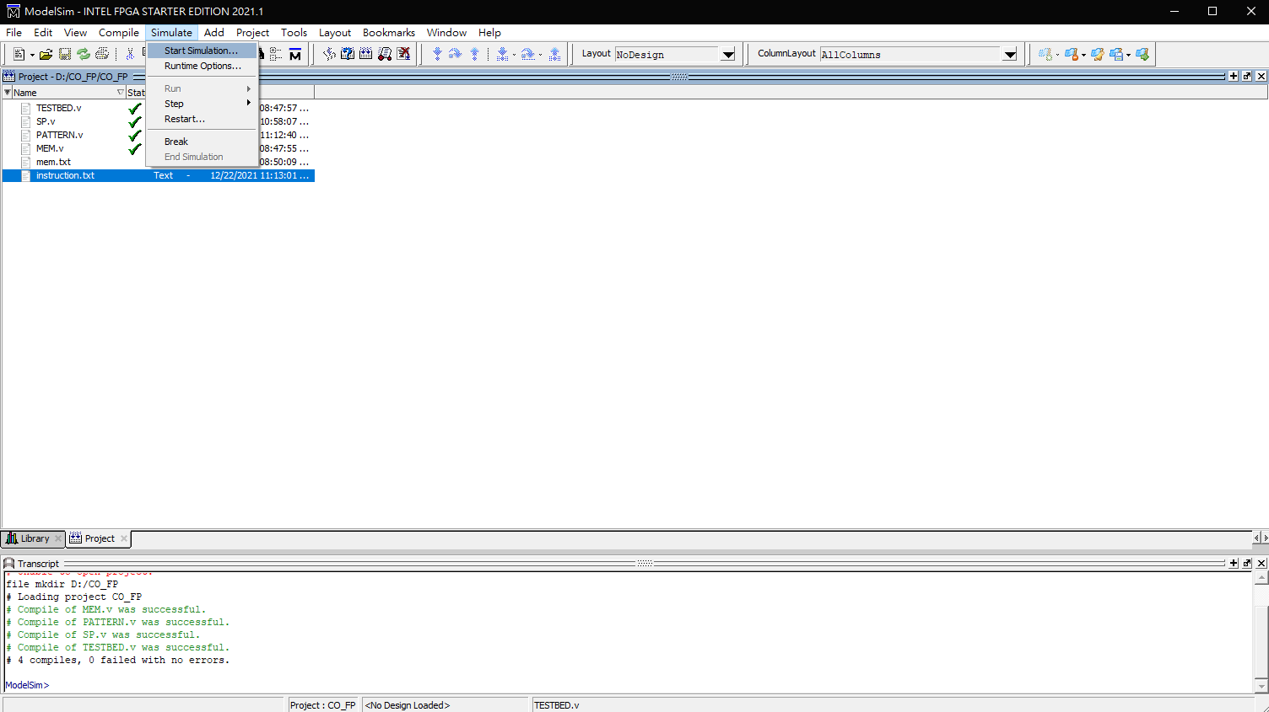
Start Simulation

Slide 13
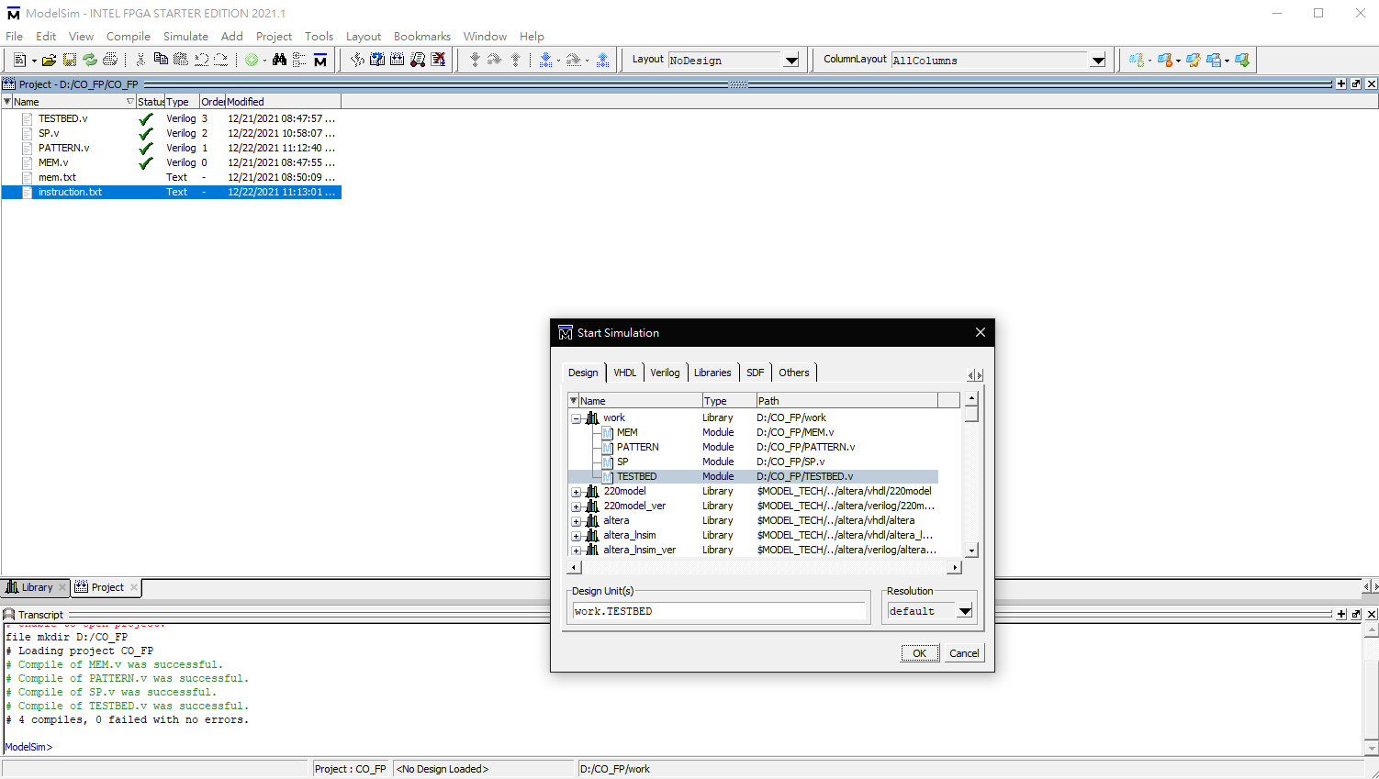

Slide 14
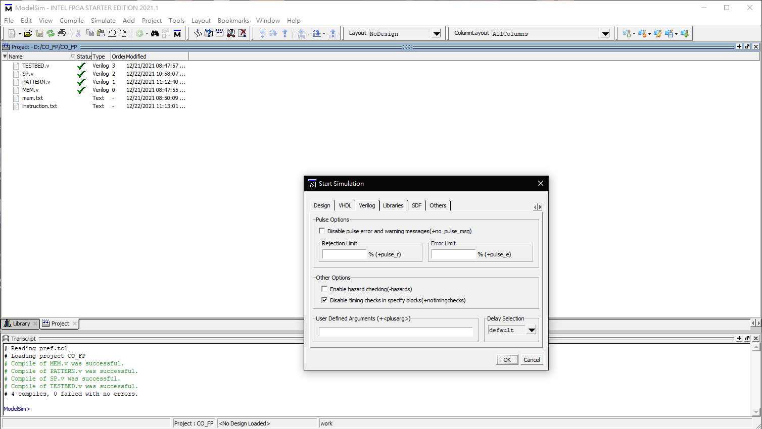

Slide 15
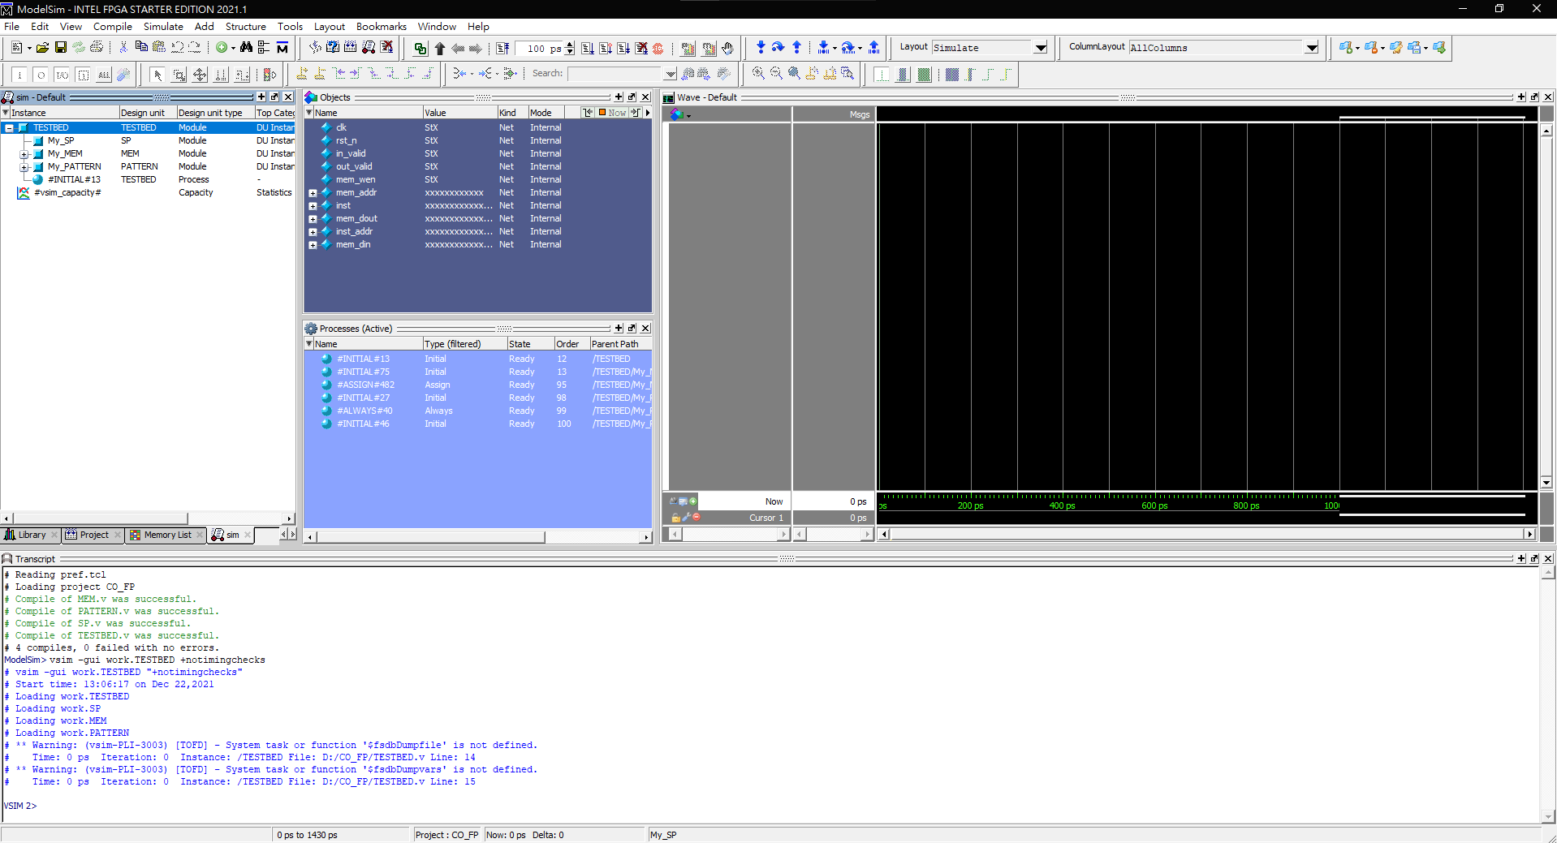
Objects in your module

Slide 16
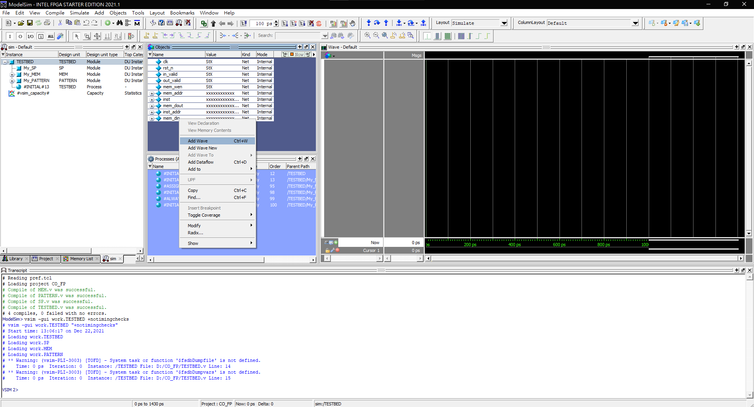
Choose the objects you want to see
Right Click
Add Wave

Slide 17
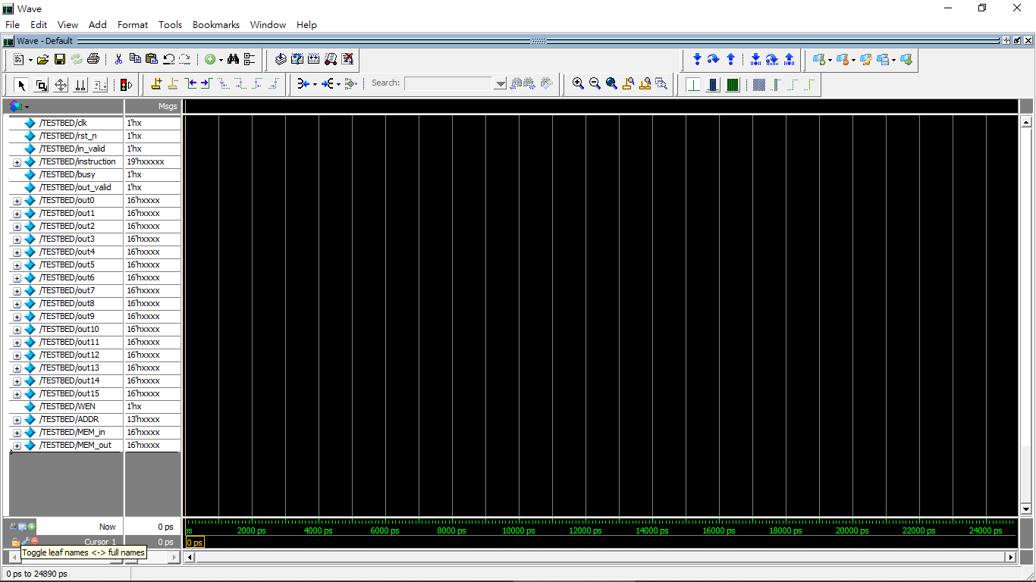

Slide 18
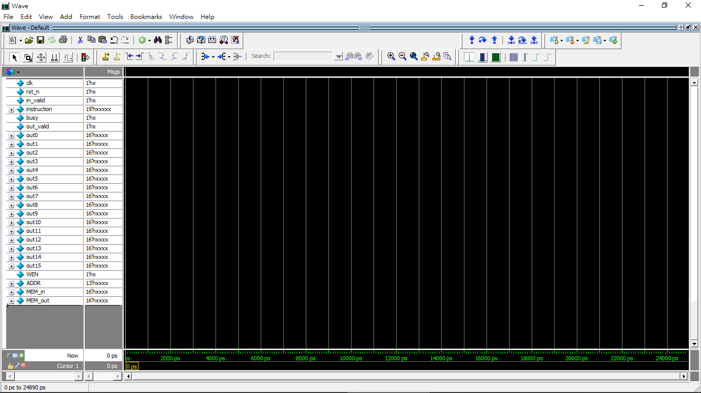

Slide 19
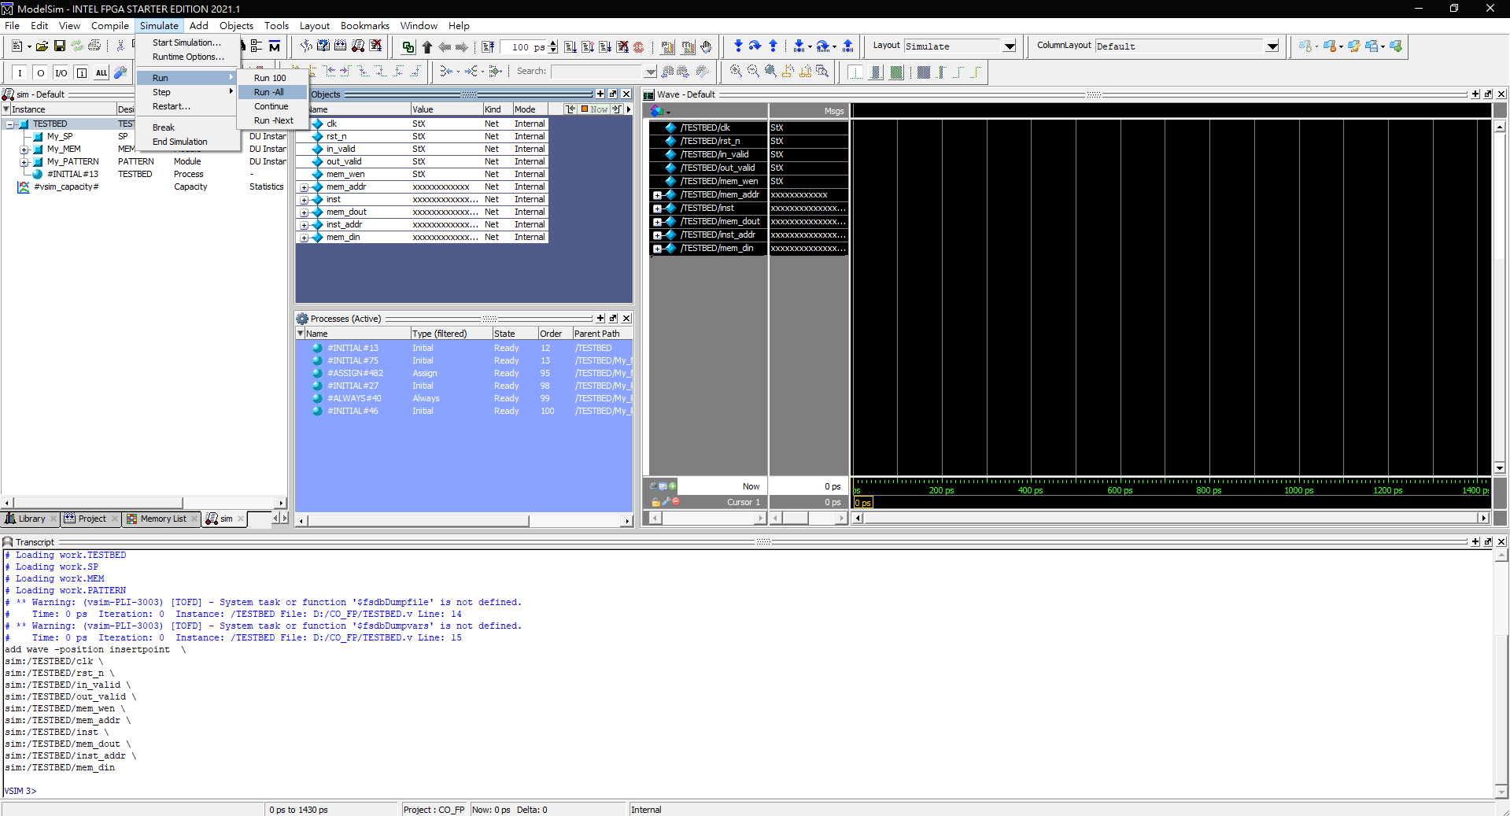
Run -All

Slide 20
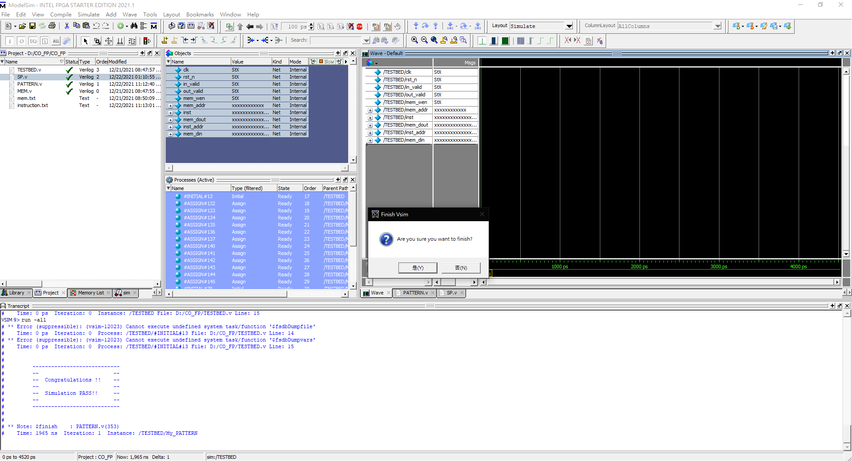
PASS!

Slide 21
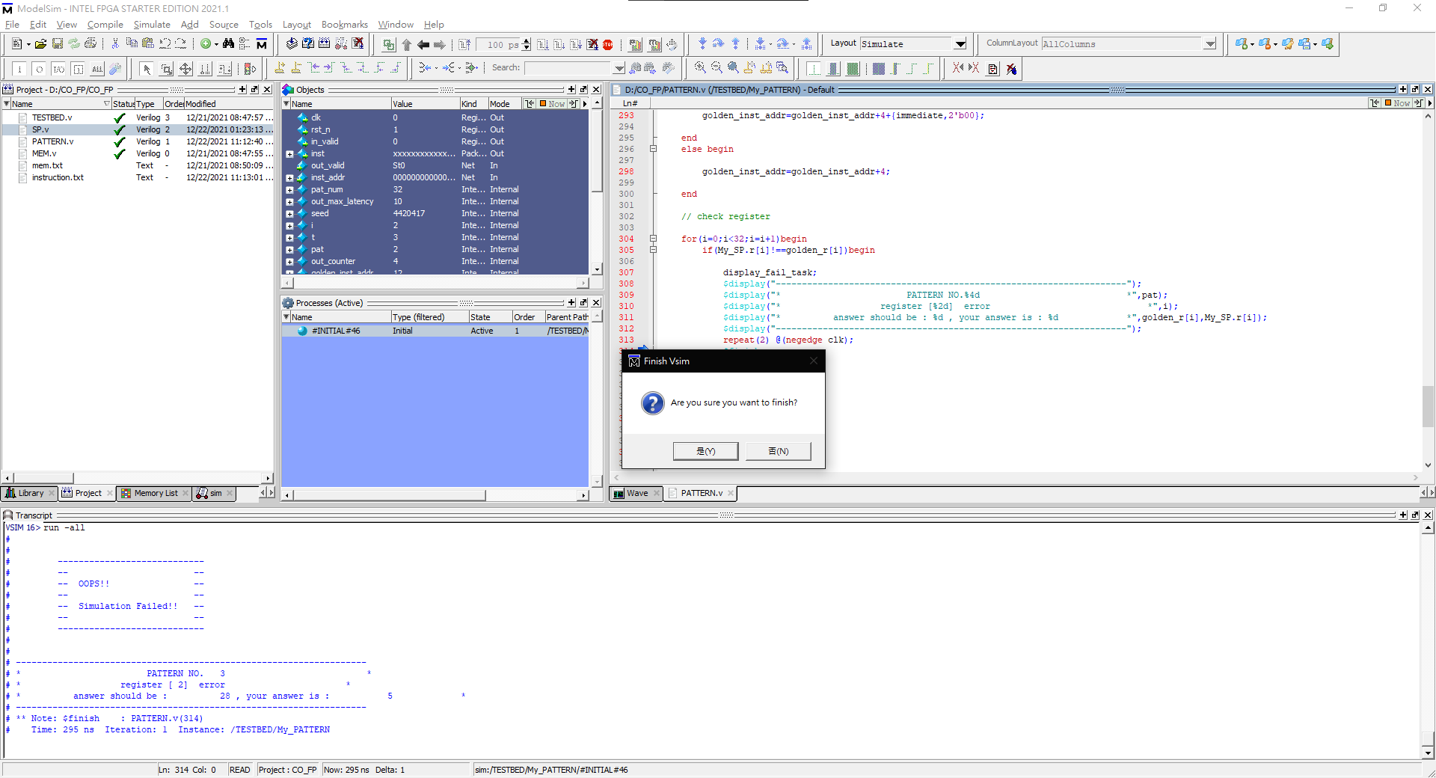
FAIL!
Please modify your hardware.

Slide 22
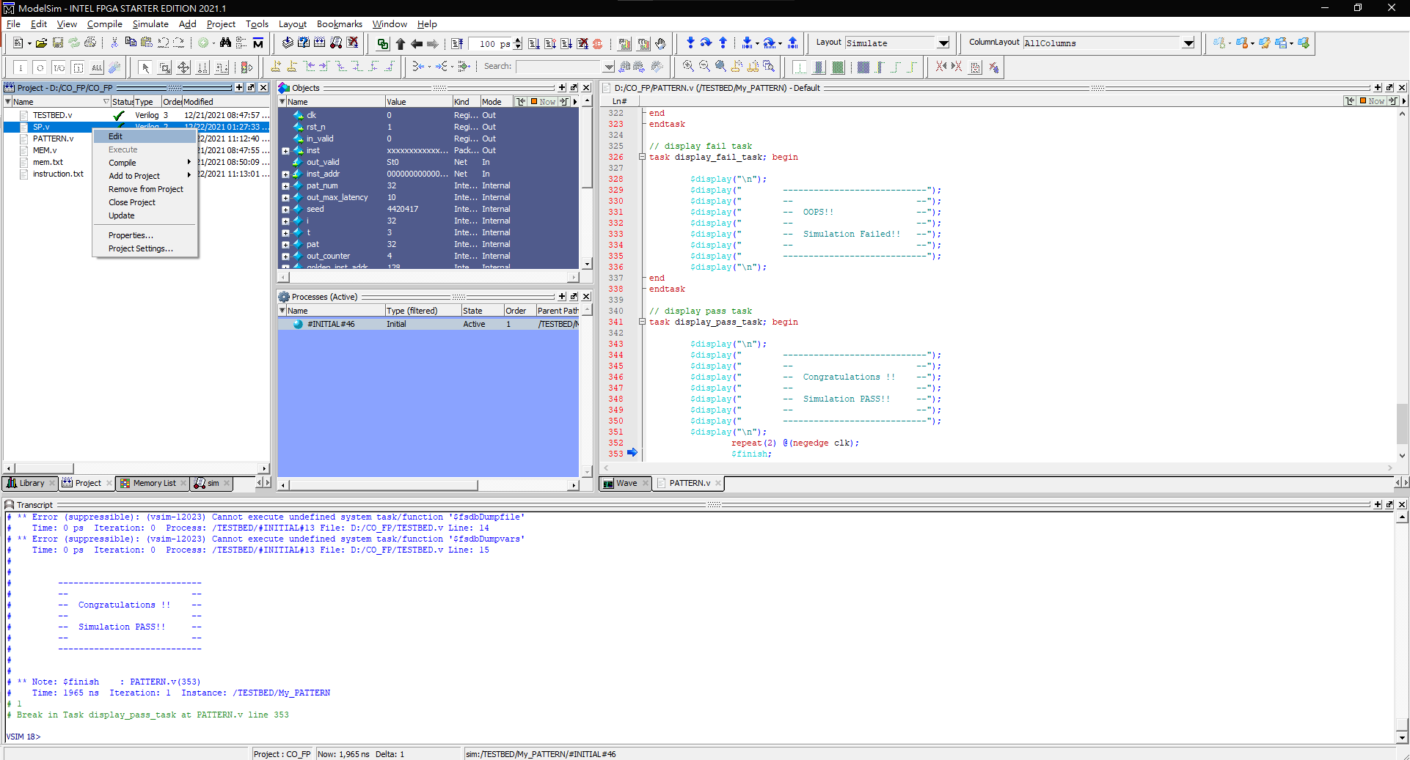
Right Click
Edit

Slide 23
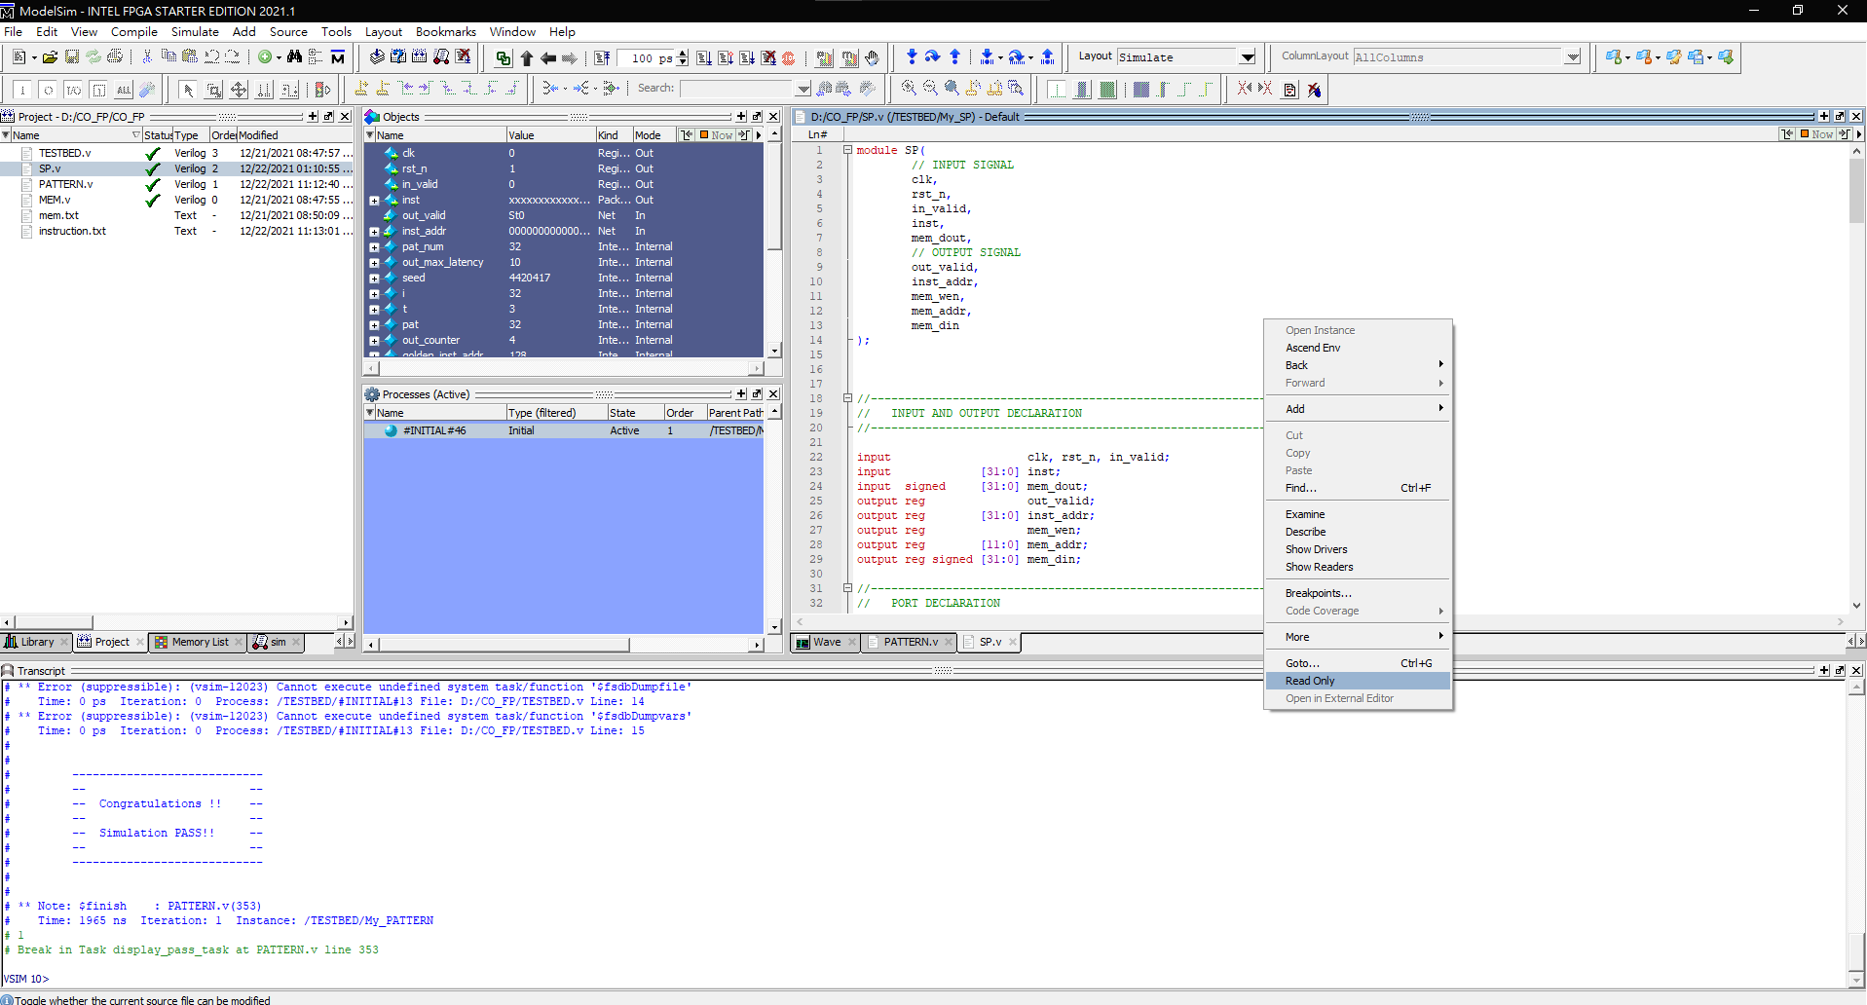
Disable

Slide 24
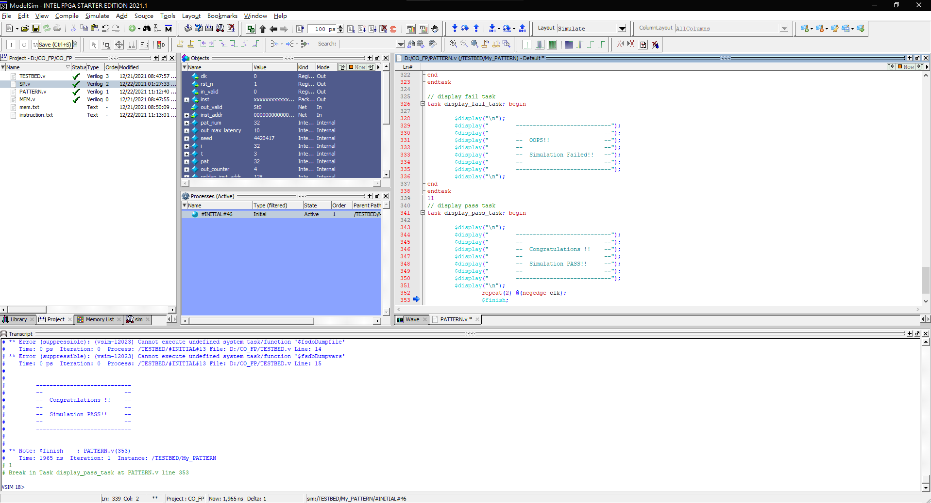

Slide 25
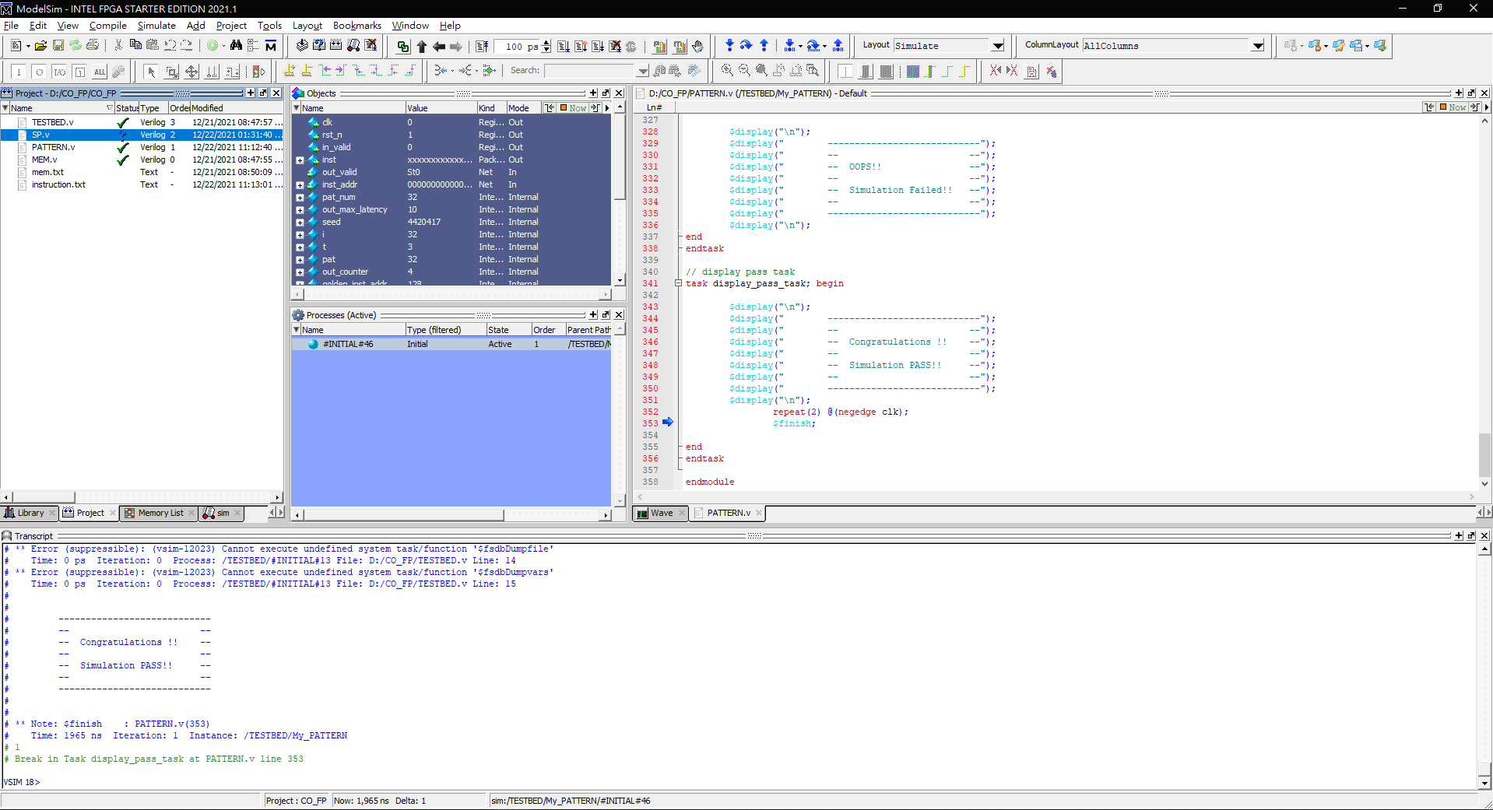
Right Click
Compile All

Slide 26
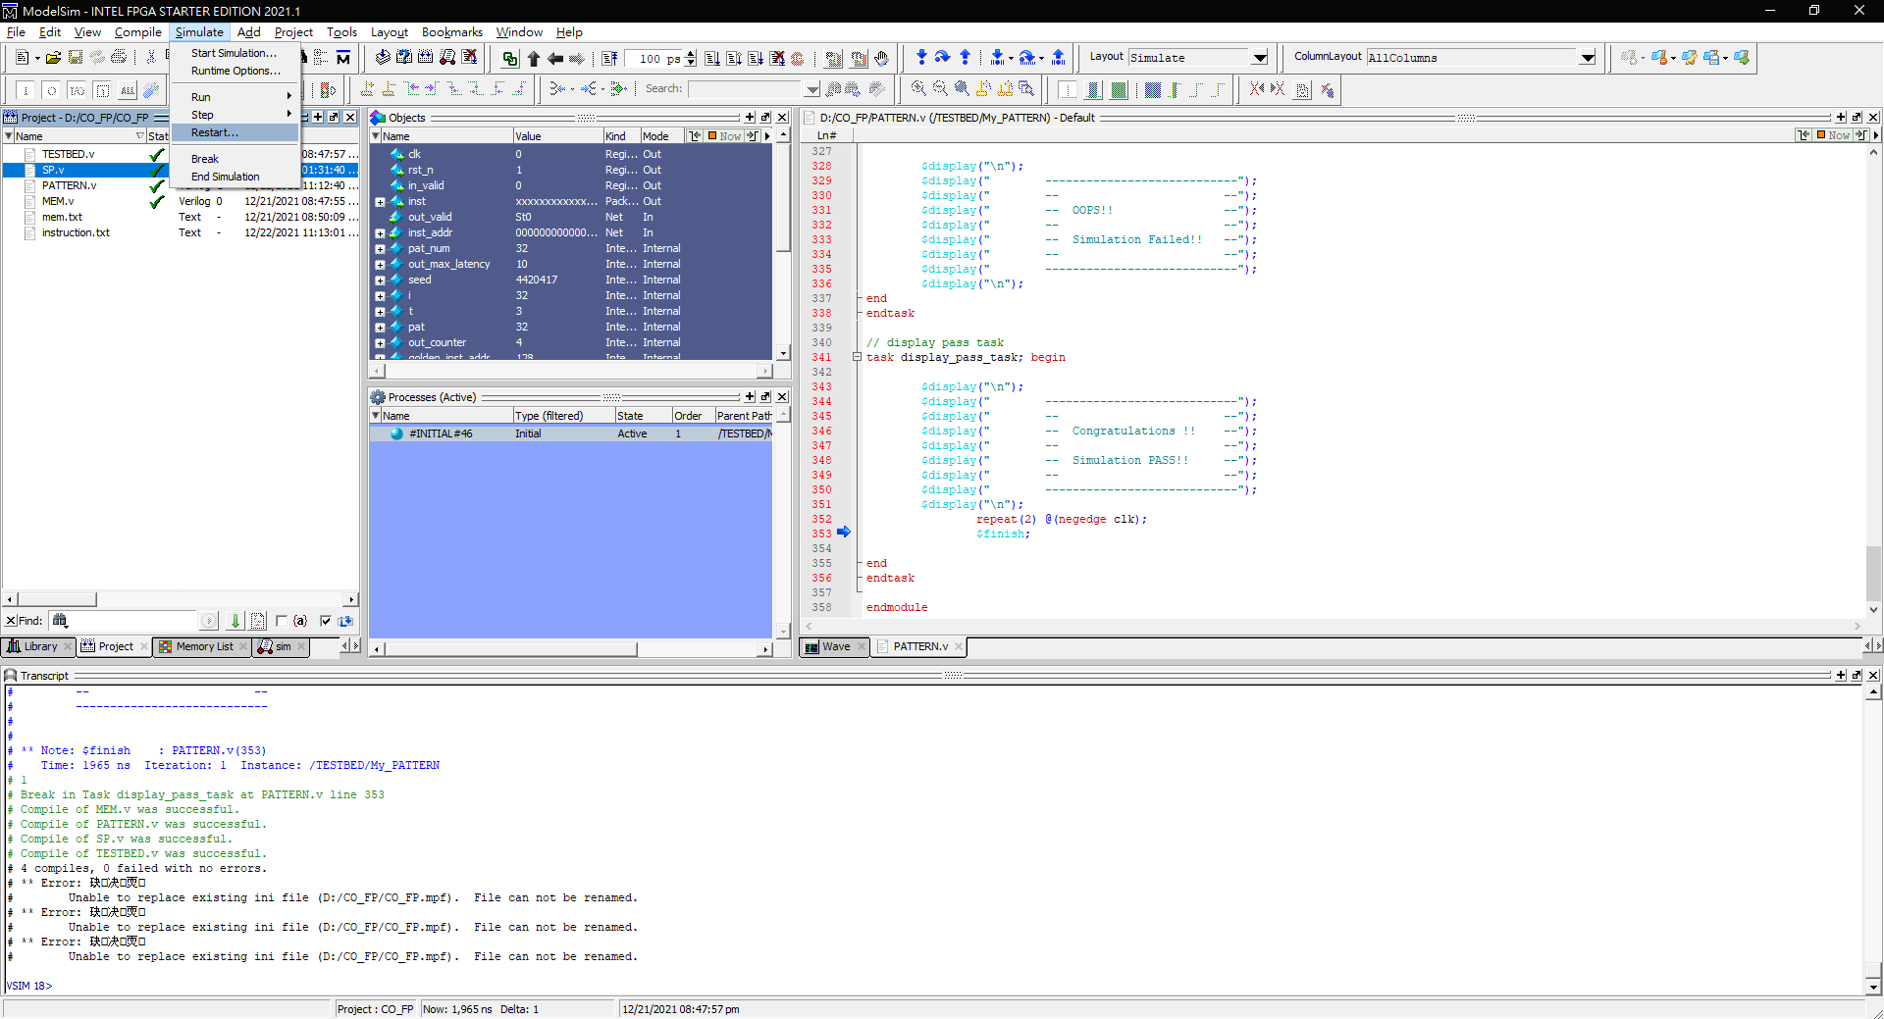
Restart

Slide 27
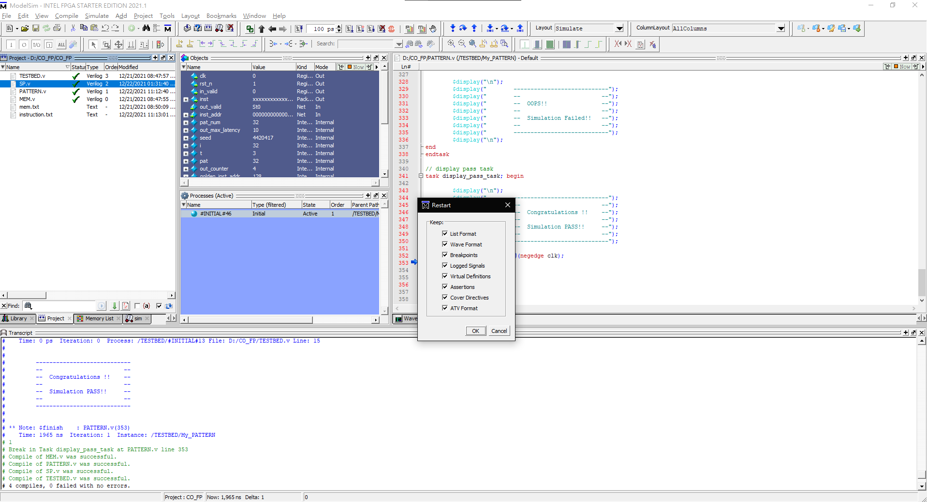

Slide 28
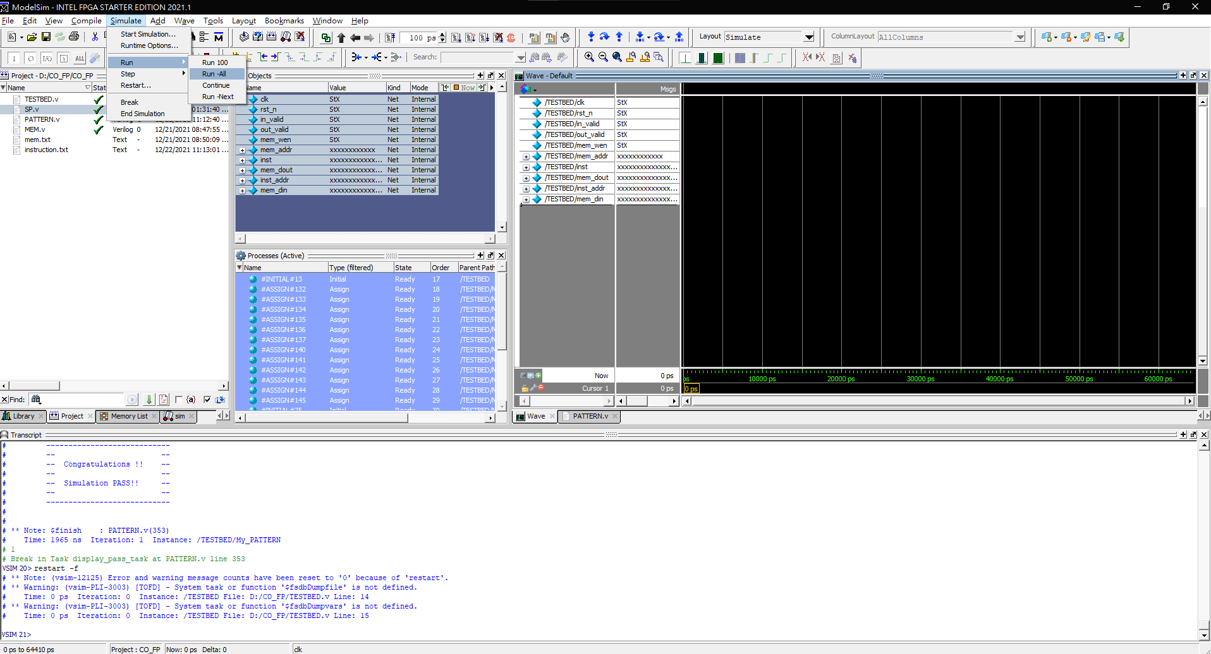
Run -All

