Slide 1

Wojciech Kryściński, Romain Paulus, Caiming Xiong, Richard Socher. "Improving Abstraction in Text Summarization ." arXiv preprint arXiv:1808.07913 (2018).
Kamal Al-Sabahi, Zhang Zuping, Yang Kang. "Bidirectional Attentional Encoder-Decoder Model and Bidirectional Beam Search for Abstractive Summarization." arXiv preprint arXiv:1809.06662 (2018).

Slide 2
Improving Abstraction in Text Summarization

Slide 3
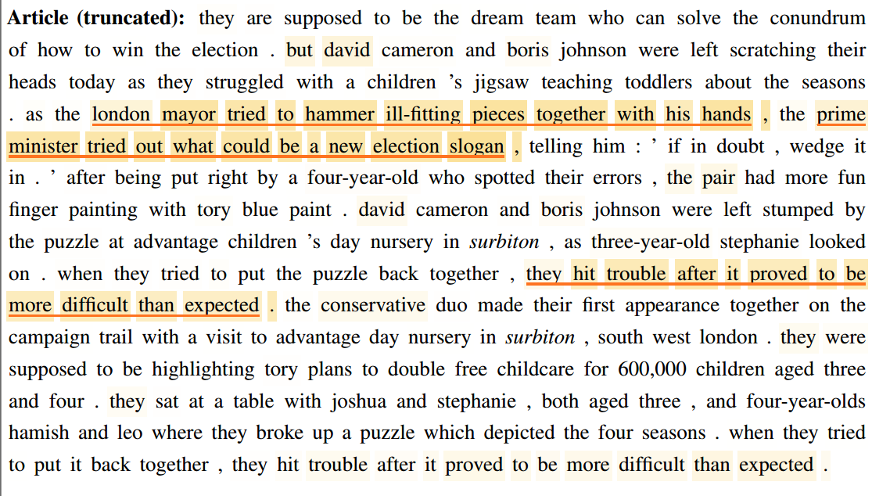
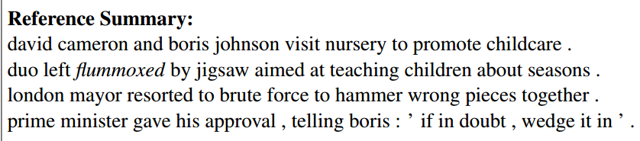
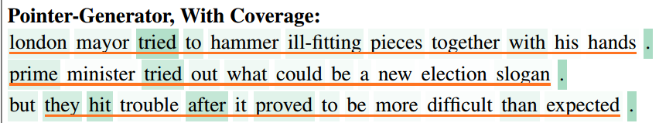
Motivation
Generated summary of state-of-the-art model：
high word overlap, low novel words!

Slide 4
Two Contributions
Decoder side: decouples the extraction and generation
A contextual network
A pertained language model
New reinforcement learning reward
novelty metric

Slide 5
Model
Baseline Paulus "A Deep Reinforced Model for Abstractive Summarization." (2017)
encoder-decoder architecture with temporal attention and intra-attention
pointer
hybrid learning objective
Language Model Fusion
contextual network
language model
Abstractive Reward
novelty metric

Slide 6
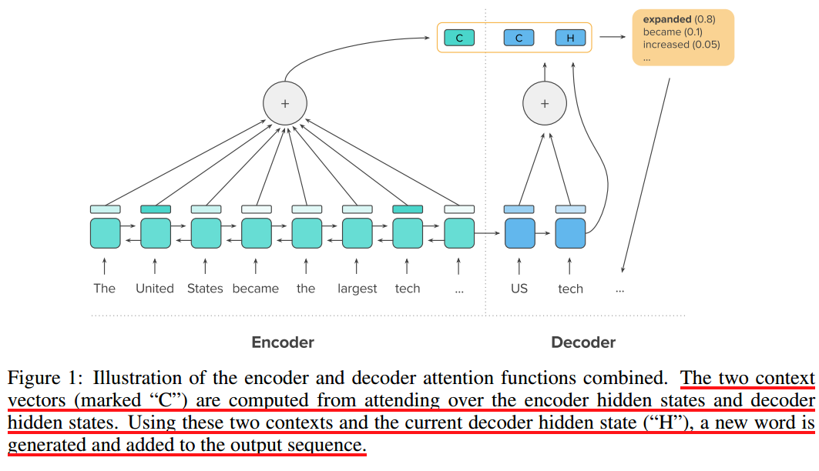
Model
Baseline:
encoder-decoder architecture with temporal attention and intra-attention
Temporal attention
Intra-attention

Slide 7
Model
Baseline:
Pointer network
Generation mode:
Copy mode:
Copy probability:
Final probability distribution:

Slide 8



Model
Baseline: hybrid learning objective
maximum likelihood loss
Reinforced learning loss
Final loss
Equal to u_{t}

Slide 9
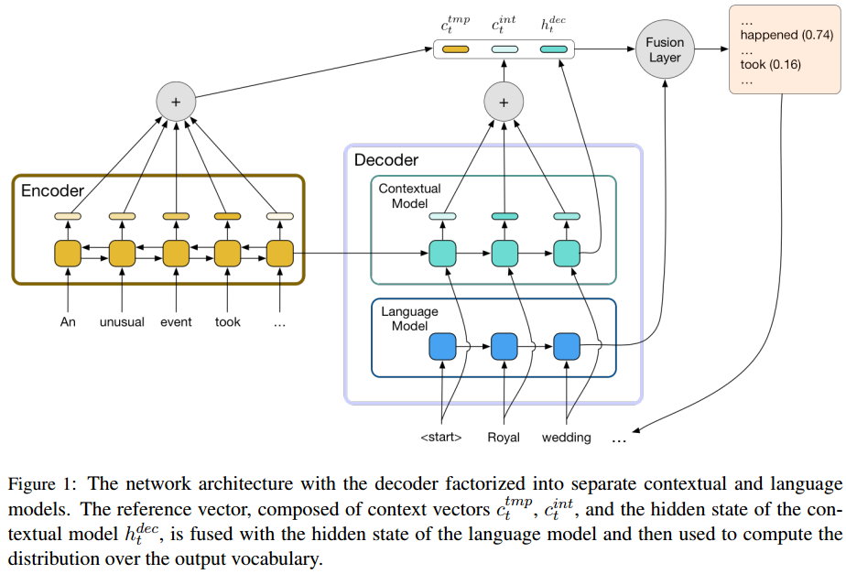

Model
Language Model Fusion

Slide 10



Model
Abstractive Reward
Un-normalized novelty metric
Normalized novelty metric (prevent output short summaries )
New Reinforced learning loss
The n-gram set of the sequence x

Slide 11
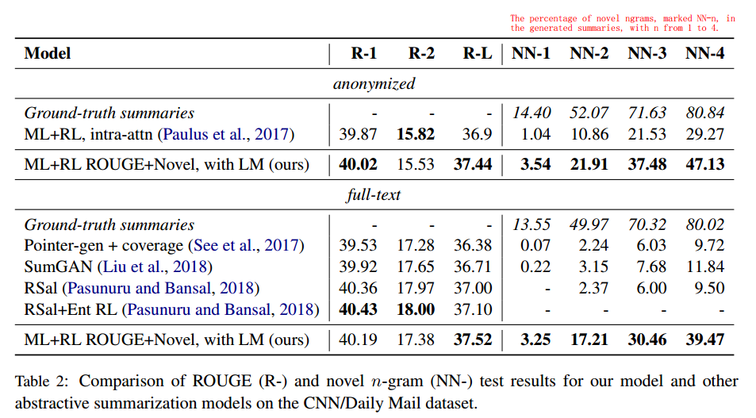
Experimental Result

Slide 12
Bidirectional Attentional Encoder-Decoder Model and Bidirectional Beam Search for Abstractive Summarization

Slide 13
