Slide 1




STUDY MATERIAL
Methods module
Comparing Europe with Data. Six methods explained with the COIL data, from the idea to the result.
Correlation · regression · panel data · classification · PCA · clustering · missing values

Slide 2
HOW TO USE THIS MODULE
Four slides per method
1
2
3
4
The idea
A real example
How to read it
Do it yourself
What the method does, in plain words. No formulas you need to memorise.
Computed with the COIL dataset, so you can reproduce every number.
What the output means, and the most common mistakes.
Menus in Power BI and Gretl. Code in Python and R only if your course uses it.
You do not need to program. Everything in this module can be done with menus; the code is there for those who prefer it, and it is on the website ready to run.
Ulysseus COIL · Comparing Europe with Data · Methods module

Slide 3
THE WORKFLOW
Every project follows the same six steps
Question
Data
Explore
Model
Interpret
Present
Three things that apply to every method
The COIL data are 32 countries. That is a small sample: keep models simple and report n in every table.
Cross-section = one year, many countries. Panel = many countries over many years. Choose the same year(s) for all countries.
Association is not causation. Your results describe patterns; explain them with the national context, do not claim effects.
Ulysseus COIL · Comparing Europe with Data · Methods module

Slide 4
CHOOSING
Which method answers your question?
Your question | Method | Section
Do two indicators move together? | Correlation | 1
How much does Y change with X, other things equal? | Linear regression | 2
Does it hold within countries over time? | Panel regression | 3
Is a country in the high or the low group? | Classification | 4
Can many indicators be summarised in a few? | PCA | 5
Which countries look alike? | Clustering | 6
Some values are missing. What now? | Missing values | 7
Ulysseus COIL · Comparing Europe with Data · Methods module

Slide 5
01
Correlation
Do two indicators move together across countries?
Ulysseus COIL · Comparing Europe with Data · Methods module

Slide 6
CORRELATION · THE IDEA
One number for "do they move together?"
1
Always look at the scatter plot first
The correlation coefficient r goes from −1 to +1. Close to +1: when one indicator is high, the other tends to be high. Close to −1: one high, the other low. Close to 0: no linear pattern.
One dot per country. The picture shows outliers and curves that r cannot.
2
r measures straight-line patterns
A strong curved relationship can have a small r.
3
Same year for every country
Comparing 2015 in one country with 2023 in another mixes time and country.
Ulysseus COIL · Comparing Europe with Data · Methods module

Slide 7
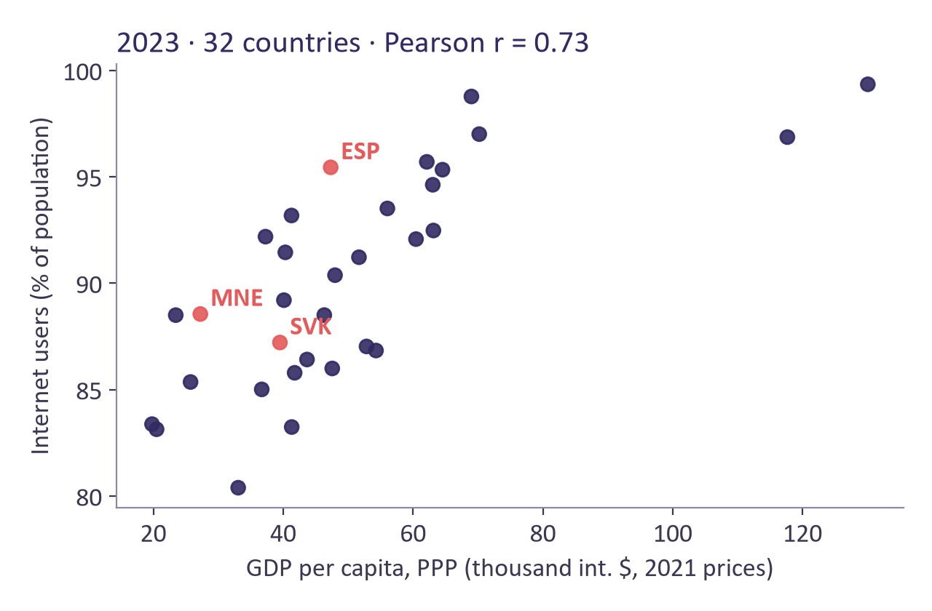
CORRELATION · EXAMPLE
Richer countries use the Internet more
r = 0.73
Internet users vs GDP per capita, 2023
32
countries (EU aggregate excluded)
Strong
positive association; without Luxembourg and Ireland, far to the right, r is still 0.74
Source: World Bank (IT.NET.USER.ZS, NY.GDP.PCAP.PP.KD). Spain, Slovakia and Montenegro in coral.
Ulysseus COIL · Comparing Europe with Data · Methods module

Slide 8
CORRELATION · READING
What r = 0.73 tells you, and what it does not
How to read it
Watch out
Countries with higher income per person tend to have a larger share of Internet users.
Spain is the country furthest above the line: about 6 points more users than expected for its income. Montenegro is slightly above, Slovakia slightly below.
Rough guide: |r| below 0.3 weak, 0.3 to 0.7 moderate, above 0.7 strong.
It does not say that income causes Internet use (or the reverse).
Two very rich countries can pull r up or down: check without them.
Use percentages or per-capita values, never totals, when countries differ in size.
Ulysseus COIL · Comparing Europe with Data · Methods module

Slide 9
CORRELATION · DO IT YOURSELF
Correlation in your tool
Power BI · menus, no code
Gretl · menus, no code
Scatter chart: X = GDP per capita, Y = Internet users, Values = country.
Filter year = 2023.
Analytics pane > Trend line.
New quick measure > Correlation coefficient.
Sample > Restrict, based on criterion: year == 2023.
Select the two variables.
View > Correlation matrix.
View > Graph specified vars > X-Y scatter.
WITH CODE · ONLY IF YOUR COURSE USES PYTHON OR R
Python
R
s = d[d.year == 2023]
print(s[["IT_NET_USER_ZS", "NY_GDP_PCAP_PP_KD"]].corr())
s <- subset(d, year == 2023)
cor(s$IT_NET_USER_ZS, s$NY_GDP_PCAP_PP_KD, use = "complete.obs")
Ulysseus COIL · Comparing Europe with Data · Methods module

Slide 10
02
Linear regression
How much does one indicator change when another changes, keeping the rest constant?
Ulysseus COIL · Comparing Europe with Data · Methods module

Slide 11
REGRESSION · THE IDEA
A line through the cloud of countries
1
Coefficient (b)
Y = b0 + b1·X1 + b2·X2 + error. Each coefficient b is the average change in Y when that X increases by one unit and the other X stay the same.
Size and sign of the association, in the units of Y per unit of X.
2
p-value
Below 0.05: the pattern is unlikely to be pure chance. It says nothing about how large or important it is.
3
R²
Share of the differences in Y between countries that the model reproduces (0 to 1).
Ulysseus COIL · Comparing Europe with Data · Methods module

Slide 12
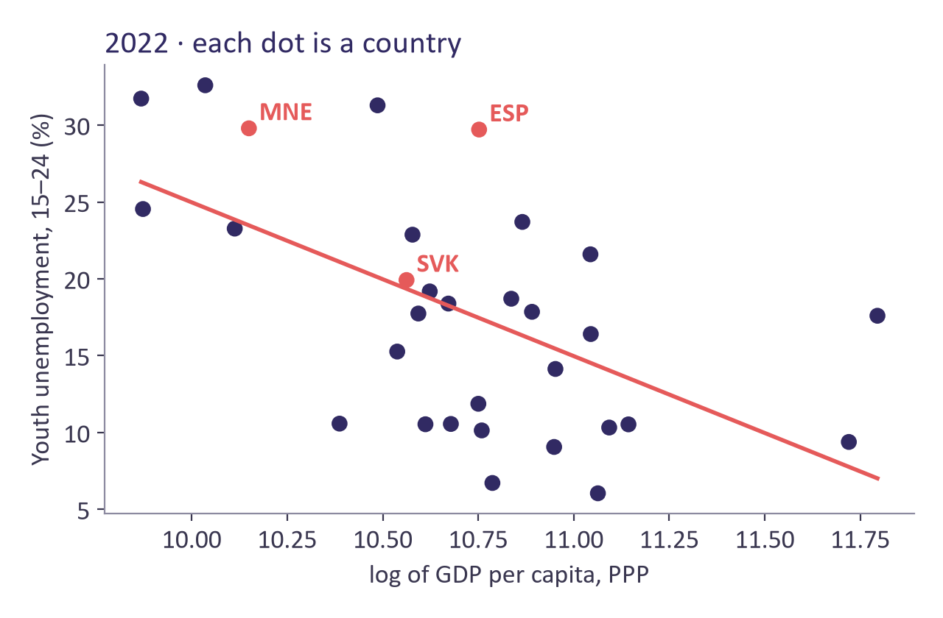
REGRESSION · EXAMPLE
Youth unemployment, education and income
-10.0
coefficient of log GDP per capita (p = 0.001)
0.006
coefficient of tertiary enrolment (p = 0.909)
R² = 0.32
31 countries, 2022
Model: youth unemployment = b0 + b1·tertiary enrolment + b2·log(GDP per capita). The line in the chart uses income only.
Ulysseus COIL · Comparing Europe with Data · Methods module

Slide 13
REGRESSION · READING
Reading the table in plain English
How to read it
Watch out
Income: with GDP per capita 10% higher, youth unemployment is about 1.0 points lower, for the same tertiary enrolment.
Tertiary enrolment: no association once income is taken into account (p = 0.909).
The model reproduces about 32% of the differences between countries; the rest depends on other things (labour laws, training systems…).
With a log X: coefficient × 0.095 ≈ change in Y for a 10% higher X.
Association, not effect: income could stand for many other things.
31 countries: add two or three variables at most.
Look for outliers in the scatter before you trust the line.
Do not try models until one is significant: decide the model from your question.
Ulysseus COIL · Comparing Europe with Data · Methods module

Slide 14
REGRESSION · DO IT YOURSELF
Regression in your tool
Power BI · menus, no code
Gretl · menus, no code
One X: scatter chart + Analytics pane > Trend line shows the fitted line.
Two or more X: Power BI has no regression table. Use Gretl (no code) or a Python/R visual.
Sample > Restrict: year == 2022.
Select GDP per capita, then Add > Logs of selected variables.
Model > Ordinary Least Squares.
Dependent: SL_UEM_1524_ZS. Regressors: SE_TER_ENRR and l_NY_GDP_PCAP_PP_KD.
WITH CODE · ONLY IF YOUR COURSE USES PYTHON OR R
Python
R
s = d[d.year == 2022]
f = "SL_UEM_1524_ZS ~ SE_TER_ENRR + log_gdp"
m = smf.ols(f, data=s).fit()
print(m.summary())
s <- subset(d, year == 2022)
m <- lm(SL_UEM_1524_ZS ~ SE_TER_ENRR + log_gdp, data = s)
summary(m)
Ulysseus COIL · Comparing Europe with Data · Methods module

Slide 15
03
Panel data and time trends
The same countries followed over the years: compare each country with itself.
Ulysseus COIL · Comparing Europe with Data · Methods module

Slide 16
PANEL · THE IDEA
Between countries or within a country?
1
Country fixed effects
A simple regression on all country-years mixes two things: differences between countries and changes within each country. Country fixed effects keep only the changes within each country.
Everything stable about a country (history, institutions, climate) is taken out.
2
Time trend
Captures what changes for everybody over the years.
3
Clustered standard errors
Years of the same country are not independent: cluster by country.
Ulysseus COIL · Comparing Europe with Data · Methods module

Slide 17
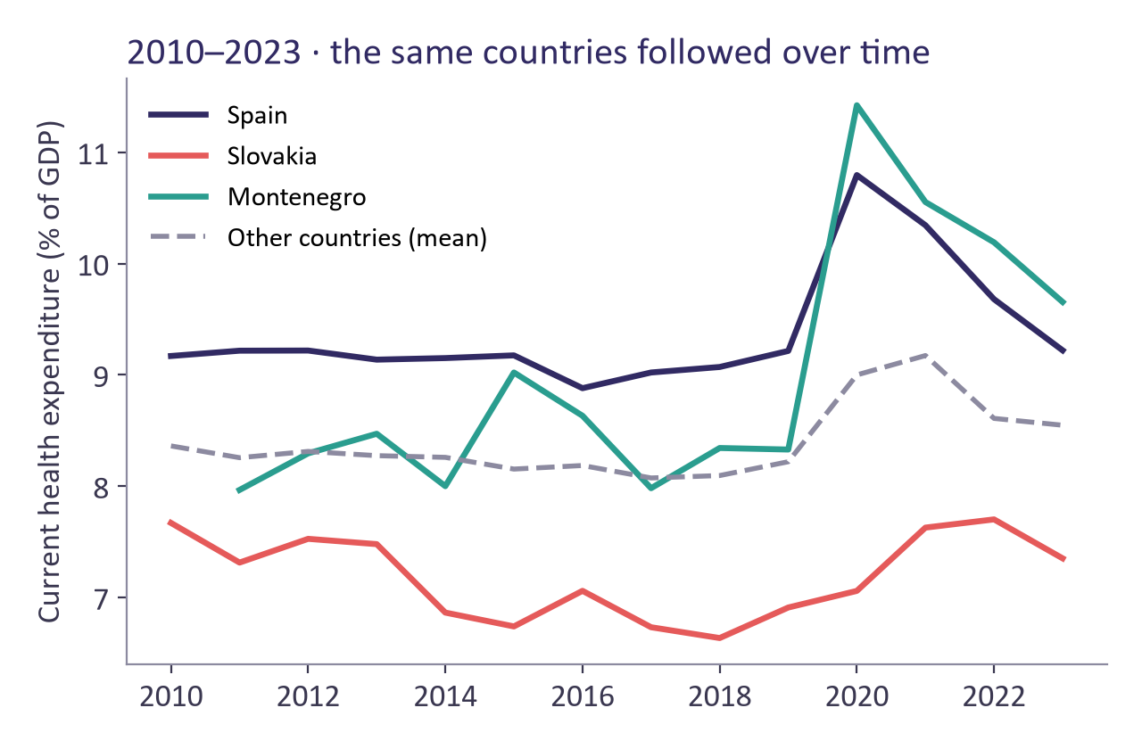
PANEL · EXAMPLE
Ageing and health expenditure, 2010–2023
+0.25
all country-years together (p < 0.001)
-0.10
within countries, with fixed effects and trend (p = 0.276)
+0.08
points of GDP per year, common trend (p = 0.056)
447 observations, 32 countries. Coefficient: change in health spending (% of GDP) per extra point of population aged 65+.
Ulysseus COIL · Comparing Europe with Data · Methods module

Slide 18
PANEL · READING
Why the two answers differ
How to read it
Watch out
Between countries: older societies spend more on health.
Within countries: in these 14 years, ageing faster did not go with spending more, once the common trend is removed.
Both are true; they answer different questions. Say which one your question is about.
2020 (COVID-19) moves every country: look at the chart, consider year dummies.
With ordinary standard errors p = 0.08; clustered by country p ≈ 0.27. Always cluster.
Small differences between software (0.27 vs 0.28) are normal.
Ulysseus COIL · Comparing Europe with Data · Methods module

Slide 19
PANEL · DO IT YOURSELF
Panel regression in your tool
Power BI · menus, no code
Gretl · menus, no code
Line chart: X = year, Y = health expenditure, Legend = country: shows the panel.
The model itself: use Gretl (no code) or a Python/R visual.
Data > Dataset structure > Panel (unit iso3, time year).
Sample > Restrict: year <= 2023.
Add > Define new variable: trend = year - 2010.
Model > Panel > Fixed or random effects: choose Fixed effects, tick Robust standard errors.
WITH CODE · ONLY IF YOUR COURSE USES PYTHON OR R
Python
R
y, x = "SH_XPD_CHEX_GD_ZS", "SP_POP_65UP_TO_ZS"
p = d[d.year.between(2010, 2023)].dropna(subset=[y, x]).copy()
p["trend"] = p.year - 2010
f = f"{y} ~ {x} + trend + C(iso3)"
m = smf.ols(f, data=p).fit(cov_type="cluster",
cov_kwds={"groups": pd.factorize(p.iso3)[0]})
print(m.params[[x, "trend"]], m.pvalues[[x, "trend"]])
library(fixest) # install.packages("fixest") once
p <- subset(d, year >= 2010 & year <= 2023)
p$trend <- p$year - 2010
m <- feols(SH_XPD_CHEX_GD_ZS ~ SP_POP_65UP_TO_ZS + trend | iso3,
data = p, cluster = ~iso3)
coeftable(m)
Ulysseus COIL · Comparing Europe with Data · Methods module

Slide 20
04
Classification
Predict the group of a country: high or low?
Ulysseus COIL · Comparing Europe with Data · Methods module

Slide 21
CLASSIFICATION · THE IDEA
From a number to a probability
1
Define the groups first
Logistic regression gives each country a probability (0 to 1) of being in the "high" group. Above 0.5 we classify it as high. Then we count how many we got right.
For example above or below the median of the indicator.
2
Confusion matrix
A 2×2 table: real group against predicted group.
3
Accuracy
Share of countries classified correctly. Compare it with 50%, the result of guessing.
Ulysseus COIL · Comparing Europe with Data · Methods module

Slide 22
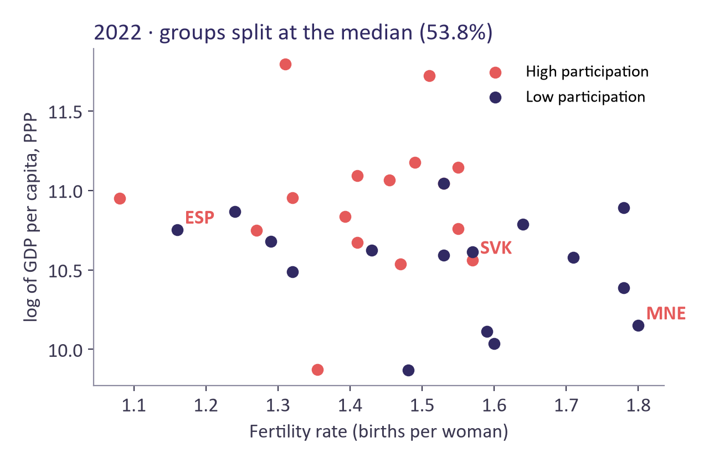
CLASSIFICATION · EXAMPLE
High or low female participation?
75%
of 32 countries classified correctly (24 of 32)
53.8%
median participation: the line between high and low
p = 0.042
income helps to classify; fertility does not (p = 0.217)
Logistic regression: high participation ~ fertility rate + log GDP per capita, 2022.
Ulysseus COIL · Comparing Europe with Data · Methods module

Slide 23
CLASSIFICATION · READING
Reading the confusion matrix
How to read it
Watch out
Real low, predicted low: 12. Real low, predicted high: 4.
Real high, predicted high: 12. Real high, predicted low: 4.
Spain is classified high but is low; Slovakia is classified low but is high. Wrong cases are interesting: explain them.
75% measured on the same countries used to fit the model is optimistic. With so few countries, use leave-one-out cross-validation if you can.
Splitting at the median throws information away: say why you do it.
Ulysseus COIL · Comparing Europe with Data · Methods module

Slide 24
CLASSIFICATION · DO IT YOURSELF
Classification in your tool
Power BI · menus, no code
Gretl · menus, no code
Key influencers visual: Analyze = high/low group, Explain by = fertility and GDP per capita. Good for exploring.
The model and the confusion matrix: Gretl (no code) or a Python/R visual.
Sample > Restrict: year == 2022.
Add > Define new variable: high = SL_TLF_CACT_FE_ZS > 53.8
Model > Limited dependent variable > Logit > Binary.
Dependent: high. Regressors: SP_DYN_TFRT_IN, l_NY_GDP_PCAP_PP_KD. The output reports the cases correctly predicted.
WITH CODE · ONLY IF YOUR COURSE USES PYTHON OR R
Python
R
s = d[d.year == 2022].copy()
fem = s.SL_TLF_CACT_FE_ZS
s["high"] = (fem > fem.median()).astype(int)
m = smf.logit("high ~ SP_DYN_TFRT_IN + log_gdp", data=s).fit()
s["pred"] = (m.predict(s) > 0.5).astype(int)
print(pd.crosstab(s.high, s.pred))
s <- subset(d, year == 2022)
fem <- s$SL_TLF_CACT_FE_ZS
s$high <- as.integer(fem > median(fem))
m <- glm(high ~ SP_DYN_TFRT_IN + log_gdp, family = binomial, data = s)
s$pred <- as.integer(predict(m, type = "response") > 0.5)
table(real = s$high, predicted = s$pred)
Ulysseus COIL · Comparing Europe with Data · Methods module

Slide 25
05
Principal component analysis
Summarise many related indicators in two or three new ones.
Ulysseus COIL · Comparing Europe with Data · Methods module

Slide 26
PCA · THE IDEA
Fewer variables, almost the same information
1
Standardise first
Many indicators say similar things (richer countries have more Internet users and live longer). PCA builds new variables, the components, that collect what the indicators share.
Otherwise the indicator with the biggest numbers dominates.
2
Variance explained
How much information each component keeps.
3
Loadings
How much each indicator weighs in a component. They tell you what the component means.
Ulysseus COIL · Comparing Europe with Data · Methods module

Slide 27
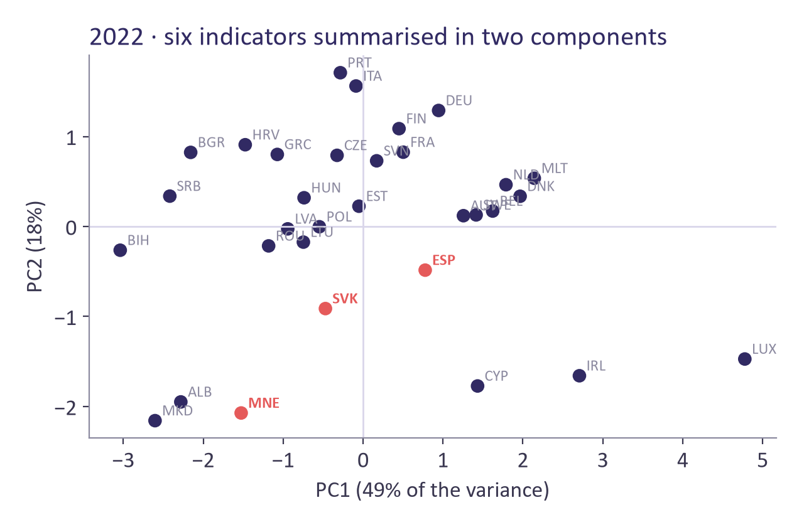
PCA · EXAMPLE
Six indicators, two components
49%
of the variance in component 1: "development"
18%
in component 2: "ageing"
67%
kept by the two together
2022, standardised: GDP per capita, services, Internet users, population 65+, unemployment, life expectancy.
Ulysseus COIL · Comparing Europe with Data · Methods module

Slide 28
PCA · READING
Naming the components from the loadings
How to read it
Watch out
Component 1: GDP per capita 0.53, Internet 0.5, life expectancy 0.45, services 0.4, unemployment -0.29. High = more developed.
Component 2: population 65+ 0.87, unemployment -0.41. High = older population.
In the chart, Montenegro is low on both; Spain is near the centre on development.
The sign of a component is arbitrary: two programs can flip it.
Naming components is your interpretation: show the loadings.
Use the components afterwards in clustering or regression if you need fewer variables.
Ulysseus COIL · Comparing Europe with Data · Methods module

Slide 29
PCA · DO IT YOURSELF
PCA in your tool
Power BI · menus, no code
Gretl · menus, no code
Power BI has no PCA. Use Gretl (no code), or a Python/R visual with the code below.
Sample > Restrict: year == 2022.
Select the six variables.
View > Principal components.
Gretl uses the correlation matrix by default, so the variables are standardised.
WITH CODE · ONLY IF YOUR COURSE USES PYTHON OR R
Python
R
cols = ["NY_GDP_PCAP_PP_KD", "NV_SRV_TOTL_ZS", "IT_NET_USER_ZS",
"SP_POP_65UP_TO_ZS", "SL_UEM_TOTL_ZS", "SP_DYN_LE00_IN"]
s = d[d.year == 2022].dropna(subset=cols)
z = StandardScaler().fit_transform(s[cols])
pca = PCA().fit(z)
print(pca.explained_variance_ratio_.round(3))
print(pd.DataFrame(pca.components_[:2].T, index=cols).round(2))
cols <- c("NY_GDP_PCAP_PP_KD", "NV_SRV_TOTL_ZS", "IT_NET_USER_ZS",
"SP_POP_65UP_TO_ZS", "SL_UEM_TOTL_ZS", "SP_DYN_LE00_IN")
s <- na.omit(subset(d, year == 2022)[, cols])
pc <- prcomp(s, scale. = TRUE)
summary(pc)
round(pc$rotation[, 1:2], 2)
Ulysseus COIL · Comparing Europe with Data · Methods module

Slide 30
06
Clustering
Which countries look alike?
Ulysseus COIL · Comparing Europe with Data · Methods module

Slide 31
CLUSTERING · THE IDEA
Groups of similar countries
1
Standardise first
k-means puts each country in one of k groups so that countries in the same group are as close as possible to the group centre. You choose k.
So that every indicator counts the same.
2
Choose k
Silhouette score (higher is better) and whether the groups make sense.
3
Describe the groups
By their centres (averages), not by the cluster number.
Ulysseus COIL · Comparing Europe with Data · Methods module

Slide 32
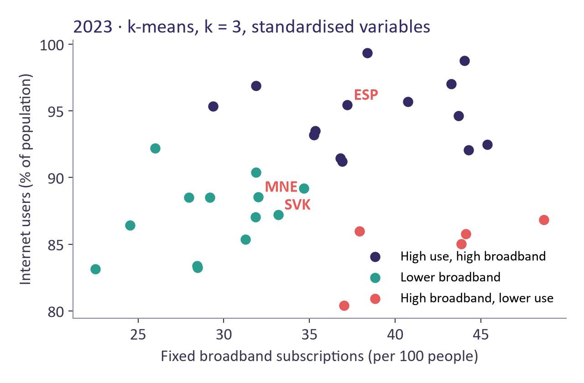
CLUSTERING · EXAMPLE
Three digital profiles in Europe, 2023
14
High use, high broadband: 94.8% use the Internet, 38.8 broadband per 100
13
Lower broadband: 87.2% use the Internet, 29.4 broadband per 100
5
High broadband, lower use: 84.8% use the Internet, 42.3 broadband per 100
k-means, k = 3 (silhouette 0.432, the highest between 2 and 6), Internet users and fixed broadband, standardised.
Ulysseus COIL · Comparing Europe with Data · Methods module

Slide 33
CLUSTERING · READING
Where do our three countries fall?
How to read it
Watch out
Spain: High use, high broadband. Slovakia and Montenegro: Lower broadband.
High broadband, lower use: BGR, CZE, FRA, GRC, PRT: many broadband lines but fewer users.
Silhouette by k: 2 → 0.397, 3 → 0.432, 4 → 0.381, 5 → 0.38, 6 → 0.384.
k-means always finds groups, even if there are none: check the silhouette and the chart.
Fix the random seed and use many starts, or the groups change each time.
Check if the groups are stable in another year.
Ulysseus COIL · Comparing Europe with Data · Methods module

Slide 34
CLUSTERING · DO IT YOURSELF
Clustering in your tool
Power BI · menus, no code
Gretl · menus, no code
Scatter chart: X = broadband, Y = Internet users, Values = country.
Filter year = 2023.
More options (…) > Automatically find clusters.
Set the number of clusters to 3.
Gretl has no built-in k-means.
Use Power BI (no code), or Python or R.
WITH CODE · ONLY IF YOUR COURSE USES PYTHON OR R
Python
R
cols = ["IT_NET_USER_ZS", "IT_NET_BBND_P2"]
s = d[d.year == 2023].dropna(subset=cols).copy()
z = StandardScaler().fit_transform(s[cols])
km = KMeans(n_clusters=3, n_init=25, random_state=2026)
s["cluster"] = km.fit_predict(z)
print(s.groupby("cluster")[cols].mean().round(1))
print(s.groupby("cluster").iso3.apply(list))
cols <- c("iso3", "IT_NET_USER_ZS", "IT_NET_BBND_P2")
s <- na.omit(subset(d, year == 2023)[, cols])
set.seed(2026)
k <- kmeans(scale(s[, -1]), centers = 3, nstart = 25)
split(s$iso3, k$cluster)
Ulysseus COIL · Comparing Europe with Data · Methods module

Slide 35
07
Missing values
Gaps are normal. Hiding them is not.
Ulysseus COIL · Comparing Europe with Data · Methods module

Slide 36
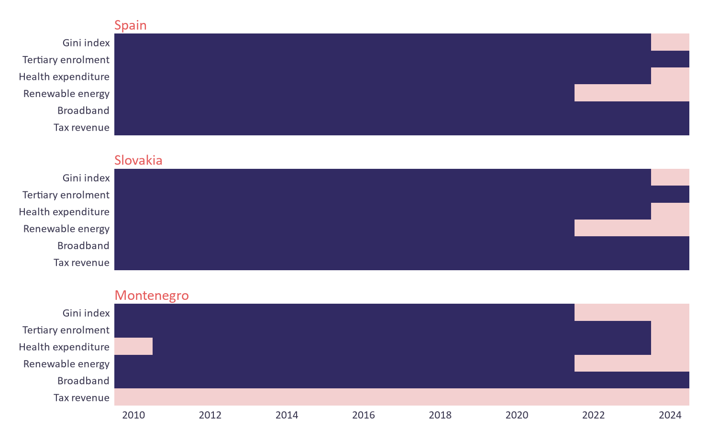
MISSING VALUES
Four honest options
1
Change year or indicator
2
Leave the country out, and say so (n = …)
3
Interpolate only between two known years, and mark it
4
Add a documented source (Eurostat, MONSTAT…)
Dark = available, pink = missing, 2010–2024
Find gaps: Power BI > Transform data > View > Column quality. Gretl: Variable > Summary statistics (number of missing values).
Ulysseus COIL · Comparing Europe with Data · Methods module

Slide 37
FROM RESULTS TO THE DASHBOARD
Six rules for charts people understand
1
One message per chart; write it as the title ("Richer countries use the Internet more").
2
Label axes with units, year and source.
3
Highlight Spain, Slovakia and Montenegro; keep the others grey.
4
Bars for comparing countries, lines for time, scatter for two indicators.
5
No 3D, no pie charts with many slices.
6
State the limits on the dashboard: n, years, gaps, association not causation.
Ulysseus COIL · Comparing Europe with Data · Methods module

Slide 38
All the code, ready to run
On the website (Resources): metodos.py (Python), metodos.R (R) and metodos.inp (Gretl). They reproduce every number in this module. Put them in the same folder as coil_indicators_gretl.csv.
Stuck? Ask your home teacher, or bring the problem to the mid-point clinic (week 5).

