Slide 1




JOINT SESSION · WEEK 3
Data workshop
Comparing Europe with Data. Be able to load and document the COIL data in your tool (Python, R, Gretl or Power BI) before the analysis starts.
Week 3 · 26 Oct – 1 Nov 2026 · 45 minutes · Microsoft Teams

Slide 2
AGENDA · 45 MINUTES
What we will do today
5 min
20 min
5 min
15 min
5 min | The dataset: indicators, sources, coverage and gaps (especially Montenegro).
20 min | Live demo, about 5 minutes per tool: loading the data, selecting countries and indicators and a first chart in Python, R, Gretl and Power BI.
5 min | How to write the data dictionary and handle missing values.
15 min | Questions from the teams.
Ulysseus COIL · Comparing Europe with Data · Data workshop

Slide 3
THE DATASET
One row per country and year
iso3 | country | year | SL_UEM_1524_ZS | NY_GDP_PCAP_PP_KD | IT_NET_USER_ZS
ESP | Spain | 2022 | 29.7 | 46733 | 94.5
ESP | Spain | 2023 | 28.7 | 47323 | 95.4
SVK | Slovakia | 2022 | 19.9 | 38649 | 89.1
SVK | Slovakia | 2023 | 19.9 | 39502 | 87.2
MNE | Montenegro | 2022 | 29.8 | 25583 | 88.2
MNE | Montenegro | 2023 | 23.3 | 27243 | 88.6
Cross-section = one year, many countries. Panel = many countries followed over many years. Codes are World Bank / IMF codes; in this file the dots are replaced by underscores, so the same names work in Python, R, Gretl and Power BI.
Before any analysis, drop the row "EUU" (EU aggregate): it is not a country.
Ulysseus COIL · Comparing Europe with Data · Data workshop

Slide 4
DATA SECTION OF THE WEBSITE
Three files with the same data
coil_indicators_gretl.csv
coil_indicators_wide.csv
coil_indicators_long.csv
One row per country and year; codes with underscores. Use it in Gretl, Python and R (all the code in the methods module uses this file).
One row per country and year; original codes with dots. Easiest for Excel and Power BI.
One row per country, year and indicator, with unit and source in every row. Handy for the data dictionary.
The Data section also shows the coverage of every indicator by country, and the list of indicators with their units.
Ulysseus COIL · Comparing Europe with Data · Data workshop

Slide 5
21 INDICATORS
What is in the dataset
Theme | Indicators (unit)
Labour market | Unemployment, total (% of labour force (modelled ILO estimate)) · Unemployment, youth (15-24) (% of labour force aged 15-24) · Female labour force participation (% of female population 15+)
Income and growth | GDP per capita, PPP (constant 2021 international $) · GDP growth (annual %) · Inflation, consumer prices (annual %) · Services, value added (% of GDP)
Inequality | Gini index (index (0-100))
Public finance | General government gross debt (% of GDP) · Tax revenue (% of GDP)
Demography | Population, total (persons) · Population aged 65 and above (% of total population) · Fertility rate (births per woman)
Education | Tertiary school enrolment (% gross) · Government expenditure on education (% of GDP)
Health | Life expectancy at birth (years) · Current health expenditure (% of GDP)
Digitalisation | Individuals using the Internet (% of population) · Fixed broadband subscriptions (per 100 people)
Environment | Renewable energy consumption (% of total final energy consumption) · CO2 emissions per capita (excl. LULUCF) (t CO2e per capita)
Ulysseus COIL · Comparing Europe with Data · Data workshop

Slide 6
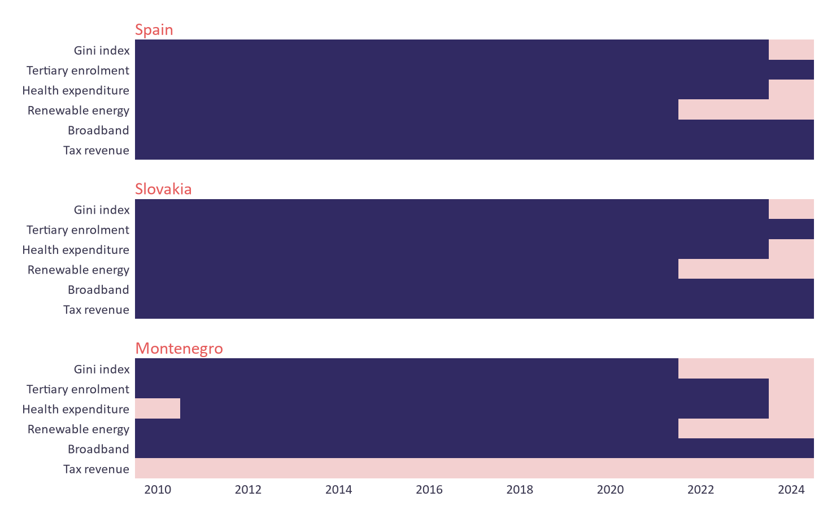
COVERAGE
Gaps you have to know about
What this means
Montenegro has no tax revenue data (15 of 15 years missing), and no CO2 or education spending series.
Renewable energy ends in 2021 for every country; the Gini index ends in 2022–2023.
Health expenditure ends in 2023.
Check coverage before you choose your indicators and years.
Dark = data available, pink = missing (2010–2024)
Ulysseus COIL · Comparing Europe with Data · Data workshop

Slide 7
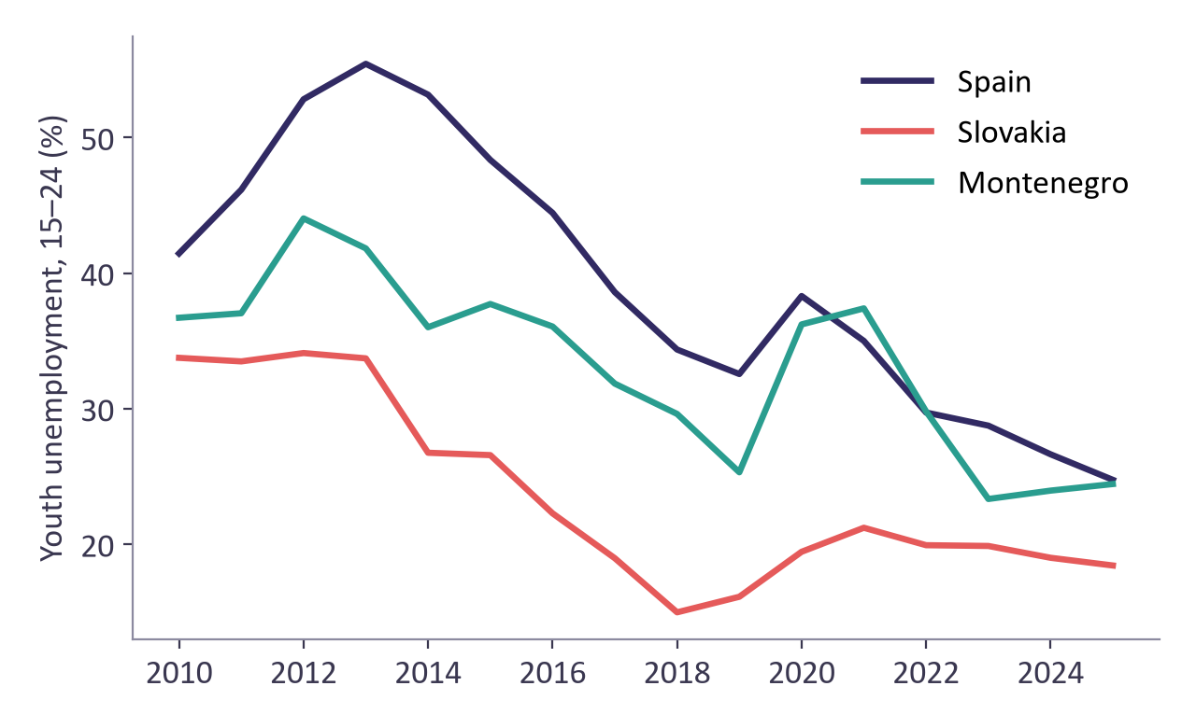
LIVE DEMO · 20 MINUTES
The same first chart in four tools
The task
Load the COIL file.
Keep Spain, Slovakia and Montenegro.
Plot youth unemployment (SL_UEM_1524_ZS) from 2010 to 2025.
Each tool takes about 5 minutes: first without code (Power BI, Gretl), then with code (Python, R).
Ulysseus COIL · Comparing Europe with Data · Data workshop

Slide 8
DEMO · NO CODE NEEDED
Without writing code: Power BI and Gretl
Power BI Desktop
Gretl
Get data > Text/CSV > coil_indicators_wide.csv > Load.
Insert a Line chart.
X-axis: year. Y-axis: SL.UEM.1524.ZS. Legend: country.
Filters pane: country is Spain, Slovakia, Montenegro.
Check that year is a whole number, not summarised.
File > Open data > User file > coil_indicators_gretl.csv.
Data > Dataset structure > Panel: unit = iso3, time = year.
Sample > Restrict, based on criterion: iso3 == "ESP" || iso3 == "SVK" || iso3 == "MNE".
For the chart, type one line in the Gretl console: panplot SL_UEM_1524_ZS --overlay
Both routes give the chart on the previous slide. The step-by-step guide for each method is in the methods module.
Ulysseus COIL · Comparing Europe with Data · Data workshop

Slide 9
DEMO · OPTIONAL
With code: Python and R (if your course uses them)
Python (pandas + matplotlib)
R (ggplot2)
import pandas as pd
import matplotlib.pyplot as plt
d = pd.read_csv("coil_indicators_gretl.csv")
h = d[d.iso3.isin(["ESP", "SVK", "MNE"])]
h.pivot(index="year", columns="country",
values="SL_UEM_1524_ZS").plot()
plt.ylabel("Youth unemployment, 15-24 (%)")
plt.show()
d <- read.csv("coil_indicators_gretl.csv")
h <- subset(d, iso3 %in% c("ESP", "SVK", "MNE"))
library(ggplot2)
ggplot(h, aes(year, SL_UEM_1524_ZS,
colour = country)) +
geom_line() +
labs(y = "Youth unemployment, 15-24 (%)")
Run the code from the folder where you saved the CSV file. In R, install ggplot2 once with install.packages("ggplot2").
Ulysseus COIL · Comparing Europe with Data · Data workshop

Slide 10
PART OF DELIVERABLE 2
The data dictionary: one row per variable
Variable | Code | Definition | Unit | Source | Years | Missing values and what we did
youth_unemp | SL.UEM.1524.ZS | Unemployment, youth (15–24) | % of labour force 15–24 | World Bank | 2010–2025 | None
health_exp | SH.XPD.CHEX.GD.ZS | Current health expenditure | % of GDP | World Bank | 2010–2023 | Montenegro 2010 missing: Montenegro enters in 2011 (unbalanced panel)
tax | GC.TAX.TOTL.GD.ZS | Tax revenue | % of GDP | World Bank | 2010–2024 | No data for Montenegro: country left out of this variable, stated in the report
Write it as soon as you choose your indicators. It saves time in every later step and it is part of deliverable 2.
Ulysseus COIL · Comparing Europe with Data · Data workshop

Slide 11
MISSING VALUES
Never fill a gap silently
1. Change the year or the indicator
2. Leave the country out
Use a year or an indicator with full coverage for your countries.
For that variable only, and say so in the report and in every table (n = …).
3. Interpolate inside a country
4. Add another source
Only between two known years, never beyond the last one. Mark the values you created.
Eurostat or the national statistics office (e.g. MONSTAT). Document it in the data dictionary.
Ulysseus COIL · Comparing Europe with Data · Data workshop

Slide 12
BY THE END OF WEEK 3
Your checklist
Your dataset is ready (one row per country and year) and every variable is documented in a data dictionary.
Every variable has its code, unit, source and years in the data dictionary.
You know which gaps affect your countries and what you will do with them.
Week 4: exploratory data analysis. Descriptive statistics and first charts are done, and the team agrees on what the data show.
Questions from the teams · 15 minutes
Ulysseus COIL · Comparing Europe with Data · Data workshop

