Slide 1

Diego Klabjan, Jun Ma, Robert Fourer – Northwestern University

Slide 2

Data query languages
  SQL, Xquery
  No procedural or declarative abilities
Procedural and declarative languages
  No data querying capabilities
Best of both worlds
DATALOG

Slide 3

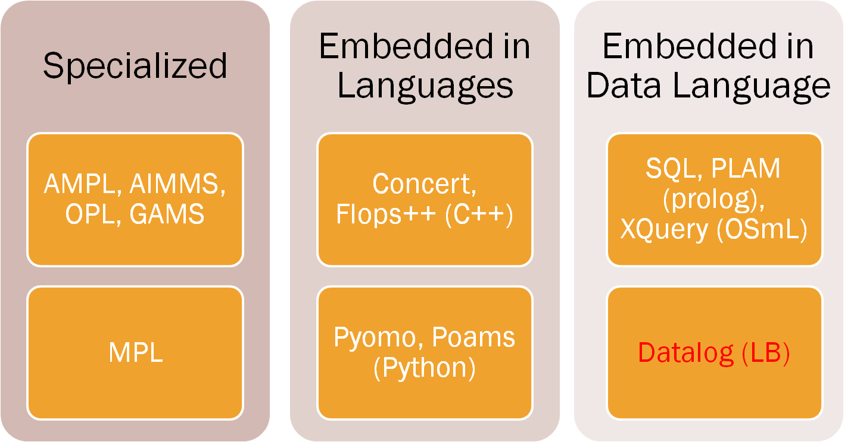

Slide 4

Modeling in SQL by Linderoth, Atamturk, Savelsbergh
SQL mainly about querying
  Not suited for algebraic modeling
Everything stored in tables
  Variables
  Constraints
Modeling non intuitive

Slide 5

Powerful data capabilities
  Superset of SQL
  Data from database
  Querying and loading
Declarative language
  Natural constructs
  Intuitive
Hardly any development effort

Slide 6
Given values to decision variables
  Easy to check feasibility
    Clearly not optimality
  Underlying logic programming in Datalog
  No extra effort required
Not the case for most other algebraic modeling languages

Slide 7

Index sets
NUTR(x), NUTR:name(x:n) -> string(n).
FOOD(x), FOOD:name(x:n) -> string(n).
Parameters
  Input data
Variables
Buy[f] = b -> FOOD(f), float[64](b),b>=0.
amt[n, f] = a -> NUTR(n), FOOD(f), float[64](a), a >= 0.
nutrLow[n] = nL -> NUTR(n), float[64](nL), nL >= 0.
cost[f] = c -> FOOD(f), float[64](c), c >= 0.

Slide 8

Multiple products (PROD), plants (ORIG) and destinations (DEST)
Ship from plants to destinations
  Transportation problem for each product

Slide 9

Limited production capacity at each plant
Objective to minimize production and transportation costs

Slide 10


Sets
Data

Slide 11
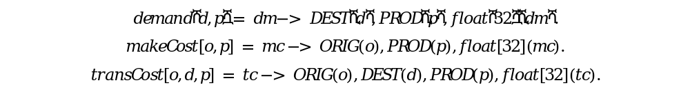
Input parameters

Slide 12

Variables
  How much to transport
  How much to produce
Other variables
  Integer replace “float” with “int”
  Binary are integer with upper bound of 1

Slide 13

Production availability
  sumTime predicate captures the left-hand side
  agg built-in aggregator
  Constraint negated (stratification restrictions of Datalog)

Slide 14
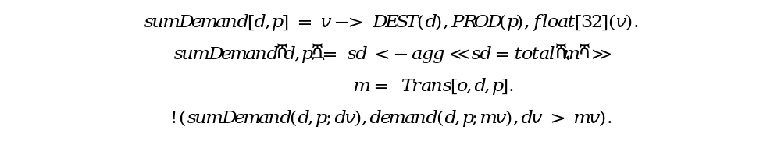
Demand constraints

Slide 15

Supply constraints

Slide 16

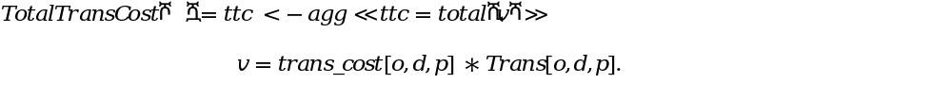
Objective function
  Production cost
  Transportation cost

Slide 17


Sum of the two cost components

Slide 18

The fleeting model
  Assign fleets to flights
  Modeled as a multi-commodity network flow problem
  Network aspects
Challenges
  Nodes at each airports sorted based on the arrival/departure time in a circular fashion
  Ordered and circular lists

Slide 19

Specification of flights
Leg(l), Leg:name(l:n) -> string(n).
Leg:table(s1,t1,s2,t2,l) ->Station(s1), Time(t1), Station(s2), Time(t2), Leg(l).
Leg:table:dStation[l]=s1 ->Station(s1), Leg(l).
Leg:table:dTime[l]=t1 -> Time(t1), Leg(l).
Leg:table:aStation[l]=s2 ->Station(s2), Leg(l).
Leg:table:aTime[l]=t2 -> Time(t2), Leg(l).

Slide 20

For each station there is a timeline consisting of network nodes
  Either arrival or departure at station
node(s,t) -> Station(s), Time(t).
node(s,t) <- Leg:table(s1,t1,_,_,_),(s=s1, t=t1);Leg:table(_,_,s2,t2,_),(s=s2, t=t2).

Slide 21

Declare ‘next’ in the list
  Time is an integer-like structure to capture times
node:nxt[s,t1] = t2 -> Station(s), Time(t1), Time(t2).
Order
node:nxt[s,t1] = t2 <- node(s,t1), node(s,t2), (Time:datetime[t1]<Time:datetime[t2],!anythingInBetween(s, t1,t2); node:frst[s]=t2, node:lst[s]=t1).

Slide 22

Piecewise linear functions
  Model them explicitly
  Unfortunately OS cannot handle them explicitly
    LogicBlox needs to convert them into a linear mixed integer program
Disjunctions
Nonlinear functions
  Long term goal

