Slide 1
IMPACT Solver for Optimization Services
Huanyuan(Wayne) Sheng
Joint work with Professor Sanjay Mehrotra and Jun Ma
Notes:
Good afternoon everybody. Today the title of my talk is impact solver for optimization services. It is the joint work I have done with professor mehrotra and jun ma as part of my ph.d thesis.

Slide 2
Outline
Brief Introduction
Impact solver
Optimization Services And Impact
Demo of Impact Solver Service
Conclusion
Notes:
In this talk I am going to share my experiences on developing the impact solver service using the standard created by optimization services. This is a derived work from our computational study in integer programming. Right now it is not completely finished but we have seen the potentials of extending impact functionality by adding web service to it.
My talk consists of five parts. First I will give a brief introduction on impact and os. Then I will describe what impact solver is and the extension work of solver in relation with optimization. After that I show you a demo illustrating our work for setting up the services. Lastly I summarize my work and mention the future research direction.

Slide 3
IMPACT -- Integrated Mathematical Programming Advanced Computational Tools
Research code for testing optimization algorithms
Current focus is on Mixed Integer Nonlinear Programming
It has a solver-side framework component for testing Optimization Services
Notes:
Ok, first for brief introduction, I will skip optimization services standard. I think professor martin, professor fourer and dr.ma have done a good job in presenting the standard. I will go directly to impact. Impact stands for integrated mathematical programming advanced computational tools. This is a research code we are writing for developing algorithms solving mixed integer nonlinear programs. I want to emphasize the last bullet point that it is natively equipped with component for testing the optimization services.

Slide 4
Impact Solver
Research Motivation
Mixed Integer Nonlinear Programming (Mehrotra and Li, presented on Monday)
Generalized branch and bound using adjoint lattice
LLL and GBR basis reduction
Interior point based search for relaxed solution
Notes:
We primarily have two motivations for writing impact. First we want to test the ideas of generalized branching and basis reduction method proposed by mehrotra and li. The details of the method was presented by prof mehrotra on Sunday, so I am not gonna talk about it in too much detail. You can also refer to the technical report of mehrotra and li if you missed that talk. For a more detailed account for implementation, several important computation issues should be considered. First is to compute the branching hyperplane starting from adjoint lattice. The next issue is that we need to reduce the basis through LLL or GBR algorithm. And last important implementation issue is that a robust interior point method for searching the relaxed solution. Those computational issues appears associated with stand-alone solver.

Slide 5
Impact Solver work in progress
LLL and GBR implementation
  High quality reduced basis
  Integrated with ellipsoidal rounding and analytical center computation
Mixed Integer Solver
  Mehrotra and Li’s Version of Lenstra’s and GBR algorithm in a branch and cut framework
  More effective than branching on variables
  Efficient tree management
Notes:
With those things in mind right now we are upgrading and improving. It is not finished yet. We want to make it more robust, solving larger problem, faster, less likely to crash. Also we want to complete the solver service implementations by adding more functionalities. However there are several computational features that have been tested in the old version of impact. The performance of overall implementations was presented by professor mehrotra yesterday and I am not going to repeat it. Just to highlight some features that are available with the old version. First impact solver could produce reduced basis good enough for branching. And modular for ellipsoidal rounding and analytic center computation are available. As for algorithm testing, we implemented the framework for Mehrotra and Li’s version of lenstra’s and gbr algorithm. Again details are not the subject of this topic. Our implementation is able to find a branching hyperplanes that are more effective than branching on single variables for some hard equality problems. Another feature is that we construct a schema to manage and store large scale branching tree in a memory efficient way. We were able to store tens of millions nodes without exhausting the 2G memory.

Slide 6
Impact and Optimization Services
Research Motivation
  Solver service
    distribution is not required.
  Need standard problem instance (OSiL), result (OSrL) and option (OSoL) representation.
  Need a standard local interface (OSInstance, OSOption, OSResult)
  Need a standard communication interface for optimization over distributed system
    Hooking up with solver – OShL
    Call up a simulation or function evaluation – OScL
    Discover solver services in OS Registry -- OSdL
Notes:
The next slides outlines the motivations for adapting our solver to optimization services standard. After carefully studying the os standard, we decided why not give a try to our own solver and make it a base for solver service. For a very generic solver services, we need input and output standard that solver has to comply with. Also we need to have protocols and interfaces that can facilitate communications among solvers. Fortunately OS already provides the guidelines for standard that tackling those implementation issues. In order to do this, we want to have standards for problem instance, interface and option standard that impact solver can take in as well as send out as a result of solve action. All those available standard prompts to build up a solver service based on impact.

Slide 7
Impact Solver Service
Built for standard instances
  OSiL: xml string/file for an optimization instance
  OSoL: xml string/file for an optimization option
  OSrL: xml string/file for an optimization result
Natively uses standard local interface (in memory problem data structure)
  OSInstance: data structure for optimization instance
  OSOption: data structure for optimization option
  OSResult: data structure for optimization result
Callable from client agent implemented in any language on any platform
  C/C++
  Java
  .net
Notes:
Then we start adapting our solver to be compatible with os. We change the input and output routine of impact. So that we can take os instance as our problem source and send the result in the mode of os result. We also changed our data structure to make them compatible with local os interface. Those data structures are natively built in the impact solver so no conversion would be needed while the solver is being called. With those set up being done, the solver is available to be used by client agent defined by optimization services, regardless the language platform of agent.

Slide 8
Impact Solver Service
solve
  Takes OSiL and OSoL and returns OSrL (string/file version)
  Synchronous call, blocking request/response,
getJobID
  Gets a unique job id generated by the solver service
  Critical for maintaining session and state on a distributed system
send
  Same input signature as the solve function but only returns a boolean
  Asynchronous (server side), non-blocking call
retrieve
  Retrieving result from anywhere and anytime.
kill
  Kill remote optimization jobs
  Critical in long running optimization jobs
  Plays an important role in fathoming tree nodes that are solved over remote computers
knock
  Get and set instant messages from the remote optimization services
Notes:
After solver side modifications, our next step would be to write the library functions for running the optimization services. The six functions shown on this slide are the basic routines required by os standard to set up services.
First function is solve. What this function does is to solve the problems in the format as either OSIL, Osol , or osintance and osoption. The returning signature is either os result or osRl.
Second function is get job id. It generates a unique job id throughout the whole session. Both client and service will rely on this id for communicating with each other.
Send function is easy to understand. It will send the optimization problems to the service. It is used for both synchronous and asynchronous call. What does synchronous and asynchronous mean here? Synchronous refers to instant call for solve function the moment we send the job and return the job instantly the moment the results are available. Asynchronous call means we send the job and let it run as long as it takes and keeps the results on the service side. Only retrieve it when we want it.
And how to retrieve it? We need the retrieve library function. This function gives user, especially the patient ones some flexibility to use our solver service.
The next function is kill. Which by its name, will kill the job submitted to the service. Again this function is important for the smoothness of the service operations. It also can be used to fathom the tree nodes during the course of solving. It is more useful when the solving is done over the distributed system.
The last function is called knock. It is a check up tool to monitor the service process. Client can send the knock and get the returning information for solver current status, like what is the gap between lower bound and upper bound, how many iterations have been called for Newton search. Or has the service found the feasible solution.
Those 6 functions are the base functions required by the os standard for setting up the services. And we can always extend it catering to our own needs.

Slide 9
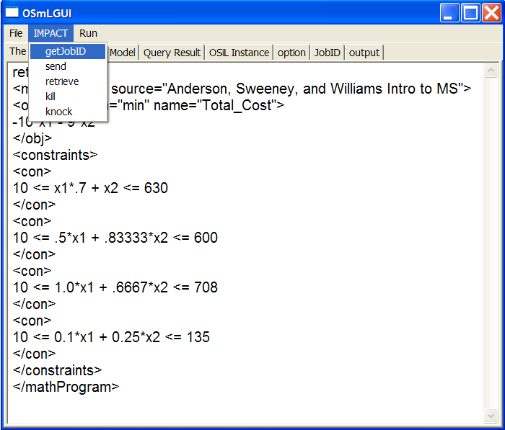
Demo
Notes:
Ok, finally we get to the fun part. I will show you a simple demo of solver service using impact solver and solver service library

Slide 10
Conclusion
Impact Solver Service is natively OS-Compatible.
  Impact solver is a scalable platform for testing research algorithms.
Optimization Services provides a comprehensive and convenient framework for developing optimization software
Notes:
Our experimental implementation has shown that by making impact solver natively os-compatible, we create a solver that is scalable platform for research algorithm. And impact can also be developed within the services context.
Our whole experiences with Os has convinced us that by make our solver compatible with optimizations services, we basically get our self a comprehensive and convenient framework for solver development.

Slide 11



