Slide 1
IMPACT Solver for Optimization Services
Huanyuan(Wayne) Sheng
Joint work with Professor Sanjay Mehrotra and Jun Ma
Notes:
Good afternoon everybody. Today the title of my talk is impact solver for optimization services. It is the joint work I have done with professor mehrotra and jun ma as part of my ph.d. thesis.

Slide 2
Outline
Brief Introduction
Impact Solver Design
Impact Solver Features
Conclusion
Notes:
In this talk I am going to share my experiences on developing the impact solver service using the standard created by optimization services. We will be focusing on the integer solver development side. My talk consists of four parts. First I will give a brief introduction on impact and os. Then I will describe the general design of impact solver, basic features the impact has. Lastly I will conclude my talk with future research trend.

Slide 3
IMPACT -- Integrated Mathematical Programming Advanced Computational Tools
Comprehensive computational packages.
Mathematical programming algorithms testing code.
Web services based solver tool.
Notes:
Ok, first for brief introduction, Impact is an acronym for integrated mathematical programming advance computational tools. We want to construct a comprehensive computational package tailored optimization study. We are interested in using IMPACT to facilitate our algorithms studies. And we want to provide web services that are specialized for integer programming.

Slide 4
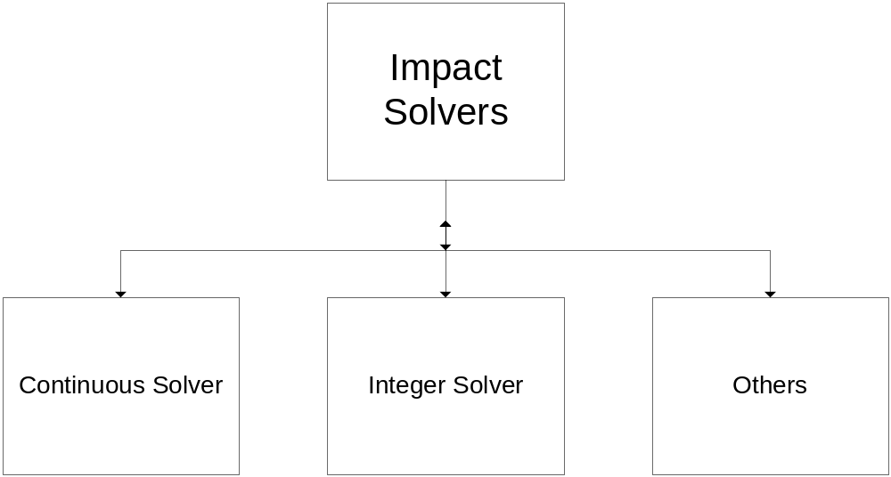
Impact Solver
General Design
Notes:
This is the components of impact solvers. Our current focus is integer solver. But we want to keep our design and framework general enough for future extension to other mathematical programming tools. Later on, we can add on continuous solver, both linear and nonlinear, cone programming solver and semi definite programming solver.

Slide 5
Impact Solver
General Design
Extension of OSSolver
Unified input and output interface
Self contained and highly customized internal routines.
Notes:
The next slide is our design philosophy. First we want to make it high compatible with OS. So with all standards and components OS has, we can naturally take advantage. We also need to face the reality that there are large varieties of algorithms out there, so the internal routines have to be individualized.

Slide 6
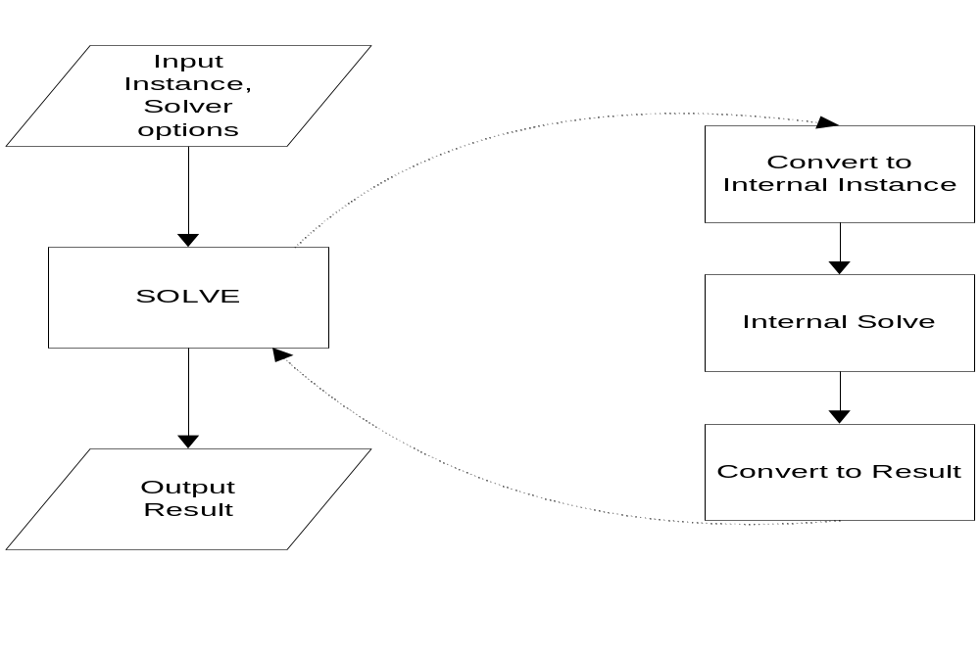
Impact Solver
General Design

Slide 7
Impact Solver Features
Impact Solver Service
  solve, getJobID, send, retrieve, kill, knock functions
  Callable from client agent implemented in any language on any platform, e.g. C/C++, Java, .net
Impact Standalone Modules
Impact Algorithms
Notes:
The slide covers the several key features of impact solver. Since we have a good compatabilities with os, we can provide most functions that os can provide. The details and demos can be found in my last year’s talk on impact services. The most significant benefit of our service is language and platforms independent.
I will talk more about next two points in the following slides. As for algorithms, I will focus on the integer programming side.

Slide 8
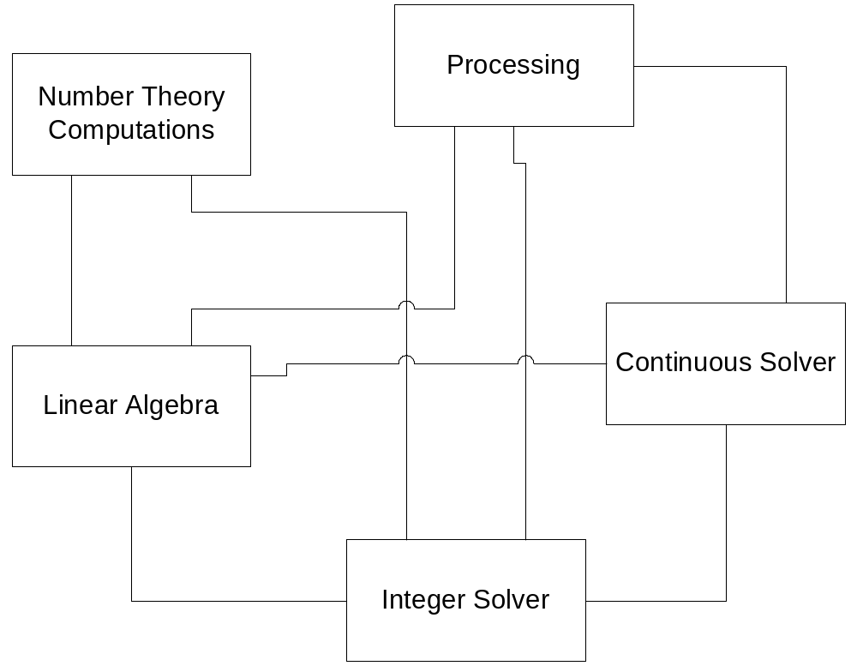
Impact Solver Features
Standalone Functions
Modules
Notes:
Those are the basic modules that are currently being developed within impact solver. We start with our own linear algebra package, Since we studied the basis reduction method for integer programming, we have implemented some simple routines for computing hermite normal form computation, LLL basis reduction. The rest three blocks are most relevant to solver development.

Slide 9
Impact Solver Features
Algorithms
Research Focus
  Mixed Integer Nonlinear Programming
  Parallel computing for MINLP
Algorithm Studies
  Heuristics for generalized branch and bound methods
  Web service based distributed parallel, e.g. communications, load balance handling.
  (See talk On Implementing a Parallel Integer Solver Using Optimization Services)
Notes:
Our research focus right now is mixed integer nonlinear programming. We are studying the practical heuristics for generalized branch and bound methods. Fundamentally it is a branch and bound method but not based on single variable, but on several variables.

Slide 10
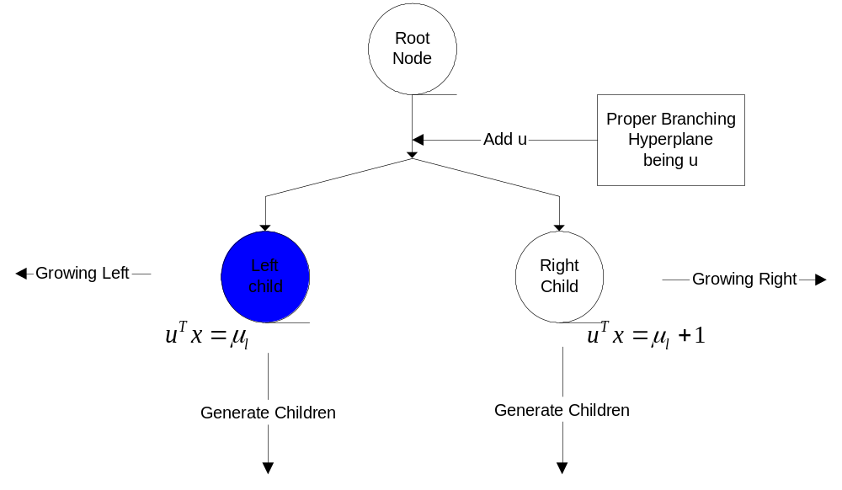
Impact Solver Features
Algorithms
Starting Node
Notes:
Now this flowchart shows our implementation for branch and bound. It has two similar procedures. What we are looking at is the very first one before branching.

Slide 11
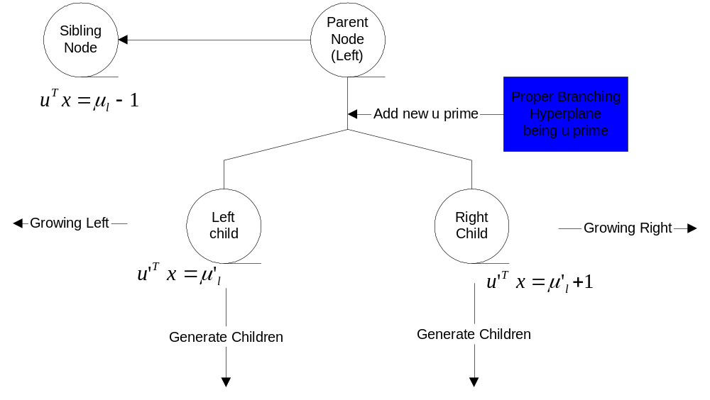
Impact Solver Features
Algorithms
Subsequent Node

Slide 12
Impact Solver Features
Algorithms
Generate Proper Branching Hyperplanes
  Basis Reduction Based (Mehrotra and Li)
    LLL
    GBR
  Heuristics (ongoing)

Slide 13
Conclusion
Impact Solver Service is natively OS-Compatible.
  Impact solver is a scalable platform for testing research algorithms.
  Impact Solver is a web service based solver tool.
Novel branch and bound approaches for MINLP are studied by using Impact solver service framework.
Parallel computing for integer programming is being developed under Impact and OS framework.
Notes:
Currently we are

Slide 14



