Slide 1
Optimization Services (OS)
-- The Internet for OR
Robert Fourer
Jun Ma
Northwestern University
Kipp Martin
University of Chicago
Jun Ma
maj@northwestern.edu
Industrial Engineering and Management Sciences, Northwestern University
11/024/2004

Slide 2
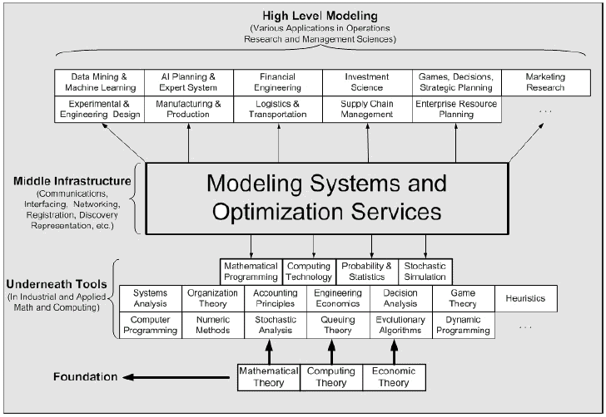
The Positioning of
Optimization Services Framework in OR/MS

Slide 3
The Positioning of
OSP Protocols (OSxL) in Computing
OSP
GET /xt/services/ColorRequest HTTP/1.0
Content Length: 442
Host: localhost
Content-type: text/xml; charset=utf-8
SOAPAction: "/getColor"
Application
Application
SOAP
Presentation
HTTP
Presentation
<soap:Envelope>
<soap:Body>
<soap:Body>
</soap:Envelope>
Session
Session
TCP
Transport
Transport
OSP – specifies soap content
Communication Interface Representation
e.g. hook (“<OSiL> … </OSiL>”)
Network
Network
IP
Link
Link
Ethernet
Physical
Physical
The 7-layer OSI Model
The 4-layer Internet model

Slide 4
Optimization Services (OS) Framework
A framework, NOT a system
  cf. constitution, NOT government/Court System. Only that the framework specifications are written in XML languages (NOT English).
  But we are in the middle of developing the modeling system according to this framework.
  We are also building libraries for other people to put up their optimization services.
Distributed environment (Local environment being just a special Case)
Service Oriented, Optimization Centered, Decentralized Architecture.
Optimization Services Components
  Modeling Language Environment (MLE) (e.g. AMPL, OSmL) -- OSModel
  Optimization Registries (e.g. The next generation NEOS) – OSRegistry
  Analyzers/Preprocessors (e.g. Mprobe, Dr. AMPL) -- OSAnalyzer
  Optimization Solvers (e.g. Lindo) -- OSSolver
  Simulation (e.g. Finite Element Analysis) -- OSSimulation
  Communication Software Agent – OSAgent
  All of the above are communicating in a common language -- OSCommon

Slide 5
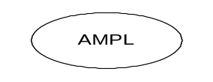


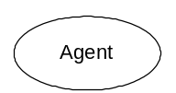


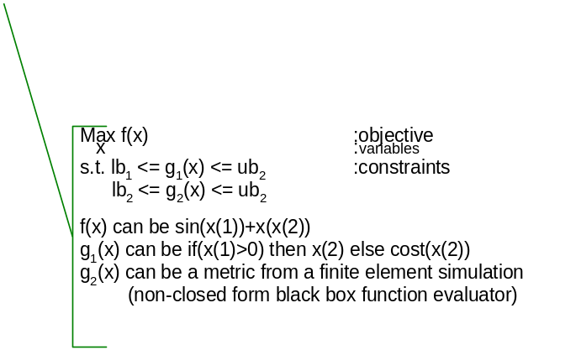





Optimization Services (OS) Framework
The next generation NEOS – possibly donated to COIN/Apache/Source Forge
THE Optimization Internet
THE Potential COmputation INfrastructure for OR (COIN-OR)
XML-based standard
browser
Web address
http/html
Web page
html form
socket
CGI
location
OS
Server
Parse to OSiL
OSP/ OSxL
Web Server
OS Server
OS Server
Data in HTML Form
HTML Checker
Database/ App Service
Google
OS Server
[Standard, Simple, Scalable] => Smooth
The General and Universal Framework for Optimization in Local and Distributed Environment.
Combining Optimization with Modern Computing Technologies.
A Next Generation Modeling System as An Internet Resource.
Standardization of Optimization Representation, Communications, Registration, and Discovery
Using Optimization Computing Tools Just Like Daily Utility Services.

Slide 6
User Experience
Open Environment
Convenience just like Using Utility Services
No High Computing Power Needed
No Knowledge in Optimization Algorithms and Software (solvers, options, etc.)
Better and More Choices of Modeling Languages
More Solver Choices
Solve More Types of Problems
Automatic Optimization Services Discovery
Decentralized Optimization Services Development and Registration
More Types of Optimization Services Components Integrated (Analyzers/Preprocessors, Problem Providers, Bench Markers)
Smooth Flow and Coordination of Various Optimization Services Components.
A Universal, Scalable and Standard Infrastructure that promotes Collaboration and Other Related Researches
Concentration on Good Modeling

