Slide 1
Optimization Services (OS)
-- A Framework for Optimization Software
-- A Computational Infrastructure
-- The Next Generation NEOS
-- The OR Internet
Jun Ma
Industrial Engineering and Management Sciences
Northwestern University
IFORS, Hawaii, 07/14/2005

Slide 2
OUTLINE
1. Motivations
2. Optimization Services and Optimization Services Protocol
3. Future and Derived Research

Slide 3
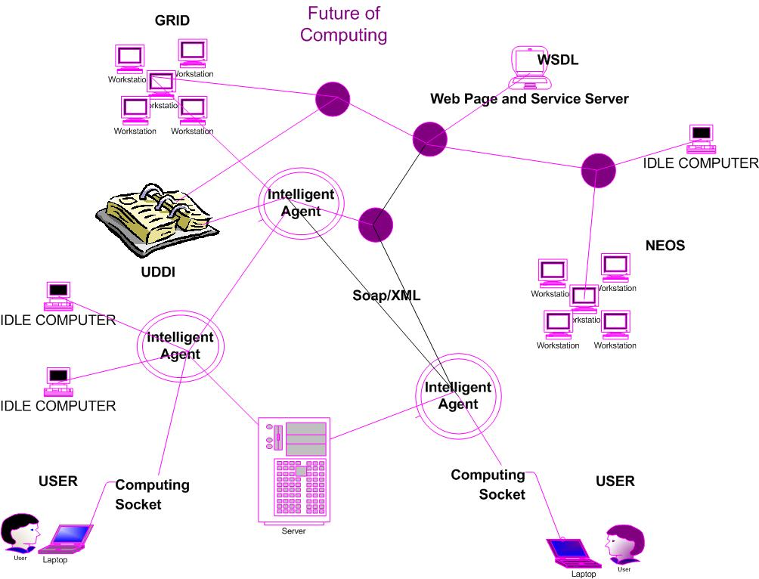
Motivation
Future of Computing

Slide 4
Motivation
But how… with so many type of components
  1. Modeling Language Environment (MLE)
  (AIMMS, AMPL, GAMS, LINGO, LPL, MOSEL, MPL, OPL, MathProg, PulP, POAMS, OSmL)
  2. Solver
  (Too many)
  3. Analyzer/Preprocessor
  (Analyzer, MProbe, Dr. AMPL)
  4. Simulation
  (Software that does heavy computation, deterministic or stochastic)
  5. Server/Registry
  (NEOS, BARON, HIRON, NIMBUS, LPL, AMPL, etc.)
  6. Interface/Communication Agent
  (COIN-OSI, CPLEX-Concert, AMPL/GAMS-Kestrel, etc.)
  7. Low Level Instance Representation
  (Next page)
  )

Slide 5
Motivation
But how… with so many optimization types and representation formats
Linear Programming Quadratic Programming Mixed Integer Linear Programming | MPS, xMPS, LP, CPLEX, GMP, GLP, PuLP, LPFML, MLE instances
Nonlinearly Constrained Optimization Bounded Constrained Optimization Mixed Integer Nonlinearly Constrained Optimization Complementarity Problems Nondifferentiable Optimization Global Optimization | MLE instances SIF (only for Lancelot solver)
Semidefinite & Second Order Cone Programming | Sparse SDPA, SDPLR
Linear Network Optimization | NETGEN, NETFLO, DIMACS, RELAX4
Stochastic Linear Programming | sMPS
Stochastic Nonlinear Programming | None
Combinatorial Optimization | None (except for TSP input, only intended for solving Traveling Sales Person problems.
Constraint and Logic Programming | None
Optimization with Distributed Data | None
Optimization via Simulation | None
OSiL

Slide 6
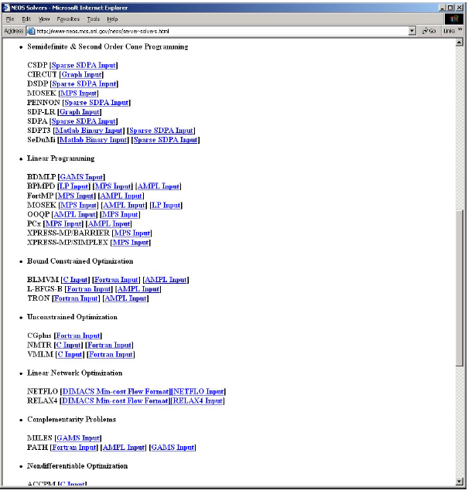
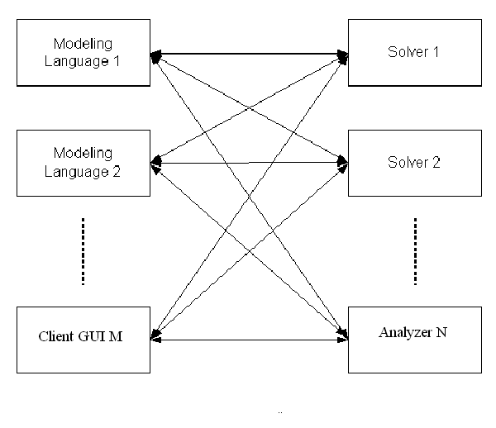
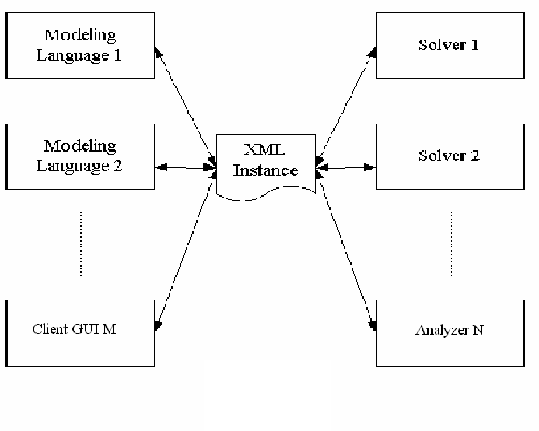
Motivation
Look at the NEOS server Web site
M X N drivers
M + N drivers

Slide 7
Motivation
As if it’s not bad enough …
  1. Tightly-coupled implementation (OOP? Why not!)
  2. Various operating systems
  3. Various communication/interfacing mechanisms
  4. Various programming languages
  5. Various benchmarking standards

Slide 8
Motivation
Now…
  The key issue is communication, not solution!
  … and Optimization Services is intended to solve all the above issues.

Slide 9
OUTLINE
1. Motivations
2. Optimization Services and Optimization Services Protocol
3. Future and Derived Research

Slide 10
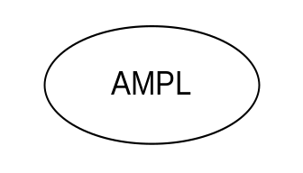
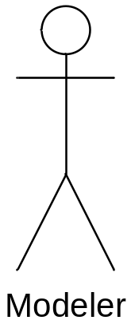
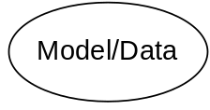
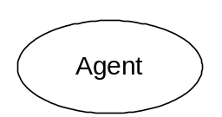
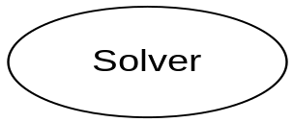
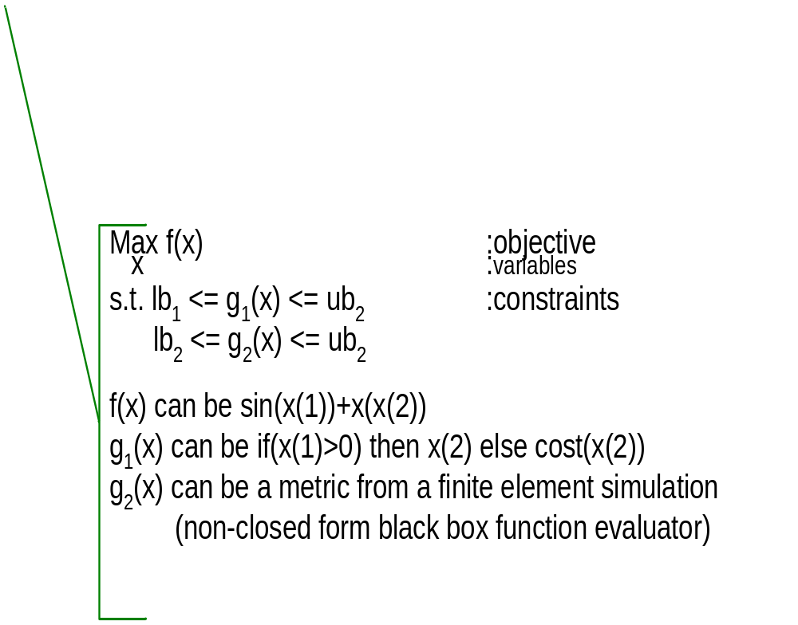
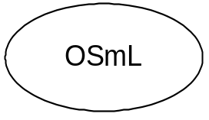
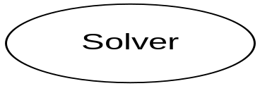
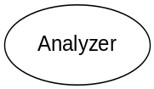
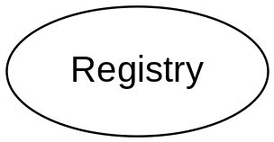
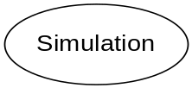
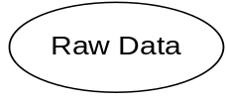
Optimization Services (OS)
What is happening behind?
XML-based standard
Web address
html form
browser
http/html
location
Web page
socket
OS
Server
CGI
Parse to OSiL
OSP -- OShL(OSiL)
Web Server
OS Server
OS Server
HTML Checker
OS Server
Google
Database/ App Service
Data in HTML Form

Slide 11
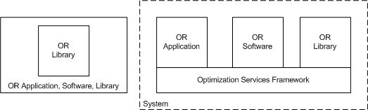
Optimization Services
What is it? – A framework for optimization software

Slide 12
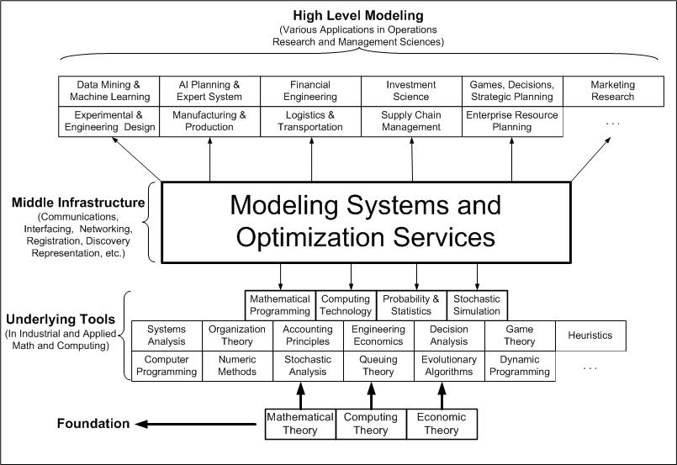
Optimization Services
What is it? – A computational infrastructure

Slide 13

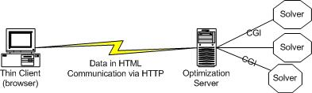
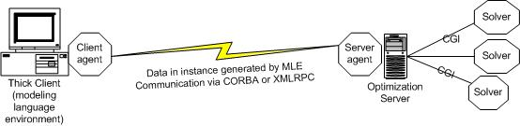
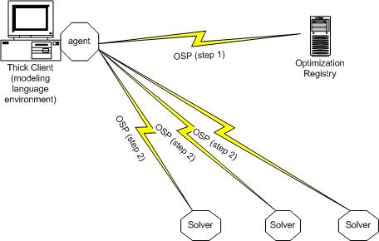
Optimization Services
What is it? – The next generation NEOS
The NEOS server and its connected solvers uses the OS framework.
NEOS accepts the OSiL and other related OSP for problem submissions
NEOS becomes an OS compatible meta-solver on the OS network
NEOS hosts the OS registry

Slide 14
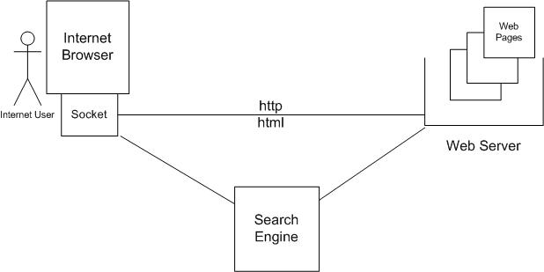
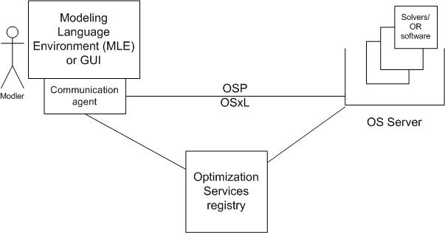
Optimization Services
What is it? – The OR Internet

Slide 15
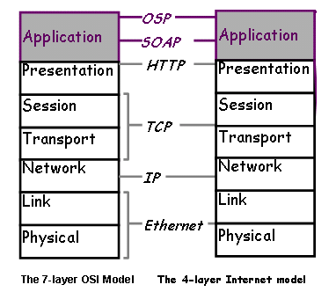
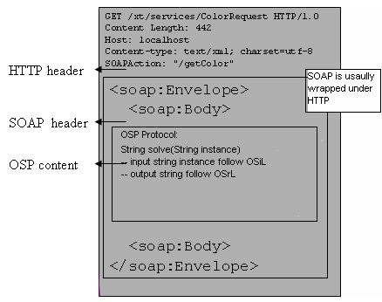
Optimization Services Protocol (OSP)
What is it? – Application level networking protocol
– Interdisciplinary protocol between CS and OR

Slide 16
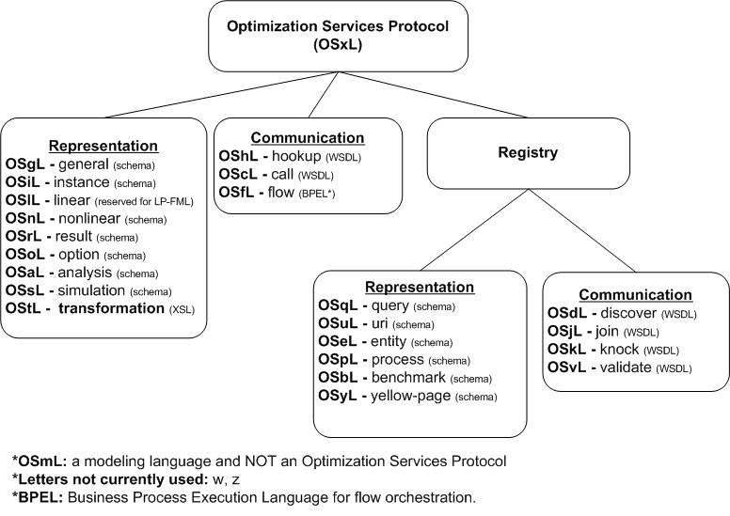
Optimization Services Protocol (OSP)
What does the protocol involve? – 20+ OSxL languages

Slide 17
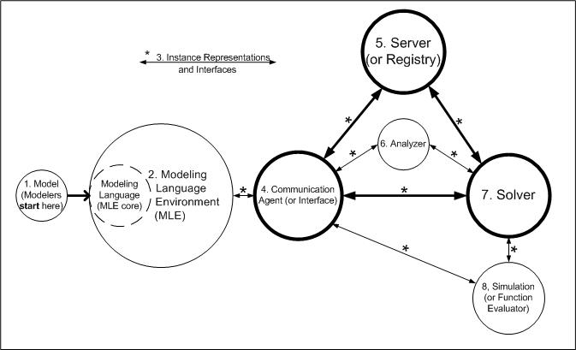
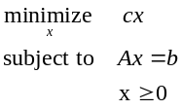
Optimization System Background
What does an optimization system look like?
users
developers
modelers

Slide 18
OUTLINE
1. Motivations
2. Optimization Services and Optimization Services Protocol
3. Future and Derived Research

Slide 19
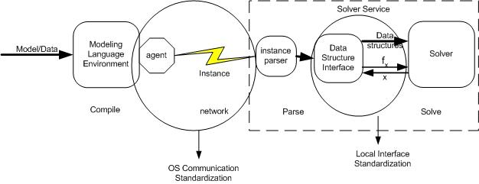
Future and Derived Research
The Optimization Services project
Standardization
Problem repository building
OS server software, library enhancement
Derived research in distributed systems (coordination, scheduling and congestion control)
Derived research in decentralized systems (registration, discovery, analysis, control)
Derived research in local systems (OSI? OSiI, OSrI, OSoI?)
Derived research in optimization servers (NEOS)
Derived research in computational software (AMPL, Knitro, Lindo/Lingo, IMPACT, OSmL, MProbe, Dr. AMPL, etc. )
Derived research in computational algorithm
Parallel computing
Optimization via simulation
Optimization job scheduling
Analyzing optimization instances according to the needs of the OS registry.
Modeling and compilation
Efficient OSxL instance parsing and preprocessing algorithms.
Effective Optimization Services process orchestration.
Promote areas where lack of progress are partly due to lack of representation schemes
Derived business model
Modeling language developers, solver developers, and analyzer developers
Library developers, registry/server developers, and other auxiliary developers
Computing on demand and “result on demand”

Slide 20

http://www.optimizationservices.org

