Slide 1
New developments in OSiL, OSoL and OS
H.I. Gassmann
R.K. Martin,J. Ma
INFORMS Annual meeting, Washington, DC, October 2008

Slide 2
Overview
Introduction
Robust Optimization
Special ordered sets
OSoL parser
Other recent additions
Future work

Slide 3
What is Optimization Services?
Set of standards for optimization
  OSiL: Problem instances
  OSrL: Optimization result
  OSoL:Solver options
Parsers and solver interfaces for local and distributed computing
COIN-OR project

Slide 4

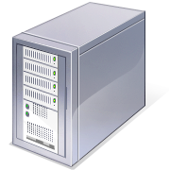


Solvers
Data
inter-change
User interface
AML
Corporate databases

Slide 5
OSiL: Optimization Services instance Language
XML schema for deterministic and stochastic programs:
  <variables>
  <objectives>
  <constraints>
  <linearConstraintCoefficients>
  <quadraticCoefficients>
  <nonlinearExpressions>
  <specialOrderedSets>
  <robustOptimization>
  …

Slide 6
Robust optimization
Example:
min f(x )
s.t. F(x ) ≤ 0
l_{x} ≤ x ≤ u_{x}
max ,c
,c
H(c) ≤ 0
l_{c} ≤ c ≤ u_{c}
Under suitable conditions, the complexity of the problem is not changed by the introduction of uncertain parameters

Slide 7
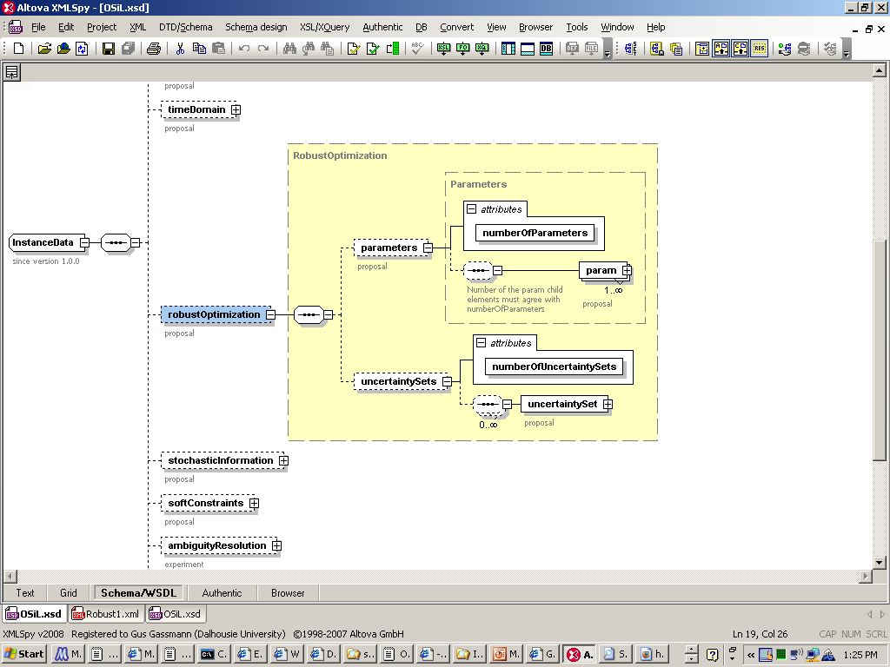
OSiL: <robustOptimization>

Slide 8
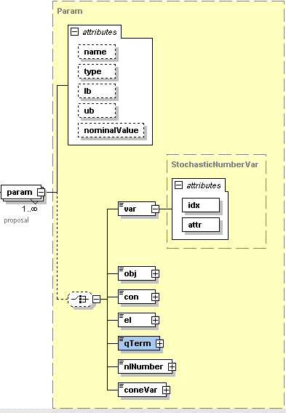
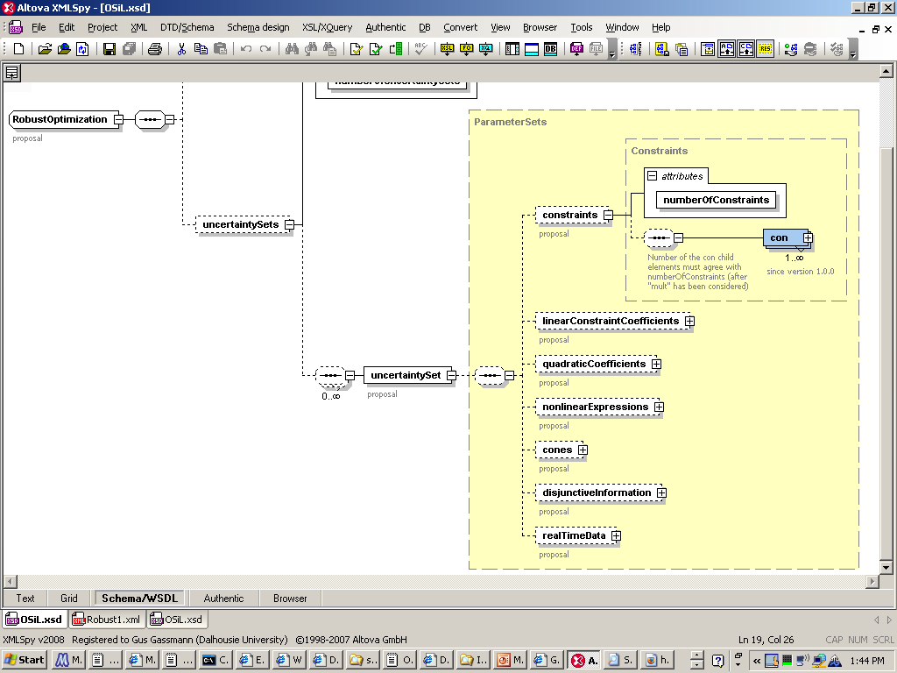

Slide 9
Special ordered sets
SOS Type 1
  At most one variable in the set can be nonzero
SOS Type 2
  At most two variables in the set can be nonzero …
  … and they must be consecutive
SOS Type 3
  Like SOS1, but there is an explicit convexity row

Slide 10
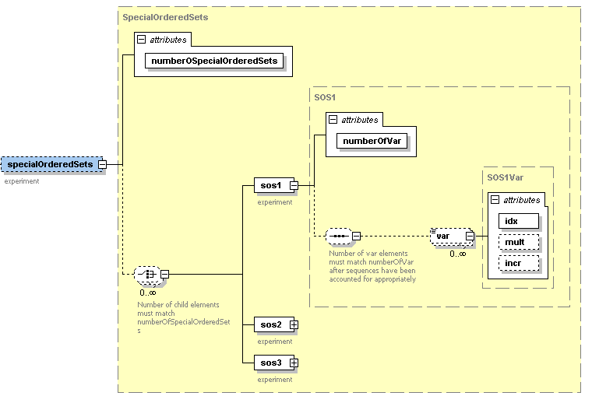
OSiL: <specialOrderedSets>

Slide 11
OSoL: Optimization Services option Language
XML schema for solver options
  General options for distributed computing
    Username, password, location, etc.
  System options
    Disk space, CPU requirements
  Job options
    Dependency on other jobs, file and directory options, time limits, etc.
  Solver options
    Tolerances, initial values, priority rules for SOS, etc.
Parser added to OS trunk on October 4

Slide 12
Other recent additions
Added solver support
  DyLP
  Bonmin
Lossless I/O for transmitting OSiL files
GAMSlinks
Visual Studio 9.0 support
Sparsity patterns for Hessian computation (CppAd)
Excel VBA interface
Precompiled Windows binaries
Current stable version 1.1.1 (released 30 September)

Slide 13
Future work
Support for stochastic programs
  Deterministic equivalent
  Decomposition solver
Disjunctions
Cone programming

Slide 14
QUESTIONS?
http://myweb.dal.ca/gassmann
http://www.optimizationservices.org
http://www.coin-or.org/projects/OS.xml
Horand.Gassmann@dal.ca

