Slide 1
Setting Up and Hosting Your Solver as Web Services via Optimization Services (OS)
Robert Fourer
Jun Ma
Northwestern University
Kipp Martin
University of Chicago
Jun Ma
maj@northwestern.edu
Industrial Engineering and Management Sciences, Northwestern University
11/04/2007

Slide 2
Outline
Motivation
OS Framework
OS Library
OS Server
Conclusion/User Experience

Slide 3
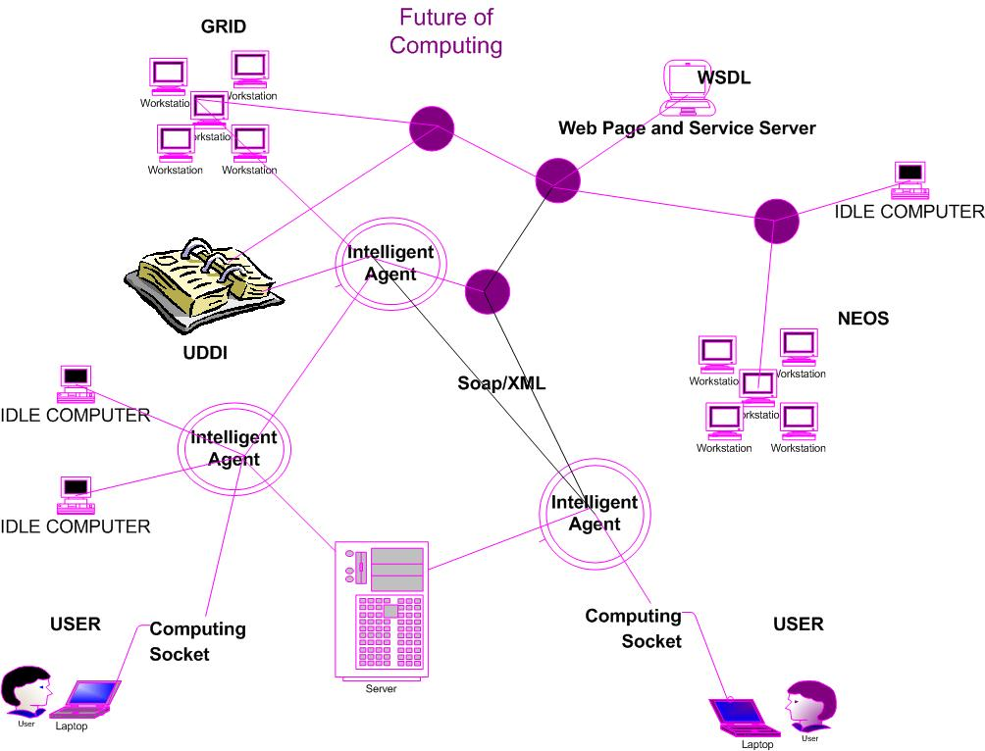
Motivation
Future of Computing

Slide 4
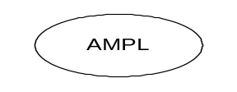


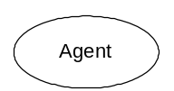




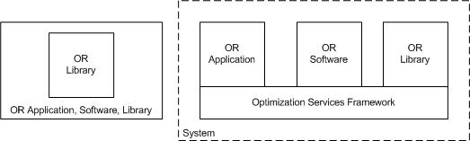
OS Framework
Optimization Services System
browser
Web address
http/html
Web page
html form
socket
CGI
location
OS
Server
Parse to OSiL
OSP/ OSxL
Web Server
OS Server
Database/ App Service
Google

Slide 5
OS Library
OSCommon
  representationParser
    OSiL Reader/Writer
    OSrL result
    OSoL option
    Etc.
  util
    data structure
    io
    xml
    etc
  communicationInterface
    OShL (hook up to solvers/analyzers: solve, send, retrieve)
    OScL (call to simulations)
    OSdL (discover in registries)
  localInterface
    OSInstance
    etc.
  nonlinear: defines all the nonlinear operator/operands/functions
OSiLReader reader = new OSiLReader();
reader.read(example.osil);
reader.getLinearConstraintCoefficients();
reader.calculateNonlinearFunction(5, x); //x is double[]

Slide 6
OS Library
OSAgent
  Solver agent
  Simulation agent
  Solver agent
OSSolver
  Utility and implementation of os-compatible solvers
OSSimulation
  Utility and implementation of os-compatible simulation.
OSRegistry
  Allows os developers to register their services
  Lets os users discover os services
  Let os users/developers validate instances
OSAnalyzer
  Utility and implementation of os-compatible analyzers.
OSScheduler
  Schedules optimization jobs over the distributed system
  Takes care of all the non-optimization related chores.
OSSolverAgent agent = new OSSolverAgent();
agent.solverAddress = “http://1.2.3.6/CbcSolverService”;
String osrlResult = agent.solve(osilInstance, osolOption);

Slide 7
OS Framework
Optimization Services Protocol (OSP)
OSP
GET /xt/services/ColorRequest HTTP/1.0
Content Length: 442
Host: localhost
Content-type: text/xml; charset=utf-8
SOAPAction: "/getColor"
Application
Application
SOAP
Presentation
HTTP
Presentation
<soap:Envelope>
<soap:Body>
<soap:Body>
</soap:Envelope>
Session
Session
TCP
Transport
Transport
OSP – specifies soap content
Communication Interface Representation
e.g. hook (“<OSiL> … </OSiL>”)
Network
Network
IP
Link
Link
Ethernet
Physical
Physical
The 7-layer OSI Model
The 4-layer Internet model

Slide 8
OS Server
  Networking Protocols: HTTP, SOAP, OSP
  (OS server: Tomcat, Axis, OS library)
  OSServer =
CbcSolverService
osp handler
soap parser
http parser

Slide 9
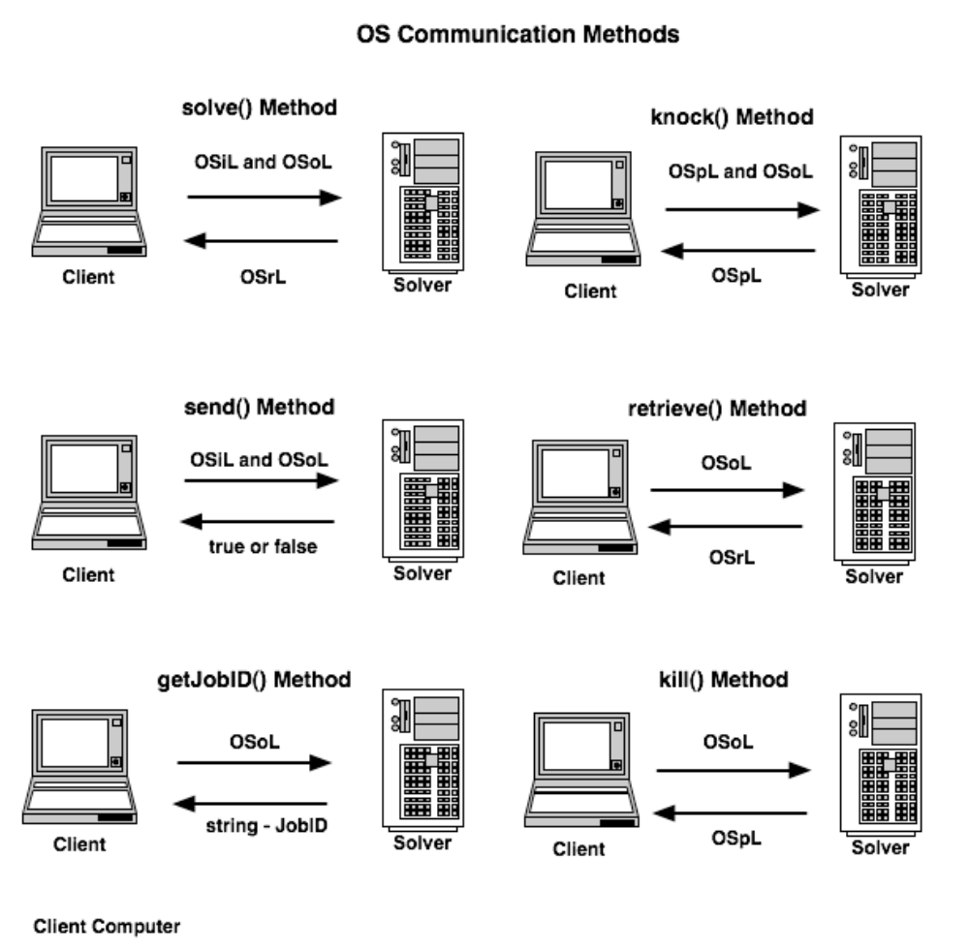
OS Server

Slide 10
Download the OSServer
Download the binary distribution:
os-distribution-release_number.zip.
The server side of the Java distribution is based on the Tomcat 5.5 implementation.
After unpacking os-distribution-release_number.zip there is a directory os-server-1.0 and a single file os.war.
For users that have not installed the Tomcat server, os-server-1.0 contains all of the necessary files for a OS Solver Service. If you do not have a Tomcat server running do the following to setup a Tomcat server with the OS Solver Service :

Slide 11
Setting up the OSServer
Step 1. Put the folder os-server-1.0 in the desired location for the OS Solver Service on the server machine.
Step 2. Connect to the Tomcat bin directory in the os-server-1.0 root and execute ./startup.sh (Linux) or ./start.bat (Windows)
Step 3. Test to see if the server is running the OSSolverService. Open a browser on the server and enter the URL
http://localhost:8080/os/OSSolverService.jws
or
http://127.0.0.1:8080/os/OSSolverService.jws
You should see a message Click to see the WSDL. Click on the link and you should see an XML description of the various methods available from the OSSolverService.
Step 4. On a client machine, create the file testremote.config with the following lines of text
-serviceLocation http://***.***.***.***:8080/os/OSSolverService.jws
-osil parincLinear.osil
where ***.***.***.*** is the IP address of the Tomcat server machine. Then, assuming the files testremote.config and parincLinear.osil are in the same directory on the client machine as the OSSolverService execute: ./OSSolverService -config testremote.config
You should get back an OSrL message saying the problem was optimized.

Slide 12
Connect to the OSServer with OSSolverService
At present, the OSSolverService takes the following parameters. The order of the parameters is irrelevant. Not all the parameters are required. However, if the solve or send service methods are invoked a problem instance location must be specified.
-osil xxx.osil this is the name of the file that contains the optimization instance in OSiL format. It is assumed that this file is available in a directory on the machine that is running OSSolverService. If this option is not specified then the instance location must be specified in the OSoL solver options file.
-osol xxx.osol this is the name of the file that contains the solver options. It is assumed that this file is available in a directory on the machine that is running OSSolverService. It is not necessary to specify this option.
-osrl xxx.osrl this is the name of the file that contains the solver solution. A valid file path must be given on the machine that is running OSSolverService. It is not necessary to specify this option.

Slide 13
Connect to the OSServer with OSSolverService
-serviceLocation url is the URL of the solver service. This is not required, and if not specified it is assumed that the problem is solved locally.
-serviceMethod methodName this is the method on the solver service to be invoked. The options are solve, send, kill, knock, getJobID, and retrieve. The use of these options is illustrated in the examples below. This option is not required, and the default value is solve.
-solver solverName Possible values for default OS installation are clp (COIN-OR Clp), cbc (COIN-OR Cbc), dylp (COIN-OR DyLP), and symphony (COIN-OR SYMPHONY). Other solvers supported (if the necessary libraries are present) are cplex (Cplex through COIN-OR Osi), glpk (glpk through COIN-OR Osi), ipopt (COIN-OR Ipopt), knitro (Knitro), and lindo LINDO. If no value is specified for this parameter, then cbc is the default value of this parameter if the the solve or send service methods are used.

Slide 14
Connect to the OSServer with OSSolverService
-mps xxx.mps this is the name of the mps file if the problem instance is in mps format. It is assumed that this file is available in a directory on the machine that is running OSSolverService. The default file format is OSiL so this option is not required.
-nl xxx.nl this is the name of the AMPL nl file if the problem instance is in AMPL nl format. It is assumed that this file is available in a directory on the machine that is
-browser browserName this paramater is a path to the browser on the local machine. If this optional parameter is specified then the solver result in OSrL format is transformed using XSLT into HTML and displayed in the browser.
-config pathToConfigureFile this parameter specifies a path on the local machine to a text file containing values for the input parameters. This is convenient for the user not wishing to constantly retype parameter values.

Slide 15
Examples (1)
./OSSolverService -solver clp -osil ./parincLinear.osil
./OSSolverService –config ./testlocalclp.config
  where testlocalclp.config looks like:
  -osil ./parincLinear.osil
  -solver clp
./OSSolverService –config ./testlocal.config
  where testlocalclp.config looks like:
  -osil ../data/osilFiles/parincQuadratic.osil
  -solver ipopt
  -serviceMethod solve
  -browser /Applications/Firefox.app/Contents/MacOS/firefox
  -osrl ./test.osrl
./OSSolverService –config ./testlocalclp.config
  where testlocalclp.config looks like:
  -osol ./demo.osol
  -solver clp
<?xml version="1.0" encoding="UTF-8"?>
<osol xmlns="os.optimizationservices.org">
<general>
<instanceLocation locationType="local">
../data/osilFiles/parincLinear.osil
</instanceLocation>
</general>
</osol>

Slide 16
Examples (2)
./OSSolverService –config ./testremote.config
  where testlocalclp.config looks like:
  -osil ./parincLinear.osil
  -serviceLocation http://gsbkip.chicagogsb.edu/os/OSSolverService.jws
  -serviceMethod send
./OSSolverService -config .testremote.config -solver clp
or by adding the line -solver clp to the testremote.config file.
./OSSolverService -osol ./remoteSolve1.osol -serviceLocation http://gsbkip.chicagogsb.edu/os/OSSolverService.jws
  where remoteSolve1.osol looks like:
<?xml version="1.0" encoding="UTF-8"?>
<osol xmlns="os.optimizationservices.org">
<general>
<instanceLocation locationType="local">c:\parincLinear.osil</instanceLocation>
<contact transportType="smtp">maj@northwestern.edu</contact>
</general>
<optimization>
<other name="os_solver">ipopt</other>
</optimization>
</osol>

Slide 17
Usage Summary
• solve(osil, osol):
– Inputs: a string with the instance in OSiL format and an optional string with the solver options in OSoL format
– Returns: a string with the solver solution in OSrL format
– Synchronous call, blocking request/response
• send(osil, osol):
– Inputs: a string with the instance in OSiL format and a string with the solver options in OSoL format (same as in solve)
– Returns: a boolean, true if the problem was successfully submitted, false otherwise
– Has the same signature as solve
– Asynchronous (server side), non-blocking call
– The osol string should have a JobID in the <jobID> element

Slide 18
Usage Summary
• getJobID( osol)
– Inputs: a string with the solver options in OSoL format (in this case, the string may be empty because no options are required to get the JobID)
– Returns: a string which is the unique job id generated by the solver service
– Used to maintain session and state on a distributed system
• knock(ospl, osol)
– Inputs: a string in OSpL format and an optional string with the solver options in OSoL format
– Returns: process and job status information from the remote server in OSpL format
• retrieve( osol)
– Inputs: a string with the solver options in OSoL format
– Returns: a string with the solver solution in OSrL format
– The osol string should have a JobID in the <jobID> element
• kill( osol)
– Inputs: a string with the solver options in OSoL format
– Returns: process and job status information from the remote server in OSpL format
– Critical in long running optimization jobs

Slide 19
Conclusion/User Experience
Open Environment
Convenience just like Using Utility Services
No High Computing Power Needed
No Knowledge in Optimization Algorithms and Software (solvers, options, etc.)
Better and More Choices of Modeling Languages
More Solver Choices
Solve More Types of Problems
Automatic Optimization Services Discovery
Decentralized Optimization Services Development and Registration
More Types of Optimization Services Components Integrated (Analyzers/Preprocessors, Problem Providers, Bench Markers)
Smooth Flow and Coordination of Various Optimization Services Components.
A Universal, Scalable and Standard Infrastructure that promotes Collaboration and Other Related Researches
Concentration on Good Modeling

Slide 20

www.optimizationservices.org
www.coin-or.org/OS

