Slide 1
Optimization Services Instance Language (OSiL), Solvers, and Modeling Languages
Robert Fourer
Jun Ma
Northwestern University
Kipp Martin
University of Chicago
Kipp Martin
University of Chicago
kipp.martin@chicagogsb.edu

Slide 2
Outline
Motivation and problem description
2. Instance and solver communication (APIs)
3. OSiLHandler and OSiLReader classes
4. Solver Interfaces
5. Concluding Remarks

Slide 3
The Problem
This talk

Slide 4
The Problem
Brief Review:
OSiL: Optimization Services instance Language. This is
an XML based format for representing a wide variety of
optimization problems.
OSrL: Optimization Services result Language. An XML based
format for representing the solution to optimization problems.

Slide 5
The Problem
We are in a loosely-coupled environment.
Solver and modeling language are separate process,
possibly on separate machines.
There are lots of solvers, both linear and nonlinear.
Given a common instance format (OSiL), how do we
communicate the instance format to solvers?

Slide 6
The Problem
How is communication done?
Through an Application Program Interface (API)
Think of an API as a specification for methods.
The methods then interact with an underlying data structure.
In the case of OSiL it is our OSExpressionTree

Slide 7
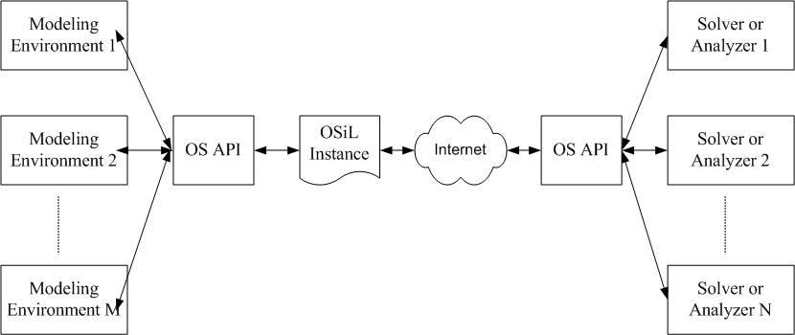
The Problem
Our Focus - the solver
side API

Slide 8
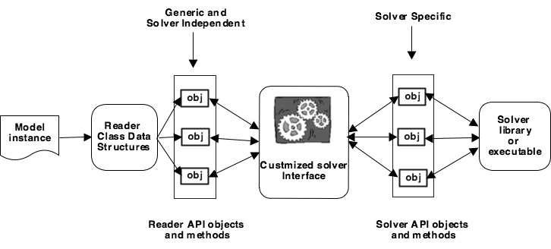
Instance and Solver Communication

Slide 9
Instance and Solver Communication
Related work: “Simple C-API Windows DLL Implementation
Of CLP, CBS, and CGL” by Bjarni Kristjannon (TD-14)
We also provide libraries with the following features:
Our libraries designed to read OSiL(replacing LPFML)
Not Windows based (Windows, Linux, and Mac)
Designed for a loosely-coupled environment
We provide libraries to read the instance and the solver
specific interface libraries.

Slide 10
Key Library Components
OSiLHandler and OSiLReader are the key solver
independent classes.
OSiLHandler -- a class that is designed to parse the XML
OSiL file. The solver never sees this. The solver does not
need to know anything about XML or OSiL.
OSiLReader -- a class that creates the necessary
data structures and provides the API for the
solver specific interface library.

Slide 11
The OSiLHandler Class
The OSiLHandler Class is designed to parse the XML.
There are two philosophies for this: SAX and DOM
SAX -- event based (data does not persist)
DOM -- tree based (data persists)
We have a C++ SAX based implementation for linear OSiL
and a Java based DOM implementation for general OSiL
Our implementations uses the Apache Xerces libraries

Slide 12
The SAX OSiLHandler Class
SAX is event based. For example:
Reading the start of an XML element
Reading the end of an XML element
Reading character data in an XML element
Reading XML attributes
The Xerces parser has a default handler that
does nothing when these events are fired. The OSiLHadler
extends the Xerces base class and actually does something.

Slide 13
The SAX OSiLHandler Class
<variables number="2">
<var name="x1" type="C" lb="0.0"/>
<var name="x2" type="C" lb="0.0"/>
</variables>
void OSiLHandler::startElement( a bunch of parameters)
case var:
processVar(attributes);
break;
processVar(attributes) get the information about the
Variable, e.g. name, type, ub, lb and puts into a vector --
again the library user never sees this
After the last var element is read, <variables> processed

Slide 14
OSiLReader Class
Two key functions:
Use the OSiLHandler to create the data structures
2. Provide the methods that constitute the API

Slide 15
OSiLReader Data Structures
Linear part of model: arrays for the constraint matrix, e.g.
double* m_mdValueCoefMatrix;
int* m_miStartCoefMatrix;
int* m_miIdxCoefMatrix;
Nonlinear part of model: an expression tree
Arrays for variable and row information (e.g. lbs and ubs)

Slide 16
OSiLReader OSExpression Tree

Slide 17
OSExpressionTree (Parsing)
We take an object oriented approach, every node in
the expression tree is an instance in the OSnLNode class
OSnLNode nlNode = null;
String sNodeName = "";
try{
sNodeName = ele.getLocalName();
String sNlNodeClass = m\_sPackageName + "." + m\_sNlNodeStartString +]
sNodeName.substring(0, 1).toUpperCase() + sNodeName.substring(1);
Class nlNodeClass = Class.forName(sNlNodeClass);
nlNode = (OSnLNode)nlNodeClass.newInstance();
} // now process attributes
“OSnLNodeTimes”
An instance of OSnLNode which is
an OSnLNodeTimes

Slide 18
OSiLReader C++ API
The OSiLHandler instantiates an osilreader object
and calls OSiLReader “on” methods when certain events “fire”
<variables number="2">
<var name="x1" type="C" lb="0.0"/>
<var name="x2" type="C" lb="0.0"/>
</variables>
void OSiLHandler::endElement( a bunch of parameters)
case variables:
osilreader_->onVariables(variables_,lb_,ub_,colDomain_)

Slide 19
OSiLReader API
The C++ OSiLReader is very flexible and provides two APIs
There are two strategies for the API:
Strategy I -- a pull strategy with get() methods
Strategy II -- an event based strategy that re-implements the
base case “on” methods

Slide 20
OSiLReader C++ API Strategy 1 - Pull
int OSiLReader::onVariables( parameters -- data from OSiLHandler){
m_mdVarLB = new double[m_iNumberVariables];
m_mdVarUB = new double[m_iNumberVariables];
/* code to fill in the arrays */
}
double* OSiLReader::getVariableUBs(){
return m_mdVarUB;
}
So the API with Strategy I is a bunch of get() methods.
e.g., _x0016_getVariableLBs(), getConstraintUBs(),
getMatrixNonzeroValues(), etc

Slide 21
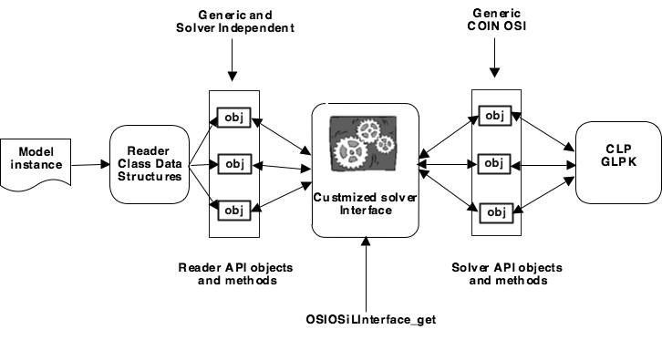
OSiLReader C++ API Strategy 1 - Pull

Slide 22
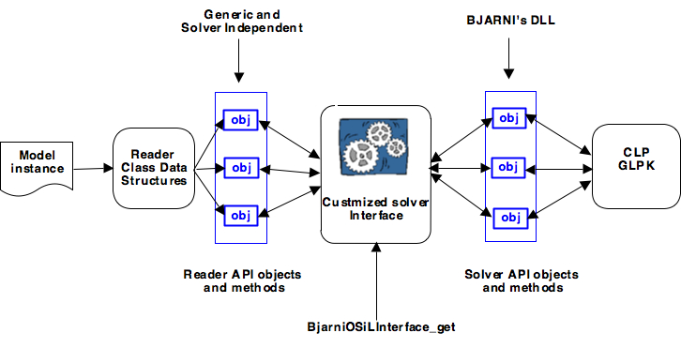
OSiLReader C++ API Strategy 1 - Pull

Slide 23
OSiLReader C++ API Strategy 1 - Pull
OSiLReader() osilreader;
m_mdVarLB = osilreader.getVariableLBs();
m_mdVarUB = osilreader.getVariableUBs();
solver_->assignProblem(m_, m_mdVarLB, m_mdVarUB,
m_mmdObjDenseCoefValue, m_mdConLB, m_mdConUB);
Either a glpk or clp solver determined by the
user at runtime.
We do a similar thing for the LINDO solver

Slide 24
OSiLReader C++ API Strategy 2 - Event
The on methods in OSiLReader are virtual. Define
A class that derives from this base clase with a new
Implementation of the on methods.
int OSiLOSIParser::onVariables( a bunch of parameters) {
lb_ = new double[nVars_];
ub_ = new double[nVars_];
std::copy(lb.begin(), lb.end(), lb_);
std::copy(ub.begin(), ub.end(), ub_);
solver_->assignProblem(m_, lb_, ub_, obj_, lhs_, rhs_);

Slide 25
OSiLReader Java Implementation
Based on OSExpressionTree
This is pull oriented. A set of get() and calculate() methods.
getConstraintLBs()
getFirstObjectiveMaxOrMin()
getMatrixNonzeroIndexes()
getNonlinearPostfix(int rowIdx)
getNonlinearPrefix(int rowIdx)
getNonlinearInfix(int rowIdx)
calculateFunction(int rowIdx, double x[])
calculateNonlinearDerivatives(int rowIdx, double x[], boolean functionEvaluated)

Slide 26
OSiLReader Java API

Slide 27
OSiLReader Java API
<nl idx="1">
<plus>
<plus>
<ln>
<times>
<var coef="1.0" idx="1"/>
<var coef="1.0" idx="0"/>
</times>
</ln>
<var coef="7.0" idx="1"/>
</plus>
<var coef="5.0" idx="0"/>
</plus>
</nl>

Slide 28
OSiLReader Java API
Call getNonlinearPostfix( 0)
This methods uses our OSExpressionTree data structure
postfix: [X1, X0, times, ln, 7.0, X1, times, plus, 5.0, X0, times, plus, 10, minus]
The Lindo Interface converts the postfix to a Lindo
instruction list.
1063 1 1063 0 1003 1021 1062 16 1063 1 1003 1001 1062 17 1063 0 1003 1001

Slide 29
OSiLReader Java API

Slide 30
Supported Platforms
Modeling Languages that can generate OSiL (or LPFML):
AMPL (linear OSiL -- LPFML)
OSmL (native)
POAMS (native linear OSiL)
Solvers:
CLP - through COIN OSI
FORTMP - LPFML
GLPK - through COIN OSI
IMPACT - native support
KNITRO - using function callback
LINDO - using instruction list format

Slide 31
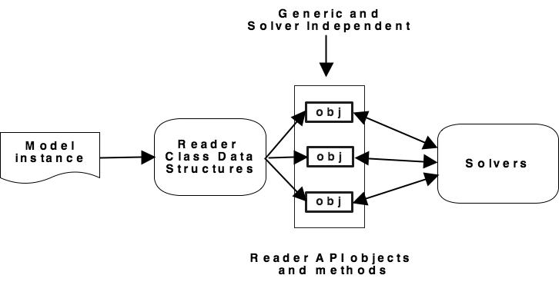
An Ideal World

Slide 32

QUESTIONS?
http://www.optimizationservices.org

