Slide 1
Optimization Services (OS)
-- Providing Solvers As Services
-- Distributed/Parallel Computing System
-- Enterprise Computing Infrastructure
-- The Operations Research Internet/Intranet
Jun Ma
Industrial Engineering and Management Sciences
Northwestern University
IEMS Advisory Board, 03/06/2006

Slide 2
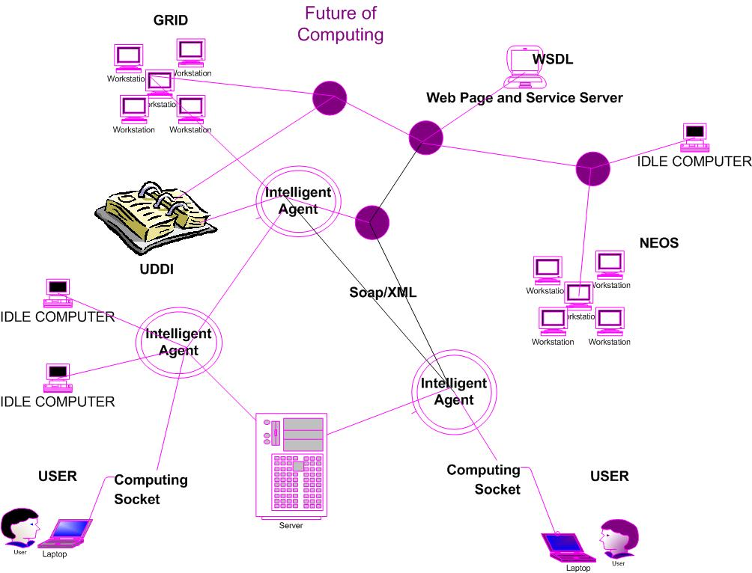
Optimization Services as Computing Utility Services
Intelligent User View
Registry
model/problem
model/problem

Slide 3
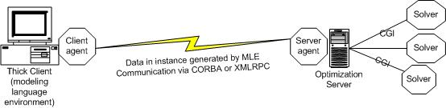
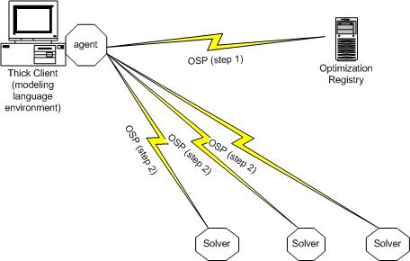
Centralized Vs Decentralized Enterprise Systems
Simplified System View
Centralized
Decentralized

Slide 4
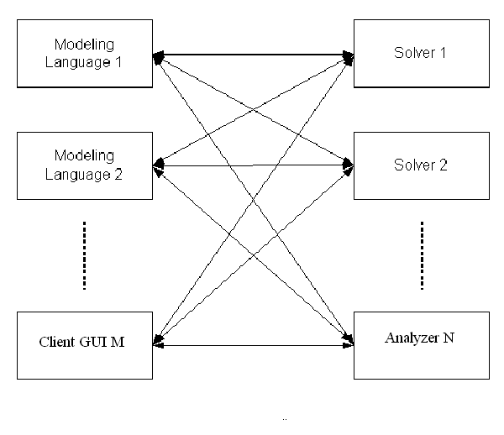
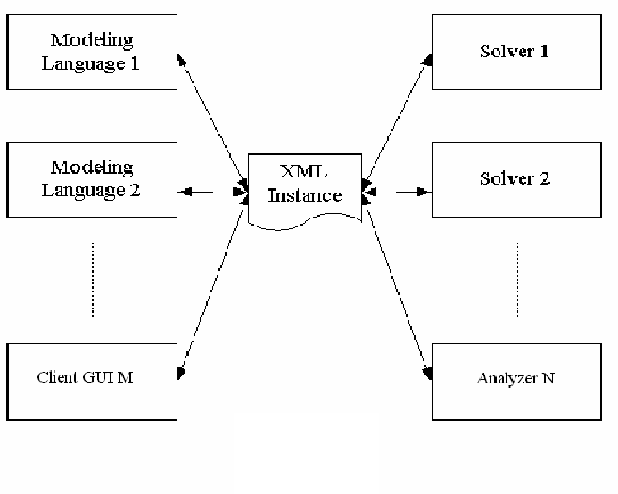
Motivation
M X N drivers
M + N drivers

Slide 5
Motivation
  1. Tightly-coupled implementation
  2. Various operating systems
  3. Various communication/interfacing mechanisms
  4. Various programming languages
  5. Various benchmarking standards
  The key issue is communication, not solution!
  … and Optimization Services is intended to solve all the above issues.

Slide 6
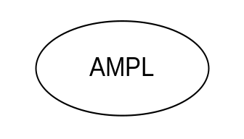

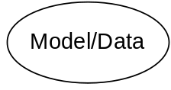
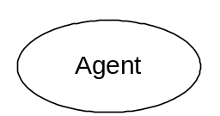
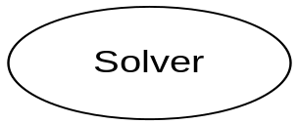
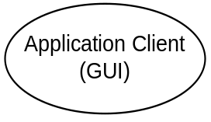

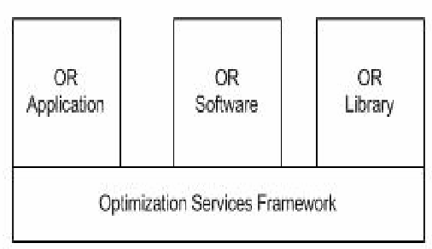

Optimization Services as Computational Internet/Intranet
Sketch View
browser
http
Web page
socket
OS Server
OSP
Web Server
OS Server
OS Server
Google

Slide 7
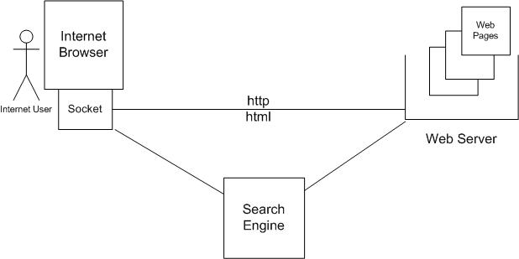
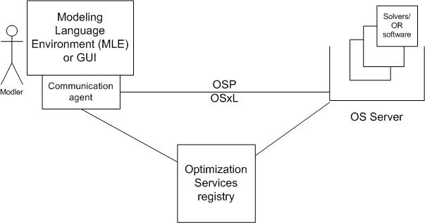
Why is it the OR Internet/Intranet
Analogy

Slide 8
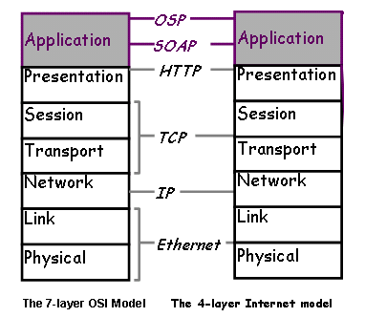
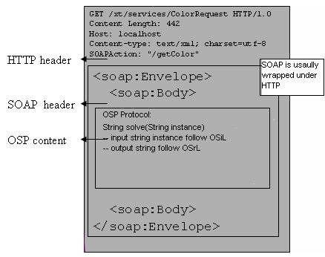
Standard -- Optimization Services Protocol (OSP)
Technical Background

Slide 9
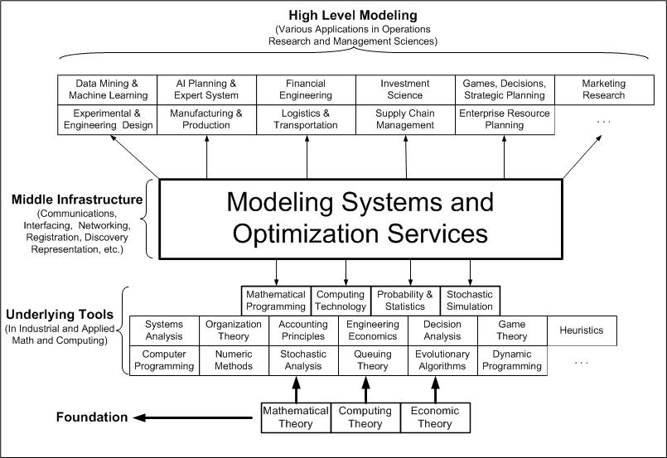
Business Values

Slide 10
Business Values
Solve more types of computational problems more efficiently
Easily deploy enterprise computing system within a company, with intelligent components in scheduling computational jobs, registering and finding computing services, routing maintenance
Provide computational software as services on dedicated servers
Let all computational software communicate with each, independent of platforms and implementations.
Save costs on expensive software licenses
Make full use of limited computational solvers

