Slide 1
On Implementing a Parallel Integer Solver Using
Optimization Services
Jun Ma
Huanyuan (Wayne) Sheng
Joint work with
Sanjay Mehrotra
Notes:
Good afternoon everybody. Today the title of my talk is impact solver for optimization services. It is the joint work I have done with professor mehrotra and jun ma as part of my ph.d thesis.

Slide 2
Outline
Brief Introduction
  Impact Generalized MIP Solver
  Optimization Services (OS)
Distributed Parallel For Integer Programming Using OS
Conclusion
Notes:
In this talk I am going to share my experiences on developing the impact solver service using the standard created by optimization services. This is a derived work from our computational study in integer programming. Right now it is not completely finished but we have seen the potentials of extending impact functionality by adding web service to it.
My talk consists of five parts. First I will give a brief introduction on impact and os. Then I will describe what impact solver is and the extension work of solver in relation with optimization. After that I show you a demo illustrating our work for setting up the services. Lastly I summarize my work and mention the future research direction.

Slide 3
Introduction
Impact GMIP Solver
IMPACT -- Integrated Mathematical Programming Advanced Computational Tools
Features
  Generalized Mixed Integer Nonlinear Solver (GMIP).
  Generalized Hyperplanes based Branch and Bound.
  Standalone Solver and Remote Solver Service.
  Unified NATIVE Interface with Optimization Services.
Notes:
Ok, first for brief introduction, I will skip optimization services standard. I think professor martin, professor fourer and dr.ma have done a good job in presenting the standard. I will go directly to impact. Impact stands for integrated mathematical programming advanced computational tools. This is a research code we are writing for developing algorithms solving mixed integer nonlinear programs. I want to emphasize the last bullet point that it is natively equipped with component for testing the optimization services.

Slide 4
Impact GMIP Solver Features
Algorithms
Research Focus
  Mixed Integer Nonlinear Programming
  Parallel computing for MINLP
Algorithm Studies
  Heuristics for generalized branch and bound methods
  Optimization Services based distributed parallel, e.g. communications, load balance handling.
Notes:
We primarily have two motivations for writing impact. First we want to test the ideas of generalized branching and basis reduction method proposed by mehrotra and li. The details of the method was presented by prof mehrotra on Sunday, so I am not gonna talk about it in too much detail. You can also refer to the technical report of mehrotra and li if you missed that talk. For a more detailed account for implementation, several important computation issues should be considered. First is to compute the branching hyperplane starting from adjoint lattice. The next issue is that we need to reduce the basis through LLL or GBR algorithm. And last important implementation issue is that a robust interior point method for searching the relaxed solution. Those computational issues appears associated with stand-alone solver.

Slide 5
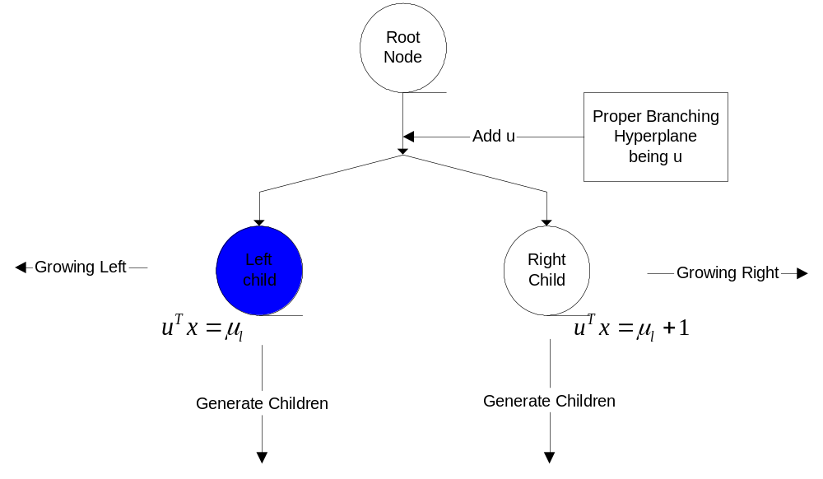
Impact GMIP Solver Features
Algorithms
Starting Node
Notes:
Now this flowchart shows our implementation for branch and bound. It has two similar procedures. What we are looking at is the very first one before branching.

Slide 6
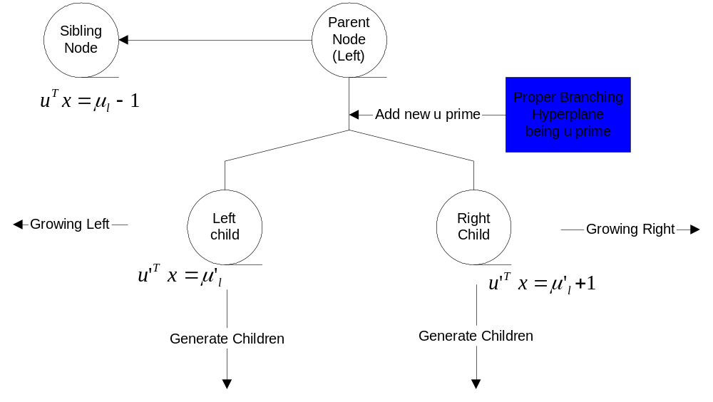
Impact GMIP Solver Features
Algorithms
Subsequent Node

Slide 7
Impact GMIP Solver Features
Algorithms
Generate Proper Branching Hyperplanes
  Basis Reduction Based (Mehrotra and Li)
    LLL
    GBR (Generalized Basis Reduction)
  Heuristics (ongoing)

Slide 8
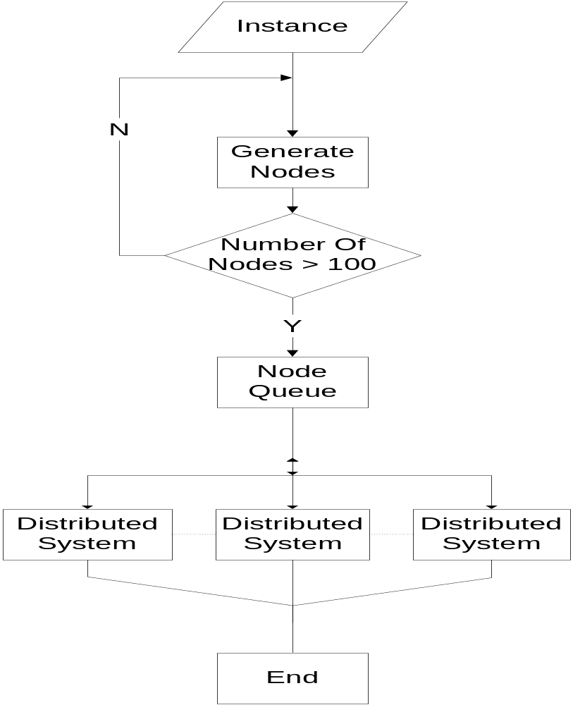

Slide 9
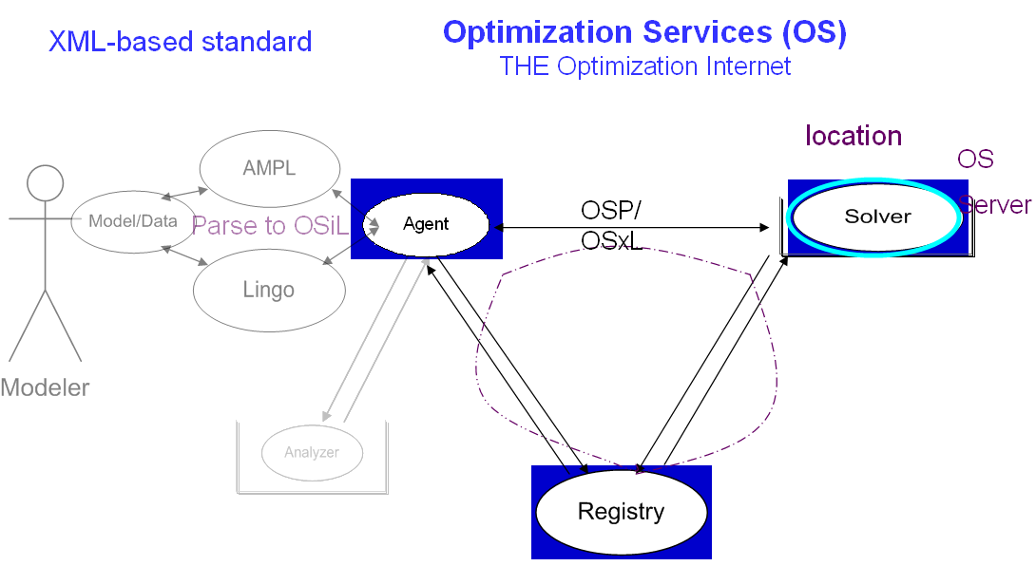
Notes:
Our experimental implementation has shown that by making impact solver natively os-compatible, we create a solver that is scalable platform for research algorithm. And impact can also be developed within the services context.
Our whole experiences with Os has convinced us that by make our solver compatible with optimizations services, we basically get our self a comprehensive and convenient framework for solver development.

Slide 10





IMPACT GMIP Parallelization over
Distributed Optimization Services
OShL
ImpactGMIP
Lindo
Nodes (OSiL Integer)
OShL
OSServer
(Linux)
Call back (OSrL)
OShL
Representation
CPLEX
OSiL - instance
OSServer
(WinXP)
OSoL - option
OShL
OSrL - result
IMPACT
OSpL - process
getJobID (String OSoL)
solve (String OSiL, String OSoL)
send (String OSiL, String OSoL)
retrieve (String OSoL)
kill (String OSoL)
knock (String OSpL, String OSoL)
OSServer
(Mac OS)
Communication
OShL - hookup

Slide 11
Conclusion
Introduced the Generalized MIP and showed it is friendliness for Parallelization
Showed Optimization Services has a general and high extendable design fit for many derived researches
Notes:
Our experimental implementation has shown that by making impact solver natively os-compatible, we create a solver that is scalable platform for research algorithm. And impact can also be developed within the services context.
Our whole experiences with Os has convinced us that by make our solver compatible with optimizations services, we basically get our self a comprehensive and convenient framework for solver development.

Slide 12



