Slide 1
An Enterprise Computational System Built on the Optimization Services (OS) Framework and Standards
-- Real World Computational Application
-- Distributed System
-- Completely based on OS Standards
Jun Ma
Robert Fourer
Northwestern University
Kipp Martin
University of Chicago
Jun Ma
INFORMS, Pittsburgh
11/08/2006

Slide 2
OUTLINE
1. Introduction
2. Illustration
3. Business Values

Slide 3
Introduction
Customer used to run legacy computational work on desktops
Need to run computational jobs on remote servers
Need renovation using modern distributed technologies
Jobs take long time
Have close to 20 dedicated computational servers
Users submit their work using some exiting Web GUI (ASP page)
Need a centralized system where all jobs go through a scheduler
Need the scheduler to keep track of all the 20 individual servers

Slide 4

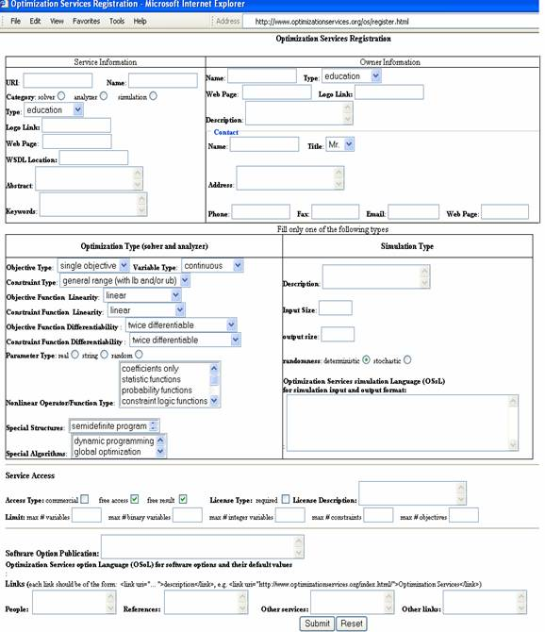








Optimization Services (OS)
Enterprise Computational System
OShL
Web Form
Modeling Language/GUI/Spread Sheet
OSiL
OShL
submit
OShL
OSServer
Representation
OSiL - instance
OShL
OSoL - option
OSrL - result
OSpL - process
OSdL
getJobID (String OSoL)
solve (String OSiL, String OSoL)
send (String OSiL, String OSoL)
retrieve (String OSoL)
kill (String OSoL)
knock (String OSpL, String OSoL)
Communication
OShL - hookup
OSdL - discover

Slide 5
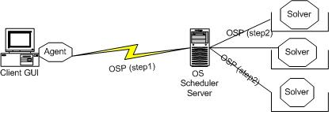
OS SOLVER Server
Remote job submission, management and control
Remote retrieval of previously submitted jobs
Session and state maintenance
Synchronous and asynchronous solver invocation
Killing long jobs over the remote server
Checking and managing service status and job statistics
Automatic job completion notification via most common protocols including emails
Persistence between service starts
Service logging
Automatic notification of critical service information to admin
Centralized user configuration
Directory and file cleanup
Disk, memory and process cleanup
Critical data backing up
Waiting job queue management
Long computational job handling
Job dependency handling
Keeping track of service utilization and preparing periodic report
Automatic input and output validation and processing
Support of machines with multiple CPUs
Support of all major operating systems
Authentication and authorization
Security

Slide 6
OS SCHEDULER Server
Most functionalities that a solver server would have
Keeping track of potentially unlimited number of computational solver services on a heterogeneous network, maintaining all their service status and job statistics.
Intelligently schedules computational jobs onto available solver services
Intelligently allocating computing resources to different jobs
Synchronous and asynchronous scheduler/solver invocation
Actively running job queue management
Finished/killed job management
Large Result Storage
User management related to their job submission
Killing long jobs over the remote server
Checking and managing scheduler/solver service status and job statistics
Persistence between service starts
Job dependency and sequencing handling

Slide 7
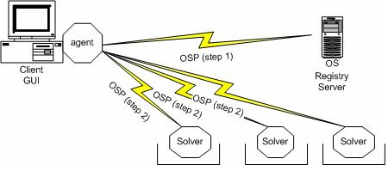
OS REGISTRY
Remote collection of service statistics and job information from potentially unlimited number of computational solver services on a heterogeneous network.
Automatically finding available computational services for client agents
On-line and off-line registration of new computational services
Dynamic update and deletion of registered services
Easily plugged with ACE scheduler server to provide a mixed centralized and decentralized distributed system
Intelligently finding computing resources to different jobs
Checking and managing registry service status and job statistics
Persistence between registry server starts
Registry service logging
Centralized user configuration
Directory and file cleanup
Disk, memory and process cleanup
Critical data backing up
Keeping track of service utilization and preparing periodic detailed and summary reports
Automatic input and output validation
Remote User control
Support of all major operating systems
Authentication and authorization
Security

Slide 8
Business Values
Solve more types of computational problems more efficiently
Easily deploy enterprise computing system within a company, with intelligent components in scheduling computational jobs, registering and finding computing services, routing maintenance
Provide computational software as services on dedicated servers
Let all computational software communicate with each, independent of platforms and implementations.
Save costs on expensive software licenses
Make full use of limited computational solvers

