Slide 1
Optimization Services (OS)
-- The Internet for OR
-- The Next Generation NEOS
(Funded by NSF)
-- An Open Source Computational Infrastructure
Robert Fourer
Jun Ma
Northwestern University
Kipp Martin
University of Chicago
Jun Ma
Annapolis,
01/07/2005

Slide 2
OUTLINE
1. Motivations
2. Introduction
3. Optimization Services and OSxL
4. An OSxL Example -- Optimization Services instance Language (OSiL)
5. Conclusion

Slide 3
Motivation
An Open, Scalable and Standard Environment that Facilitates Development & Use of OR Software and Promotes Collaboration and Other Related Researches
Convenience And Power
  Just like Using Utility Services (therefore the name – Optimization Services)
  Knowledge in Optimization Algorithms and Software (solvers, options, etc.) Required of Users Should be As Little As Possible
  Better and More Choices of Modeling Languages and Solver
  More Types of Optimization Services (Analyzers/Preprocessors, Problem Providers, Bench Markers, Registry, Simulation etc.)
  Solve More Types of Problems
Distributed and Decentralized Environment
  Automatic Optimization Services Discovery
  Optimization Services Development and Registration

Slide 4
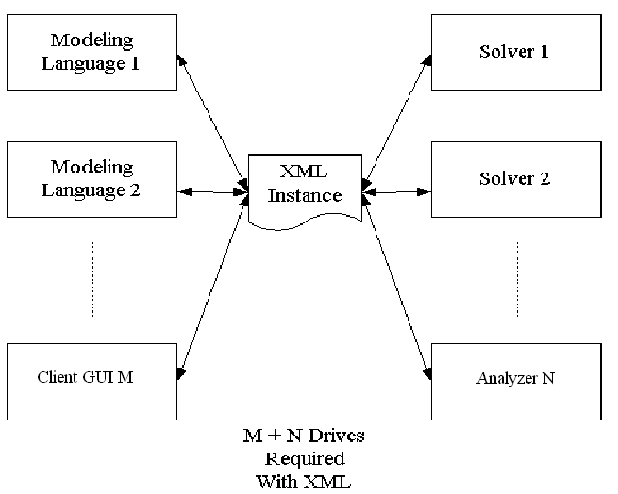
Motivation
For example, it would be nice to have an instance representation language.
This is specified by the Optimization Services instance Language (OSiL)

Slide 5
Introduction
Optimization Services is
A framework, NOT a system
  cf. constitution, NOT government/Court System. Only that the framework specifications are written in XML languages (NOT English).
  But we are in the middle of developing the modeling system according to this framework.
  We are also building libraries for other people to put up their optimization services.
Distributed environment (Local environment being just a special Case)
Service Oriented, Optimization Centered, Decentralized Architecture.

Slide 6
Introduction
Optimization Services Components
  Modeling Language Environment (MLE) (e.g. AMPL, OSmL) -- OSModeler
  Optimization Registries (e.g. The next generation NEOS) – OSRegistry
  Analyzers/Preprocessors (e.g. Mprobe, Dr. AMPL) -- OSAnalyzer
  Optimization Solvers (e.g. Lindo) -- OSSolver
  Simulation (e.g. Finite Element Analysis) -- OSSimulation
  Communication Software Agent – OSAgent
  All of the above are communicating in a common language -- OSCommon

Slide 7
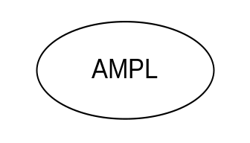
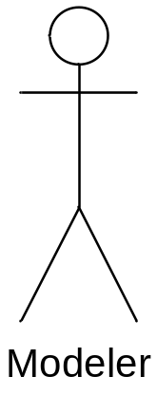
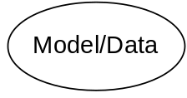
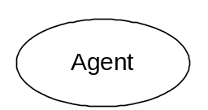
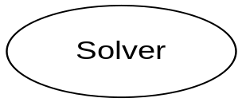
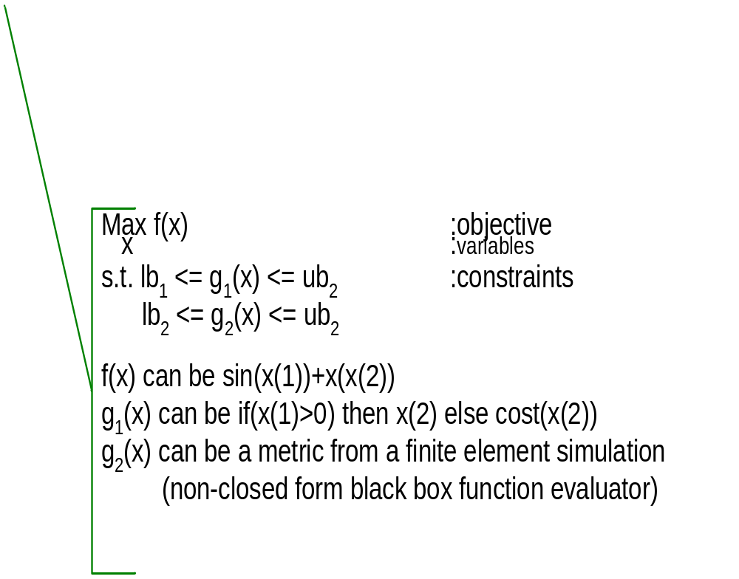
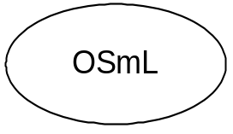

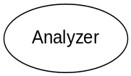
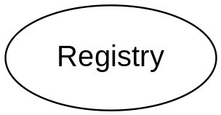
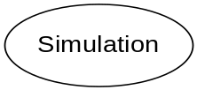
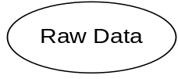
Optimization Services (OS)
THE Optimization Internet
XML-based standard
Web address
html form
browser
http/html
location
Web page
socket
OS
Server
CGI
Parse to OSiL
OSP/ OSxL
Web Server
OS Server
OS Server
HTML Checker
OS Server
Google
Database/ App Service
Data in HTML Form
OSiL – Optimization Services instance Language

Slide 8
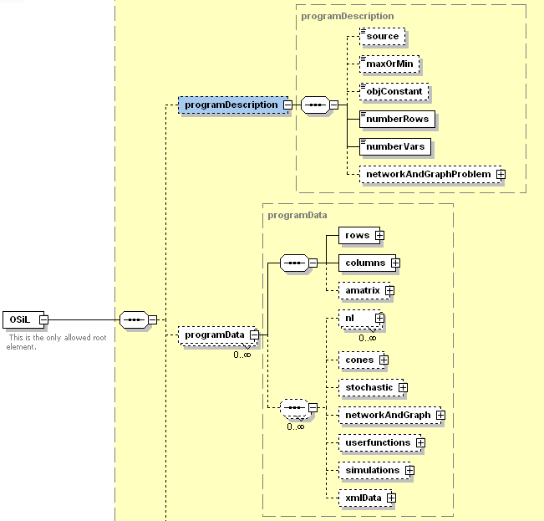
Optimization Services instance Language (OSiL) Schema

Slide 9
OSiL Schema
Nonlinear Expressions and OSnL Schema
  220 Major Nodes (Operators/Operands)
  Arithmetic Operators, Elementary Functions, Statistical and Probability Functions, Constants, Operands, Logic and Relational Operator, Trigonometric Function, Special Elements
  User Defined Functions
  Simulations
  XMLData and xPath Elements
  Quadratic Programming Nodes
OS API (OSiLReader/OSiLWriter) and OS Expression Tree
Connecting to Solvers
All Major Optimization Types Supported

Slide 10
OSiL Schema
-Linear
-Mixed integer
-Bound constrained optimization
-General quadratic optimization
-Nonlinear unconstrained/constrained
-General mixed integer nonlinear
-General nonlinear with user-defined functions
-Global optimization
-General nonlinear with simulations (black-box functions)
-Optimization over simulation/nondifferentiable optimization
-General nonlinear with xml data (either locally within the OSiL or remotely located)
-General nonlinear with data look up (XPath)
-Network and graph definition
-Network programming
-Constraint/logic programming
-Semidefinite programming
-Semi-infinite programming
-Cone programming
-Complementarity problem
-Stochastic linear/nonlinear (distribution problem, distribution based recourse problem, scenario based recourse problem, chance constrained)
-Combinatorial optimization/Heuristic Optimization (TSP, MST, SP, MF, MCF, VRP, Set Covering, Coloring etc. etc.)

Slide 11
Conclusion
Sufficient Motivation for Optimization Services
Optimization Services as the Internet for OR
  Simple
  Scalable
  Standard
  Smooth
An OSxL Example – Optimization Services instance Language
  Cleanly Designed from Scratch
  Highly Extendable
  State-of-art Expression Tree Design
  Supports All Major Optimization Types
  Built for Distributed and Decentralized Systems
  Comes with Natively Designed OSiL APIs (OSiLReader/Writer)
  Already Connected with Solvers

