Slide 1
Optimization Services Instance Language
(OSiL)
Part I
Robert Fourer
Jun Ma
Northwestern University
Kipp Martin
University of Chicago
Jun Ma
maj@northwestern.edu
Industrial Engineering and Management Sciences, Northwestern University
11/22/2004

Slide 2
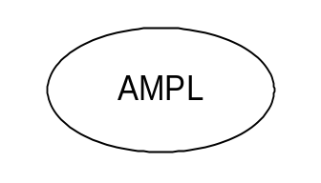
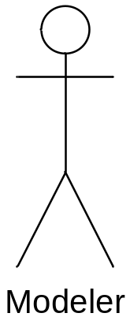
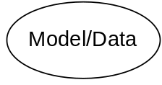
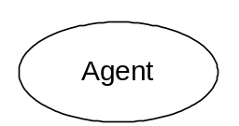
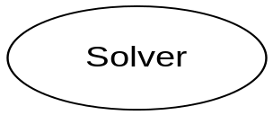
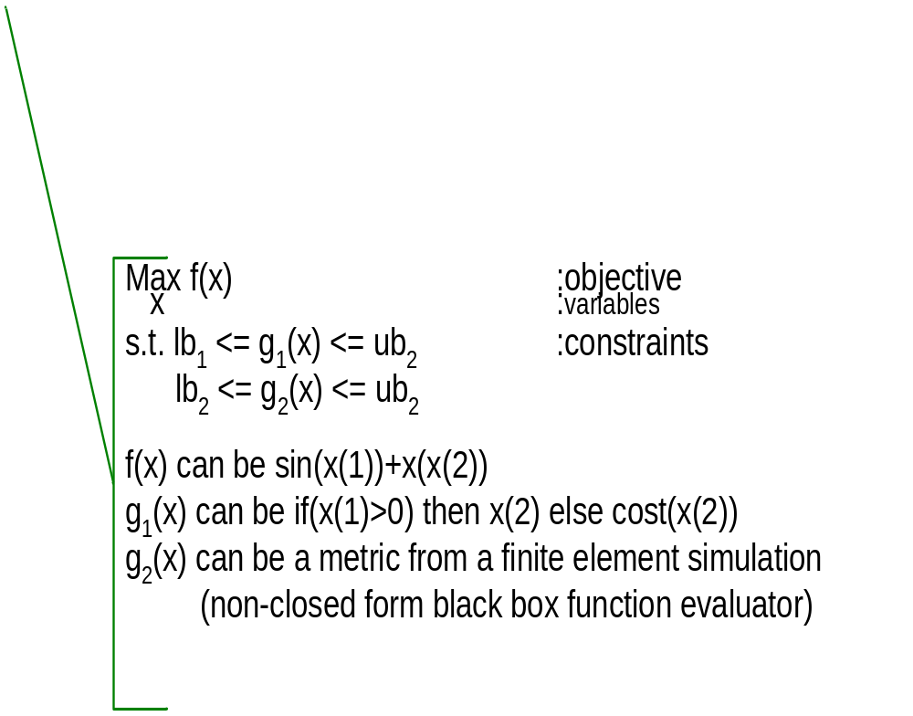
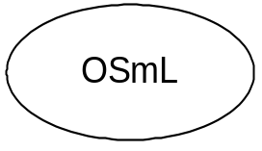
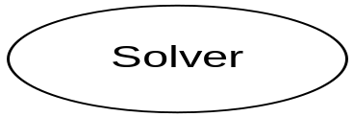
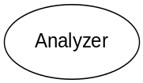
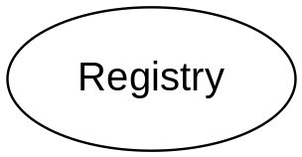
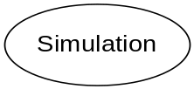
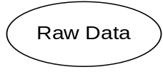
Optimization Services (OS) Framework
THE Optimization Internet
XML-based standard
Web address
html form
browser
http/html
location
Web page
socket
OS
Server
CGI
Parse to OSiL
OSP/ OSxL
Web Server
OS Server
OS Server
HTML Checker
OS Server
Google
Database/ App Service
Data in HTML Form
OSiL – Optimization Services instance Language

Slide 3
OUTLINE
1. Introduction and motivation
2. Model versus Instance
3. Why XML?
4. The OSiL Schema
5. Conclusion

Slide 4
There is a proliferation of modeling languages and solvers
AIMMS | CLP
AMPL | CPLEX
GAMS | GLPK
LINGO | LINDO
OSmL | MINOS
MPL | MOSEK
OPL | Xpress-MP

Slide 5
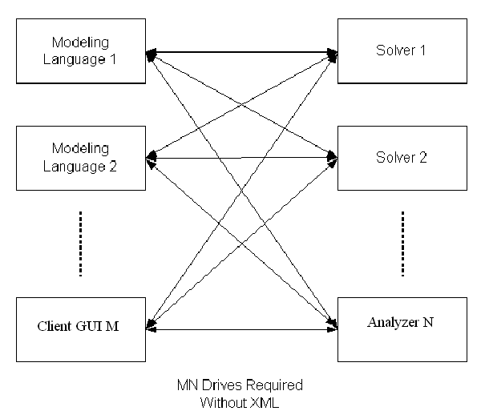
Consequence:
a lot of drivers are need for every modeling language to talk to every solver

Slide 6
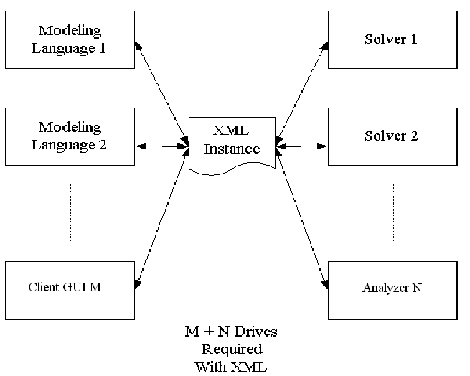
It would be nice to have an instance representation language.

Slide 7
A MODEL
set PROD; # products
set DEP; # processing departments
param hours {DEP}; # time available in each department
param rate {DEP,PROD}; # hours used in each dept per product unit made
param profit {PROD}; # profit per unit of each product made
var Make {PROD} >= 0; # number of units of each product to be made
maximize TotalProfit:
sum {j in PROD} profit[j] * Make[j];
subject to HoursAvailable {i in DEP}:
sum {j in PROD} rate[i,j] * Make[j] <= hours[i];
This is a model. It is symbolic, general, concise,
and understandable (Fourer, 1983).

Slide 8
DATA
param: PROD: profit :=
std 10
del 9 ;
param: DEP: hours :=
cutanddye 630
sewing 600
finishing 708
inspectandpack 135 ;
param: rate: std del :=
cutanddye 0.7 1.0
sewing 0.5 0.8333
finishing 1.0 0.6667
inspectandpack 0.1 0.25 ;

Slide 9
MODEL + DATA = INSTANCE
maximize TotalProfit:
10*Make[‘std’] + 9*Make[‘del’];
subject to HoursAvailable[‘cutanddye’]:
0.7*Make[‘std’] + Make[‘del’] <= 630;
subject to HoursAvailable[‘sewing’]:
0.5*Make[‘std’] + 0.8333*Make[‘del’] <= 600;
subject to HoursAvailable[‘finishing’]:
Make[‘std’] + 0.6667*Make[‘del’] <= 708;
subject to HoursAvailable[‘inspectandpack’]:
0.1*Make[‘std’] + 0.25*Make[‘del’] <= 135;
Objective: represent a model instance using XML.

Slide 10
Why not MPS?
NAME PRODMIX
ROWS
N TPROFIT
L HRSCUT
L HRSSEW
L HRSFIN
L HRSINS
COLUMNS
MAKESTD TPROFIT 10
MAKESTD HRSCUT 0.7 HRSSEW 0.5
MAKESTD HRSFIN 1 HRSINS 0.1
MAKEDEL TPROFIT 9
MAKEDEL HRSCUT 1 HRSSEW 0.8333
MAKEDEL HRSFIN 0.6667 HRSINS 0.25
RHS
RHS1 HRSCUT 630
RHS1 HRSSEW 600
RHS1 HRSFIN 708
RHS1 HRSINS 135
ENDATA

Slide 11
The Case for XML
1. Validation against a schema provides for error checking
2. Validation against a schema promotes stability of a standard
3. The schema can restrict data values to appropriate types, e.g. row
names to string, indices to integer, coefficients to double
4. The schema can define keys to insure, for example, no row or column
name is used more than once.
5. The schema can be extended to include new constraint types or
solver directives
6. There is a lot of open source software to make parsing easy.

Slide 12
XML and Optimization Systems
When instances are stored in XML format, optimization technology
solutions are more readily integrated into broader IT infrastructures
2. XML is used for Web Services – important for distributed computing
3. The XML format lends itself well to compression – more on this later
4. The XML format can be combined with other technologies, e.g.
XSLT to present results in human readable formats
Encryption standards are emerging for XML – possibly important
in a commercial setting.

Slide 13
XML Concepts
XML (Extensible Markup Language) – an XML file contains both data
and Markup (Elements (tags) and Attributes)
The tags are organized in a tree like structure. The closing tag of a
child element preceding the closing tag of its parent.
<rows>
<row rowName=“cutanddye" rowUB="630"/>
<row rowName="sewing" rowUB="600"/>
<row rowName="finishing" rowUB="708"/>
<row rowName="inspectandpack" rowUB="135"/>
</rows>
ELEMENT
ATTRIBUTE

Slide 14
XML Schema Concepts – a Row Class
<xs:element name="rows">
<xs:complexType>
<xs:sequence>
<xs:element name="row" minOccurs="0" maxOccurs="unbounded">
<xs:complexType>
<xs:attribute name="rowName" type="xs:string" use="optional"/>
<xs:attribute name="rowUB" type="xs:double" use="optional"/>
<xs:attribute name="rowLB" type="xs:double" use="optional"/>
<xs:attribute name="mult" type="xs:int" use="optional"/>
</xs:complexType>
</xs:element>
</xs:sequence>
</xs:complexType>
</xs:element>

Slide 15
XML Concepts – a Row Object
<rows>
<row rowName=“cutanddye" rowUB="630"/>
<row rowName="sewing" rowUB="600"/>
<row rowName="finishing" rowUB="708"/>
<row rowName="inspectandpack" rowUB="135"/>
</rows>

Slide 16
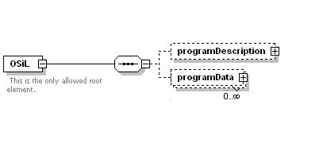
OSiL Schema
General Architecture

Slide 17
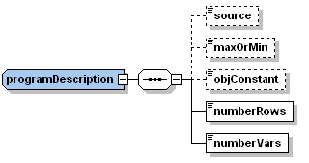
OSiL Schema
Information about the instance
No Information on Solver (OSoL)
*No Meta-Information (OSaL)
No Result Information (OSrL)

Slide 18
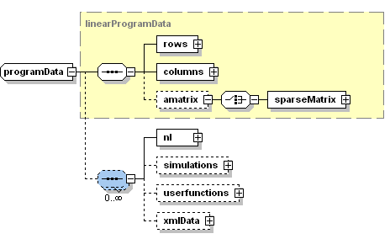
OSiL Schema
2. The instance data
Originates from LPFML

Slide 19
OSiL Schema
2. The instance data (rows and columns)
<rows>
<row rowName="HoursAvailable[‘cutanddye’]" rowUB="630"/>
<row rowName="HoursAvailable[‘sewing’]" rowUB="600"/>
<row rowName="HoursAvailable[‘finishing’]" rowUB="708"/>
<row rowName="HoursAvailable[‘inspectandpack’]" rowUB="135"/>
</rows>
<columns>
<col objVal="10" colName="Make[‘std’]" colType="C" colLB="0.0"/>
<col objVal="9" colName="Make[‘del’]" colType="C" colLB="0.0"/>
</columns>

Slide 20

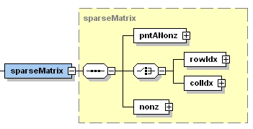
OSiL Schema
2. The instance data (the A matrix)

Slide 21
OSiL Schema
2. The instance data (the A matrix)
<sparseMatrix>
<pntANonz>
<el>2</el><el>4</el>
</pntANonz>
<rowIdx>
<el>1</el><el>2</el>
<el>0</el><el>1</el>
</rowIdx>
<nonz>
<el>1</el><el>2</el>
<el>-3</el><el>4</el>
</nonz>
</sparseMatrix>
0 -3
4
0

Slide 22
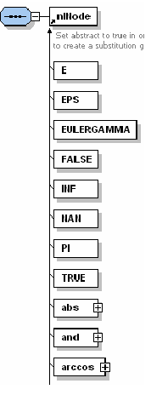
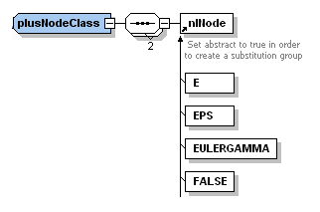
OSiL Schema
3. Extensions

Slide 23
Conclusion and Extension
The libraries are to be open source. Check
http://www.optimizationservices.org
2. Libraries to be licensed under a non-copyleft license
Extensions include Networks, SDP, Quadratic, Complementarity, Stochastic Programming, Constraint/Logic/Combinatorial, General Nonlinear

