Slide 1
Optimization Services (OS) Framework and
OSP Protocols (OSxL)
“Combining Operations Research with Computing Technology”
Robert Fourer
Jun Ma
Northwestern University
Kipp Martin
University of Chicago
Jun Ma
maj@northwestern.edu
10/24/2004
INFORMS Conference, Denver

Slide 2
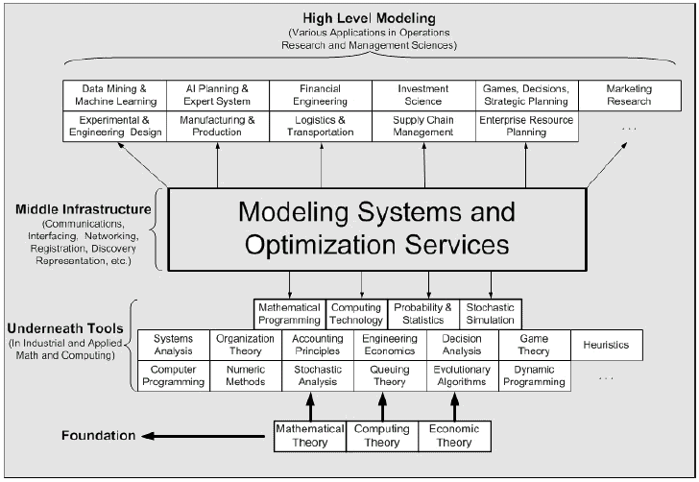
The Positioning of
Optimization Services Framework in OR/MS

Slide 3
The Positioning of
OSP Protocols (OSxL) in Computing
OSP
GET /xt/services/ColorRequest HTTP/1.0
Content Length: 442
Host: localhost
Content-type: text/xml; charset=utf-8
SOAPAction: "/getColor"
Application
Application
SOAP
Presentation
HTTP
Presentation
<soap:Envelope>
<soap:Body>
<soap:Body>
</soap:Envelope>
Session
Session
TCP
Transport
Transport
OSP – specifies soap content
Communication Interface Representation
e.g. hook (“<OSiL> … </OSiL>”)
Network
Network
IP
Link
Link
Ethernet
Physical
Physical
The 7-layer OSI Model
The 4-layer Internet model

Slide 4
Optimization Services (OS) Framework
A framework, NOT a system
  cf. constitution, NOT government/Court System. Only that the framework specifications are written in XML languages (NOT English).
  cf. DOM/SAX, NOT Xerces, Crimson, or other real implementations/providers.
  But we are in the middle of developing the modeling system according to this framework.
  We are also building libraries for other people to put up their optimization services.
Distributed environment (Local environment being just a special Case)
Service Oriented Decentralized Architecture (Registry NOT Server).
Optimization Services Components
  Modeling Language Environment (MLE) (e.g. AMPL, OSmL) -- OSModel
  Optimization Registries (e.g. The next generation NEOS) – OSRegistry
  Analyzers/Preprocessors (e.g. Mprobe, Dr. AMPL) -- OSAnalyzer
  Optimization Solvers (e.g. Lindo) -- OSSolver
  Simulation (e.g. Finite Element Analysis) -- OSSimulation
  Communication Software Agent – OSAgent
  All of the above are communicating in a common language -- OSCommon

Slide 5
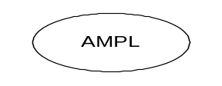


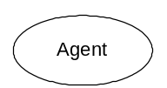


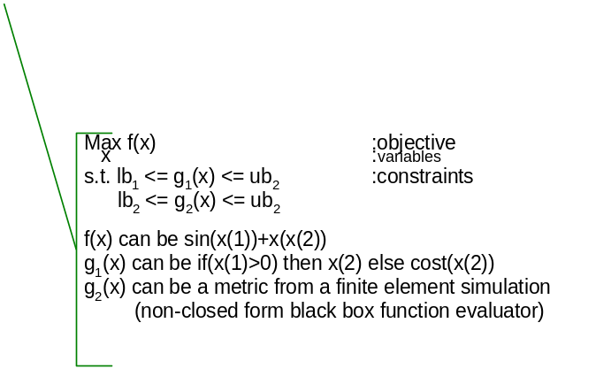





Optimization Services (OS) Framework
The next generation NEOS
THE Optimization Internet
the Universal distributed/local COIN for OR
XML-based standard
location
Web Service Server
hook
(instance)
OShL
(OSiL)
Parse to OSiL
(result)
(OSrL)
Invoke
(instance)
(analysis)
Join
(Entity Description)
Call
(in/out)
OSjL
(OSeL)
OScL
(OSsL)
OShL
(OSiL)
(OSaL)
Web Service Server
Discover
(query)
Web Service Server
OSdL
(OSqL)
URL
Flow (OSfL)
(OSuL)
Web Service Server
[Standard, Simple, Scalable] => Smooth
The General and Universal Framework for Optimization in Local and Distributed Environment.
Combining Optimization with Modern Computing Technologies.
A Next Generation Modeling System as An Internet Resource.
Standardization of Optimization Representation, Communications, Registration, and Discovery
Using Optimization Computing Tools Just Like Daily Utility Services.

Slide 6
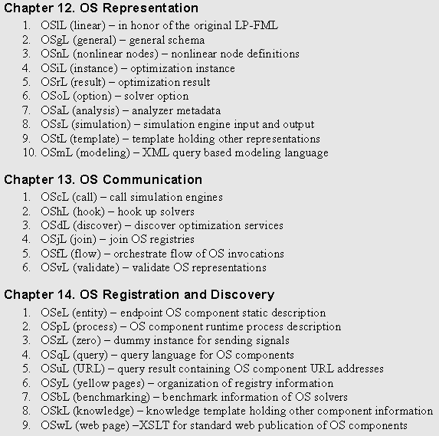

Slide 7
User Experience Movement
Open Environment
Convenience just like Using Utility Services
No High Computing Power Needed
No Knowledge in Optimization Algorithms and Software (solvers, options, etc.)
Better and More Choices of Modeling Languages
More Solver Choices
Solve More Types of Problems
Automatic Optimization Services Discovery
Decentralized Optimization Services Development and Registration
More Types of Optimization Services Components Integrated (Analyzers/Preprocessors, Problem Providers, Bench Markers)
Smooth Flow and Coordination of Various Optimization Services Components.
A University, Scalable and Standard Infrastructure that promotes Collaboration and Other Related Researches
Concentration on Good Modeling

Slide 8
Why Not MathML
"Need." Content MathML includes more than we need in the OR/MS community. If an instance unintentionally includes these features which shouldn't be allowed, MathML DTD or Schema would still validate while none of the solvers would ever recognize such features.
"Design." OSnL has a very consistent recursive design There is also a one -to-one correspondence between each node element in the expression tree and each node class in the parsing library. Content MathML cannot achieve the consistency because it has to tailor to general needs. The <apply> element in Content MathML consistently result in lengthier representation of nonlinear functions than OSiL.
"Specialty" We have all the special features such as XPath node, user functions and parameters, variable subscripts supported. Content MathML can work around some, but in awkward ways.
"Level." There is a reason that Content MathML is not called "Computation MathML." MathML is at a different level of the "bottom", maybe higher because it's still intended for "symbolic" content representation. Content MathML is a content-faithful transformation from the high level in that Content MathML retains original content. OSiL may be more appropriately called "Computation MathML." For example OSiL does substitution for high level identifiers and it's a "numerical instance" at the bottom, which no longer retains all the information of the original model.
"Control." The OR community does not have control over the design of MathML. Certain features that are critical in optimization may not be "naturally" built or not supported at all in MathML. As long as one feature is not supported at all in Content MathML, we should not adopt it.
"Flexibility." We can embed MathML in OSnL and OSiL, while MathML does not embed OSxL.
"Optimization." Critical optimization related information are treated more importantly than other general math information.

