Slide 1
Applied stochastic programming models and computation
H.I. Gassmann
Dalhousie University

Slide 2
Outline
Introduction to stochastic programming
Scope of study
Results

Slide 3
Milestones in stochastic programming
1955 – First models and algorithms (Dantzig; Beale)
1956 – Airline scheduling problem (Ferguson and Dantzig)
1959 – Chance-constrained programming (Charnes and Cooper)
1969 – L-shaped method (van Slyke and Wets)
1984 – Nested Benders decomposition (Birge)
1989 – Russell Yasuda Kasai model (Cariño et al.)
1995 – OSL/SE (IBM)
2003 – van der Vlerk’s on-line bibliography on SP contains 3840 entries
2006 – EURO application prize (Zenios et al.)

Slide 4
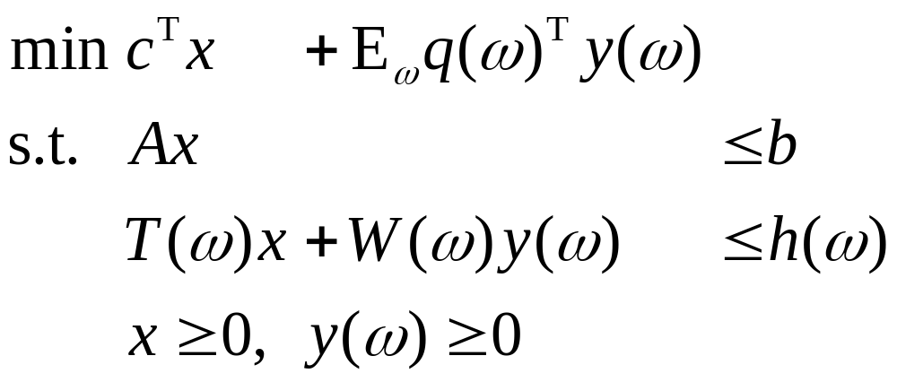
Two-stage recourse model

Slide 5
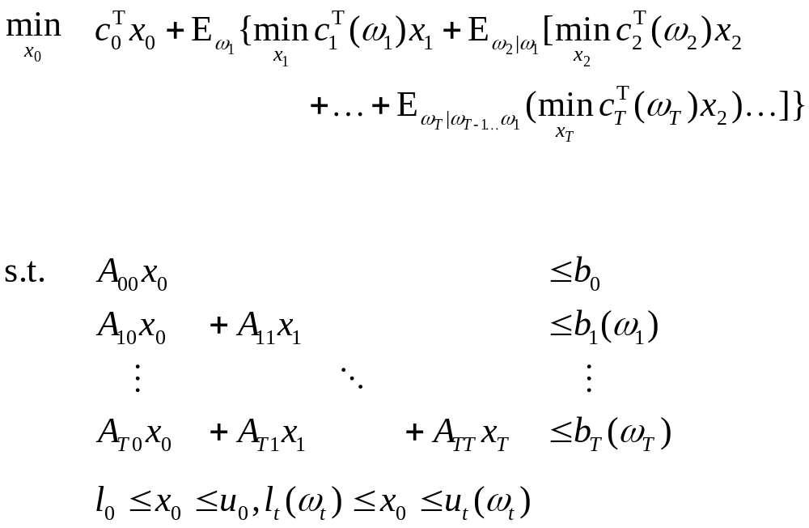
Multistage recourse model

Slide 6
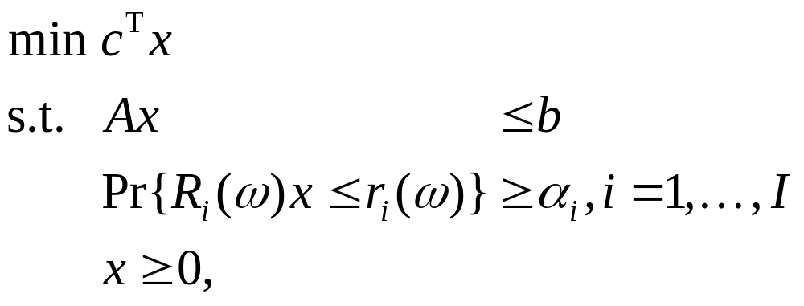
Chance-constraint model

Slide 7
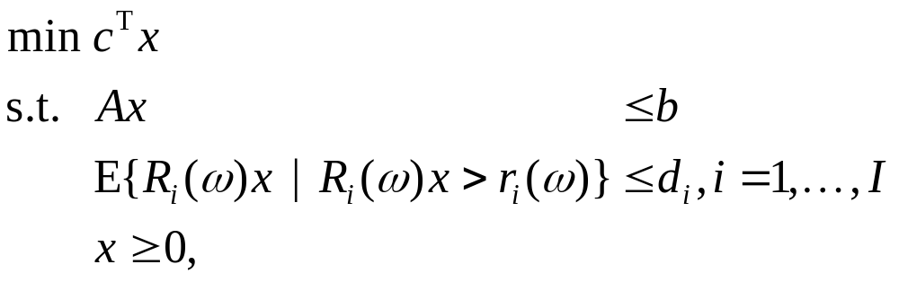
Integrated chance-constraints

Slide 8
Scope of the study
Included
  Applications and novel models
  Computational papers
  All types of stochastic programs
  Illustrative and “industrial-strength” models
Not included
  Theoretical papers
  New algorithms for old models
  Randomly generated problems

Slide 9
The sources
Research bibliographies
  Stancu-Minasian and Wets (1976)
  P. Birge (1984)
  Van der Vlerk (2003)
Citation indexes
Online searches
Result: 144 models

Slide 10
Papers by year
Decade | Number
1956-1965 | 2
1966-1975 | 13
1976-1985 | 26
1986-1995 | 31
1996-2005 | 72
Total | 144

Slide 11
Papers by application area
Application | Number of Problems
Finance | 30
Energy planning | 16
Scheduling | 14
Water management | 12
Capacity expansion | 9
Agriculture/Fishery/Forestry | 8
Transportation | 8
Operations Management | 8
Supply chain management | 7
Blending problems | 4
Telecommunications | 3
Other | 27

Slide 12
How published?
Source | Number of Problems
Operations Research | 12
Management Science | 11
Annals of Operations Research | 6
European Journal of Operational Research | 6
Mathematical Programming | 4
Other journal | 56
Book / collection | 26
SPEPS | 8
Other web source | 4
Technical report | 4

Slide 13
Features
Feature | Number of problems
Random RHS | 94
Random Cost | 52
Random Bounds | 1
Random Subdiagonal Blocks | 41
Random Blocks on Diagonal | 39
Linking Constraints | 2
Integer Variables | 26
Chance Constraints | 34
Integrated Chance Constraints | 3

Slide 14
Features by decade
Feature | ‘56- ’65 | ‘66- ’75 | ‘76- ’85 | ‘86- ’95 | ‘96- ’05
Random RHS | 2 | 9 | 22 | 17 | 44
Random Cost | 1 | 2 | 3 | 11 | 35
Random Bounds | 0 | 1 | 0 | 0 | 0
Random Subdiagonal Blocks | 0 | 2 | 3 | 14 | 22
Random Blocks on Diagonal | 0 | 4 | 3 | 12 | 20
Linking Constraints | 1 | 5 | 16 | 23 | 46
Integer Variables | 0 | 0 | 0 | 0 | 2
Chance Constraints | 1 | 4 | 12 | 5 | 12
Integrated Chance Constraints | 0 | 0 | 0 | 0 | 3

Slide 15
Number of stages
Number of stages | Number of problems
Single stage | 29
Two-stage | 41
Multistage | 75
Staircase | 51
Non-staircase | 24

Slide 16
Number of stages per decade
Number of stages | ‘56- ‘65 | ‘66- ’75 | ‘76- ‘85 | ‘86- ‘95 | ‘96- ‘05
Single stage | 0 | 5 | 7 | 4 | 13
Two stages | 1 | 5 | 4 | 10 | 21
Multiple stages | 1 | 3 | 18 | 16 | 37
Staircase | 0 | 1 | 12 | 12 | 26
Non-staircase | 1 | 2 | 6 | 4 | 11

Slide 17
Scope of the application
Scope | Number of problems
Serious application | 21
Academic model | 55
Illustrative example | 53
Toy problem | 6

Slide 18
Conclusions
SP applications are getting more numerous
Finance applications dominate
Considerable breadth of other applications

