Slide 1
LPFML: A W3C XML Schema for
Linear and Integer Programming
Robert Fourer
Northwestern University
4er@iems.northwestern.edu
Leonardo Lopes
University of Arizona
leo@sie.arizona.edu
Kipp Martin
University of Chicago
kipp.martin@gsb.uchicago.edu
Denver INFORMS 2004

Slide 2
OUTLINE
1. Introduction and motivation
2. Model versus Instance
3. Why XML?
4. The LPFML Schema
5. Compression
6. The libraries
7. Testing under loosely and tightly coupled scenarios
8. The license

Slide 3
There is a proliferation of modeling languages
and solvers
AIMMS | CLP
AMPL | CPLEX
GAMS | GLPK
LINGO | LINDO
Mosel | MINOS
MPL | MOSEK
OPL | Xpress-MP

Slide 4
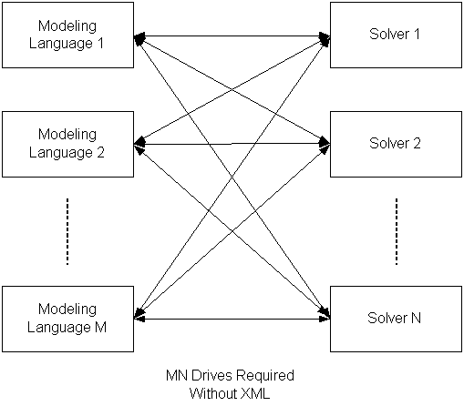
Consequence: a lot of drivers are need for every
modeling language to talk to every solver

Slide 5
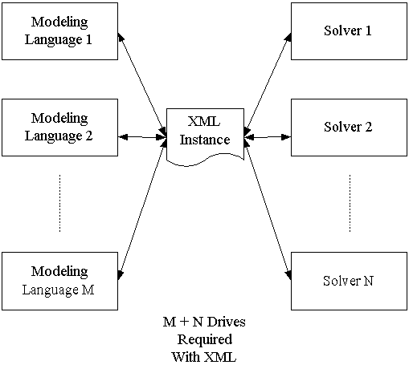
It would be nice to have an instance representation
language.

Slide 6
A MODEL
set PROD; # products
set DEP; # processing departments
param hours {DEP}; # time available in each department
param rate {DEP,PROD}; # hours used in each dept per product unit made
param profit {PROD}; # profit per unit of each product made
var Make {PROD} >= 0; # number of units of each product to be made
maximize TotalProfit:
sum {j in PROD} profit[j] * Make[j];
subject to HoursAvailable {i in DEP}:
sum {j in PROD} rate[i,j] * Make[j] <= hours[i];
This is a model. It is symbolic, general, concise,
and understandable (Fourer, 1983).

Slide 7
DATA
param: PROD: profit :=
std 10
del 9 ;
param: DEP: hours :=
cutanddye 630
sewing 600
finishing 708
inspectandpack 135 ;
param: rate: std del :=
cutanddye 0.7 1.0
sewing 0.5 0.8333
finishing 1.0 0.6667
inspectandpack 0.1 0.25 ;

Slide 8
MODEL + DATA = INSTANCE
maximize TotalProfit:
10*Make[‘std’] + 9*Make[‘del’];
subject to HoursAvailable[‘cutanddye’]:
0.7*Make[‘std’] + Make[‘del’] <= 630;
subject to HoursAvailable[‘sewing’]:
0.5*Make[‘std’] + 0.8333*Make[‘del’] <= 600;
subject to HoursAvailable[‘finishing’]:
Make[‘std’] + 0.6667*Make[‘del’] <= 708;
subject to HoursAvailable[‘inspectandpack’]:
0.1*Make[‘std’] + 0.25*Make[‘del’] <= 135;
Objective: represent a model instance using XML.

Slide 9
Why not MPS?
NAME PRODMIX
ROWS
N TPROFIT
L HRSCUT
L HRSSEW
L HRSFIN
L HRSINS
COLUMNS
MAKESTD TPROFIT 10
MAKESTD HRSCUT 0.7 HRSSEW 0.5
MAKESTD HRSFIN 1 HRSINS 0.1
MAKEDEL TPROFIT 9
MAKEDEL HRSCUT 1 HRSSEW 0.8333
MAKEDEL HRSFIN 0.6667 HRSINS 0.25
RHS
RHS1 HRSCUT 630
RHS1 HRSSEW 600
RHS1 HRSFIN 708
RHS1 HRSINS 135
ENDATA

Slide 10
The Case for XML
1. Validation against a schema provides for error checking
2. Validation against a schema promotes stability of a standard
3. The schema can restrict data values to appropriate types, e.g. row
names to string, indices to integer, coefficients to double
4. The schema can define keys to insure, for example, no row or column
name is used more than once.
5. The schema can be extended to include new constraint types or
solver directives
6. There is a lot of open source software to make parsing easy.

Slide 11
XML and Optimization Systems
When instances are stored in XML format, optimization technology
solutions are more readily integrated into broader IT infrastructures
2. XML is used for Web Services – important for distributed computing
3. The XML format lends itself well to compression – more on this later
4. The XML format can be combined with other technologies, e.g.
XSLT to present results in human readable formats
Encryption standards are emerging for XML – possibly important
in a commercial setting.

Slide 12
XML Concepts
XML (Extensible Markup Language) – an XML file contains both data
and Markup (Elements (tags) and Attributes)
The tags are organized in a tree like structure. The closing tag of a
child element preceding the closing tag of its parent.
<rows>
<row rowName=“cutanddye" rowUB="630"/>
<row rowName="sewing" rowUB="600"/>
<row rowName="finishing" rowUB="708"/>
<row rowName="inspectandpack" rowUB="135"/>
</rows>
ATTRIBUTE
ELEMENT

Slide 13
XML Concepts
Key idea – a schema. Similar to the concept of a class in
object orient programming.
Schema
Class
XML File
Object
We need a schema to represent an instance.

Slide 14
XML Concepts – a Row Class
<xs:element name="rows">
<xs:complexType>
<xs:sequence>
<xs:element name="row" minOccurs="0" maxOccurs="unbounded">
<xs:complexType>
<xs:attribute name="rowName" type="xs:string" use="optional"/>
<xs:attribute name="rowUB" type="xs:double" use="optional"/>
<xs:attribute name="rowLB" type="xs:double" use="optional"/>
<xs:attribute name="mult" type="xs:int" use="optional"/>
</xs:complexType>
</xs:element>
</xs:sequence>
</xs:complexType>
</xs:element>

Slide 15
XML Concepts – a Row Object
<rows>
<row rowName=“cutanddye" rowUB="630"/>
<row rowName="sewing" rowUB="600"/>
<row rowName="finishing" rowUB="708"/>
<row rowName="inspectandpack" rowUB="135"/>
</rows>

Slide 16
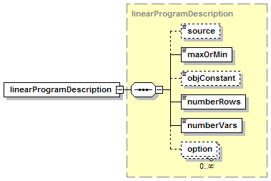
LPFML Schema
1. Information about the instance

Slide 17
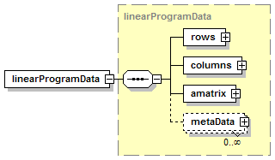
LPFML Schema
2. The instance data

Slide 18
LPFML Schema
2. The instance data (rows and columns)
<rows>
<row rowName="HoursAvailable[‘cutanddye’]" rowUB="630"/>
<row rowName="HoursAvailable[‘sewing’]" rowUB="600"/>
<row rowName="HoursAvailable[‘finishing’]" rowUB="708"/>
<row rowName="HoursAvailable[‘inspectandpack’]" rowUB="135"/>
</rows>
<columns>
<col objVal="10" colName="Make[‘std’]" colType="C" colLB="0.0"/>
<col objVal="9" colName="Make[‘del’]" colType="C" colLB="0.0"/>
</columns>

Slide 19

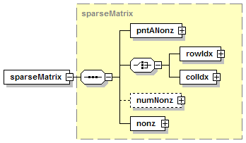
LPFML Schema
2. The instance data (the A matrix)

Slide 20
LPFML Schema
2. The instance data (the A matrix)
<sparseMatrix>
<pntANonz>
<el>2</el><el>4</el>
</pntANonz>
<rowIdx>
<el>1</el><el>2</el>
<el>0</el><el>1</el>
</rowIdx>
<nonz>
<el>1</el><el>2</el>
<el>-3</el><el>4</el>
</nonz>
</sparseMatrix>
0 -3
4
0

Slide 21
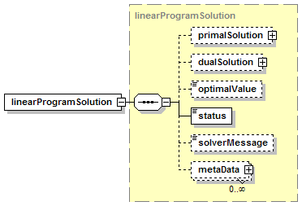
LPFML Schema
3. Information about the solution

Slide 22
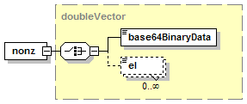
Compression – Base 64
<nonz>
<el>.7</el><el>.5</el>
<el>1.0</el><el>0.1</el>
<el>1.0</el><el>0.8333</el>
<el>0.6667</el><el>0.25</el>
</nonz>
<nonz>
<base64BinaryData numericType="double" sizeOf="8">
ZmZmZmZm5j8AAAAAAADgPwAAAAAAAPA/mpmZmZmZuT8AAAAAA
ADwP7U3+MJkquo/S8gHPZtV5T8AAAAAAADQPw==</base64BinaryData>
</nonz>

Slide 23
Compression – Structural
Min x1 + x2 + x3 + x4 + x5 + x6
s.t.
x1 + x2 >= 1
x1 + x2 + x6 >= 1
+ x3 + x4 >= 1
+ x3 + x4 + x5 >= 1
+ x4 + x5 + x6 >= 1
+ x2 + x5 + x6 >= 1
<nonz><el mult=“16”>1</el></nonz>
<rowIdx>
<el>0</el><el>1</el><el>0</el><el>1</el>
<el>5</el><el>2</el><el>3</el>
<el mult="3" incr="1">2</el>
<el mult="3" incr="1">3</el>
<el>1</el><el>4</el><el>5</el>
</rowIdx>

Slide 24
The LPFML Libraries
A set of open source libraries for reading and writing LP instances
in XML format.
Objective: hide all of the parsing and writing of XML in the library
Corollary: library users should only have to deal with optimization
concepts such as objectives, constraints, etc.
Objective: allow changes and extensions to the schema without
any solver or modeling language code to be rewritten

Slide 25
The LPFML Libraries - Parsing
Current C++ library based on SAX (Simple API for XML).
Our libraries use the Apache Xerces libraries.
Key classes are FMLHandler and FMLParser.
FMLHandler inherits from SAX2 ContentHandler.
The FMLHandler “gets the data” from the XML file when elements
and attributes are read.

Slide 26
The LPFML Libraries - Parsing
FMLParser is solver independent. It instantiates an FMLHandler
Object and passes to the constructor an FMLParser object.
handler = new FMLHandler(this, encodingName, expandNamespaces)
Provides numerous “dummy” methods:
onVariableCount(),
onObjectiveSense(),
onAMatrix(),
etc
The handler object calls these methods when reading elements
and attributes.

Slide 27
The LPFML Libraries - Parsing
It is up to the user to implement their own solver specific FMLParser
class. For example, in FMLLINDOParser we have
void FMLLINDOParser::onObjectiveSense(const bool isMin)
{
if(isMin) nDir_ = LS_MIN;
else nDir_ = LS_MAX;
// make sure objConstant_ gets initialized
objConstant_ = 0.;
}
There is no XML involved in writing the solver specific FMLParser
that inherits from the FMLParser. It is hidden from the solver
developer.

Slide 28
The LPFML Libraries - Parsing
Current open source FMLParses include:
OSI/COIN
LINDO
FORTMP
lp_solve (coming soon)
OSI/COIN – low level API for solvers. If a solver supports OSI/COIN
they can read FML. For example, CLP and GLPK.

Slide 29
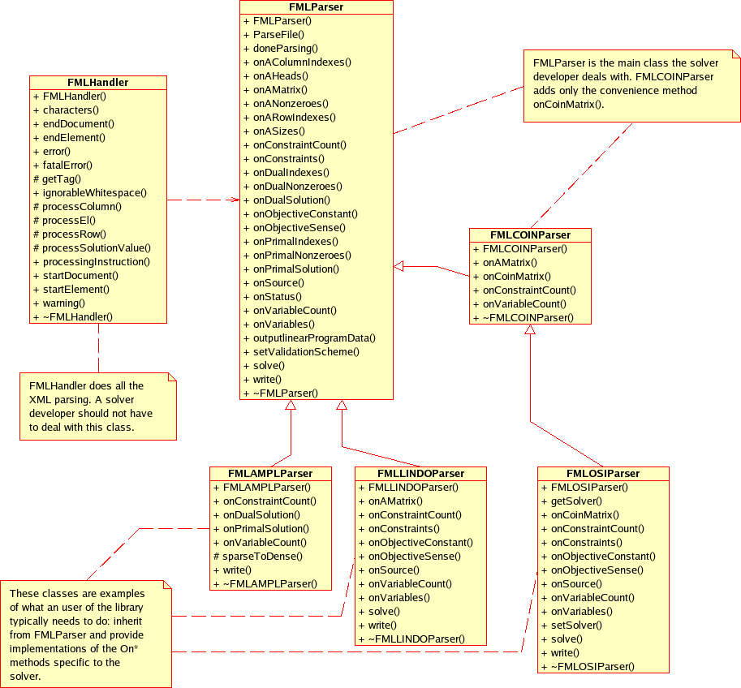
The LPFML Libraries - Parsing

Slide 30
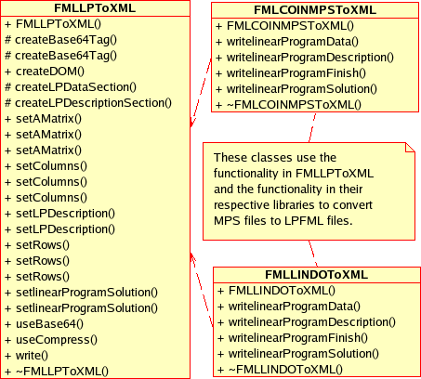
The LPFML Libraries - Writing

Slide 31
LPFML - Testing
Basic scenarios:
Tightly coupled scenario where modeling system and solver
communicate directly with each other on same machine.
Performance important here.
Loosely coupled environments where modeling system and solver
on different machines. File size important here.
3. Pre and post-processing environments. Flexibility key here.

Slide 32
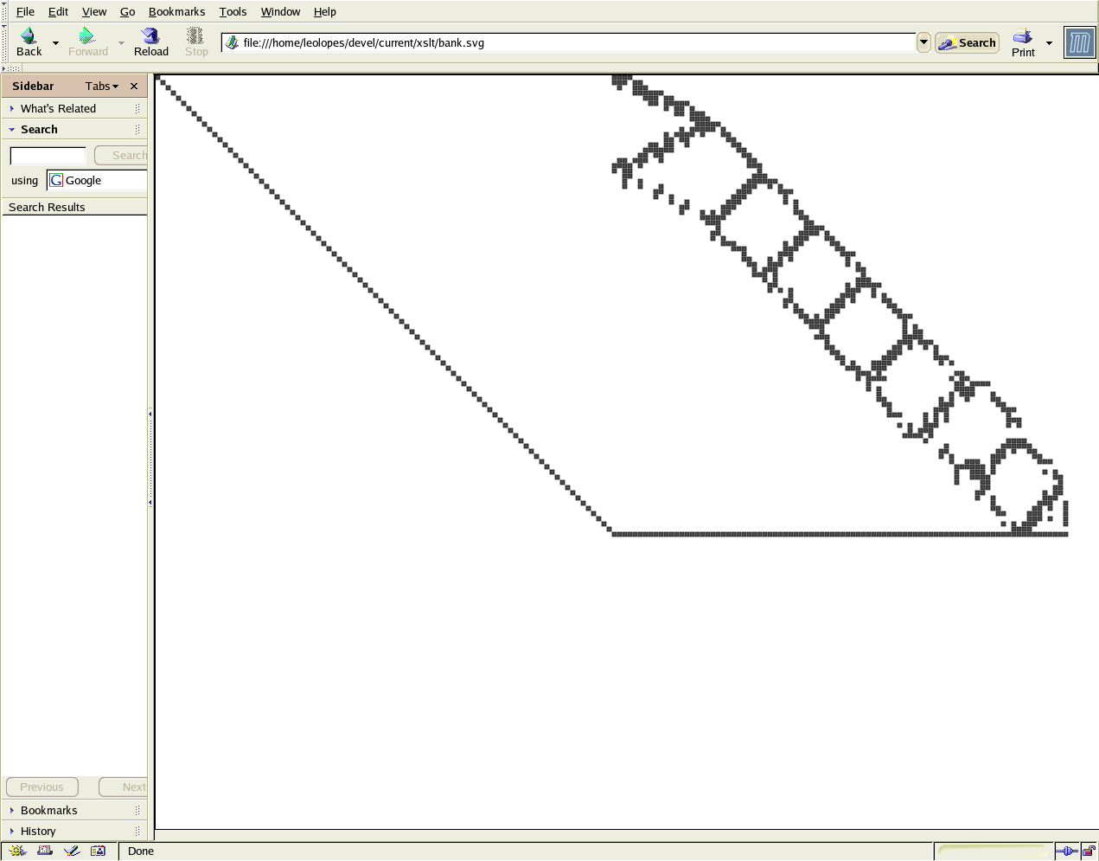
Scenario – Pre and Post Processing

Slide 33
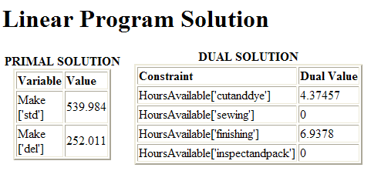
Scenario – Pre and Post Processing

Slide 34
Conclusion and Extension
The libraries are open source. See
http://gsbkip.chicagogsb.edu/fml/fml.html
2. Libraries licensed under a non-copyleft license
Obvious extensions in the linear area include networks, SOS,
quadratic, and stochastic programming.
For more general extensions into nonlinear and optimizaton
services framework see Jun Ma (SB16.4), “A Unified XML-Based
Framework for Optimization Services.”

