Slide 1
Extensions to the OSiL schema: Matrix and cone programming
Horand I. Gassmann, Dalhousie University
Jun Ma, Kipp Martin, Imre Polik
Notes:
Abstract:
A lot of attention has been given recently to cone programming and matrix programming, using, for instance, relaxations of hard mixed integer programs using variables whose values are required to form symmetric positive semidefinite matrices or satisfy similar cone constraints. This talk presents efforts to facilitate the formulation of such problems within the OSiL framework, an XML schema used to allow a unified representation format for a large variety of mathematical optimization problem instances. OSiL is part of the OS project, an open source project under the COIN-OR umbrella.

Slide 2
Outline
Matrices and optimization
Optimization Services
OSiL (Optimization Services instance Language)
Cone and matrix programming
Extensions to OSiL
Matrices
Cones
Matrix programming
OS and CSDP

Slide 3
Matrices in optimization
Coefficient matrices in linear programming
Jacobian and Hessian matrices, gradient vectors
Matrix variables in positive semidefinite programming
Formats for sparse matrix representations
Harvard format (starts, indices and values)
MPS, CPLEX LP format
SDP format
Static (real) values only, even SDP result format

Slide 4
Cone and matrix programming
Constraints (and objectives) expressed in terms of cones
Second order cones
Cones of positive semidefinite matrices
Orthant cones (linear cones)
Cones of nonnegative polynomials (over some interval)
Solvers: CSDP, SeDuMi, Mosek, Cplex, Gurobi, FICO
Unified treatment within the Optimization Services framework

Slide 5
Sample problems
Second order cone program
Semidefinite program

Slide 6
CSDP
Open-source project (COIN-OR)
Solves
Assumes A_{i}, C, X are real and symmetric
: positive semidefinite

Slide 7
Optimization Services
Framework for optimization in a distributed computing environment
XML schemas for communicating instances, options, results, …
Implementation (COIN-OR project OS)
OSSolverService
OSAmplClient
OSServer
callable library
Notes:
Framework in computer science sense: a collection of patterns
A pattern is a repeatable application of concrete steps
e.g. optimization: modeling (instance generation) – solver – solution report

Slide 8
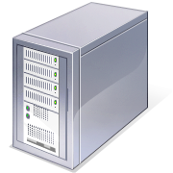


Solvers
Data inter-change
User interface
AML
Corporate databases

Slide 9
“Core” OS and OSiL
Problems handled
Linear programs
Integer programs
MILP
Convex NLP
Discrete NLP
Nonconvex NLP
Available solvers
Clp
Cbc
SYMPHONY
Ipopt
Bonmin
Couenne
Glpk
Cplex
Gurobi
Mosek

Slide 10
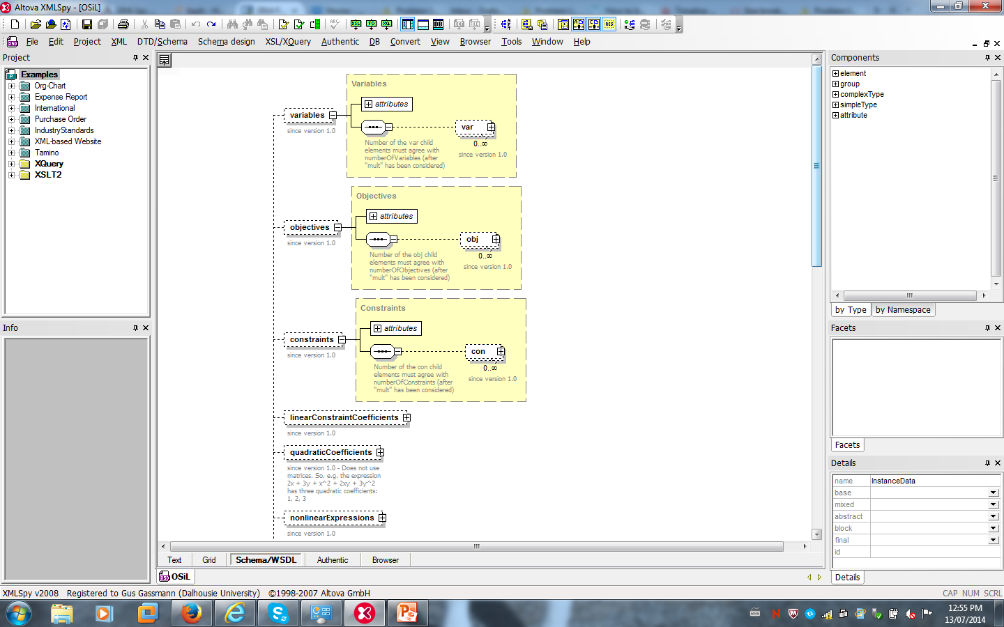
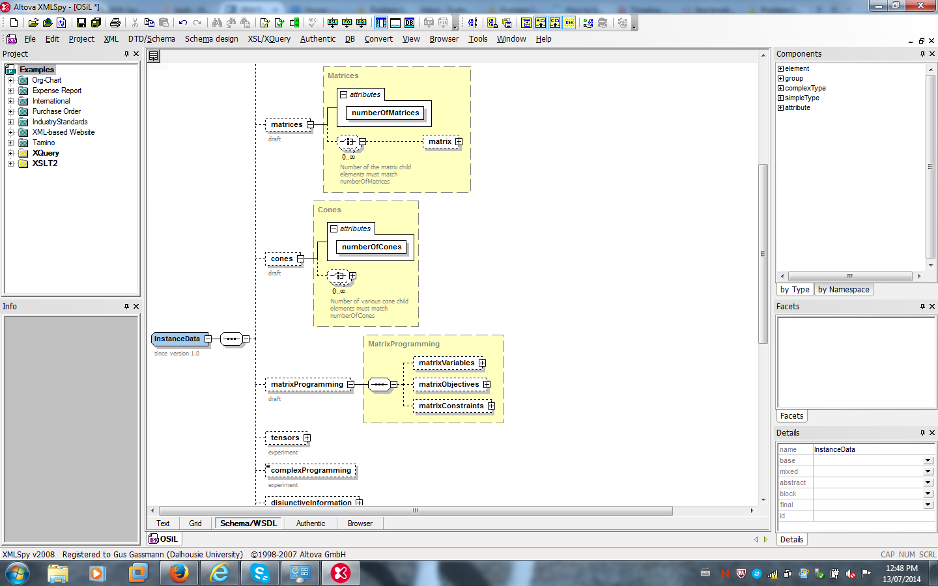
“Core” OSiL elements
Variable types (C,I,B)
Upper and lower bounds
Possibly multi-objective
Maximize or minimize
Linear objective coefficients
Upper and lower bounds

Slide 11
Requirements and challenges
Cone inclusions, e.g.,
X is symmetric, positive semidefinite
Ax lies in the rotated quadratic cone RC(1,2;3..n)
Matrix expressions, e.g.,
AXB + BXA
trace A^{T}X
What does a linear matrix expression look like?

Slide 12
Design principles
Preserve core
Be as general as possible
Respect sparsity
Avoid painting yourself into corners
New constructs
<matrix>
<cone>
<matrixProgramming>

Slide 13
OSiL and matrices
Constant matrices
Matrix variables X (or ?)
General matrices (e.g., Hessian, Jacobian, etc.)
Symmetry
Sparsity
Block structure
Matrix construction, e.g., A = a a^{T}
One matrix type or several?

Slide 14
OSiL: Matrix and cone extensions

Slide 15
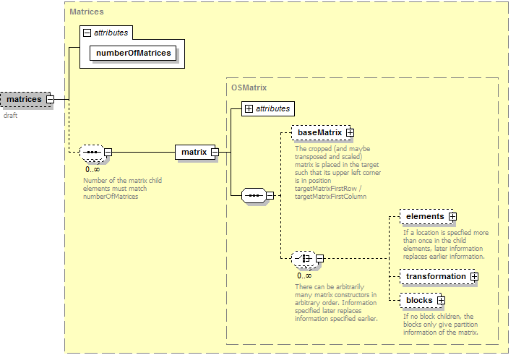
The <matrices> element

Slide 16
Example 1 – elements
<matrices numberOfMatrices= "4">
<matrix numberOfRows="2" numberOfColumns="1">
<elements>
<constantElements numberOfEl="2">
<start>
<el> 0 </el> <el> 2 </el>
</start>
<indexes>
<el> 0 </el> <el> 1 </el>
</indexes>
<values>
<el> 1 </el> <el> 2 </el>
</values>
</constantElements>
</elements >
</matrix>

Slide 17
Example 2 - transformation
<matrix numberOfRows="2" numberOfColumns="2">
<transformation>
<matrixTimes>
<matrix matrixIdx="0"/>
<matrixTranspose>
<matrix matrixIdx="0"/>
</matrixTranspose>
</matrixTimes>
</transformation>
</matrix>

Slide 18
Example 3 - blocks
<matrix numberOfRows="3" numberOfColumns="4">
<blocks numberOfBlocks="2">
<colOffsets numberOfEl="3">
<el>0</el> <el>2</el> <el>4</el>
</colOffsets>
<rowOffsets numberOfEl="3">
<el>0</el> <el>2</el> <el>3</el>
</rowOffsets>
<block blockRowIdx="0" blockColIdx="0">
<baseMatrix baseMatrixIdx="1"/>
</block>
<block blockRowIdx="1" blockColIdx="1">
<baseMatrix baseMatrixIdx="0" baseTranspose="true" scalarMultiplier="-3"/>
</block>
</blocks>
</matrix>

Slide 19
Example 4 – base matrix
<matrix numberOfRows="5" numberOfColumns="5">
<baseMatrix
baseMatrixIdx="2"
baseMatrixFirstRow="0"
baseMatrixFirstCol="0"
baseMatrixLastRow="2"
baseMatrixLastCol="2"
baseTranspose="false"
scalarMultiplier="1.0"
targetMatrixFirstRow="1"
targetMatrixLastRow ="1"
/>
</matrix>

Slide 20
Example 5 – variable references
<matrix numberOfRows="2" numberOfColumns="2" symmetry="lower">
<elements>
<varReferenceElements numberOfEl="3">
<start>
<el> 0 </el> <el> 2 </el> <el> 3 </el>
</start>
<indexes>
<el> 0 </el> <el> 1 </el> <el> 1 </el>
</indexes>
<values>
<el mult="3" incr="1"> 0 </el>
</values>
</varReferenceElements >
</elements >
</matrix>

Slide 21
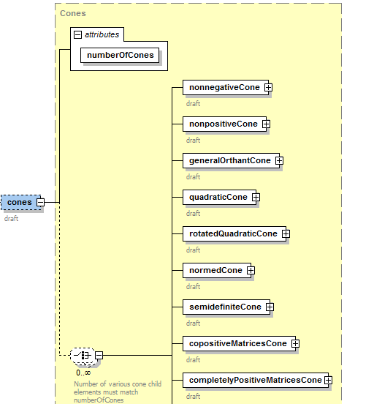
The <cones> element
…

Slide 22
The <cones> element - Example
<cones numberOfCones="4">
<nonnegativeCone numberOfRows= "2" numberOfColumns= “2"/>
<quadraticCone numberOfRows= "4" numberOfColumns= "1"/>
<semidefiniteCone numberOfRows= "2" numberOfColumns= "2"/>
<nonnegativePolynomialsCone maxDegree="4"
numberOfRows= "2" numberOfColumns= "1"/>
<intersectionCone numberOfRows= "2" numberOfColumns= “2">
<components numberOfEl="2“>
<el>2</el> <el>0</el>
</components>
</intersectionCone>
</cones>
Cone of nonneg. poly. in two variables
Cone of symmetric positive semidefinite 2x2 matrices with nonnegative entries

Slide 23
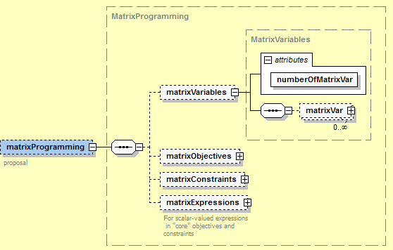
<matrixProgramming>

Slide 24
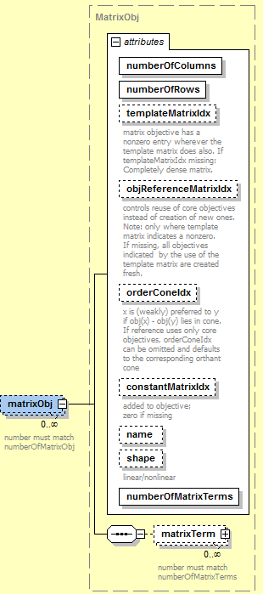
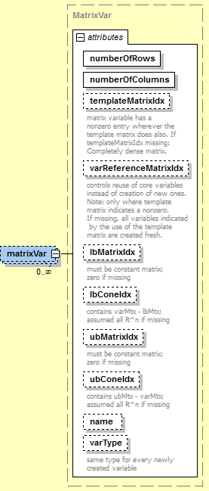
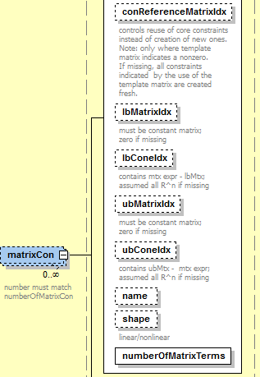
<matrixVar>, <matrixObj>, <matrixCon>

Slide 25
<matrixVar> example
Recall:
C₀ is the cone of 2x2 positive semidefinite matrices
X = M₄ is positive semidefinite (i.e., in C₀):
<matrixVar numberOfRows="2" numberOfColumns="2" varReferenceMatrixIdx="4" lbConeIdx="0"/>

Slide 26
<matrixProgramming> example
<matrixProgramming>
<matrixVariables numberOfMatrixVar="1">
<matrixVar numberOfRows="2" numberOfColumns="2" varReferenceMatrixIdx="4" lbConeIdx="0"/>
</matrixVariables>
<matrixExpressions numberOfExpr="3">
<expr idx="-1" shape="linear">
<matrixTrace>
<matrixTimes>
<matrix matrixIdx="1"/>
<matrix matrixIdx="4"/>
</matrixTimes>
</matrixTrace>
</expr>
…
</matrixExpressions >
</matrixProgramming>

Slide 27
Future work
Complete the parser
Translate SDP problems (SDPlib)
Write CSDP driver

Slide 28
How to get OS
Download
Binaries
http://www.coin-or.org/download/binary/OS
OS-2.1.1-win32-msvc9.zip
OS-2.3.0-linux-x86_64-gcc4.3.2.tgz
Stable source
http://www.coin-or.org/download/source/OS/
OS-2.8.0.tgz
OS-2.8.0.zip
Development version (using svn)
svn co https://projects.coin-or.org/svn/OS/releases/2.8.0 COIN-OS
svn co https://projects.coin-or.org/svn/OS/trunk COIN-OS

Slide 29

QUESTIONS?
http://www.optimizationservices.org
https://projects.coin-or.org/OS
Horand.Gassmann@dal.ca

