Slide 1

The Optimization Services Project
on COIN-OR
Robert Fourer, Jun Ma
Industrial Engineering & Management Sciences
Northwestern University
[4er,maj]@iems.northwestern.edu
Kipp Martin
Graduate School of Business
University of Chicago
kmartin@gsb.uchicago.edu
IFORS 2008
Johannesberg, South Africa — 13-18 July 2008 — MC17.3

Slide 2
The Optimization Services Project on COIN-OR
Each modern optimization modeling system has developed its own way of representing problem instances. As a result, each optimization solver package requires a separate ”driver” for every supportedmodeling system. We describe Optimization Services (OS), a unified framework for a newgeneration of distributed optimization systems that make solvers readily available over the Internet. OS incorporates XML-based standards for representing and communicating optimization problem information, so that only a single driver is required for each solver. Components of OS include OSiL, a new XML-based representation for optimization problem instances, and OSInstance, a corresponding in-memory representation. An open source library, hosted on COIN-OR, provides application programming interfaces for reading and writing OSiL and OSInstance and for converting between them. Related languages and libraries handle the passing of options to solvers and the retrieval of results, as well as protocols for facilitating solver registration, client and scheduler discovery, and communication between the various components of the optimization process. The OS project is intended to have advantages for both developers and users of optimization software.

Slide 3
“Optimization Services”
(OS)
A framework for providing optimization tools
  XML-based
  Service-oriented
  Distributed
  Decentralized
A project for implementing such a framework
  Straightforward and ubiquitous access
  Powerful solvers
Using a robust service-oriented architecture
  Linking modeling languages,
  solvers, schedulers, data repositories
  Residing on different machines, in different locations,
  using different operating systems.

Slide 4
OS on the Internet
Home site: www.optimizationservices.org
  Overview, standards, publications, presentations, FAQs
  Contact information, downloads, licenses
Developer site: https://projects.coin-or.org/OS
  Wiki, source repository, timeline, register, login, search
Newsgroup:
groups.google.com/group/optimizationservices
COIN mailing list:
list.coin-or.org/mailman/listinfo/os
. . . newsgroup and COIN mailing list
are automatically cross-posted

Slide 5
OS on the Internet
Home site: www.optimizationservices.org
  Overview, standards, publications, presentations, FAQs
  Contact information, downloads, licenses
Developer site: www.coin-or.org/projects/OS.xml
  Login, register, wiki, source repository, timeline, search
Newsgroup:
groups.google.com/group/optimizationservices
COIN mailing list:
list.coin-or.org/mailman/listinfo/os
. . . newsgroup and COIN mailing list
are automatically cross-posted

Slide 6
OS Licenses, etc.
Written in multiple languages
  C/C++
  Java
  .NET
Released as open source code
  Under the Common Public License (“CPL”)
Available as a COIN-OR project
  Released this year
  More solvers being added
    Bonmin most recently

Slide 7
OS Builds: Platforms
Unix
  Mac
  Linux
Windows
  Windows (MS Visual Studio)
  Cygwin (gcc)
  MSYS (gcc, cl.exe)

Slide 8
OS Builds: Integration
Core (OSCommon library)
Modeler side
  AMPL / .nl
  LINGO, What’s Best (planned)
  MATLAB
Solver side
  COIN OSI
  AMPL/ASL
  Linear: CLP, CBC, CPLEX, Impact
  Nonlinear: IPOPT, LINDO, KNITRO, Bonmin
  CppAD (automatic differentiation)
. . . some still unstable
. . . looking for developers to provide others

Slide 9
Sample Solver Services
Linear
  CLP
  CBC
  Impact
Nonlinear
  IPOPT
  LINDO

Slide 10
OS Downloads
OSxL XML schemas (OSRepresentation library)
OSxL WSDL files (OSCommunication library)
  . . . in a zipped file or individually

Slide 11
OS Downloads (cont’d)
Sources and builds on common platforms
  C/C++
    readers/writers
    client agent for contacting remote services
    interfaces to solvers and modeling systems
    automatic differentiation, etc.
  Java (to be put up)
    same features as C/C++, plus
    Web Services, server, distributed systems.
  .NET (C#) (to be put up)
    similar to Java but not as complete

Slide 12
OS Repository
Linear (netlib basic, infeasible, Kennington)
  Individual XML (OSiL format) files available now
  Zip files to come
Mixed integer (mainly from miplib 2003)
Nonlinear
  CUTE now, more to come
Stochastic
  Thanks to Gus Gassmann
  . . . all known documentation
  (source, solution, description, type, etc.)

Slide 13
Standards
OS framework provides standards in 3 areas
  Optimization instance representation
  Optimization communication
    accessing
    interfacing
    orchestration
  Optimization service registration and discovery

Slide 14
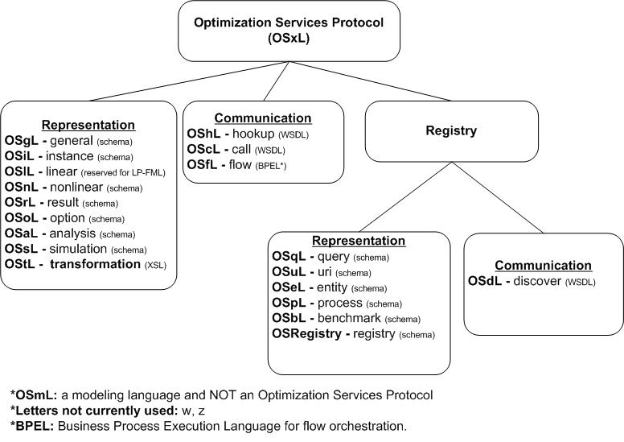
Standards

Slide 15
Quick Overview
Modeler
Solver
OSiL, OSInstance
OSoL, OSOption
OSrL, OSResult
XML text files
  OSiL, OSoL, OSrL
In-memory data structures
  OSInstance, OSOption, OSResult

Slide 16
The Modeling System Interface
Motivation
  For any standard format
  For an XML-based format
Text files
  XML schema
  OSiL example
  Compression
  Extensions
In-memory data structures
  Objects and methods
  Writing a generator
  Translating from a modeling language

Slide 17
XML Means “Tagged” Text Files . . .
Motivation
Example: html for a popular home page
<html><head><meta http-equiv="content-type" content="text/html; charset=UTF-8"><title>Google</title><style><!--
body,td,a,p,.h{font-family:arial,sans-serif;}
.h{font-size: 20px;}
.q{text-decoration:none; color:#0000cc;}
//-->
</style>
</head><body bgcolor=#ffffff text=#000000 link=#0000cc vlink=#551a8b alink=#ff0000 onLoad=sf()><center><table border=0 cellspacing=0 cellpadding=0><tr><td><img src="/images/logo.gif" width=276 height=110 alt="Google"></td></tr></table><br>
.......
<font size=-2>&copy;2003 Google - Searching 3,307,998,701 web pages</font></p></center></body></html>
  . . . a collection of XML tags is designed for a special purpose
  . . . by use of a schema written itself in XML

Slide 18
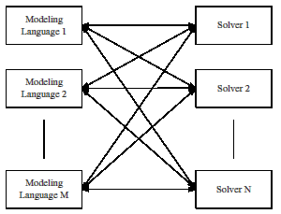
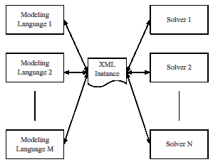
Advantage of any standard
Motivation
MN drivers
without a standard
M + N drivers
with a standard

Slide 19
Advantages of an XML Standard
Motivation
Specifying it
  Unambiguous definition via a schema
  Provision for keys and data typing
  Well-defined expansion to new name spaces
Working with it
  Parsing and validation via standard utilities
  Amenability to compression and encryption
  Transformation and display via XSLT style sheets
  Compatibility with web services

Slide 20
OSiL: Optimization Problem Instances
Design goals
  Simple, clean, extensible, object-oriented
Standard problem types supported
  Linear
  Quadratic
  General nonlinear
  Mixed integer for any of above
  Multiple objective for any of above
  Complementarity

Slide 21
OSiL (cont’d)
Extensions (stable or near-stable)
  User-defined functions
  XML data (within the OSiL or remotely located)
  Data lookup (via XPath)
  Logical/combinatorial expressions and constraints
  Simulations (black-box functions)

Slide 22
OSiL (cont’d)
Prototypes
  Cone & semidefinite programming
  Stochastic
    recourse, penalty-based, scenario (implicit or explicit)
    risk measure/chance constrained
    major univariate, multivariate, user-defined distributions
    general linear transformation and ARMA processes
    R. Fourer, H.I. Gassmann, J. Ma, and R.K. Martin,
    “An XML-Based Schema for Stochastic Programs.”
    Forthcoming in Annals of Operations Research.

Slide 23
What about “MPS Form”?
Motivation
Weaknesses
  Standard only for LP and MIP, not for
  nonlinear, network, complementarity, logical, . . .
  Standard not uniform (especially for SP extension)
  Verbose ASCII form, with much repetition of names
  Limited precision for some numerical values
Used for
  Collections of (mostly anonymous) test problems
  Bug reports to solver vendors
Not used for
  Communication between modeling systems and solvers

Slide 24
Text from the OSiL Schema
Text files
<xs:complexType name="Variables">
<xs:sequence>
<xs:element name="var" type="Variable" maxOccurs="unbounded"/>
</xs:sequence>
<xs:attribute name="number" type="xs:positiveInteger" use="required"/>
</xs:complexType>
<xs:complexType name="Variable">
<xs:attribute name="name" type="xs:string" use="optional"/>
<xs:attribute name="init" type="xs:string" use="optional"/>
<xs:attribute name="type" use="optional" default="C">
<xs:simpleType>
<xs:restriction base="xs:string">
<xs:enumeration value="C"/>
<xs:enumeration value="B"/>
<xs:enumeration value="I"/>
<xs:enumeration value="S"/>
</xs:restriction>
</xs:simpleType>
</xs:attribute>
<xs:attribute name="lb" type="xs:double" use="optional" default="0"/>
<xs:attribute name="ub" type="xs:double" use="optional" default="INF"/>
</xs:complexType>

Slide 25
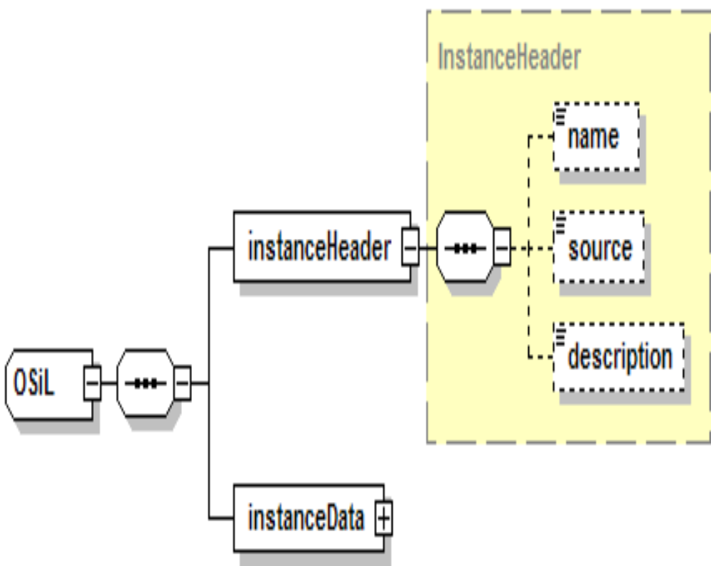
Diagram of the OSiL Schema
Text files

Slide 26
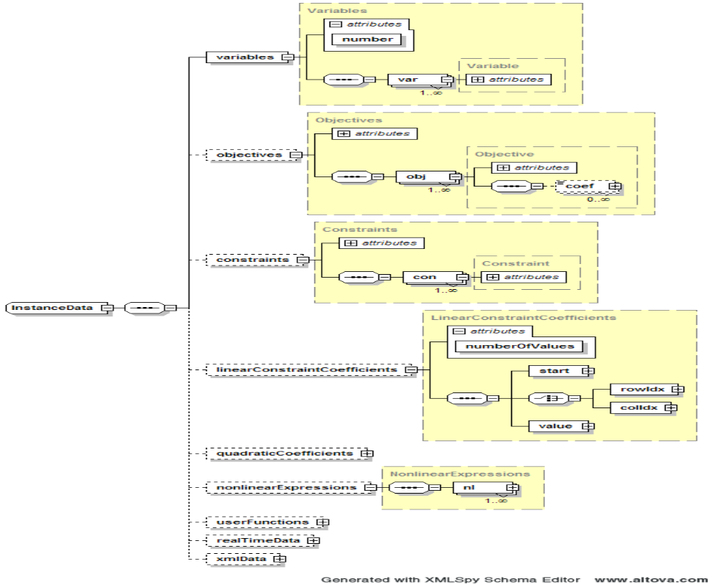
Details of OSiL’s instanceData Element
Text files

Slide 27
Details of OSiL’s instanceData Element
Text files

Slide 28
Example: A Problem Instance (in AMPL)
Text files
ampl: expand _var;
Coefficients of x[0]:
Con1 1 + nonlinear
Con2 7 + nonlinear
Obj 0 + nonlinear
Coefficients of x[1]:
Con1 0 + nonlinear
Con2 5 + nonlinear
Obj 9 + nonlinear
ampl: expand _obj;
minimize Obj:
(1 - x[0])^2 + 100*(x[1] - x[0]^2)^2 + 9*x[1];
ampl: expand _con;
subject to Con1:
10*x[0]^2 + 11*x[1]^2 + 3*x[0]*x[1] + x[0] <= 10;
subject to Con2:
log(x[0]*x[1]) + 7*x[0] + 5*x[1] >= 10;

Slide 29
Example in OSiL
Text files
<instanceHeader>
<name>Modified Rosenbrock</name>
<source>Computing Journal3:175-184, 1960</source>
<description>Rosenbrock problem with constraints</description>
</instanceHeader>
<variables number="2">
<var lb="0" name="x0" type="C"/>
<var lb="0" name="x1" type="C"/>
</variables>
<objectives number="1">
<obj maxOrMin="min" name="minCost" numberOfObjCoef="1">
<coef idx="1">9</coef>
</obj>
</objectives>
<constraints number="2">
<con ub="10.0"/>
<con lb="10.0"/>
</constraints>

Slide 30
Example in OSiL (continued)
Text files
<linearConstraintCoefficients numberOfValues="3">
<start>
<el>0</el>
<el>1</el>
<el>3</el>
</start>
<rowIdx>
<el>0</el>
<el>1</el>
<el>1</el>
</rowIdx>
<value>
<el>1.0</el>
<el>7.0</el>
<el>5.0</el>
</value>
</linearConstraintCoefficients>
<quadraticCoefficients numberOfQPTerms="3">
<qpTerm idx="0" idxOne="0" idxTwo="0" coef="10"/>
<qpTerm idx="0" idxOne="1" idxTwo="1" coef="11"/>
<qpTerm idx="0" idxOne="0" idxTwo="1" coef="3"/>
</quadraticCoefficients>

Slide 31
Example in OSiL (continued)
Text files
<nl idx="-1">
<plus>
<power>
<minus>
<number type="real" value="1.0"/>
<variable coef="1.0" idx="1"/>
</minus>
<number type="real" value="2.0"/>
</power>
<times>
<power>
<minus>
<variable coef="1.0" idx="0"/>
<power>
<variable coef="1.0" idx="1"/>
<number type="real" value="2.0"/>
</power>
</minus>
<number type="real" value="2.0"/>
</power>
<number type="real" value="100"/>
</times>
</plus>
</nl>

Slide 32
Example in OSiL (continued)
Text files
<nl idx="1">
<ln>
<times>
<variable idx="0"/>
<variable idx="1"/>
</times>
</ln>
</nl>

Slide 33
OSrL: Optimization Problem Results
Counterpart to OSiL for solver output
  General results such as serviceURI, serviceName, instanceName, jobID, time
  Results related to the solution such as status
  (unbounded, globallyOptimal, etc.), substatus, message
  Results related to variables (activities),
  objectives (optimal levels), constraints (dual values)
  Service statistics such as currentState, availableDiskspace, availableMemory, currentJobCount, totalJobsSoFar, timeLastJobEnded, etc.
  Results related to individual jobs including
  state (waiting, running, killed, finished), userName, submitTime, startTime, endTime, duration, dependencies, scheduledStartTime, requiredDirectoriesAndFiles.

Slide 34
OSrL (cont’d)
Additional solution support
  Support for non-numeric solutions
  such as those returned from
  combinatorial or constraint programming solvers
  Support for multiple objectives
  Support for multiple solutions
  Integration of analysis results
  collected by the solver

Slide 35
OSoL: Optimization Options
Counterpart to OSiL for solver instructions
  General options including serviceURI, serviceName, instanceName, instanceLocation, jobID, license, userName, password, contact
  System options including minDiskSpace, minMemorySize, minCPUSpeed
  Service options including service type
  Job options including scheduledStartTime, dependencies. requiredDirectoriesAndFiles, directoriesToMake, directoriesToDelete,
  filesToCreate, filesToDelete, processesToKill, inputFilesToCopyFrom, inputFilesToCopyTo, etc.
Limited standardization of algorithmic options
  Currently only initial values

Slide 36
OSoL (cont’d)
Including support for:
  Various networking communication mechanisms
  Asynchronous communication (such as specifying
  an email address for notification at completion)
  Stateful communication (achieved mainly through the built-in mechanism of associating a network request with a unique jobID)
  Security such as authentication and licensing
  Retrieving separately uploaded information
  (when passing a large file as a string argument is inefficient)
  Extended or customized
  solver-specific or algorithm-specific options

Slide 37
Other XML Schema-Based Standards
Kept by the OS registry
  OSeL (entity, experimental): static information
  on optimization services (such as type, developer)
  OSpL (process, near stable): dynamic information
  on optimization services (such as jobs being solved)
  OSbL (benchmark, experimental): benchmark information on optimization services
For use by the discovery process
  OSqL (query, experimental): specification of the query format used to discover the optimization services in the OS registry
  OSuL (uri/url, experimental): specification of the discovery result (in uri or url) sent back by the
  OS registry

Slide 38
Other Schema-Based Standards (cont’d)
Formats and definitions
  OSsL (simulation, stable): format for input and output used by simulation services invoked via the Optimization Services to obtain function values
  OSgL (general, near stable): definitions of general elements and data types used by other OSxL schemas.
  Usually included in the beginning of another OSxL schema through the statement:
  <xs:include schemaLocation="OSgL.xsd"/>
  OSnL (nonlinear, stable): definitions (operators, operands, etc.) of the nonlinear, combinatorial, and other nodes used in other OSxL’s, mainly OSiL

Slide 39
Other WSDL-Based Standards
WSDL
  Web Service Definition Language
WSDLs for OS (stable)
  OShL (hook): for invoking solver/analyzer services
  OSdL (discover): for invoking optimization registry services to register and discover services
  OScL (call) for invoking simulation services,
  usually to obtain function values.

Slide 40
www.optimizationservices.org . . .
. . . Questions?

