Slide 1
Recent Changes to the Optimization Services Project
H.I. Gassmann, Faculty of Management
J. Ma, Northwestern University
R.K. Martin, The University of Chicago
CORS/INFORMS, June 2009

Slide 2
Outline
Overview of OS
OSiL – OS instance language
OSoL – OS option language
OSrL – OS result language
Future plans

Slide 3
Optimization Services (OS)
A set of standards to facilitate communication between modeling languages, solvers, problem analyzers, simulation engines, and registry and discovery services in a distributed computing environment.
Programming language, operating system, and hardware independent.
Open and available for everyone in the OR community to use free of charge.
Optimization should be as easy as hooking up to the network.

Slide 4




Solvers
Data
inter-change
User interface
AML
Corporate databases

Slide 5
Optimization Services
Optimization services is needed because there is/are:
Numerous modeling languages each with their own format for storing the underlying model.
Numerous solvers each with their own application program interface (API).
Numerous operating system, hardware, and programming language combinations.
No standard for representing problem instances, especially nonlinear optimization instances.
No real standard for registry and discovery services.

Slide 6
Why a standard interface?
.
.
.
.
.
.
.
.
.
.
.
.
Modelling systems
Solvers
Modelling systems
Solvers
n*m hook-ups
n+m hook-ups

Slide 7
What Is Optimization Services (OS)?
A set of XML-based standards for representing information relevant to the practice of optimization, most importantly optimization instances (OSiL), optimization results (OSrL), and optimization solver options (OSoL).
Open source libraries that support and implement many (eventually all) of the standards.
A robust API for both solver algorithms and modeling systems. The API is for linear, integer, general nonlinear and stochastic programs.
A command line executable OSSolverService for reading problem instances (in OSiL format, AMPL nl format, or MPS format) and calling a solver either locally or on a remote server.

Slide 8
What Is Optimization Services (OS)?
Utilities that convert MPS files and AMPL nl files into the OSiL XML-based format.
Standards that facilitate the communication between clients and optimization solvers using Web Services and libraries that support these standards.
An executable program OSAmplClient that is designed to work with the AMPL modeling language. OSAmplClient appears as a "solver" to AMPL and, based on options given in AMPL, contacts solvers either remotely or locally to solve instances created in AMPL.
Server software that works with Apache Tomcat and Apache Axis. This software uses Web Services technology and acts as middleware between the client that creates the instance, and solver on the server that optimizes the instance and returns the result.

Slide 9
How to get OS
Download
  Binaries
    http://www.coin-or.org/download/binary/OS
      OS-1.0.0-win32-msvs-v8.zip
      OS-1.1.1-linux-x86_64-icc10.1.tgz
  Stable source
    http://www.coin-or.org/download/source/OS/
      OS-1.1.1.tgz
      OS-1.1.1.zip
  Development version (using svn)
    svn co https://projects.coin-or.org/svn/OS/releases/1.1.1 COIN-OS

Slide 10
Solver support
All versions of OS download with COIN-OR solvers
  Clp
  Cbc
  Ipopt
  Bonmin
  Couenne
  Symphony
Additional support
  Cplex
  GLPK
  Lindo

Slide 11
Main components of OS
OSiL and OSInstance
OSoL and OSOption
OSrL and OSResult
OSpL
OSSolverService
OSAmplClient

Slide 12
OSiL
XML schema for mathematical programs
  Linear
  Integer
  Nonlinear
  Stochastic
  Multiobjective
  …

Slide 13
Why XML?
Existing parsers to check syntax
Easy to generate automatically
Tree structure naturally mirrors expression trees for nonlinear functions
Arbitrary precision and name space
Automatic attribute checking (e.g., nonnegativity)
Querying capabilities via XQuery
Encryption standards being developed
Easy integration into broader IT infrastructure

Slide 14
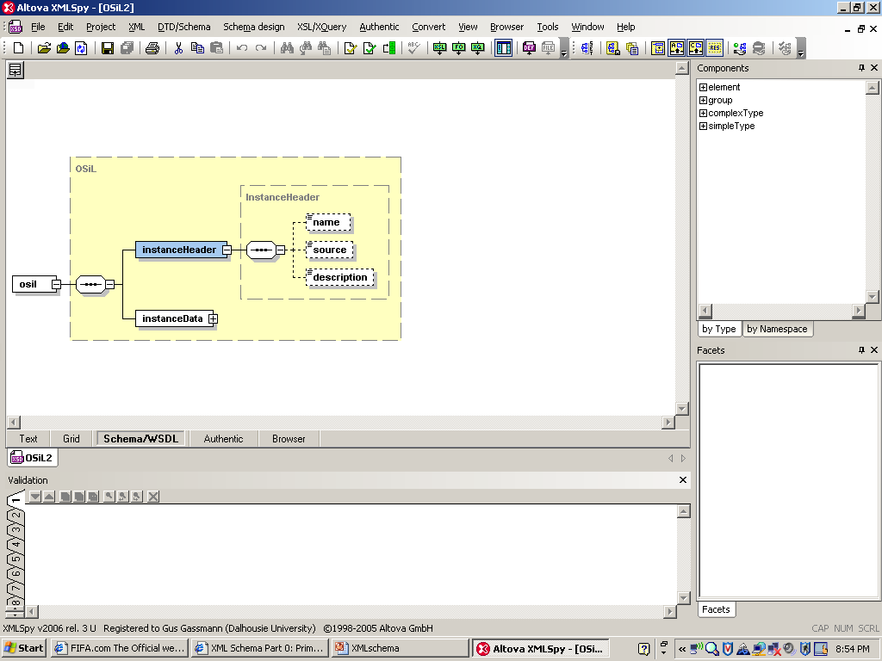
OSiL Schema – Header information

Slide 15
Header information – Example
<?xmlversion="1.0" encoding="UTF8"?>
<osil xmlns="os.optimizationservices.org"
xmlns:xsi="htt://www.w3.org/2001/XMLSchemainstance"
xsi:schemaLocation="os.optimizationservices.org
http://www.optimizationervices.org/schemas/2.0/OSiL.xsd">
<instanceHeader>
<name>FinPlan</name>
<source>
Birge and Louveaux, Stochastic Programming
</source>
<description>
Three-stage stochastic investment problem
</description>
</instanceHeader >
<instanceData>
...
</instanceData>
</osil>

Slide 16
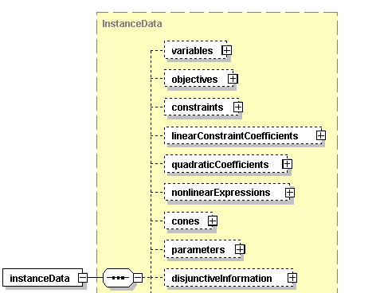
OSiL Schema – Deterministic data
…

Slide 17
Instance data –Variables, objectives, constraints
<variables numberOfVariables="8">
<var name="invest01" type="C" lb="0.0"/>
<var name="invest02"/>
<var name="invest11"/>
<var name="invest12"/>
<var name="invest21"/>
<var name="invest22"/>
<var name="w"/>
<var name="u"/>
</variables>
<objectives numberOfObjectives="1">
<obj maxOrMin="max" numberOfObjCoef= "2" lb="0.0">
<coef idx="6"/>1.</coef>
<coef idx="7"/>-4.</coef>
</obj>
</objectives>
<constraints numberOfConstraints="4">
<con name="budget0" lb="55" ub="55"/>
<con name="budget1" lb="0" ub="0"/>
<con name="budget2" lb="0" ub="0"/>
<con name="budget3" lb="80" ub="80"/>
</constraints>

Slide 18
Instance data –
Core matrix (sparse matrix form)
<linearConstraintCoefficients
numberOfValues=“14">
<start>
<el>0</el>
<el>2</el>
<el>4</el>
<el>6</el>
<el>8</el>
<el>10</el>
<el>12</el>
<el>13</el>
<el>14</el>
</start>
<rowIdx>
<el>0</el>
<el>1</el>
<el>0</el>
<el>1</el>
<el>1</el>
<el>2</el>
<el>1</el>
<el>2</el>
<el>2</el>
<el>3</el>
<el>2</el>
<el>3</el>
<el>3</el>
<el>3</el>
</rowIdx>
<value>
<el>1</el>
<el>1.25</el>
<el>1</el>
<el>1.14</el>
<el>1</el>
<el>1.25</el>
<el>1</el>
<el>1.14</el>
<el>1</el>
<el>1.25</el>
<el>1</el>
<el>1.14</el>
<el>1</el>
<el>-1</el>
</value>

Slide 19
Representation of uncertainty
Explicit event trees
  Scenario formulation
  Only record data items that differ from parent scenario
Implicit trees (distribution-based formulation)
  Continuous or discrete random variables
  Linked to problem coefficients via transformations
  Incomplete information
Probabilistic constraints
  Simple chance constraints
  Joint chance constraints
Robust formulations

Slide 20
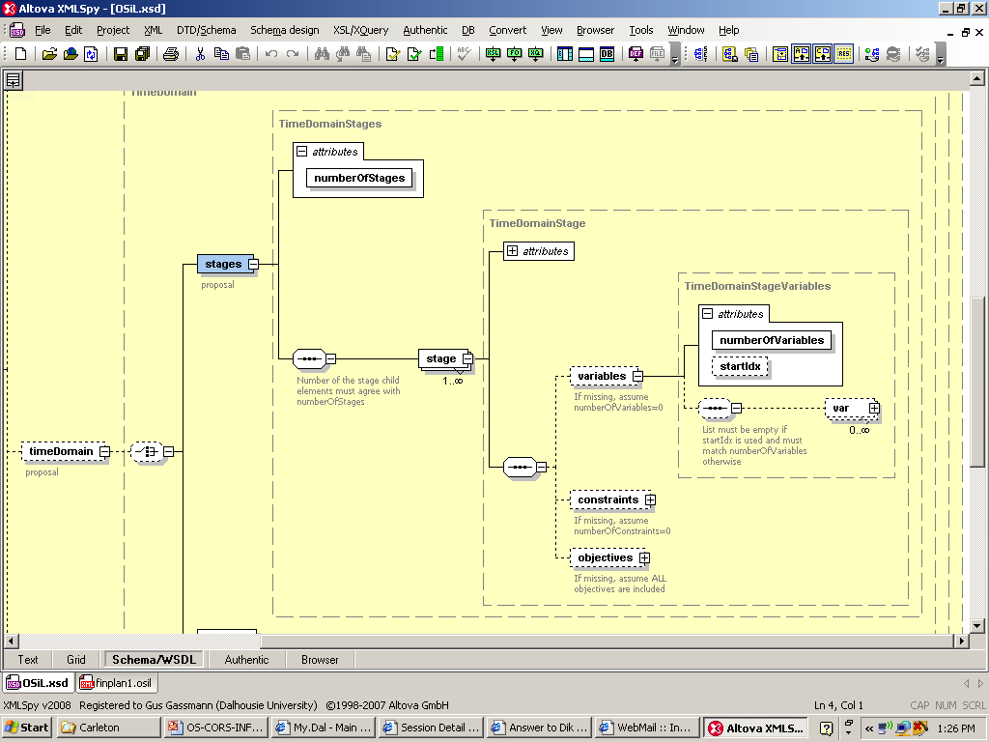
OSiL Schema – Dynamic structure

Slide 21
Dynamic information – Example
<stages numberOfStages="4">
<stage>
<variables numberOfVariables="2" startIdx="0“/>
<constraints numberOfConstraints="1" startIdx="0"/>
</stage>
<stage>
<variables numberOfVariables="2" startIdx="2"/>
<constraints numberOfConstraints="1" startIdx="1"/>
</stage>
<stage>
<variables numberOfVariables="2" startIdx="4"/>
<constraints numberOfConstraints="1" startIdx="2"/>
</stage>
<stage>
<variables numberOfVariables="2">
<var idx="6"> <var idx="7">
</variables>
<constraints numberOfConstraints="1" startIdx="3"/>
</stage>
</stages>

Slide 22
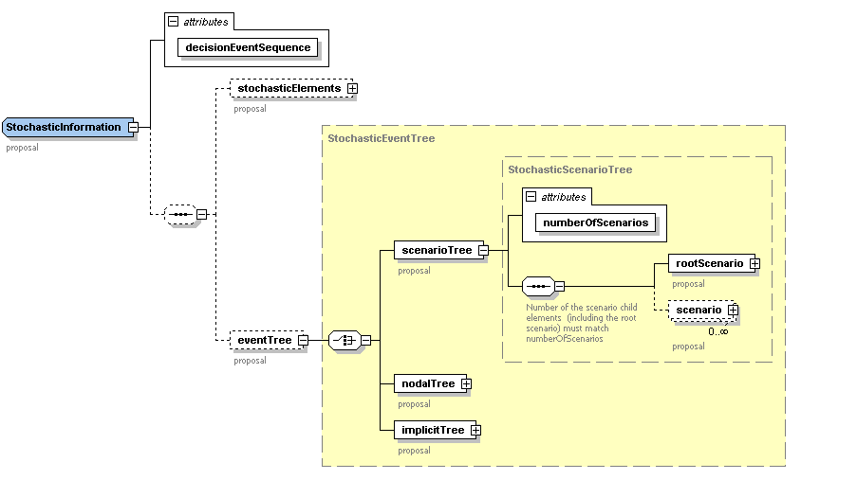
Explicit and implicit event trees

Slide 23
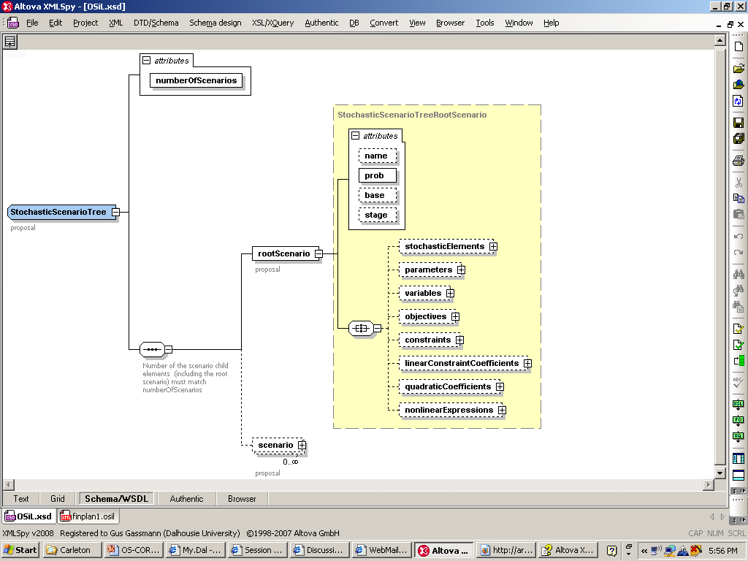
Scenario trees

Slide 24
Scenario tree – Example
<stochasticInformation decisionEvenSequence="DecisionAfterEvent">
<eventTree>
<scenarioTree numberOfScenarios="8">
<rootScenario prob="1" stage="0"/>
<scenario prob="0.5" stage="3" parent="0">
<linearConstraintCoefficients>
<el rowIdx="3" colIdx="4">1.06</el>
<el rowIdx="3" colIdx="5">1.12</el>
</linearConstraintCoefficients>
</scenario>
<scenario prob="0.5" stage="2" parent="0">
…

Slide 25
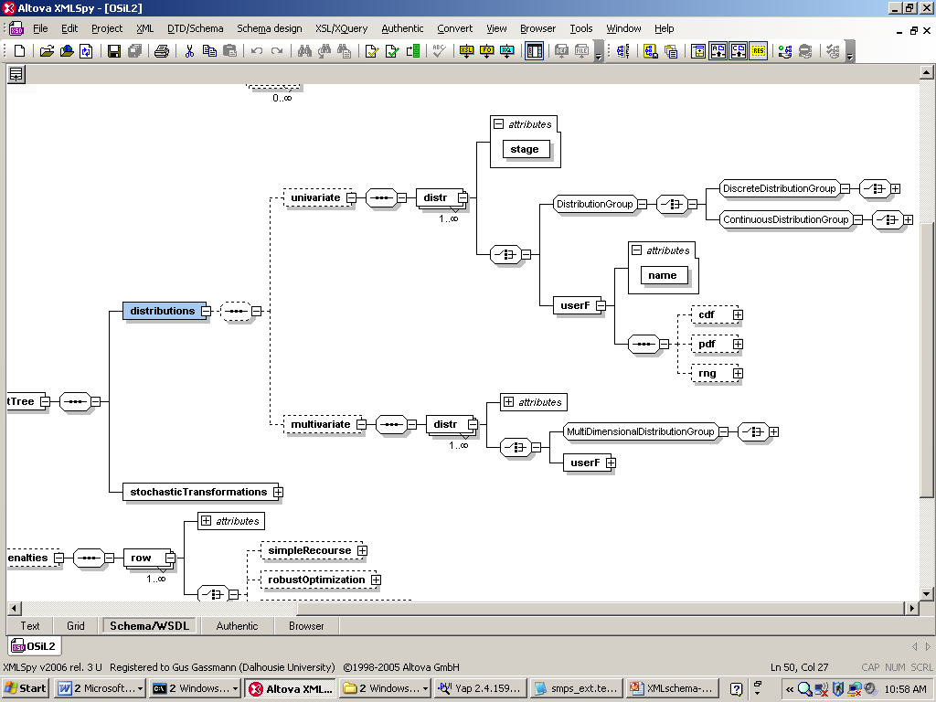
Distributions (implicit tree)

Slide 26
Discrete random vector
<distributions>
<multivariate>
<distr stage="1">
<multiDimensionalDistributionGroup>
<multivariateDiscrete>
<scenario>
<prob>0.5</prob>
<el>1.25</el>
<el>1.14</el>
</scenario>
<scenario>
<prob>0.5</prob>
<el>1.06</el>
<el>1.12</el>
</scenario>
</multivariateDiscrete>
</multiDimensionalDistributionGroup>
</distr>
…
</multivariate>
</distributions>

Slide 27
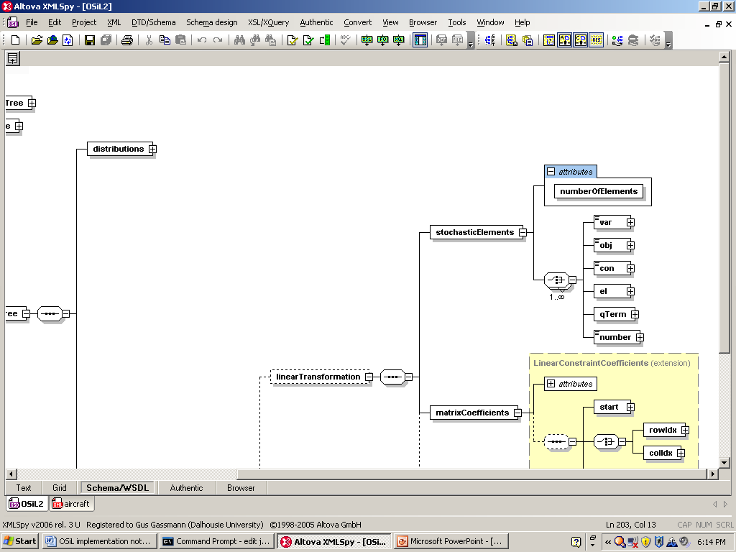
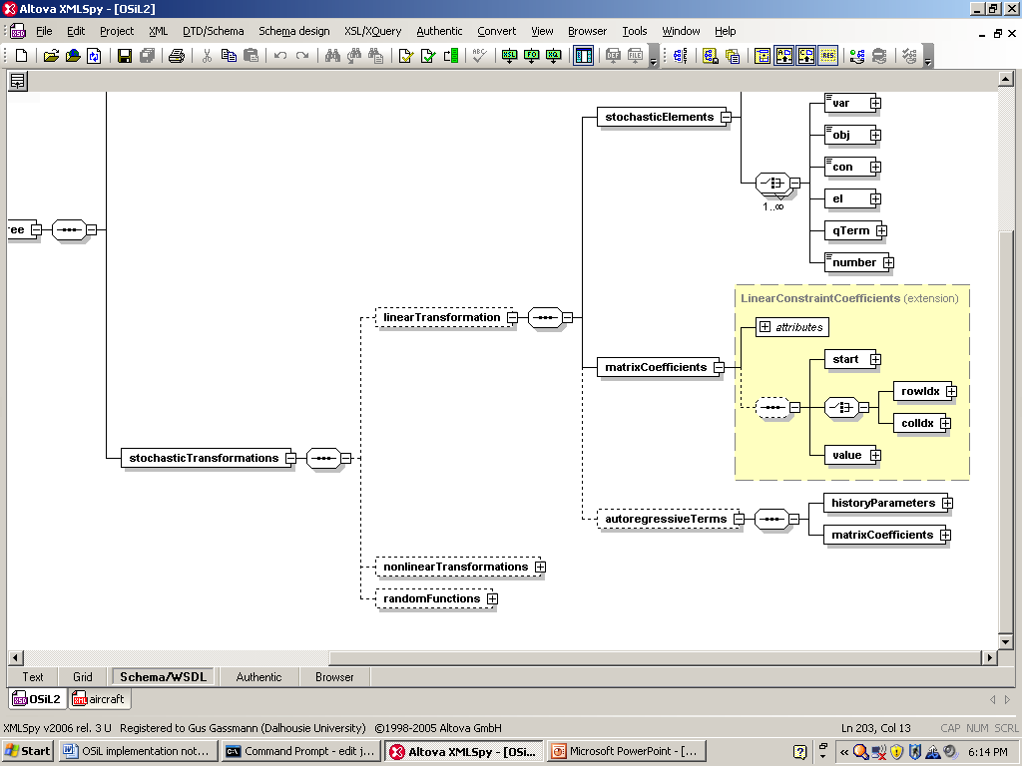
Transformations – p = f(v)

Slide 28
Linear transformation – Example
<stochasticTransformation>
<linearTransformation>
<stochasticElements
numberOfElements="6">
<el rowIdx="1" colIdx="0"/>
<el rowIdx="1" colIdx="1"/>
<el rowIdx="2" colIdx="2"/>
<el rowIdx="2" colIdx="3"/>
<el rowIdx="3" colIdx="4"/>
<el rowIdx="3" colIdx="5"/>
</stochasticElements>
<matrixCoefficients
numberOfElements="6">
<start>
<el>0</el>
<el>1</el>
<el>2</el>
<el>3</el>
<el>4</el>
<el>5</el>
<el>6</el>
</start>
<rowIdx>
<el>0</el>
<el>1</el>
<el>2</el>
<el>3</el>
<el>4</el>
<el>1</el>
</rowIdx>
<value>
<el mult=“6">1.0</el>
</value>
</matrixCoefficients>
</linearTransformation>
</stochasticTransformation>

Slide 29
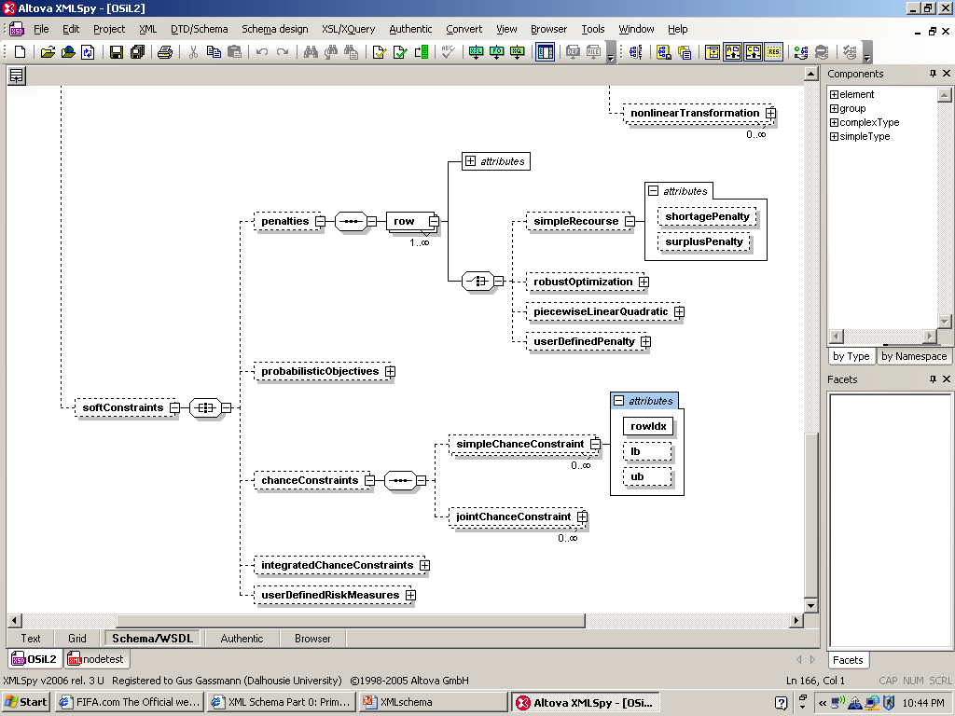
Penalties and probabilistic constraints

Slide 30
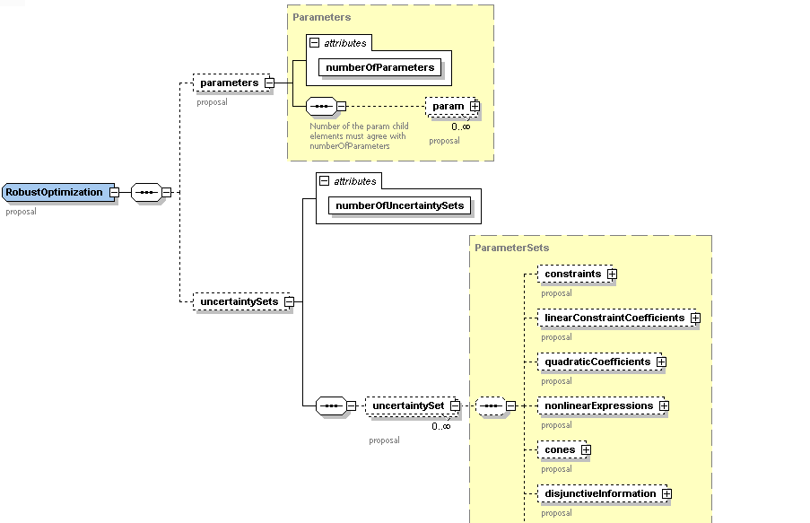
Robust optimization

Slide 31
Capabilities
Arbitrary nonlinear expressions
Arbitrary distributions
Scenario trees
Stochastic problem dimensions
Simple recourse
Soft constraints with arbitrary penalties
Probabilistic constraints
Arbitrary moment constraints

Slide 32
OSInstance: In-memory representation
XML elements correspond to C++ classes
Child elements mapped as member classes
set(), get() and calculate() methods
class OSInstance{
public:
OSInstance();
InstanceHeader *instanceHeader;
InstanceData *instanceData;
}; // class OSInstance

Slide 33
OSoL – OS option language
Solver options
Initializations of variables
System requirements
Job parameters
In-memory representation: OSOption
API: get(), set(), add() methods

Slide 34
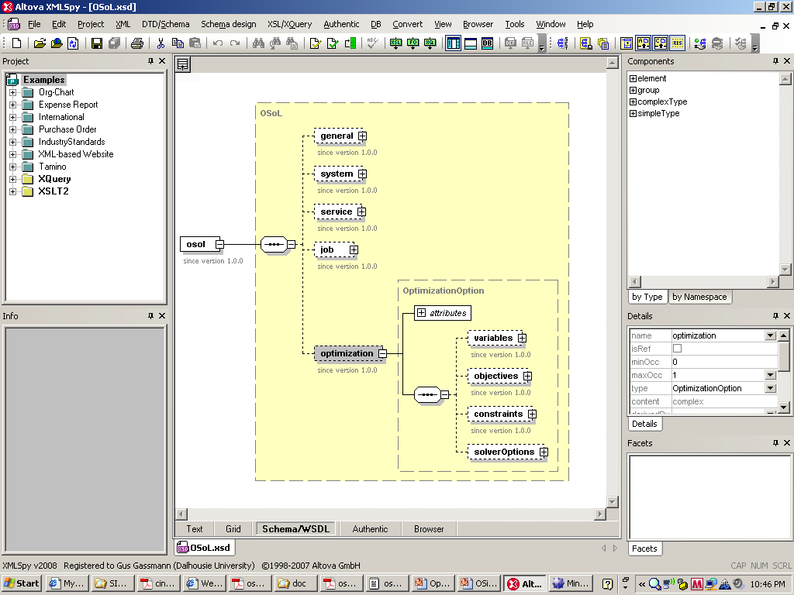
OSoL schema

Slide 35
Sample .osol file
<?xml version="1.0" encoding="UTF-8"?>
<osol xmlns="os.optimizationservices.org" xmlns:xsi="http://www.w3.org/2001/XMLSchema-instance" xsi:schemaLocation="os.optimizationservices.org http://www.optimizationservices.org/schemas/2.0/OSoL.xsd">
<optimization numberOfVariables="2">
<variables>
<initialVariableValues numberOfVar="2">
<var idx="0" value="5."/> <var idx="1" value="5."/>
</initialVariableValues>
</variables>
<solverOptions numberOfSolverOptions="3">
<solverOption name="tol" solver="ipopt" type="numeric"
value="1.e-9"/>
<solverOption name="print_level" solver="ipopt"
type="integer" value="5"/>
<solverOption name="max_iter" solver="ipopt" type="integer"
value="2000"/>
</solverOptions>
</optimization>
</osol>

Slide 36
OSrL and OSResult
Result of the optimization
  Solution status
  Statistics
  Value of primal and dual variables
Can be displayed in a browser

Slide 37
Sample result file
<?xml version="1.0" encoding="UTF-8"?><?xml-stylesheet type="text/xsl“
href="../stylesheets/OSrL.xslt"?>
<osrl xmlns="os.optimizationservices.org"
xmlns:xsi=http://www.w3.org/2001/XMLSchema-instance
xsi:schemaLocation="os.optimizationservices.org
http://www.optimizationservices.org/schemas/2.0/OSrL.xsd" >
<general>
<generalStatus type="normal"/>
<serviceName>Ipopt solver service</serviceName>
<instanceName>Original Rosenbrock</instanceName>
<message>Ipopt solver finishes to the end.</message>
</general>
<optimization numberOfSolutions="1" numberOfVariables="2“
numberOfConstraints="0" numberOfObjectives="1">
<solution targetObjectiveIdx="-1">
<status type="locallyOptimal" description="SUCCESS[IPOPT]:
Algorithm terminated normally at a locally optimal point,
satisfying the convergence tolerances."/>
<variables numberOfOtherVariableResults="2">
<values numberOfVar="2">
<var idx="0">1.0000000011552117</var>
<var idx="1">1.0000000023142723</var>
</values>

Slide 38
Sample result file (cont’d)
<other numberOfVar="2" name="varL"
description="Lagrange Multiplier on the Variable Lower Bound">
<var idx="0">7.701488100457089e-10</var>
<var idx="1">7.701498562828543e-10</var>
</other>
<other numberOfVar="2" name="varU"
description="Lagrange Multiplier on the Variable Upper Bound">
<var idx="0">0</var>
<var idx="1">0</var>
</other>
</variables>
<objectives >
<values numberOfObj="1">
<obj idx="-1">1.3359955006550299e-18</obj>
</values>
</objectives>
</solution>
</optimization>
</osrl>

Slide 39
Current status and future plans
Changes to OSoL and OSrL schemas and API
Version 2.0 released this week
Stochastic extensions to be finalized
Proof of concept:
  Generate and solve deterministic equivalent
  Link to MSLiP
  Link to sampling-based solvers

Slide 40
How to get OS
Binaries
  http://www.coin-or.org/download/binary/OS
    OS-1.0.0-win32-msvs-v8.zip
    OS-1.1.1-linux-x86_64-icc10.1.tgz
Source code
  http://www.coin-or.org/download/source/OS/
    OS-1.1.1.tgz
    OS-1.1.1.zip

Slide 41
Get involved
There are several ways you can help make COIN-OR better:
Download and use COIN-OR software
Send us feedback
Volunteer your time
Become an Associate Member of the COIN-OR Foundation
Contribute code or documentation

Slide 42
QUESTIONS?
http://myweb.dal.ca/gassmann
http://www.optimizationservices.org
http://www.coin-or.org/projects/OS.xml
Horand.Gassmann@dal.ca

