Slide 1
Optimization Services (OS)
Today: open Interface for Hooking Solvers to Modeling Systems
Jun Ma
Northwestern University
Next generation distributed optimization (NEOS)
- Framework for Optimization Software Design
- Hosting Optimization/Computing as Services
- Standardizing representation/Communication
Joint with
Robert Fourer – Northwestern University
Kipp Martin – University of Chicago
at
DIMACS Workshop on COIN-OR
Rutgers University
07/19/2006

Slide 2
Sequence of Our Talks
  An overview of Optimization Services and concepts (Jun Ma)
  Using optimization services libraries as an interface for modeling systems (Bob Fourer)
  Using optimization services libraries as an interface for solvers (Kipp Martin)

Slide 3
Outline of My Part
  Motivation
  What is Optimization Services (OS) and
  Optimization Services Protocol (OSP)
  “vs.” – fundamentals and clarifications
  Sharing our lessons and insights that we learned the hard way
  Current State of Optimization Services
  Derived and Future Research/Potential Collaboration
  Major User and Business Values

Slide 4
Motivation
  1. Tightly-coupled implementation
  2. Various operating systems
  3. Various communication/interfacing mechanisms
  4. Various programming languages
  5. Various benchmarking standards
  The key issue is communication (includes interfacing), not solution!
  … and Optimization Services is intended to solve all the above issues.

Slide 5
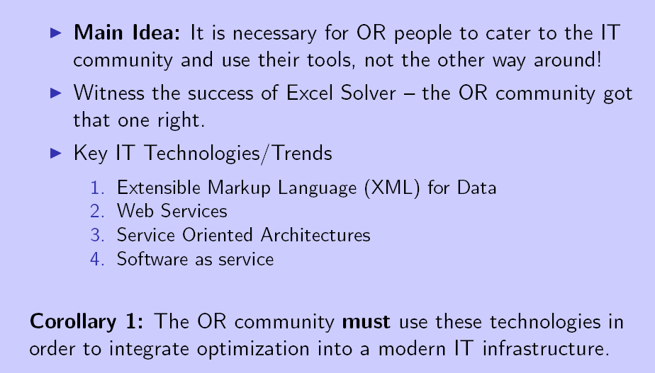
Motivation

Slide 6
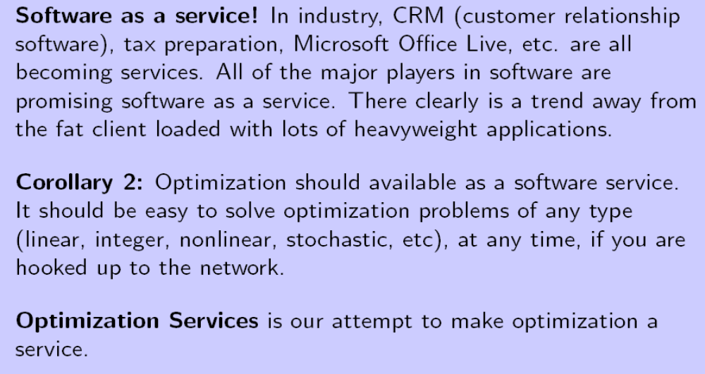
Motivation
be
constraint programming

Slide 7
  What is Optimization Services (OS) and
  Optimization Services Protocol (OSP)

Slide 8
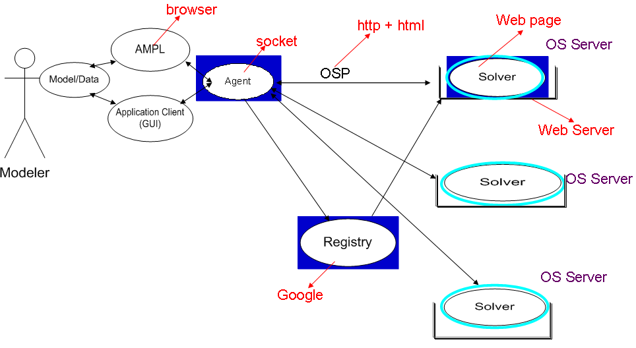
What is OS and OSP
Service (public forefront/wrapper)

Slide 9
What Does Optimization Services Do
  Provide a set of standards and protocols for distributed optimization (local as a special case)
  Provide protocols for representing problem instances, solution instances, and option instances
  Provide protocols that facilitate (stateful) communication (synchronous and asynchronous) between solvers and clients that use the solvers
  Provide protocols allow clients that use optimization solvers to discover their existence over the network and allow solvers to register their existence
  Provide libraries that can be used in a modeling environment to read, write, communicate model instances and solutions

Slide 10
  “vs.” – fundamentals and
  concept clarifications
  Either you don’t see
  Or it’s so obvious
  -- Michael Henderson
  But always easy to forget
  -- Jun Ma

Slide 11
Standardizing vs. Not Standardizing
  Clarify what OS tries to standardize and
  what OS does not do
  OS is intended to be a universal framework …
  … there are many different reasons for making the decision not to standardize certain things
  e.g. Model vs. Instance
  e.g. Solver vs. Instance

Slide 12
Design vs. Implementation
  Optimization Services is more about design
  70% vs. 30% is the current state
  90% vs. 10% is at least my goal
  The current OS design is the result of thinking about everything at the same time from scratch rather than sequentially (LPFML is subsumed by OSiL)
  A good design takes time but usually looks natural and simple after it is finished.
  A good design is extendable, but we will be on the very conservative when it comes to extending the core.

Slide 13
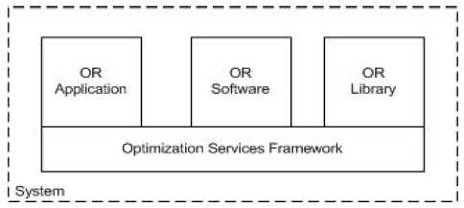
Framework vs. Library
Implementation
(c++, java, .net)
Think of Sun J2EE (now Java EE 5) and IBM Websphere
Design

Slide 14
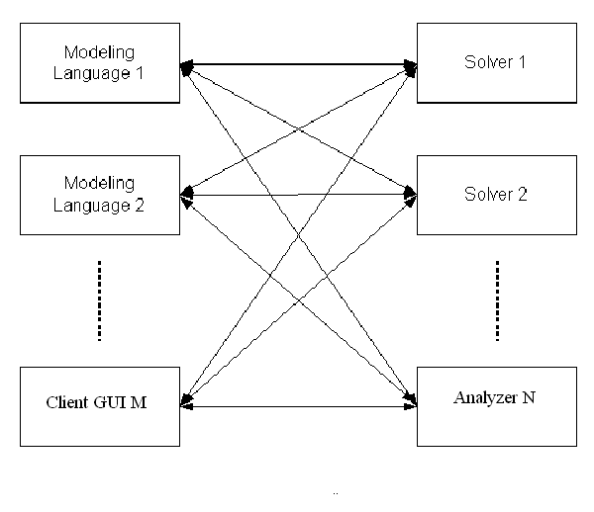
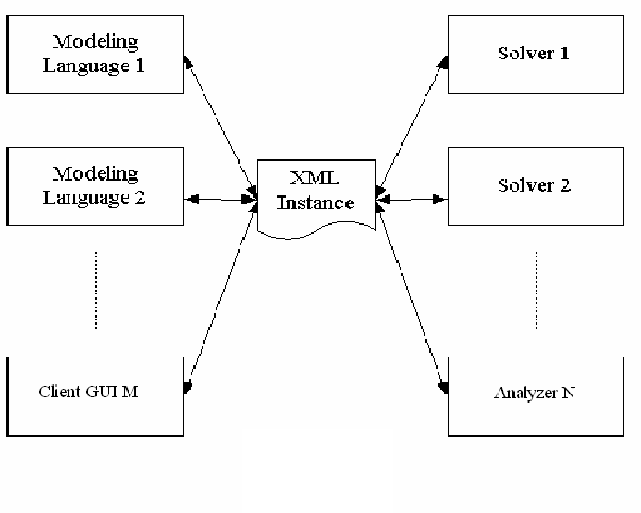
Model vs. Instance
M X N drivers
M + N drivers
OSiL
(OSInstance)
Robert Fourer
Kipp Martin
Model: AIMMS, AMPL, GAMS, LINGO, LPL, MOSEL, MPL, OPL, OSmL, POAMS, PuLP, spreadsheets, GUIs
Instance = Model + Data: MPS, xMPS, LP, LPFML, SIF, SDPA, .nl (
AMPL), instruction list (Lingo)
Optimization Services doesn’t standardize model
(Think of user-friendliness, Java/byte code, .net/MSiL)

Slide 15
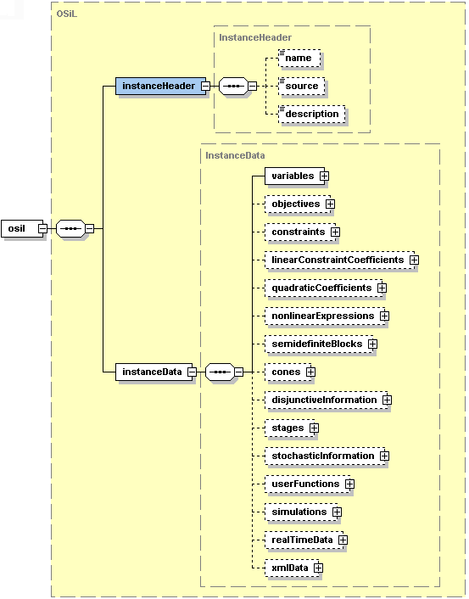
Instance vs. solver
Instance (what OS standardizes)
Optimization Services instance Language (OSiL) – string/file &
OSInstance – in-memory object/data strcutre
Solver API
(What OS does NOT standardize)
Lindo API, Concert, OSI, Impact API
Standardizing Solver API ==
Standardizing API for algorithms
-- standardizing instance can save 90% of the time of code
(think of SQL vs. JDBC/ODBC)

Slide 16
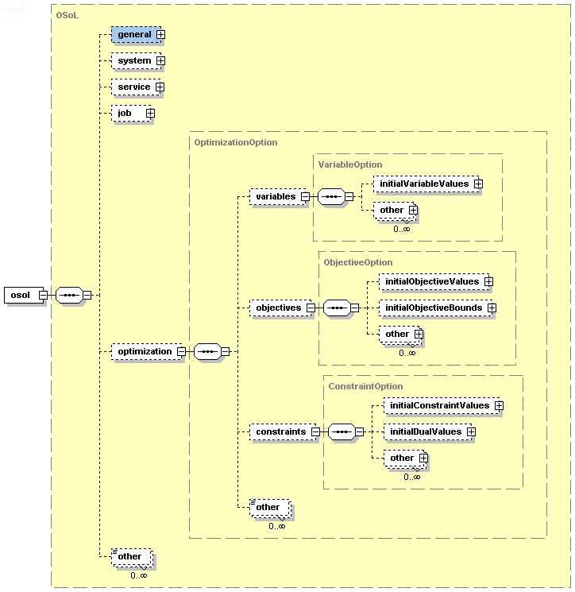
Instance vs. Option
Instance vs. Option ==
Instance vs. Solver/Algorithm
solveMIP == solve() + option->MIP
solveGOP == solve() + option->global
initialSolve == solve() + option->init
similar for other methods
OS does have a format for option
But mainly for services
Hardly any for optimization
Use <other> elements

Slide 17
Methods vs. Arguments
  initialSolve(String OSiL, String OSoL)
  solveMIP (OSInstance instanceObject)
  setOSInstance(OSInstance instanceObject)
  setOSOption(OSOption optionObject)
  minimizeUsingBranchAndBound( )
  OS standardizes the arguments not Solver Methods
  Think about ODBC/JDBC and SQL
  ODBC/JDBC is about database connectivity and is the method part (how). Methods include execute, update, delete, etc. etc. etc. etc.
  SQL is the query to be sent to the database through ODBC/JDBC and is the argument part (what). “select *.* from … where … “

Slide 18
Communication vs. Representation
  Communication is similar to “Methods” (how)
  Representation is similar to “Arguments” (what)
  HTTP is the communication
  HTML is the representation
  HTML is sent via HTTP
  OS standardizes both communication and representation
  Communication are the methods on services (OShL)
  Representation is about what to communicate (OSiL, OSoL, OSrL, OSpL etc. – only strings not objects)

Slide 19
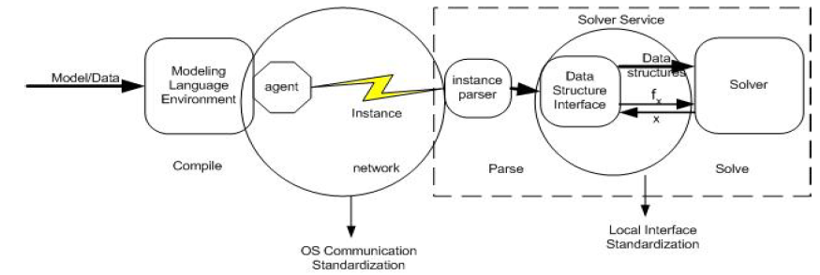
Services vs. Solver
OS standardizes Service API
NOT solver API
OSiL (String)
Only instance
OShL (hook)
getJobID(OSoL) → jobIDString //key in maintaining state
solve(OSiL, OSoL) → OSrL //synchronous call
send(OSiL, OSoL) → true/false //asynchronous call
retrieve(OSoL) → OSrL //coupled mainly with send
kill(OSoL) → OSpLOutput //different from “stop” on IE
Knock(OSpLInput, OSoL) → OSpLOutput //intermediate process info

Slide 20
Distributed vs. Local
Optimization Services partially started as a next-generation NEOS project; therefore with “distributed” in mind
But you always start from a local computer and sooner or later it will reach the other local computer
“Local” is a derived research of Optimization Services and is what the next two talks about for today

Slide 21
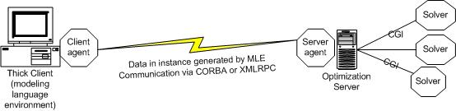
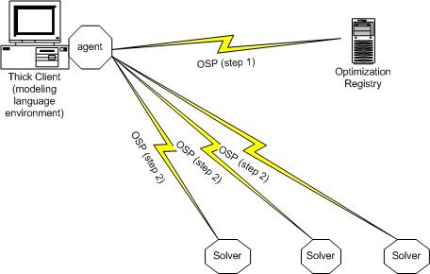
Centralized vs. Decentralized
Centralized
Decentralized

Slide 22
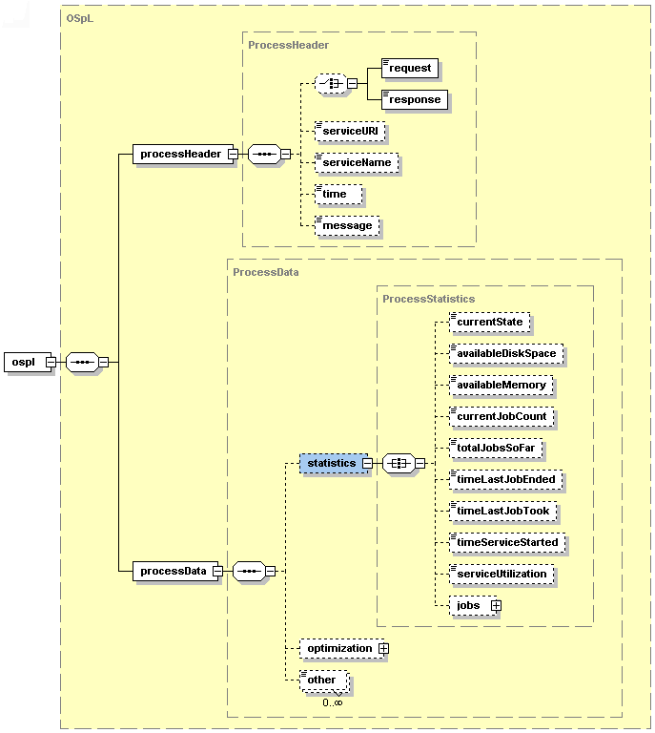
Result vs. Process
  Result → the final output of solver/service
  OS does Standardize (OSrL)
  Process → Intermediate Result? (OSpL)
  OS mainly standardizes the service part, only a little on the optimization part

Slide 23
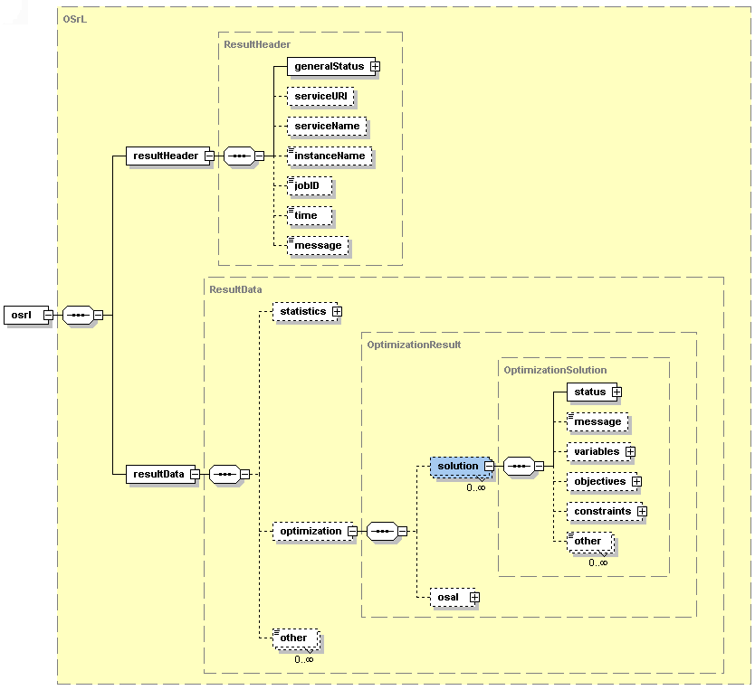
Result vs. Analysis
  Result → OSrL
  Analysis → OSaL (ongoing)

Slide 24
State of Optimization Services
  Implementation in C++, Java, .net
  Instance Extension (core is linear)
  Integer, nonlinear, constraint programming user-functions, optimization via simulation, real-time, ongoing: disjunctive, cone, semidefinite, (Fourer, Ma, Martin)
  GlobalOptimization? NetworkandGraph?
  Stochastic Extension (Fourer, Gassmann, Ma, Martin)
  Modeling Languages
  OSmL [native] (Ma, Martin)
  AMPL (Fourer, Ma, Martin)
  Lingo (Ma, Martin, Shrage //todo)
  Spreadsheet, GAMS //planned)
  Solvers
  IMPACT [native] - convex/GMIP/Parallel (Ma, Mehrotra, Sheng)
  CPLEX, Knitro, Lindo, CLP, CBC, CLP, GLPK, planned IPOPT, etc. (Ma, Martin, Sheng)
  Framework/System (commercial deployment, and noncommercial (NEOS planned)
  Licenses (CPL)
  Third party (Leo Lopez etc.)

Slide 25
OS Repository
  Netlib, Kenninton, Infeasible_set, MIP 2003
  COPS (planned)
  -- all represented in OSiL
  -- all well documented
  OS Web pages (www.optimizationservices.org under construction, soon mutually linked with COIN-OR.org)
  OS Repository and Documents will be available from both sites.

Slide 26
Derived and Future Research/Potential Collaboration
Chapter 10 Future Work and Derived Research from Optimization Services
10.1 The Optimization Services Project
10.2 Standardization
10.3 Problem Repository Building
10.4 Library Building
10.5 Derived Research in Distributed Systems
10.6 Derived Research in Decentralization
10.7 Derived Research in Local Systems
10.8 Derived Research in Optimization Servers
10.9 Derived Research in Computational Software
10.10 Derived Research in Computational Algorithms
10.11 Commercialization and Derived Business Models

Slide 27
User Experience
Open Environment
Convenience just like Using Utility Services
No High Computing Power Needed
No Knowledge in Optimization Algorithms and Software (solvers, options, etc.)
Better and More Choices of Modeling Languages
More Solver Choices
Solve More Types of Problems
Automatic Optimization Services Discovery
Decentralized Optimization Services Development and Registration
More Types of Optimization Services Components Integrated (Analyzers/Preprocessors, Problem Providers, Bench Markers)
Smooth Flow and Coordination of Various Optimization Services Components.
A Universal, Scalable and Standard Infrastructure that promotes Collaboration and Other Related Researches
Concentration on Good Modeling

Slide 28
Business Values
Solve more types of computational problems more efficiently
Easily deploy enterprise computing system within a company, with intelligent components in scheduling computational jobs, registering and finding computing services, routing maintenance
Provide computational software as services on dedicated servers
Let all computational software communicate with each, independent of platforms and implementations.
Save costs on expensive software licenses
Make full use of limited computational solvers

Slide 29


