Slide 1
Optimization via Simulation
under
Optimization Services (OS)
Jun Ma
Industrial Engineering and Management Sciences
Northwestern University
IFORS, Hawaii, 07/14/2005

Slide 2
OUTLINE
1. Optimization via Simulation – two case studies
2. Optimization Services (simulation part)
3. Optimization Services via Simulation representation and communication

Slide 3
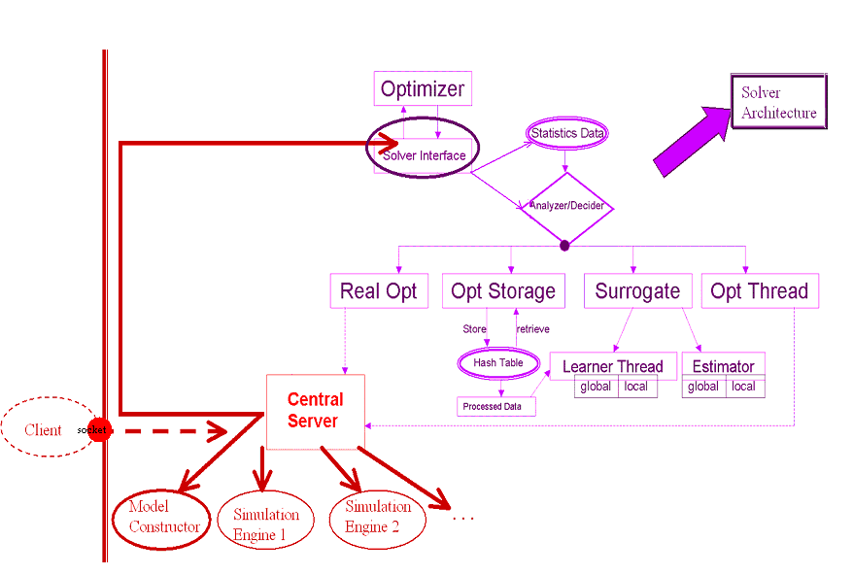
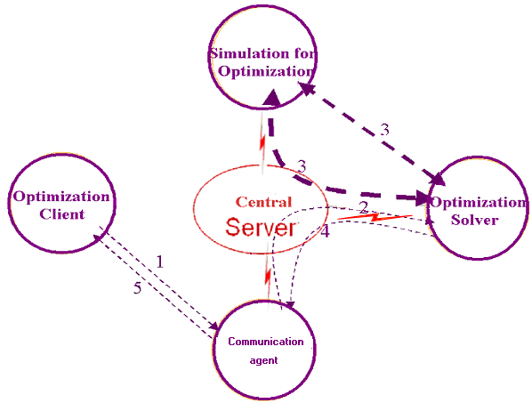
Optimization via Simulation
Case 1: Motorola Optimization System

Slide 4
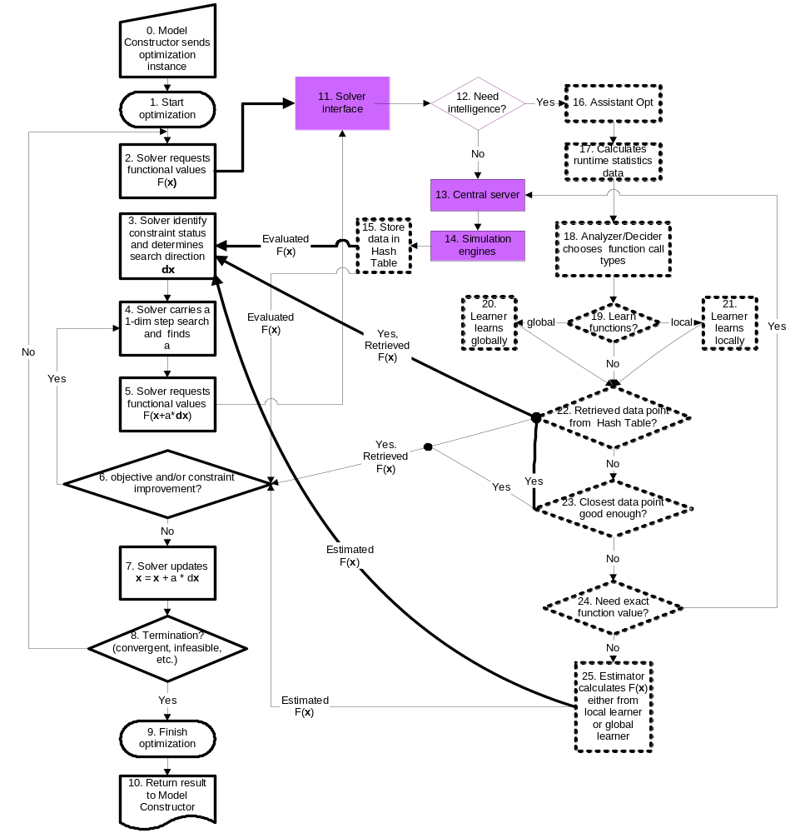

Slide 5
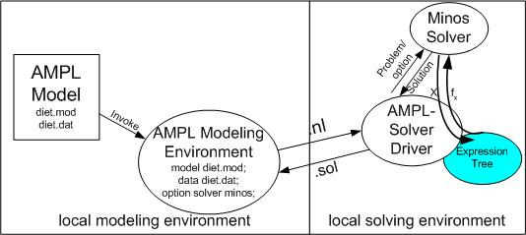
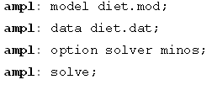
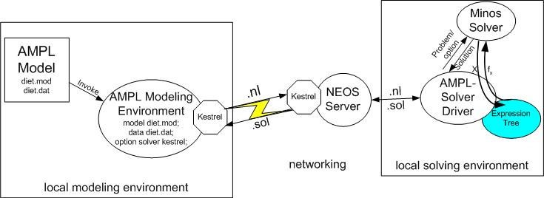
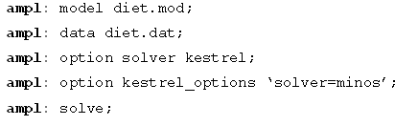
Optimization via Simulation?
Case 2: MPL, NEOS and Kestrel
ampl: option optimizationservices on

Slide 6
OUTLINE
1. Optimization via Simulation – two case studies
2. Optimization Services (Simulation Part)
3. Optimization Services via Simulation representation and communication

Slide 7
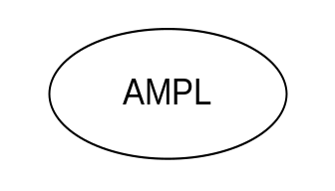
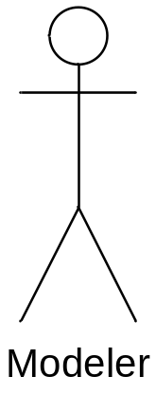
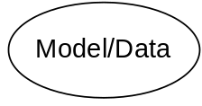
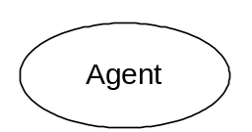
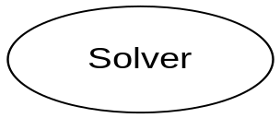
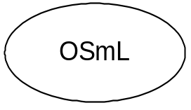
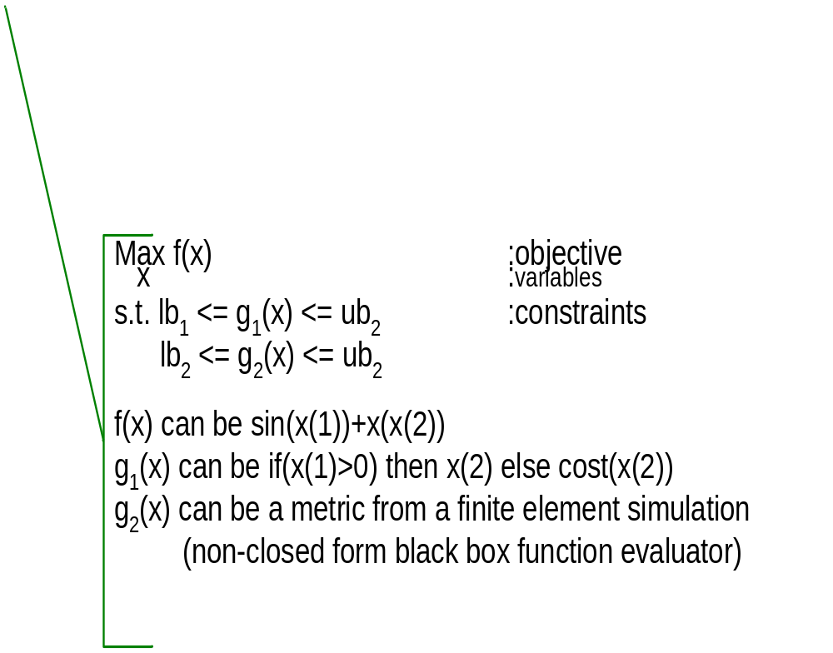
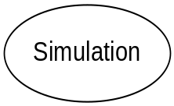
Optimization Services (OS)
OS
Server
Parse to OSiL
OSP -- OShL(OSiL)
OS Server
location

Slide 8
OUTLINE
1. Optimization via Simulation – two case studies
2. Optimization Services (Simulation Part)
3. Optimization Services via Simulation representation and communication

Slide 9
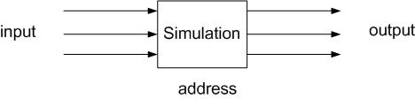
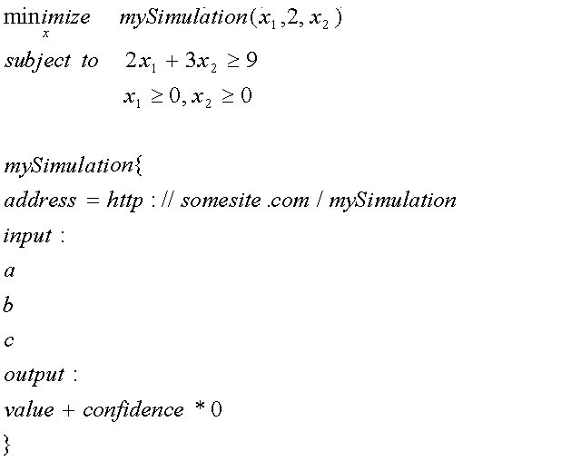
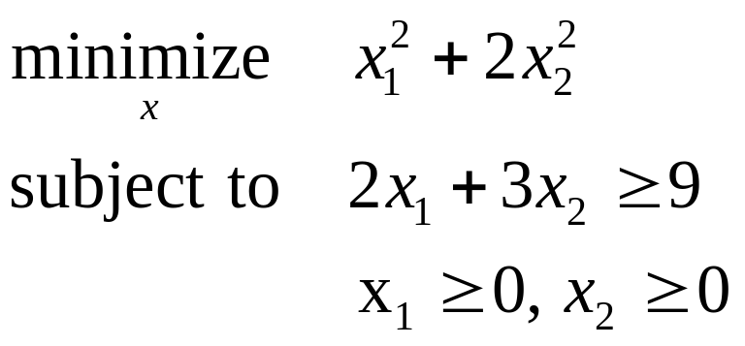
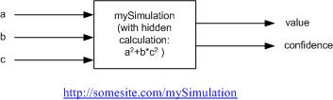
An Optimization Services View of a Simulation

Slide 10
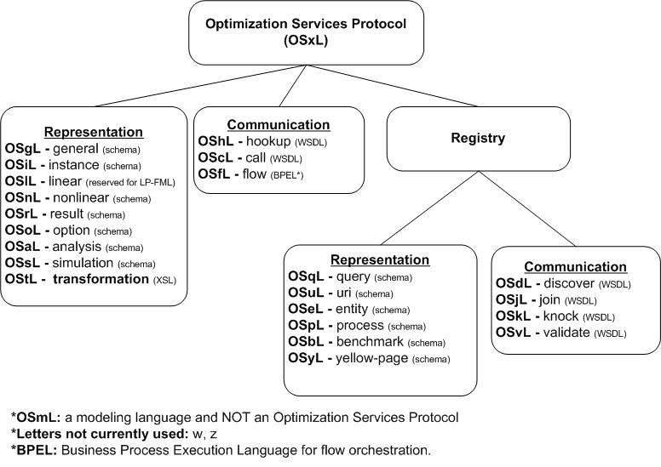
Optimization Services Protocol (OSP)
What does the protocol involve? – 20+ OSxL languages

Slide 11
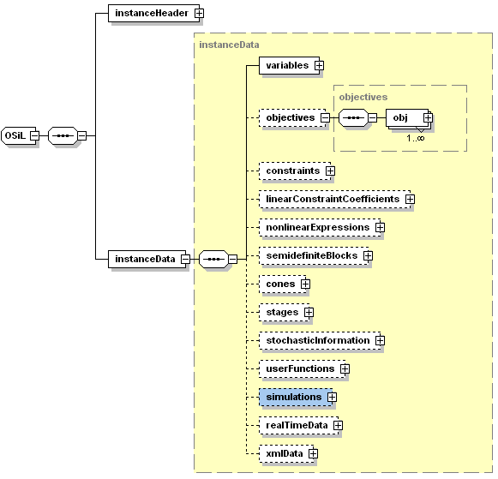
<Simulations> element in OSiL

Slide 12
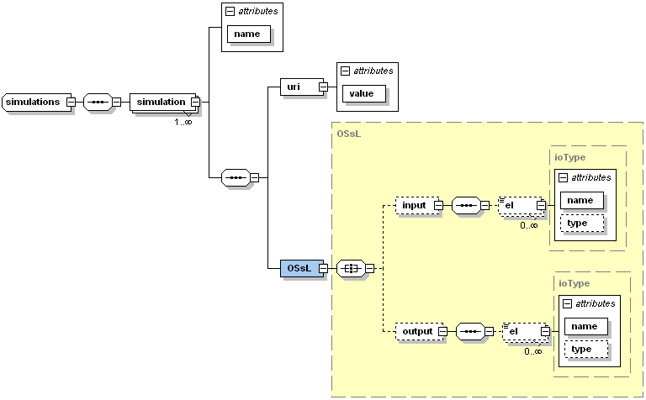
<Simulations> element in OSiL

Slide 13
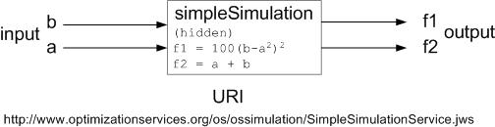
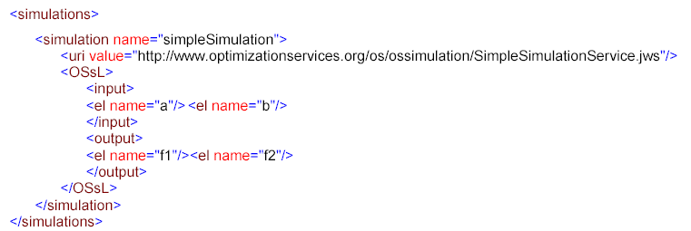

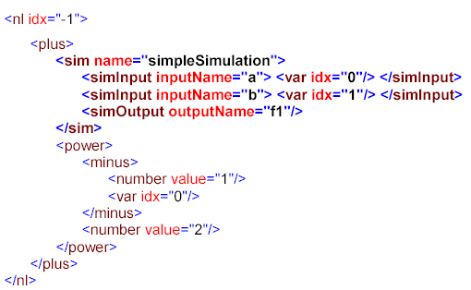
<Simulation> element in OSiL

Slide 14
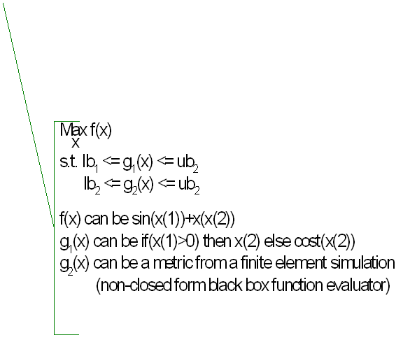


Optimization Services (OS)
OS
Server
Parse to OSiL
OSP -- OShL(OSiL)
OS Server
location

Slide 15

http://www.optimizationservices.org

