Slide 1
Optimization Services (OS)
-- The Internet for OR
-- The Next Generation NEOS
Robert Fourer
Jun Ma
Northwestern University
Kipp Martin
University of Chicago
Jun Ma
Motorola, Schaumburg
01/18/2005

Slide 2
OUTLINE
1. Motivations
2. Introduction
3. Optimization Services and OSxL
An OSxL Example –
Optimization Services instance Language (OSiL)
5. Business Values
6. Conclusion

Slide 3
Motivation
Supply chain modeler should just concentrate on writing a good supply chain model.
An open, scalable and standard environment that facilitates Development & use of OR software and promotes collaboration and other related researches
Convenience and power
  Just like using utility services (therefore the name – Optimization Services)
  Knowledge in optimization algorithms and software (solvers, options, etc.) required of users should be as little as possible
  Better and more choices of modeling languages and solvers
  More types of optimization services (analyzers/preprocessors, problem providers, bench markers, registry, simulation etc.)
  Solve more types of problems
Distributed and decentralized environment
  Automatic optimization services discovery
  Optimization services development and registration

Slide 4
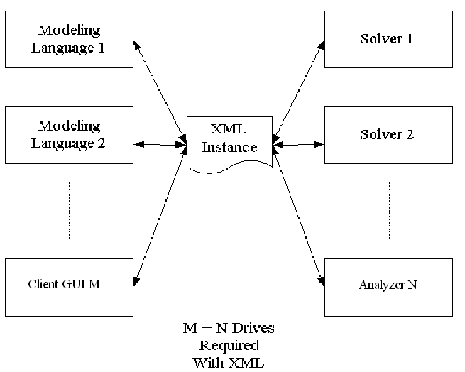
Motivation
For example, it would be nice to have an instance representation language.
This is specified by the Optimization Services instance Language (OSiL)

Slide 5
Introduction
Optimization Services is
A framework, NOT a system
  cf. constitution, NOT government/Court System. Only that the framework specifications are written in XML languages (NOT English).
  But we are developing the modeling system according to this framework.
  We are also building libraries for other people to put up their optimization services.
Distributed environment (Local environment being just a special case)
Service oriented, optimization centered, decentralized architecture.

Slide 6
Introduction
Optimization Services Components
  Modeling Language Environment (MLE) (e.g. AMPL, OSmL) (Fourer, Martin, People from MPL, GAMS, AIMMS, LINDO)
  Optimization Registries (e.g. The next generation NEOS) (Optimization Technology Center under Argonne and NU)
  Analyzers/Preprocessors (e.g. Mprobe, Dr. AMPL) (Chinneck, Orban etc.)
  Optimization Solvers (e.g. Lindo) (Mehrotra, Schrage/Lindo, Nocedal, All NEOS Solvers, COIN-OR)
  Simulation (e.g. Reliability, Finite Element Analysis) (Companies like Motorola, GM, IBM etc.)
  Communication Software Agent – OSAgent (NEOS/OTC, Kestrel/AMPL, Kestrel/GAMS)
  All of the above are communicating in common languages (Bradley, Gassman, Birge etc.)

Slide 7
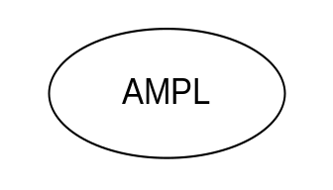
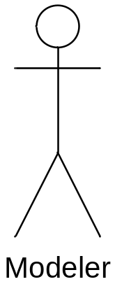
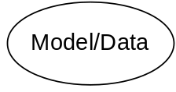
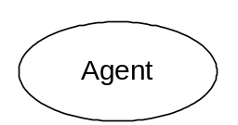
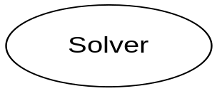
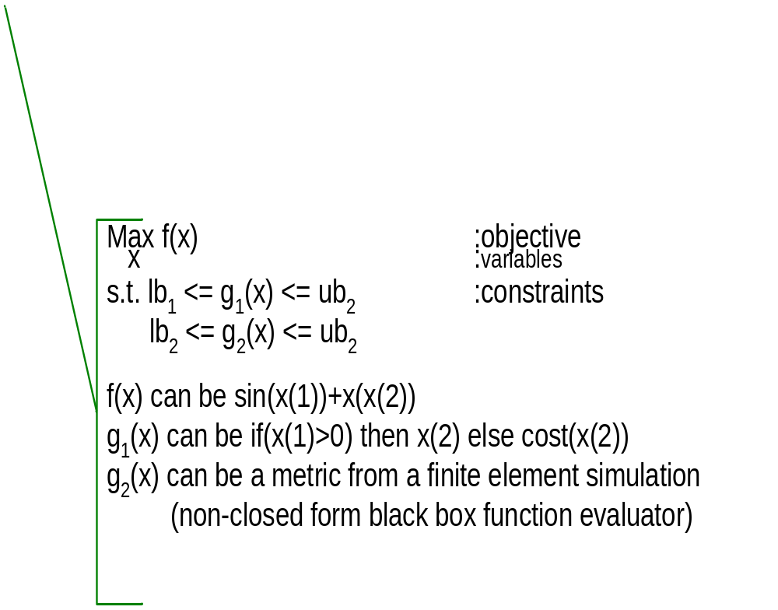
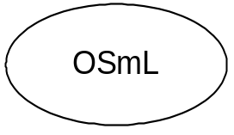
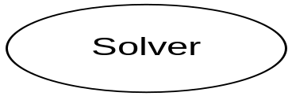
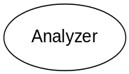
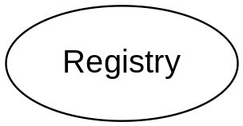
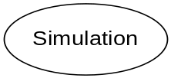
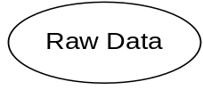
Optimization Services (OS)
THE Optimization Internet
XML-based standard
Web address
html form
browser
http/html
location
Web page
socket
OS
Server
CGI
Parse to OSiL
OSP/ OSxL
Web Server
OS Server
OS Server
HTML Checker
OS Server
Google
Database/ App Service
Data in HTML Form
OSiL – Optimization Services instance Language

Slide 8
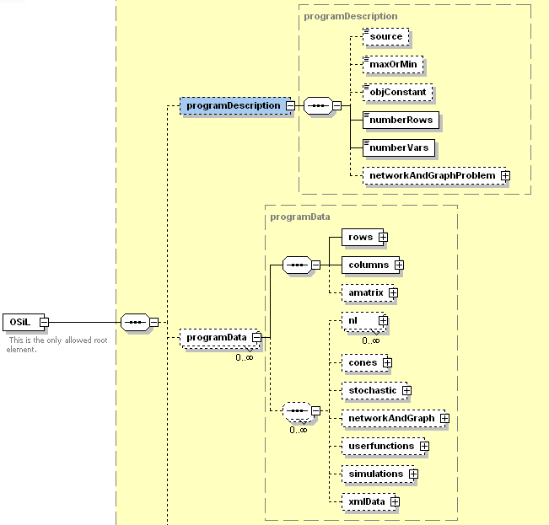
Optimization Services instance Language (OSiL) Schema

Slide 9
OSiL Schema
Nonlinear Expressions and OSnL Schema
  220 major nodes (operators/operands)
  Arithmetic operators, elementary functions, statistical and probability functions, constants, operands, logic and relational operator, trigonometric function, special elements
  User defined functions
  simulations
  XMLData and xPath elements
  Quadratic programming nodes
OS API (OSiLReader/OSiLWriter) and OS Expression Tree
Connecting to solvers
All major optimization types supported

Slide 10
OSiL Schema: Supported Optimization Types
-Linear
-Mixed integer
-Bound constrained optimization
-General quadratic optimization
-Nonlinear unconstrained/constrained
-General mixed integer nonlinear
-General nonlinear with user-defined functions
-Global optimization
-General nonlinear with simulations (black-box functions)
-Optimization over simulation/nondifferentiable optimization
-General nonlinear with xml data (either within OSiL or remotely located)
-General nonlinear with data look up (XPath)
-Network and graph definition
-Network programming
-Constraint programming
-Semidefinite programming
-Semi-infinite programming
-Cone programming
-Complementarity problems
-Stochastic linear/nonlinear (distribution based recourse problem, scenario based recourse problem, chance constrained)
-Combinatorial optimization/Heuristic Optimization (TSP, MST, SP, MF, MCF, VRP, Set Covering, Coloring etc. etc.)

Slide 11
Business Values
Market
  Operations Research in general
  Everything that involves optimization of some kind
  (Knowledge Management, Business Process Management, Supply Chain)
Technology
  An OR Internet of solvers that can easily be adapted within an Intranet
  Goes beyond the VP System
  New standards
  A Complete Suite
  Computing on Demand/Charge by Solution
  Highly publicized Optimization Services Registry
  Solve More Types of Problems
  High entry barriers
Strategy
  Authorities
  A Wide Level of Corporation and Support Being Formed around the Critical Core of Optimization Serivices
  Control over Optimization Services Registry and Domain
  Derived Consulting Services
  Presences at all major conferences -- INFORMS, ICS IFORS
  (two sessions) etc.

Slide 12
NEOS Excerpts
I have been using the NEOS site for about a month now. It has greatly helped in the work I am doing here at General Motors. I have been able to build and solve a prototype combinatorial auction MIP model using AMPL and NEOS in a fraction of the time it would have required me to do this had I needed to requisition a solver and install it locally. Because of this, internal GM customers have been able to see the benefits of optimization in this business context, and will most likely give the go ahead for a full scale development project. This will help GM, and will also help the solver vendor as they will probably get a sale at the end of the project. I have also built two prototype equilibrium models for two separate projects and solved them using the PATH solver. I wouldn't have even attempted going down this road had it not been for NEOS since GM has no complementarity solvers in-house to the best of my knowledge. As it is, I've been able to bring this class of models to bear on these problems, and, as a result, created a valuable solution for two different internal GM customers. These prototype models will also, hopefully, be eventually embedded into full blown enterprise applications which will, ultimately, result in a sale to the solver vendor.
http://www-neos.mcs.anl.gov/neos/stories.html

Slide 13
Conclusion
Sufficient Motivation for Optimization Services
Optimization Services as the Internet for OR
  Simple
  Scalable
  Standard
  Smooth
An OSxL Example –
Optimization Services instance Language
  Cleanly Designed from Scratch
  Highly Extendable
  State-of-art Expression Tree Design
  Supports All Major Optimization Types
  Built for Distributed and Decentralized Systems
  Comes with Natively Designed OSiL APIs (OSiLReader/Writer)
  Already Connected with Solvers

