Slide 1
Optimization Services Framework and
OSxL Protocols
Jun Ma
Northwestern University
09/14/04

Slide 2
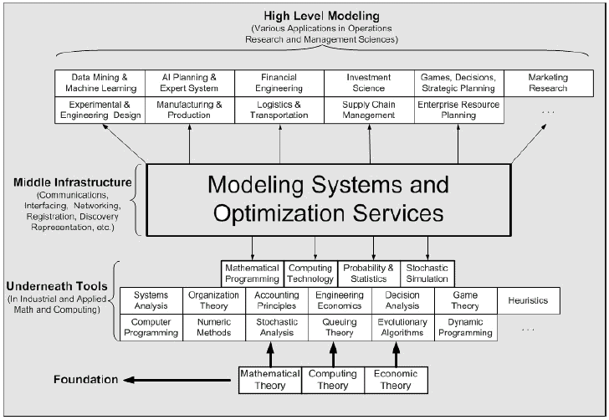
The Positioning of
Optimization Services Framework in OR/MS

Slide 3
What is “Optimization Services” (OS)?
A proper noun. It’s intended as a standard, and it’s all new
A framework, NOT a system (cf. constitution, NOT government/Court System)
Only that the specifications are written in XML (NOT English)
Intended for next generation modeling systems as Internet resources.
Distributed Environment (cf. Local Environment is a Special Case, e.g. Monitor and CPU)
Decentralized Environment (Registry Vs. Server)
A Universal Idea (System Decomposition, Interfacing, Representation)
General Principle (4S)
  Standard (oasis-open.org: discussion list -> technical committee -> draft -> Standard)
  Simple (not the framework, but the framework components. Libraries provided)
  Scalable (general OSxL specification design, where ‘x’ stands for any other 25 letters)
  Smooth (Service Oriented Architecture or SOA, cf. Utility Services)

Slide 4
System Components
Models and Instances
Modeling Languages Environments, Transformation Engine, etc.
Optimization Servers/Registries
Clients and Interfaces
Preprocessors/Analyzers
Optimization Solvers
Function Evaluators and Simulation Engines
Others? (Benchmark Problem Services etc.)

Slide 5
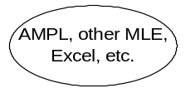





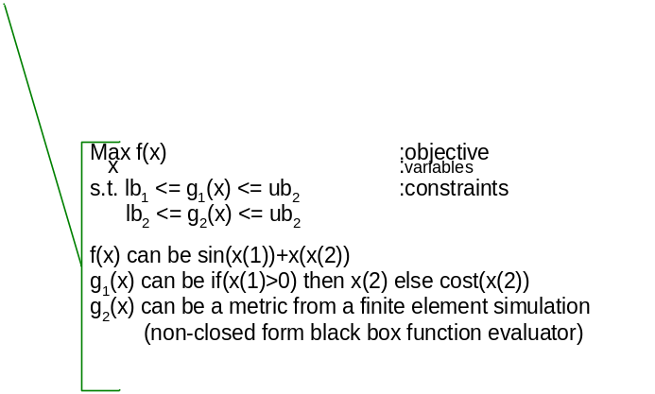




OS Framework and
OSxL Specification
communication (representation)
XML-based standard
location
Web Service Server
hook
(instance)
OShL
(OSiL)
Parse to OSiL
(result)
(OSrL)
Invoke
(instance)
(analysis)
Join
(Entity Description)
Call
(in/out)
OSjL
(OSeL)
OScL
(OSsL)
OShL
(OSiL)
(OSaL)
Web Service Server
Discover
(query)
Web Service Server
OSdL
(OSqL)
URL
Flow (OSfL)
(OSuL)
Web Service Server
[Standard, Simple, Scalable] => Smooth
The General and Universal Framework for Optimization in Local and Distributed Environment.
Combining Optimization with Modern Computing Technologies.
A Next Generation Modeling System as An Internet Resource.
Standardization of Optimization Representation, Communications, Registration, and Discovery
Using Optimization Computing Tools Just Like Daily Utility Services.

Slide 6
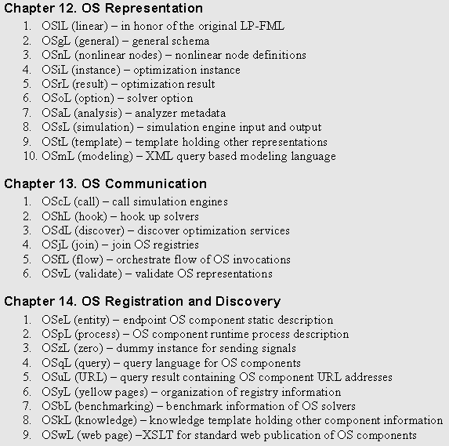

Slide 7
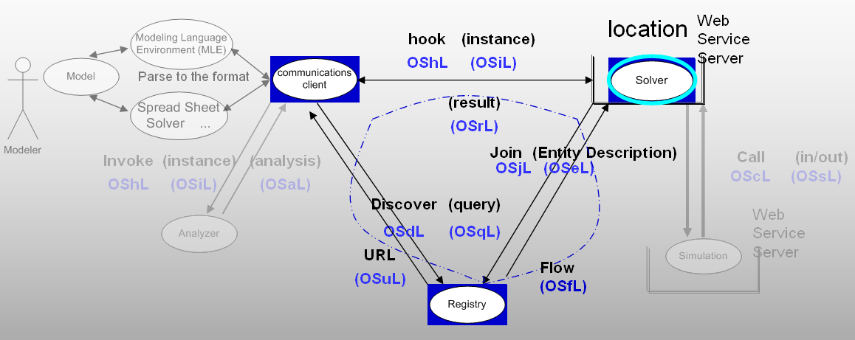
OS Framework and
XML-based standard OSxL Specification
communication (representation)
[Standard, Simple, Scalable] => Smooth
The General and Universal Framework for Optimization in Local and Distributed Environment.
Combining Optimization with Modern Computing Technologies.
A Next Generation Modeling System as An Internet Resource.
Standardization of Optimization Representation, Communications, Registration, and Discovery
Using Optimization Computing Tools Just Like Daily Utility Services.

