Slide 1
Optimization Services hookup Language (OShL)
-- API for invoking Remote Solver Service
-- Think of HTTP/HTML, JDBC/ODBC
-- Open Source
-- Platform Independent
-- Programming Language Independent
Jun Ma
Robert Fourer
Northwestern University
Kipp Martin
University of Chicago
Jun Ma
INFORMS, Pittsburgh
11/08/2006

Slide 2
OUTLINE
1. Optimization Services and OSP (OSxL’s)
2. Invoking a remote solver service
3. Optimization Services hookup Language (OShL)
4. Conclusion

Slide 3
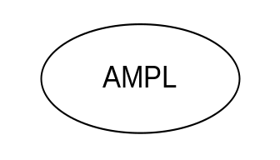

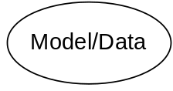
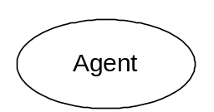
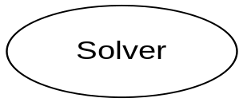
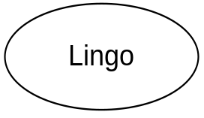
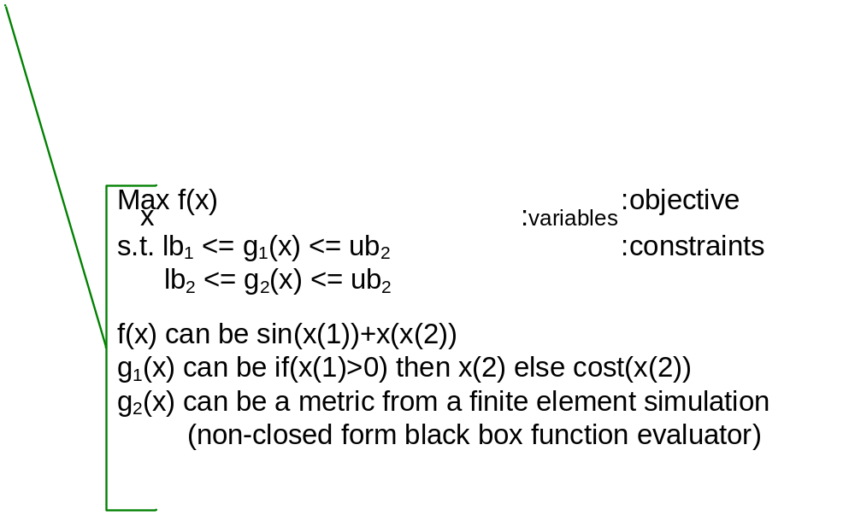
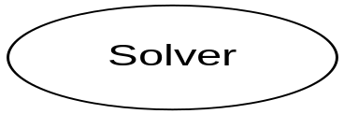
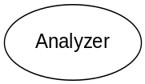
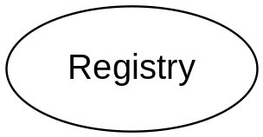
Optimization Services (OS)
THE Optimization Internet
XML-based standard
Web address
html form
browser
http/html
location
Web page
socket
OS
Server
CGI
Parse to OSiL
OSP/ OSxL
Web Server
OS Server
Google
OS Server
OShL – Optimization Services hookup Language

Slide 4
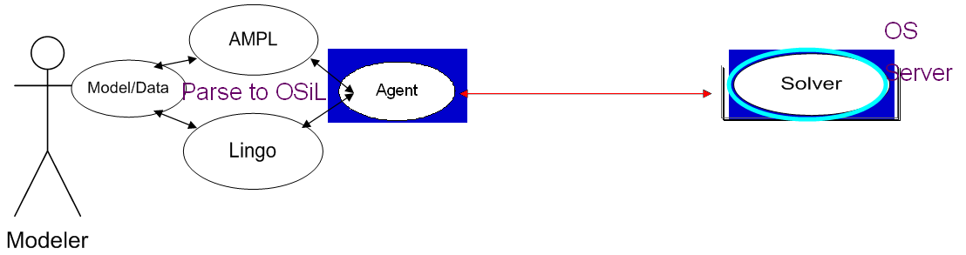
Invoking remote solver service (1)
solve(instance, option) -> result
getJobID(option) -> jobID
Requirement
Solution
1. Platform Independent
OS is Web services based
2. Language Independent
OShL is XML Based WSDL
3. Protocol Independent
OShL is in SOAP envelope
4. Type compatibility
Uses all strings as arguments
5. Simple
6 methods, 2 args, only 1 method impl., no network knowledge req.
6. Built-in state/session maintenance
jobID
7. Request and response/Blocking
solve(instance, option) -> result

Slide 5
Invoking remote solver service (2)
send(instance, option) -> true/false
retrieve(option) -> result
kill(option) -> killProcessResult
Requirement
Solution
8. Communication only
No specification on arguments
Argument specification -> xml schemas -> OSiL, OSoL, OSrL etc.
9. Truly asynchronous (server side)
send(instance, option) -> true/false
10. Retrieve anytime, anywhere
jobID, service-oriented architecture
11. Must stop remote process
Kill (≠ stop on the browser)

Slide 6
Invoking remote solver service (3)
knock(inputProcess, option) -> outputProcess
Requirement
Solution
8. Dynamic process information (heartbeat)
Knock
9. Extendable
2 inputs, 1 output (leverages on OSpL)
ping
getServiceStatistics
setServiceStatistics
getJobStatistics
setJobStatistics
getOptmizationStatistics
setOptmizationStatistics
getAll
setAll
notifyJobCompletion
requestJob

Slide 7
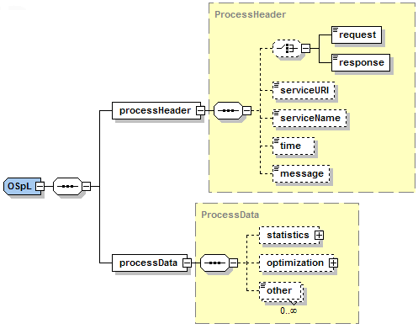
Invoking remote solver service (4)
knock(inputProcess, option) -> outputProcess

Slide 8
Optimization Services hookup Language (OShL)
getJobID (String OSoL) -> jobID
solve (String OSiL, String OSoL) -> OSrL
send (String OSiL, String OSoL) -> true/false
retrieve (String OSoL) -> OSrL
kill (String) -> OSpL
knock(String OSpL, String OSoL) -> OSpL

Slide 9
Our OShL-compatible solver hosting SERVER reference impl.
Remote job submission, management and control
Remote retrieval of previously submitted jobs
Session and state maintenance
Synchronous and asynchronous solver invocation
Killing long jobs over the remote server
Checking and managing service status and job statistics
Automatic job completion notification via most common protocols including emails
Persistence between service starts
Service logging
Automatic notification of critical service information to admin
Centralized user configuration
Directory and file cleanup
Disk, memory and process cleanup
Critical data backing up
Waiting job queue management
Long computational job handling
Job dependency handling
Keeping track of service utilization and preparing periodic report
Automatic input and output validation and processing
Support of machines with multiple CPUs
Support of all major operating systems
Authentication and authorization
Security

Slide 10
Conclusion
Optimization Services, OS Protocols (OSP => OSxL’s)
Design Requirement in Invoking Remote Solver Service
Optimization Services
Optimization Services will be released end of the year or beginning of next year.
Almost all major parties (commercial, open source, research projects) are adopting it (It’s a private process now!)
Next generation NEOS
Critical role in Cyber-infrastructure
A Mega COIN project – touches nearly all the major COIN optimization-related projects
“Run-Time” COIN (COmputational INfrastructure)
Optimization Internet
Contact us in private

