Slide 1
OSiL: An XML-based schema for stochastic programs
H.I. Gassmann, R. Fourer, J. Ma, R.K. Martin
SP XI Vienna, August 2007

Slide 2
Outline
Motivation and review
A four-stage investment problem
OSiL format
Conclusions and future work

Slide 3
Why a standard?
Benchmarking
Archiving
Algorithm development
Distributed computing
Sharing of problem instances

Slide 4
Why XML?
Existing parsers to check syntax
Easy to generate automatically
Tree structure naturally mirrors expression trees for nonlinear functions
Arbitrary precision and name space
Automatic attribute checking (e.g., nonnegativity)
Querying capabilities via XQuery
Encryption standards being developed
Easy integration into broader IT infrastructure

Slide 5
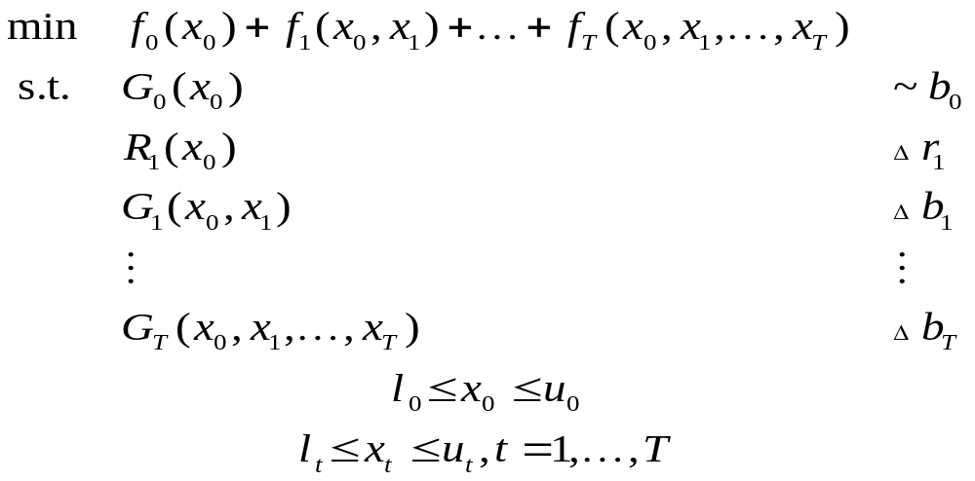
Stochastic programs
“ ”
Any data item with nonzero subscript may be random
(including dimensions where mathematically sensible)
~ stands for arbitrary relations (≤, =, ≥)
Δ means ~ with probability 1
or with probability at least β
or with expected violation at most v
or …

Slide 6
Problem classes and time domain
Single-stage problems
  Mean-variance problems (Markowitz)
  Robust optimization
  Chance-constrained problems
  Reformulated and solved as deterministic nonlinear problems

Slide 7
Problem classes and time domain (cont’d)
Two-stage problems with recourse
  Solved by
    Deterministic equivalent methods
    Benders decomposition
    Stochastic quasigradient methods
    Stochastic decomposition (Higle and Sen)
    Monte Carlo sampling (Shapiro and Homem-de-Mello)
    Regression approximation (Deák)
  Distributions
    Known
    Approximated (by scenario generation)
    Partially known (moments, distribution type, support, etc.)

Slide 8
Problem classes and time domain (cont’d)
Multi-stage recourse models
  Deterministic equivalent
  Nested Benders decomposition
  Progressive hedging
  Multistage stochastic decomposition
  Probabilistic constraints and risk measures can be added as “linking constraints”

Slide 9
Problem classes and time domain (cont’d)
Horizon problems (Grinold, Sethi)
Markov reward processes
Continuous time problems

Slide 10
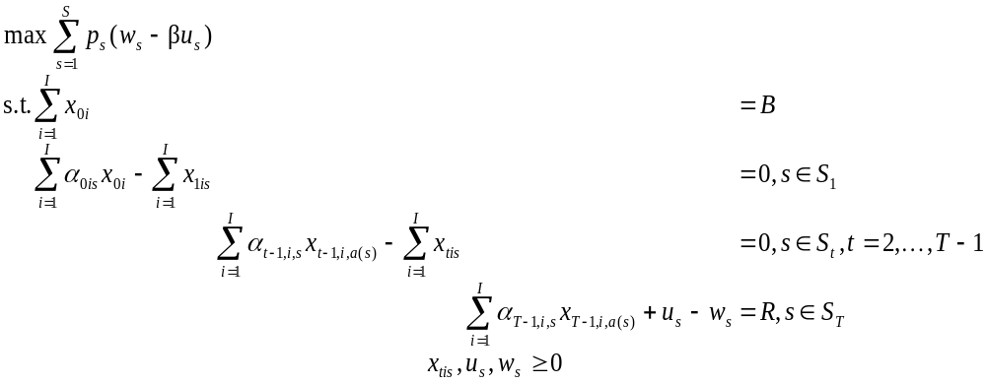
Example (Birge)
S₀
S₁
S₂
I = 2, T = 3, B = 55, R = 80,
α_{t1} = {1.25, 1.06},
α_{t2} = {1.14, 1.12}
…

Slide 11
Markup languages
Intersperse text (data) and information about it (formatting, etc.)
Examples
  TeX (extensible through user \def)
  HTML
  VRML
  XML

Slide 12
OSiL Schema
Written in XML
Very flexible
Intended to handle as many types of mathematical programs as possible
  Linear and integer
  Nonlinear
  Stochastic
  …

Slide 13
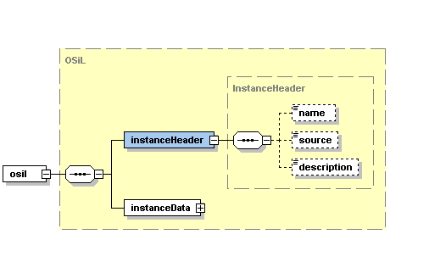
OSiL Schema – Header information

Slide 14
Header information – Example
<?xmlversion="1.0"encoding="UTF8"?>
<osil xmlns="os.optimizationservices.org“
xmlns:xsi=http://www.w3.org/2001/XMLSchemainstance
xsi:schemaLocation="OSiL.xsd">
<instanceHeader>
<name>FinancialPlan_JohnBirge</name>
<source>
Birge and Louveaux, Stochastic Programming
</source>
<description>
Three-stage stochastic investment problem
</description>
</instanceHeader >
<instanceData>
...
</instanceData>
</osil>

Slide 15
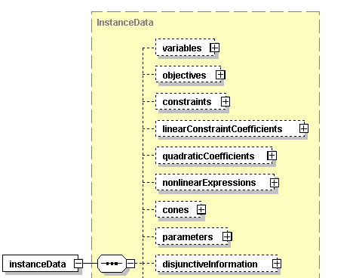
OSiL Schema – Deterministic data
…

Slide 16
Instance data –
Variables, objectives, constraints
<variables numberOfVariables="8">
<var name="invest01" type="C" lb="0.0"/>
<var name="invest02"/>
<var name="invest11"/>
<var name="invest12"/>
<var name="invest21"/>
<var name="invest22"/>
<var name="w"/>
<var name="u"/>
</variables>
<objectives numberOfObjectives="1">
<obj maxOrMin="max" numberOfObjCoef= "2" lb="0.0">
<coef idx="6"/>1.</coef>
<coef idx="7"/>-4.</coef>
</obj>
</objectives>
<constraints numberOfConstraints="4">
<con name="budget0" lb="55" ub="55"/>
<con name="budget1" lb="0" ub="0"/>
<con name="budget2" lb="0" ub="0"/>
<con name="budget3" lb="80" ub="80"/>
</constraints>

Slide 17
Instance data –
Core matrix (sparse matrix form)
<linearConstraintCoefficients
numberOfValues=“14">
<start>
<el>0</el>
<el>2</el>
<el>4</el>
<el>6</el>
<el>8</el>
<el>10</el>
<el>12</el>
<el>13</el>
<el>14</el>
</start>
<rowIdx>
<el>0</el>
<el>1</el>
<el>0</el>
<el>1</el>
<el>1</el>
<el>2</el>
<el>1</el>
<el>2</el>
<el>2</el>
<el>3</el>
<el>2</el>
<el>3</el>
<el>3</el>
<el>3</el>
</rowIdx>
<value>
<el>1</el>
<el>1.25</el>
<el>1</el>
<el>1.14</el>
<el>1</el>
<el>1.25</el>
<el>1</el>
<el>1.14</el>
<el>1</el>
<el>1.25</el>
<el>1</el>
<el>1.14</el>
<el>1</el>
<el>-1</el>
</value>

Slide 18
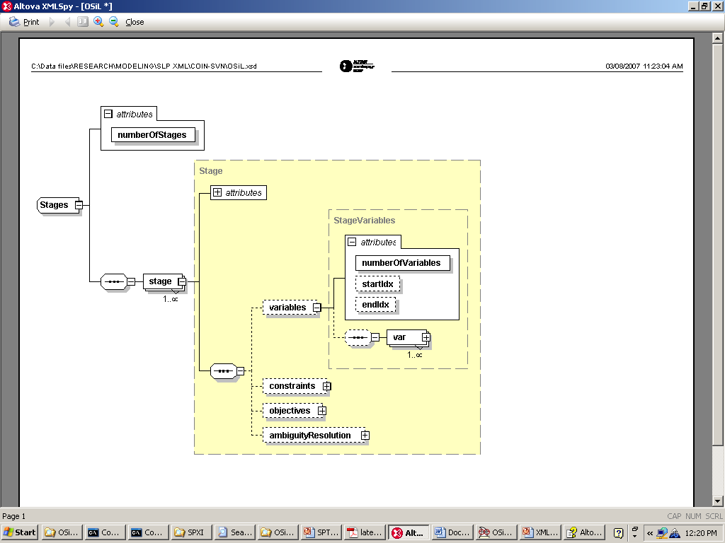
OSiL Schema – Dynamic structure

Slide 19
Dynamic information – Example
<stages numberOfStages="4">
<stage>
<variables numberOfVariables="2" startIdx="0" endIdx="1"/>
<constraints numberOfConstraints="1" startIdx="0"/>
</stage>
<stage>
<variables numberOfVariables="2" startIdx="2" endIdx="3"/>
<constraints numberOfConstraints="1" startIdx="1"/>
</stage>
<stage>
<variables numberOfVariables="2" startIdx="4" endIdx="5"/>
<constraints numberOfConstraints="1" startIdx="2"/>
</stage>
<stage>
<variables numberOfVariables="2">
<var idx="6"> <var idx="7">
</variables>
<constraints numberOfConstraints="1" startIdx="3"/>
</stage>
</stages>

Slide 20
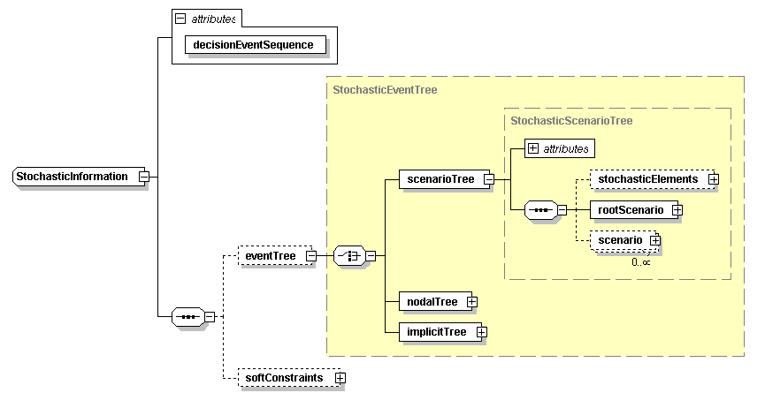
Explicit and implicit event trees

Slide 21
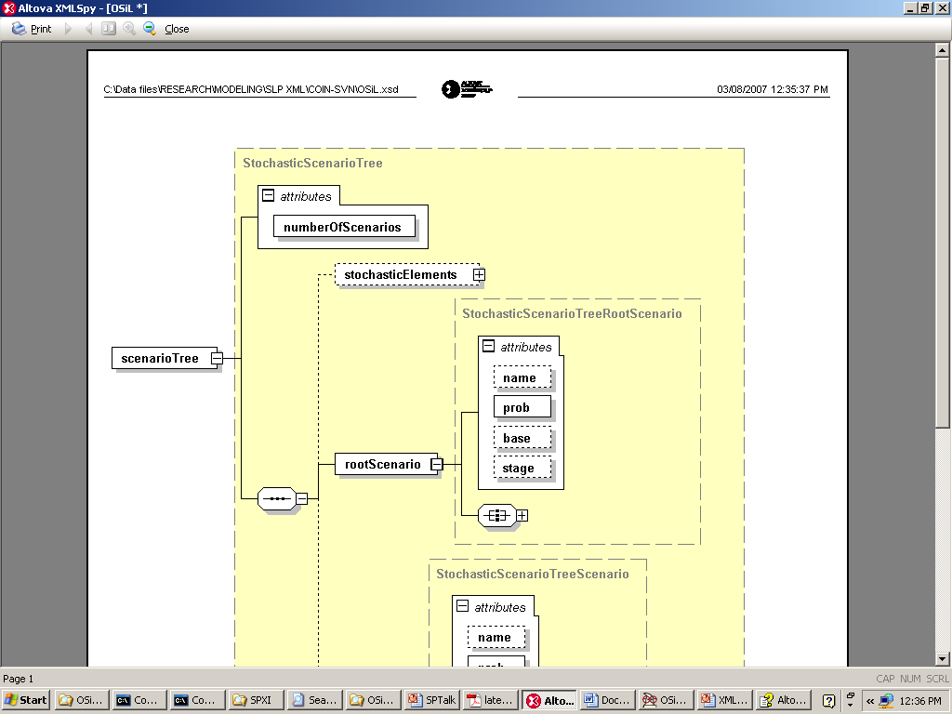
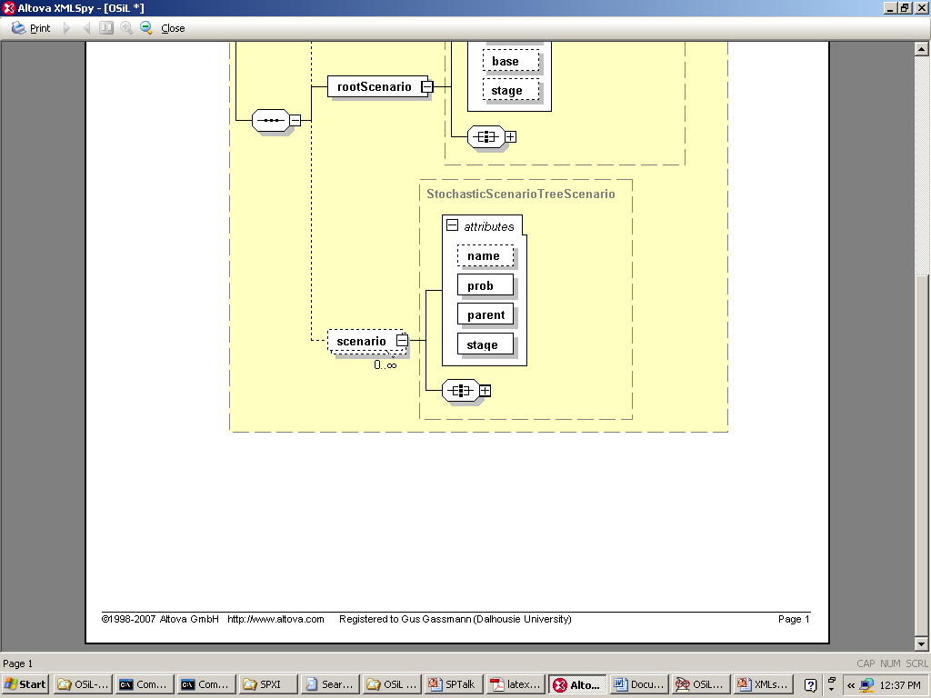
OSiL Schema – Scenario trees

Slide 22
Scenario tree – Example
<stochasticInformation decisionEvenSequence="DecisionAfterEvent">
<eventTree>
<scenarioTree numberOfScenarios="8">
<rootScenario prob="0.125" stage="0"/>
<scenario prob="0.125" stage="3" parent="0">
<linearConstraintCoefficients>
<el rowIdx="3" colIdx="4">1.06</el>
<el rowIdx="3" colIdx="5">1.12</el>
</linearConstraintCoefficients>
</scenario>
<scenario prob="0.125" stage="2" parent="0">
…

Slide 23
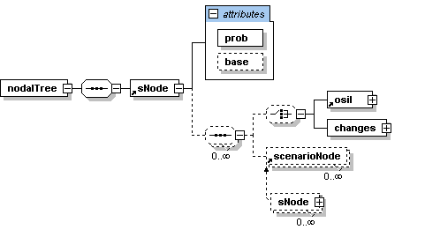
Node-by-node representation for stochastic problem dimensions

Slide 24
Node-by-node – Example
<stochasticInformation decisionEvenSequence="DecisionAfterEvent">
<eventTree >
<nodalTree>
<sNode prob="1" base="coreProgram">
<sNode prob="0.5" base="coreProgram">
<sNode prob="0.5" base="coreProgram">
<sNode prob="0.5" base="coreProgram"/>
<sNode prob="0.5" base="firstSibling">
<changes>
<el rowIdx=“3" colIdx="4">1.06</el>
<el rowIdx="3" colIdx="5">1.12</el>
</changes>
</sNode>
</sNode>
…

Slide 25
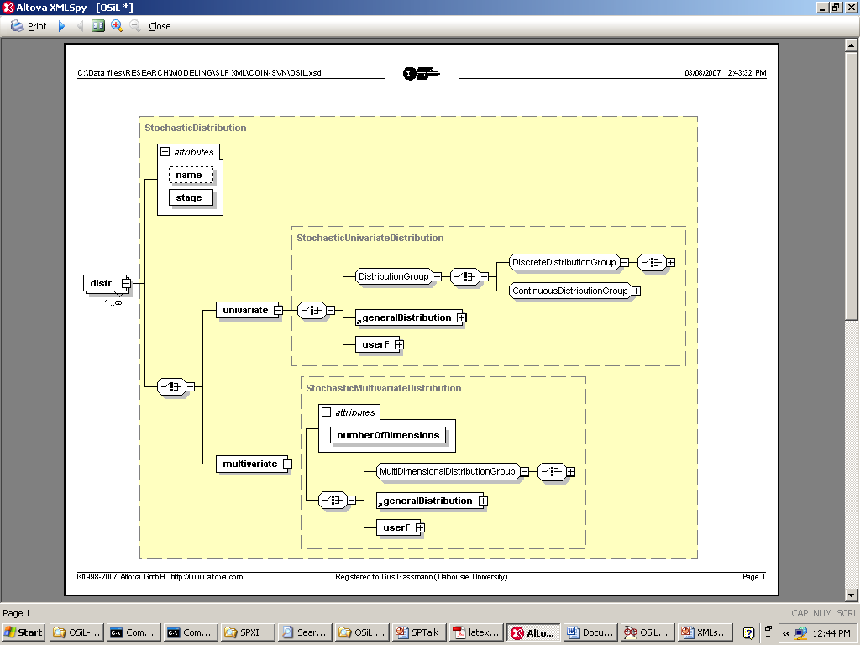


Distributions (implicit tree)

Slide 26
Discrete random vector
<distributions>
<multivariate>
<distr stage="1">
<multiDimensionalDistributionGroup>
<multivariateDiscrete>
<scenario>
<prob>0.5</prob>
<el>1.25</el>
<el>1.14</el>
</scenario>
<scenario>
<prob>0.5</prob>
<el>1.06</el>
<el>1.12</el>
</scenario>
</multivariateDiscrete>
</multiDimensionalDistributionGroup>
</distr>
…
</multivariate>
</distributions>

Slide 27
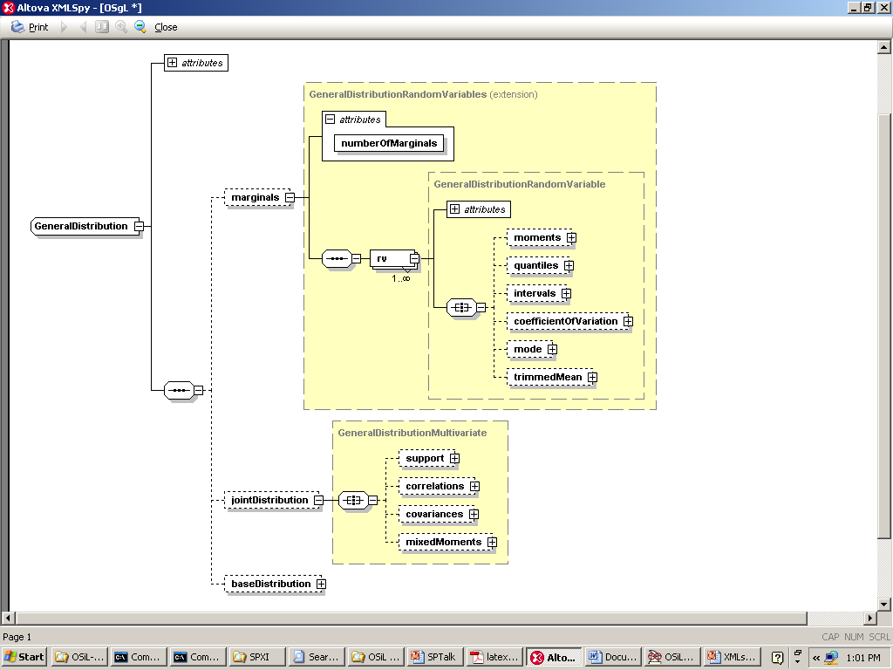
General distribution (incomplete information)

Slide 28
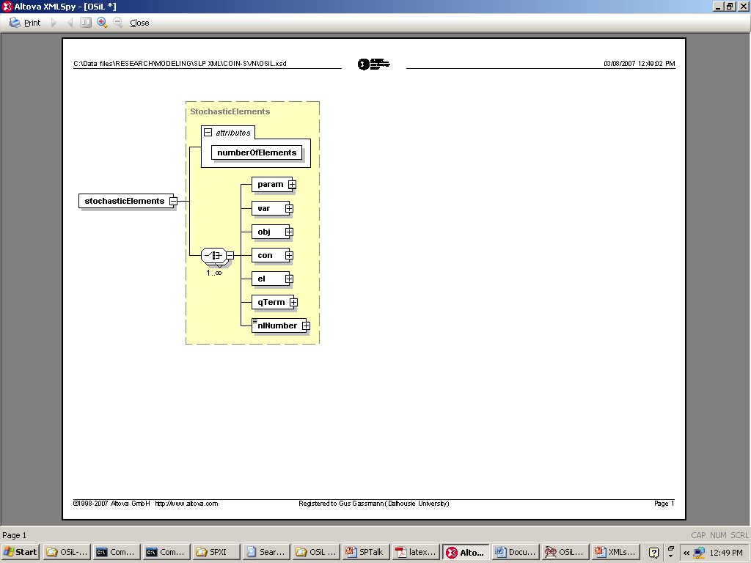
Transformations
Random variables separated from model entities
Linked to stochastic problem elements by transformations (linear or nonlinear)
Useful for factor models and other stochastic processes

Slide 29
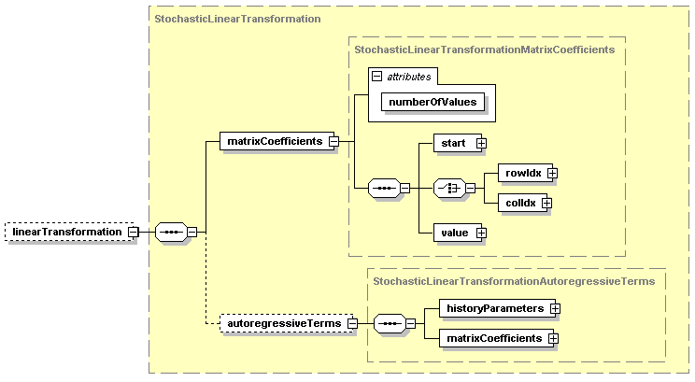
OSiL schema – Linear transformations

Slide 30
Linear transformation – Example
<stochasticTransformation>
<linearTransformation>
<stochasticElements
numberOfElements="6">
<el rowIdx="1" colIdx="0"/>
<el rowIdx="1" colIdx="1"/>
<el rowIdx="2" colIdx="2"/>
<el rowIdx="2" colIdx="3"/>
<el rowIdx="3" colIdx="4"/>
<el rowIdx="3" colIdx="5"/>
</stochasticElements>
<matrixCoefficients
numberOfElements="6">
<start>
<el>0</el>
<el>1</el>
<el>2</el>
<el>3</el>
<el>4</el>
<el>5</el>
<el>6</el>
</start>
<rowIdx>
<el>0</el>
<el>1</el>
<el>2</el>
<el>3</el>
<el>4</el>
<el>1</el>
</rowIdx>
<value>
<el mult="6">1.0</el>
</value>
</matrixCoefficients>
</linearTransformation>
</stochasticTransformation>

Slide 31
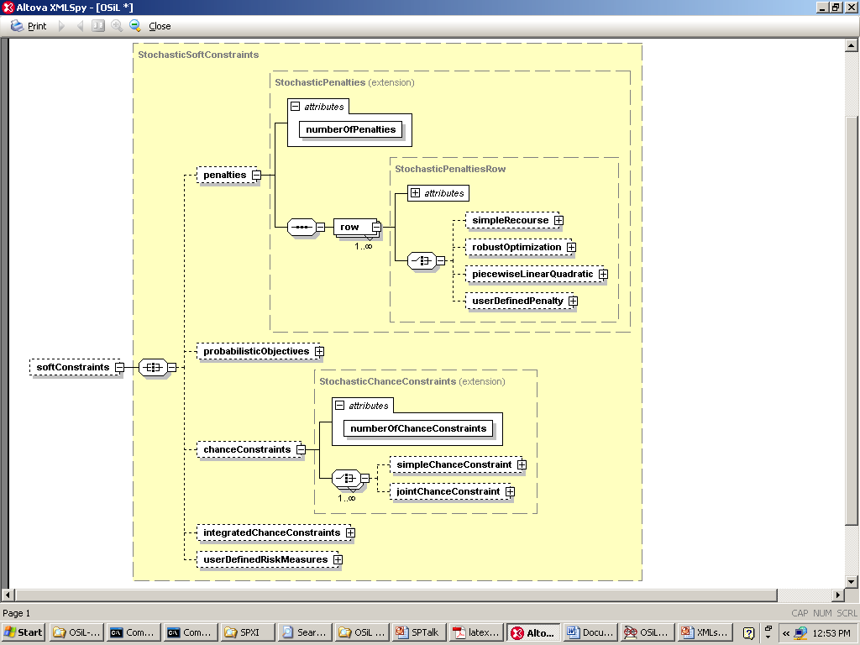
Penalties and probabilistic constraints

Slide 32
Nonlinear expression –
(2x₀ – x₁²)² + (1 – x₀)²
<plus>
<power>
<minus>
<var coef="2.0" idx="0"/>
<power>
<var coef="1.0" idx="1"/>
<number value="2"/>
</power>
</minus>
<number value="2"/>
</power>
<power>
<minus>
<number value="1"/>
<var coef="1.0" idx="0"/>
</minus>
<number value="2"/>
</power>
</plus>

Slide 33
Capabilities
Arbitrary nonlinear expressions
Arbitrary distributions
Scenario trees
Stochastic problem dimensions
Simple recourse
Soft constraints with arbitrary penalties
Probabilistic constraints
Arbitrary moment constraints

Slide 34
Further work
Internal data structures (OSInstance)
OSiLWriter: SMPS → OSiL
Library of problems (netlib, POSTS, Ariyawansa and Felt, Watson, SIPLib,…)
Readers
Solver interfaces
Buy-in

Slide 35
QUESTIONS?
http://www.optimizationservices.org
http://myweb.dal.ca/gassmann

