Slide 1
An XML-based schema for stochastic programs
H.I. Gassmann, R. Fourer, J. Ma, R.K. Martin
INFORMS Meeting, November 2005, San Francisco

Slide 2
Outline
Motivation
Stochastic programs: Dynamic and stochastic structure
Taxonomy of problems
A three-stage investment problem
OSiL format
Stochastic extensions
Conclusions and future work

Slide 3
Motivation
General format for as wide a variety of problem instances as possible
Essential for benchmarking, archiving, algorithm development
Useful for distributed computing
Nonlinear capabilities

Slide 4
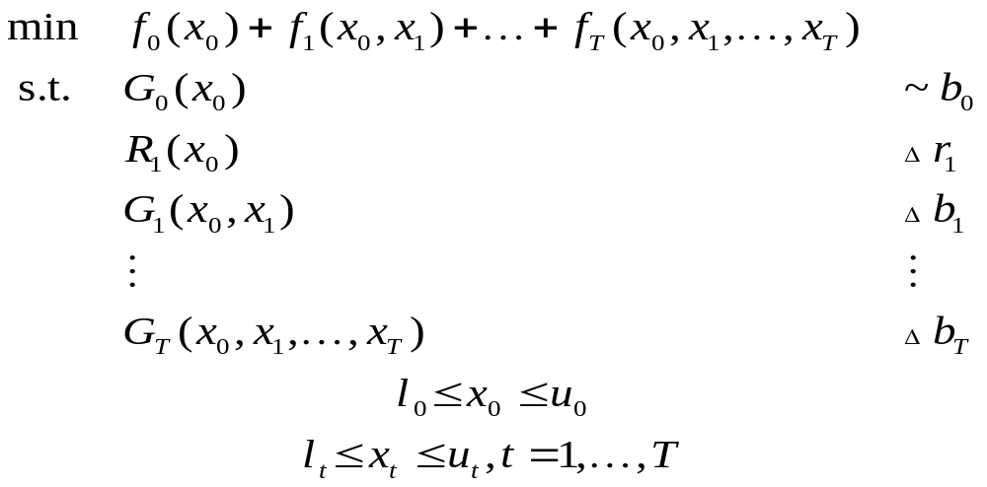
Stochastic programs
Any data item with nonzero subscript may be random
(including dimensions where mathematically sensible)
~ stands for arbitrary relation (≤, =, ≥)

Slide 5
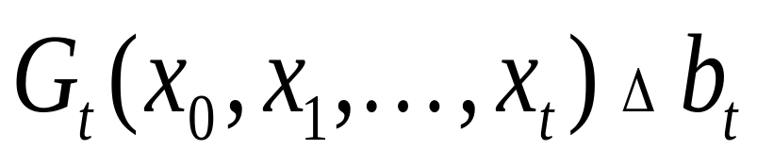
Constraints involving random elements
Δ means ~ with probability 1
or with probability at least β
or with expected violation at most v
or …
Notes:
Probability 1: Deterministic constraint or almost surely
Probability β: Probabilistic constraint (VaR)
Expected violation: CVaR

Slide 6
Problem classes
Recourse problems
  All constraints hold with probability 1
Chance-constrained problems
  Typically single stage
Hybrid problems
  Recourse problems including features such as chance constraints or integrated chance constraints

Slide 7
Dynamic and stochastic structure
Dynamic structure
  Periods/stages
Stochastic structure
  Independent random variables
  Period-to-period independence
  Scenario tree
  Factor models
  ARMA processes
  Trap states and stochastic problem dimensions

Slide 8
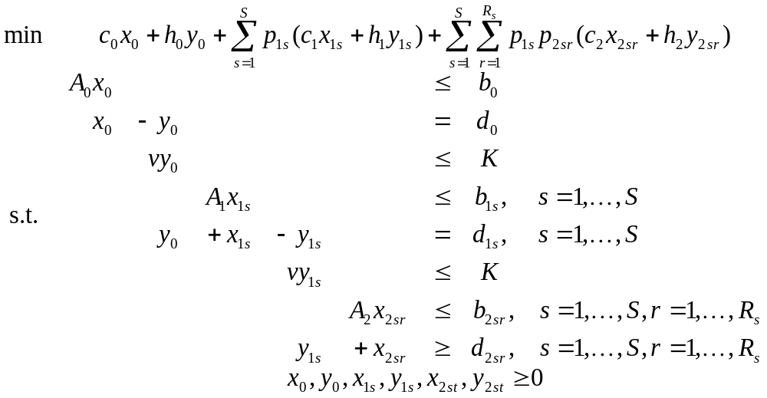
A sample problem

Slide 9
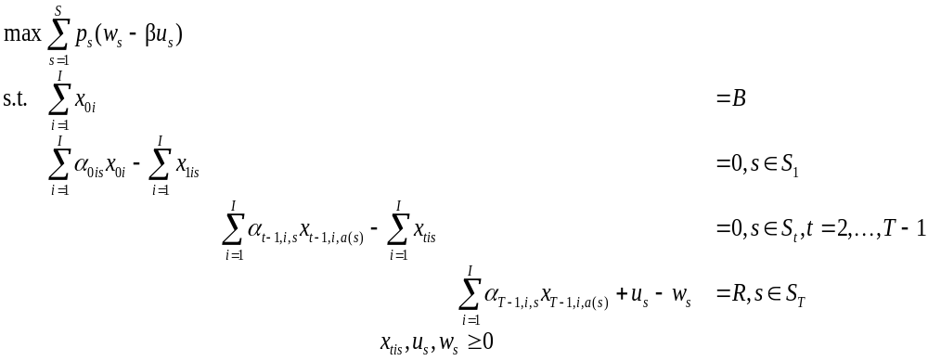
Example (Birge)
S₀
S₁
S₂
…

Slide 10
SMPS format
Three files based on MPS format
  Core file for deterministic problem components
  Time file for dynamic structure
  Stoch file for stochastic structure
Disadvantages
  Old technology
  Limited precision (12 digits, including sign)
  Limited name space (8 characters)
  Direction of optimization (min/max) ambiguous
  Linear constraints, quadratic objective only

Slide 11
Example
I = 2, T = 3, B = 55, R = 80, α_{t1} = {1.25, 1.06}, α_{t2} = {1.14, 1.12}
Core file
ROWS
Budget0
Object
Budget1
Budget2
Budget3
COLS
X01 Budget0 1.0
X01 Budget1 1.25
...
RHS
rhs1 Budget0 55.
rhs1 Budget3 80.
ENDATA
Stoch file
BLOCKS DISCRETE
BL Block1 0.5
X01 Budget1 1.25
X02 Budget1 1.14
BL Block1 0.5
X01 Budget1 1.06
X02 Budget1 1.12
BL Block2 0.5
X11 Budget2 1.25
X12 Budget2 1.14
...
ENDATA

Slide 12
Algebraic modelling languages
Characteristics
  Similar to algebraic notation
  Powerful indexing capability
  Data verification possible
Disadvantages
  Discrete distributions only
  Limited consistency checks for stochastic structure

Slide 13
AMPL model
param T;
param penalty;
param budget;
param target;
set instruments;
set scenarios;
param prob{scenarios};
set slice{t in 0..T} within scenarios;
param ancestor {t in 1..T, s in slice[t]};
var over {slice[T]};
var under{slice[T]};
param return {t in 1..T, i in instruments,s in slice[t]};
var invest {t in 0..T-1,i in instruments,s in slice[t]};
maximize net_profit:
sum{s in scenarios} prob[s]*(over[s] - penalty*under[s]);
subject to wealth{t in 0..T, s in slice[t]}:
(if t < T then sum{i in instruments} invest[t,i,s]) =
(if t = 0 then budget
else sum {i in instruments}
return[t,i,s]*invest[t-1,i,ancestor[t,s]]
+ if t = T then under[s] - over[s] + target);

Slide 14
OSiL – Optimization Services instance Language
Written in XML
  Easy to accommodate new features
  Existing parsers to check syntax
Easy to generate automatically
Trade-off between verbosity and human readability
Stochastic extensions for dynamic and stochastic structure

Slide 15
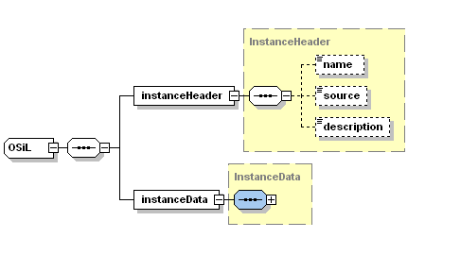

Slide 16
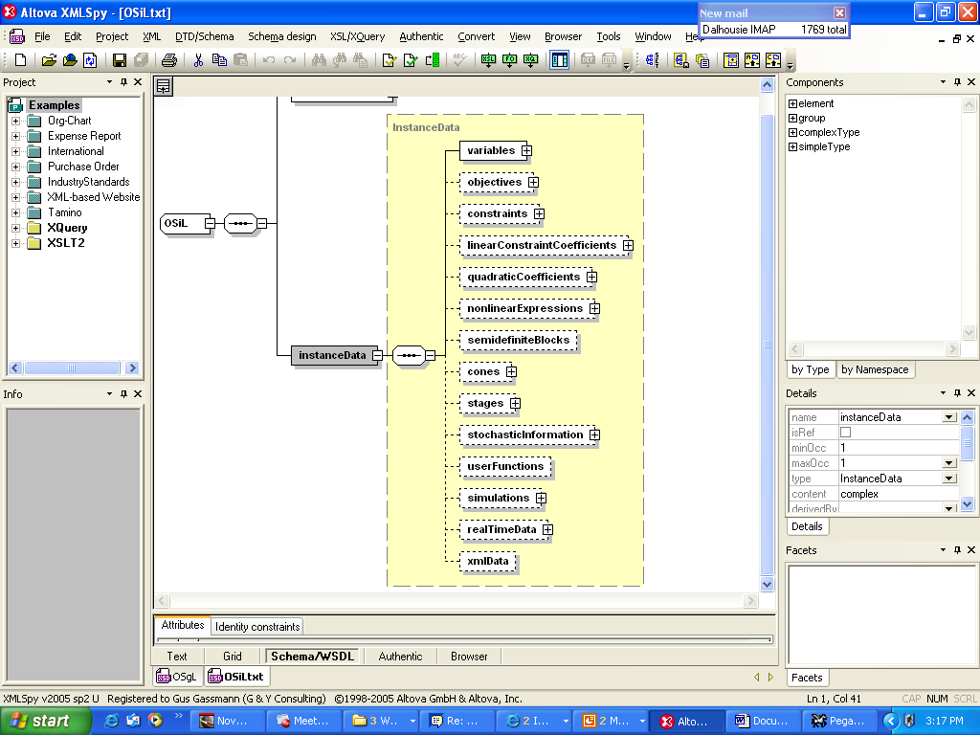
…

Slide 17
OSiL – Header information
<?xmlversion="1.0"encoding="UTF8"?>
<OSiL xmlns="os.optimizationservices.org“
xmlns:xsi=http://www.w3.org/2001/XMLSchemainstance
xsi:schemaLocation="OSiL.xsd">
<programDescription>
<source>FinancialPlan_JohnBirge</source>
<maxOrMin>max</maxOrMin>
<objConstant>0.</objConstant>
<numberObjectives>1</numberObjectives>
<numberConstraints>4</numberConstraints>
<numberVariables>8</numberVariables>
</programDescription>
<programData>
...
</programData>
</OSiL>

Slide 18
OSiL – Program data –
Constraints and variables
<constraints>
<con name="budget0“ lb="55“ ub="55"/>
<con name="budget1“ lb="0“ ub="0"/>
<con name="budget2“ lb="0“ ub="0"/>
<con name="budget3“ lb="80“ ub="80"/>
</constraints>
<variables>
<var name="invest01“ type="C“ lb="0.0"/>
<var name="invest02"/>
<var name="invest11"/>
<var name="invest12"/>
<var name="invest21"/>
<var name="invest22"/>
<var objCoef="1“ name="w"/>
<var objCoef="4“ name="u"/>
</variables>

Slide 19
OSiL –
Core matrix (sparse matrix form)
<coefMatrix>
<listMatrix>
<start>
<el>0</el>
<el>2</el>
<el>4</el>
<el>6</el>
<el>8</el>
<el>10</el>
<el>12</el>
<el>13</el>
</start>
<rowIdx>
<el>0</el>
<el>1</el>
<el>0</el>
<el>1</el>
<el>1</el>
<el>2</el>
<el>1</el>
<el>2</el>
<el>2</el>
<el>3</el>
<el>2</el>
<el>3</el>
<el>3</el>
<el>3</el>
</rowIdx>
<value>
<el>1</el>
<el>1.25</el>
<el>1</el>
<el>1.14</el>
<el>1</el>
<el>1.25</el>
<el>1</el>
<el>1.14</el>
<el>1</el>
<el>1.25</el>
<el>1</el>
<el>1.14</el>
<el>1</el>
<el>1</el>
</value>

Slide 20
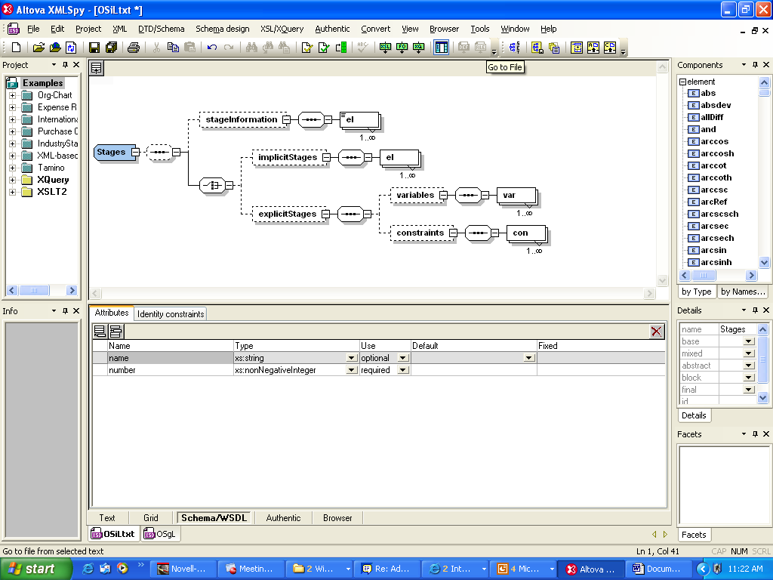
Dynamic structure

Slide 21
What is a stage?
Stages form a subset of the time structure
Stages comprise decisions and events
Events must either precede all decisions or follow all decisions
Should a stage be decision – event or event – decision?

Slide 22
OSiL – dynamic information
<stages number="4" order="decisionEvent" >
<implicitOrder>
<el startRowIdx="0" startColIdx="0"/>
<el startRowIdx="1" startColIdx="2"/>
<el startRowIdx="2" startColIdx="4"/>
<el startRowIdx="3" startColIdx="6"/>
</implicitOrder>
</stages>

Slide 23
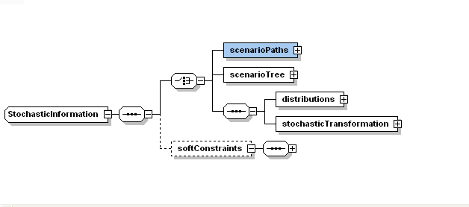
Explicit and implicit event trees

Slide 24
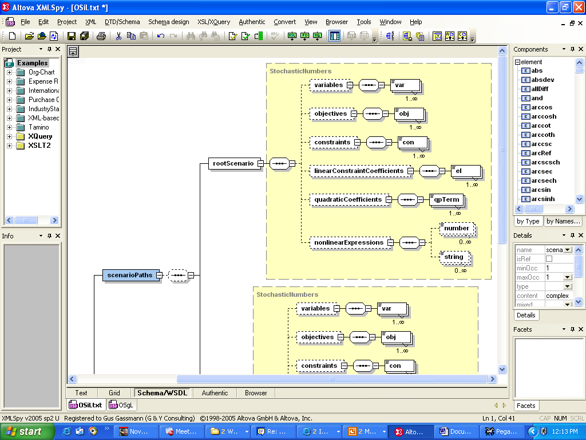
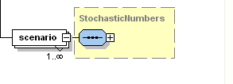
Scenario trees

Slide 25
OSiL – Stochastic information
<stochastic>
<explicitScenario>
<scenarioTree>
<sNode prob="1" base="coreProgram">
<sNode prob="0.5" base="coreProgram">
<sNode prob="0.5" base="coreProgram">
<sNode prob="0.5" base="coreProgram"/>
<sNode prob="0.5" base="firstSibling">
<changes>
<el rowIdx=“3" colIdx="4">1.06</el>
<el rowIdx="3" colIdx="5">1.12</el>
</changes>
</sNode>
</sNode>
…

Slide 26
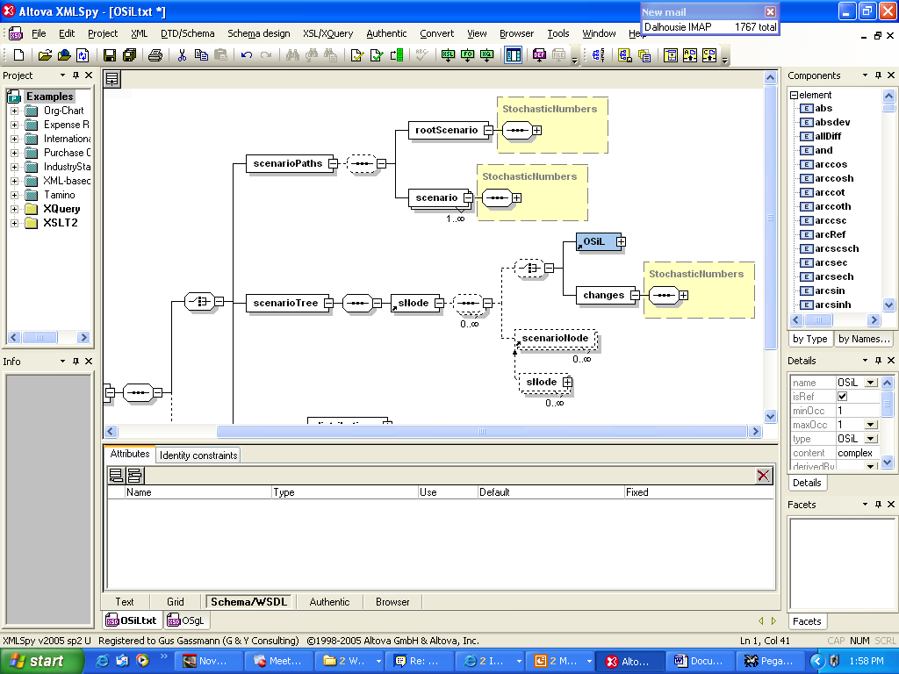
Node-by-node representation for stochastic problem dimensions

Slide 27
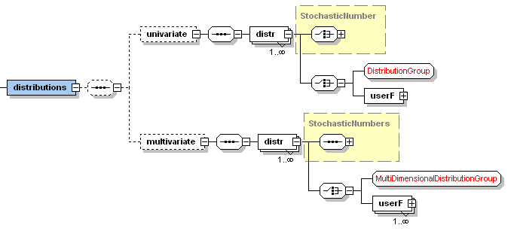
Distributions

Slide 28
OSiL – discrete random vector
<distributions>
<multivariate>
<dist name="dist1">
<multivariateDiscrete>
<scenario>
<prob>0.5</prob>
<el>1.25</el>
<el>1.14</el>
</scenario>
<scenario>
<prob>0.5</prob>
<el>1.06</el>
<el>1.12</el>
</scenario>
</multivariateDiscrete>
</dist>
</multivariate>
</distributions>

Slide 29
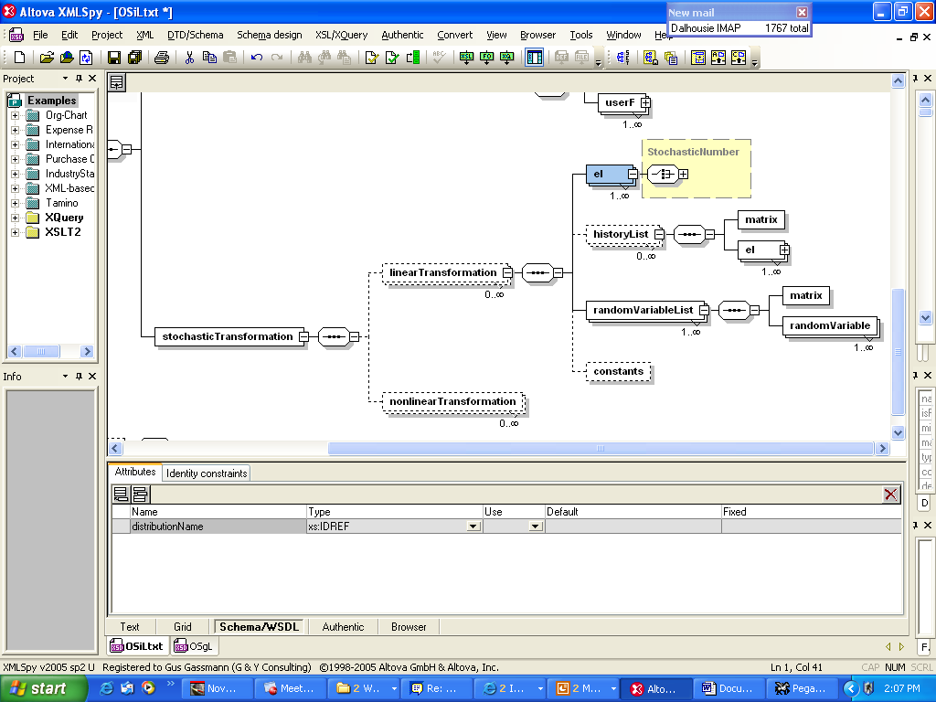
Transformations

Slide 30
OSiL – Linear transformation
<stochasticTransformation>
<linearTransformation stage="0">
<el name="dist1">
<el rowIdx="3" colIdx="4"/> <el rowIdx="3" colIdx="5"/>
</el>
<randomVariableList>
<coefMatrix>
<listMatrix>
<start> <el>0</el> <el>1</el> <el>2</el> </start>
<rowIdx> <el>0</el> <el>1</el> </rowIdx>
<value> <el>1.0</el> <el>1.0</el> </value>
</listMatrix>
</coefMatrix>
</randomVariableList>
</linearTransformation>
<linearTransformation stage=“1">
…
</stochasticTransformation>

Slide 31
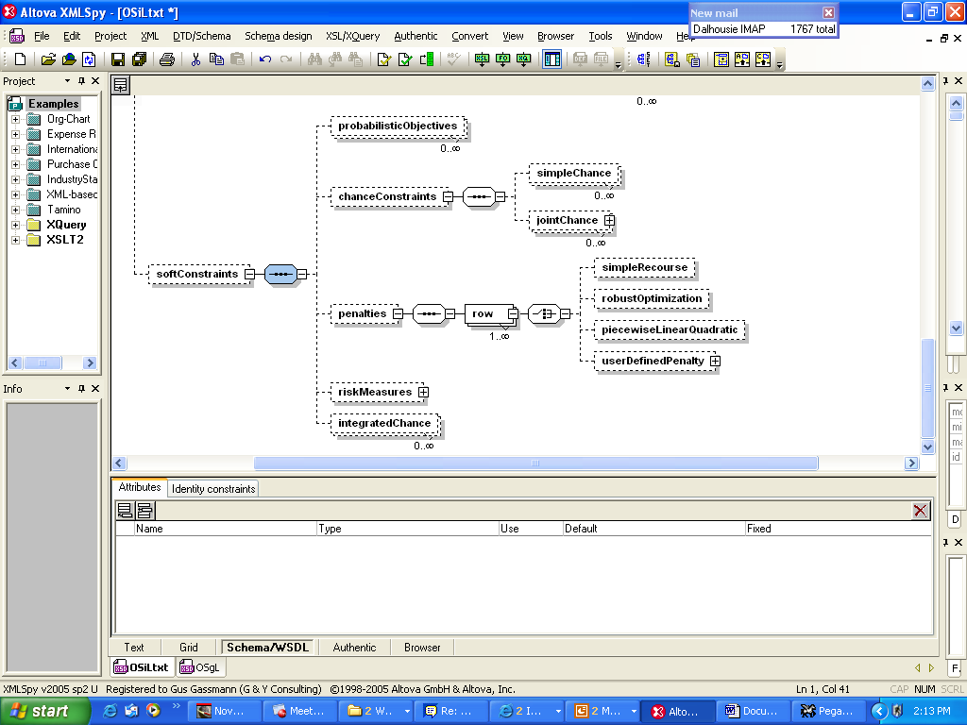
Penalties and probabilistic constraints

Slide 32
Capabilities
Arbitrary nonlinear expressions
Arbitrary distributions
Scenario trees
Stochastic problem dimensions
Simple recourse
Soft constraints with arbitrary penalties
Probabilistic constraints
Arbitrary moment constraints

Slide 33
Nonlinear expression –
(x₀ – x₁²)² + (1 – x₀)²
<plus>
<power>
<minus>
<var coef="1.0" idx="0"/>
<power>
<var coef="1.0" idx="1"/>
<number value="2"/>
</power>
</minus>
<number value="2"/>
</power>
<power>
<minus>
<number value="1"/>
<var coef="1.0" idx="1"/>
</minus>
<number value="2"/>
</power>
</plus>

Slide 34
Further work
Readers
Internal data structures
Solver interfaces
Library of problems
Buy-in

Slide 35

QUESTIONS?
http://www.optimizationservices.org

