Slide 1
Web Site (www.coin-or.org)
Getting around the Web Site to
Build and Use COIN-OR
JP Fasano
IBM Watson

Slide 2
Objective
Familiarity with web site
  Projects
  Faqs, documentation, help
  Source code
  Building, running
Build & run a COIN-OR project

Slide 3
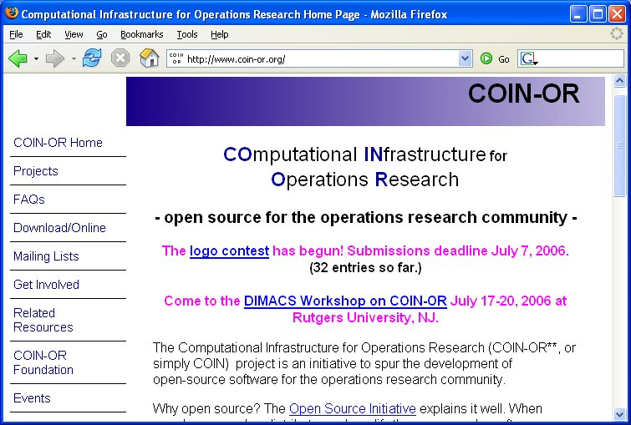
www.coin-or.org Home Page
Notes:
The projects link is a good place to start to get a quick overview of the projects and find links with a projects details.
Signing up for mailing lists allows one to follow Coin-or discussions.
The look of the page may change after the Logo Contest (there is still time to submit a logo!).

Slide 4
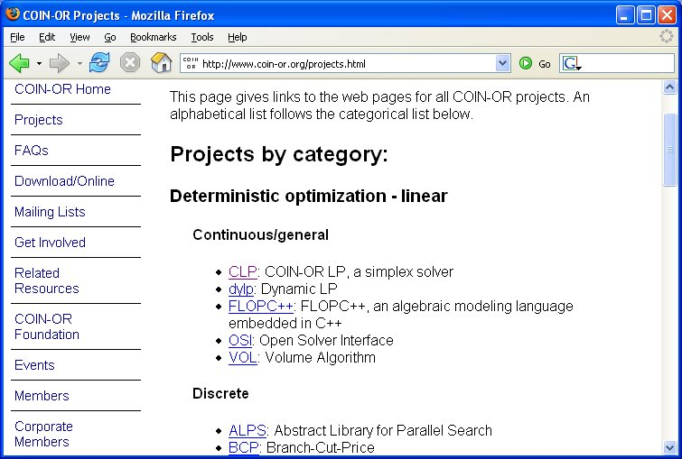
Projects Page
Notes:
Projects page has an overview of the projects by category.
Other categories are:
Deterministic optimization – nonlinear
Stochastic optimization
Metaheuristics
Systems of equations nonlinear
The projects are linked to their Trac Page.

Slide 5
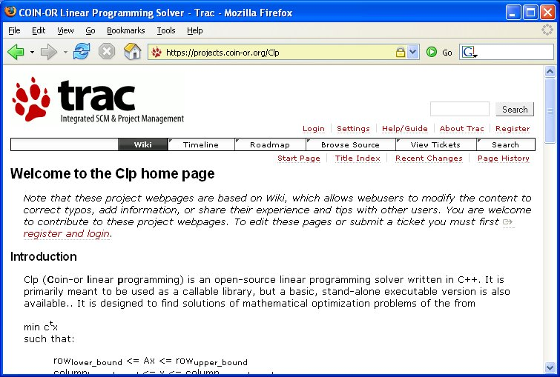
Clp Trac Page
Notes:
Clp’s Trac page is typical.
Project description
Download and install instructions
Documentation links
Project FAQs
Bug (ticket) reporting
Web interface to source
These are Wiki pages. Anyone can enhance and update.
Anyone can report create a bug report (ticket).
To write to the pages one must register and login due to malicious changes.
To register follow the “register and login” link.

Slide 6
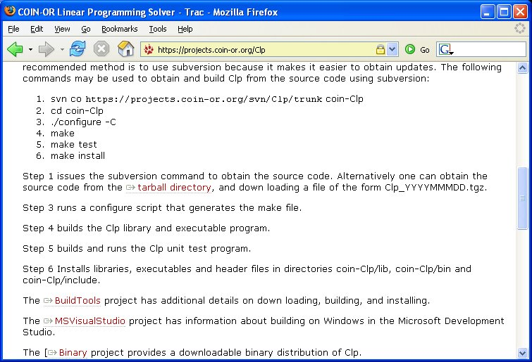
Clp Build Instructions on Trac Page
Notes:
Instructions are provided for obtaining the source code and building.
Downloading a tar ball is pointed out as an alternative way to obtain the source.
More details on how to obtain and build the source are provided on the BuildTools project pages.
A link on how to build with Microsoft Visual Studio is provided.
A link to the pre-built binary is provided.

Slide 7
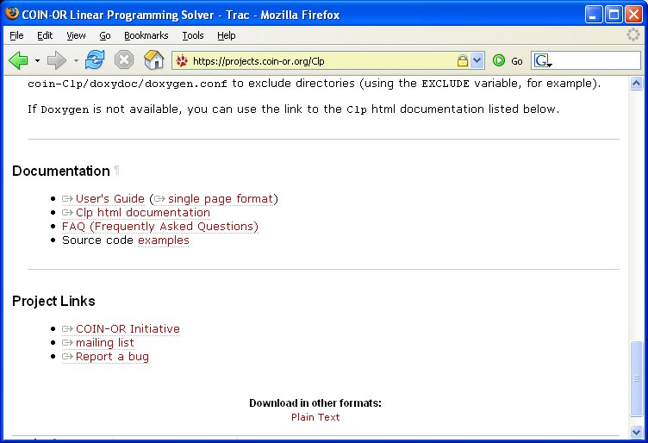
Clp Documentation on Trac Page
Notes:
Clp has a User’s Guide
Html documentation generated from specially formatted comments in the header files with Doxygen.
FAQ’s which are Wiki pages. Users can add things they have learned and figured out.
For many, the sample code is a good place to start.

Slide 8
Build Clp
Unix

Slide 9
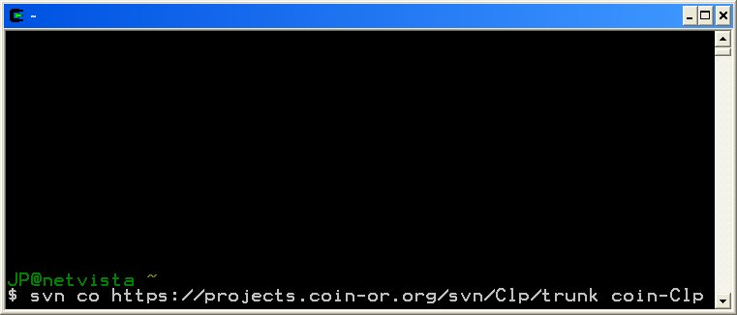
Build Clp on Unix
Notes:
Subversion command line checkout command. Alternatives are to get source from tarballs, or use gui clients which are discussed in the BuildTools project.
“CO” is an abbreviation for checkout.
The url of the repository and Clp’s location in the repository is specified.
The directory where the code is to be checkout is the last parameter.

Slide 10
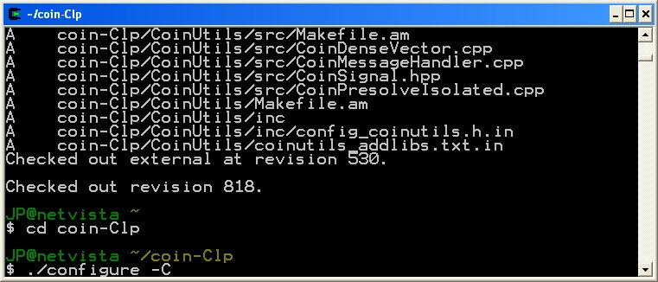
Build Clp on Unix
Notes:
change to the directory that contains the checkout Clp code.
Run configure is part of the AutoTools process. Configure looks at the client machine to see how it is setup and generates the makefile.
The –C option tells configure to cache some of its results to speed up performance. It is optional.
Many other options are available (build with debug). See the BuildTools project for details.

Slide 11
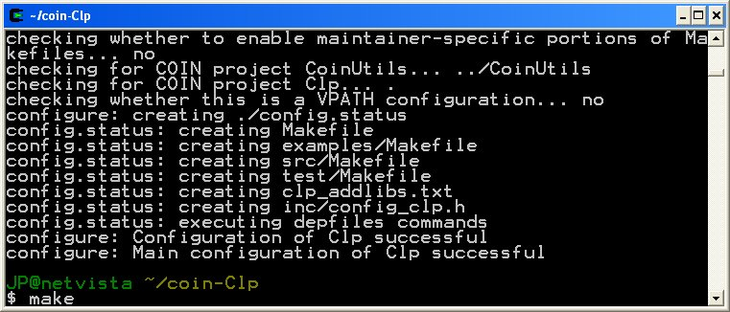
Build Clp on Unix
Notes:
configure runs successfully. The make file has been created.
Run ‘make’ to build Clp libraries and executables.

Slide 12
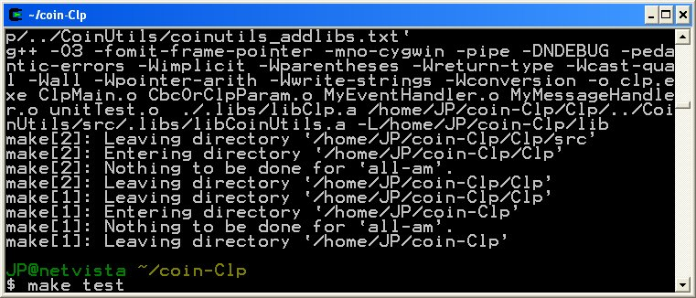
Build Clp on Unix
Notes:
Run ‘make test’ to test the installation. This runs clp’s unitTest program.

Slide 13
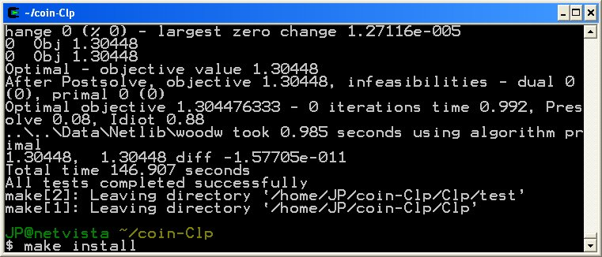
Build Clp on Unix
Notes:
Notice message “All tests completed successfully”
Run ‘make install’ to move libraries, headers and executables to coin-Clp/lib, coin-Clp/include, coin-Clp/bin. One should not use the libraries or executables from the src directories.

Slide 14
Run Clp executable
Experiment with Clp options

Slide 15
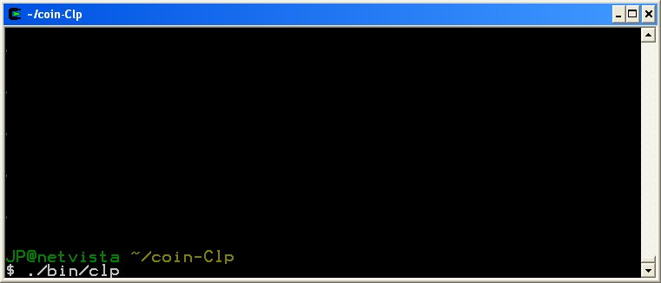
Experimenting with clp executable
Notes:
“make install” moved the executable to the bin directory
Run the clp.

Slide 16
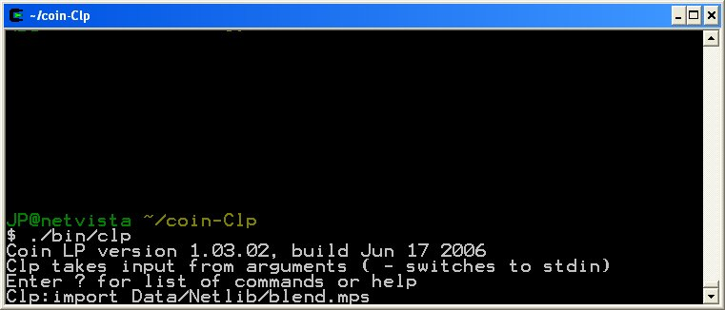
Experimenting with clp executable
Notes:
? Provides help and list of commands and help. Commands are available for selecting things like: presolve, scale, primal/dual, simples/barrier, and many others.
import reads an mps file. Import? Provides more help on the import command. Clp comes with sample problems with will be in the coin-Clp/Data directory.
import Data/Netlib/blend.mps reads the this netlib problem which was obtained when Clp was checkout out from subversion.

Slide 17
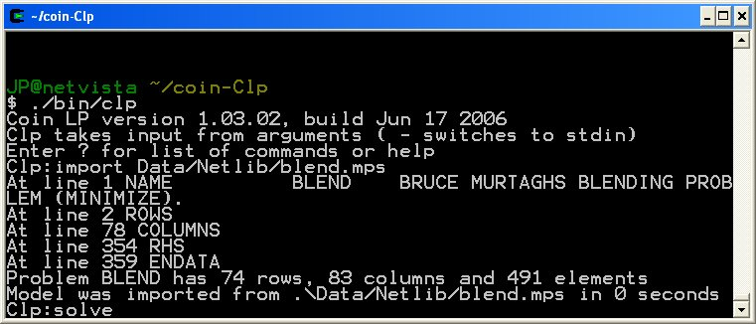
Experimenting with clp executable
Notes:
solve – invokes default lp solver

Slide 18
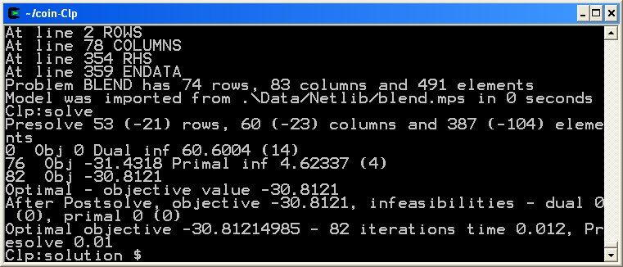
Experimenting with clp executable
Notes:
Problem is solved with objective value -30.8.
solution $ - prints solution to standard out.

Slide 19
Building Examples
coin-Clp/Clp/examples/minimum.cpp
Unix
Notes:
mimimum.cpp is on of the simplest examples. There are many other more interesting examples.

Slide 20
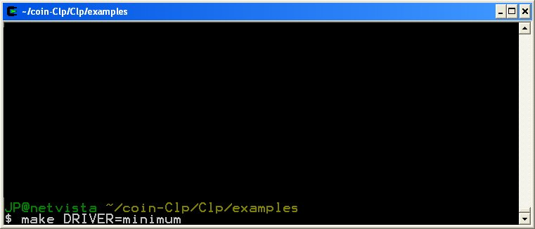
Build and run coin-Clp/Clp/examples/minimum.cpp
Notes:
Change to the examples directory
“make DRIVER=minimum” builds the example minimum.cpp

Slide 21
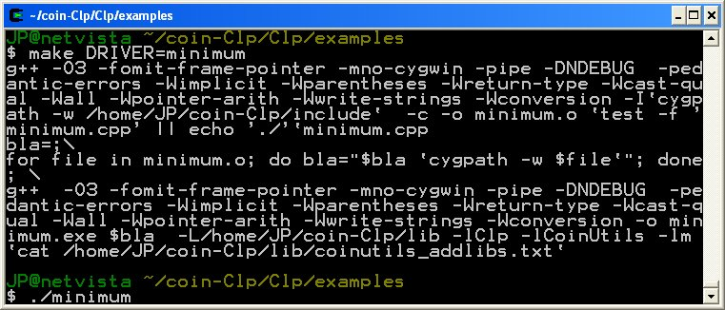
Build and run coin-Clp/Clp/examples/minimum.cpp
Notes:
“./minimum” runs the example.

Slide 22
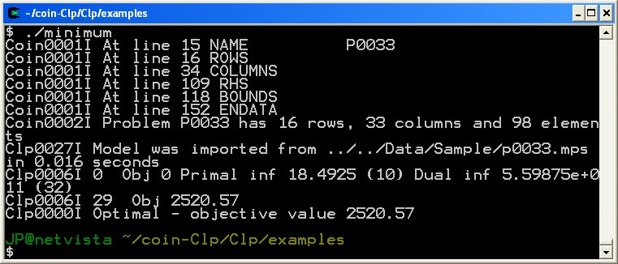
Build and run coin-Clp/Clp/examples/minimum.cpp
Notes:
minimum has finished running.

Slide 23
Windows: Obtaining Source
Using TortoiseSVN Client

Slide 24
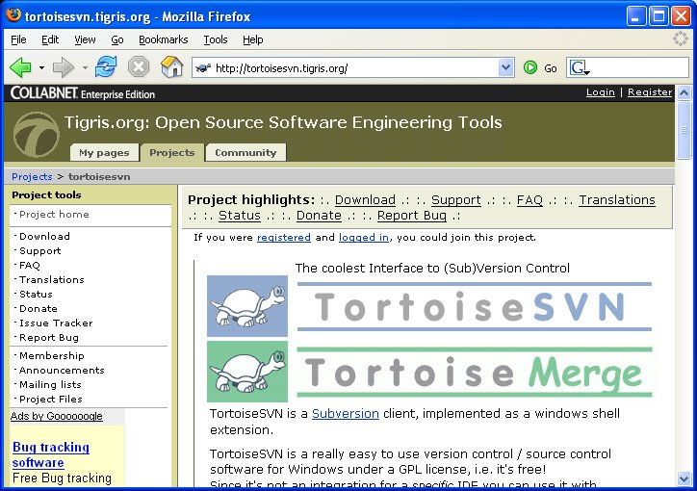
A Subversion Windows Client
Notes:
tortoiseSVN (tortoisesvn.tigris.org) is one of many Subversion clients available.
A list of some of these clients is available in the BuildTools project (projects.coin-or.org/BuildTools/wiki/user-download).

Slide 25
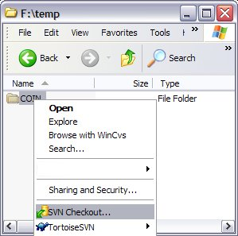
TortiseSVN: Checkout
Notes:
From Windows explorer, right click on directory where you would like to checkout Clp

Slide 26
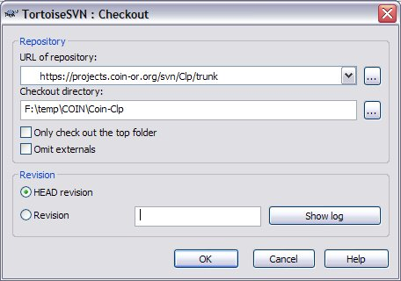
TortiseSVN: Checkout
Notes:
Enter url of subversion repository
add coin-Clp to checkout directory.
press OK

Slide 27
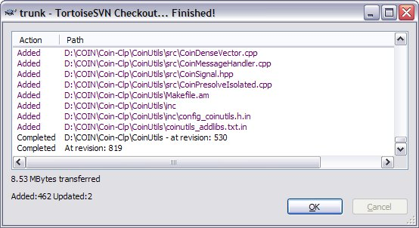
TortiseSVN: Checkout
Notes:
Subversion checkout finished.

Slide 28
Build Clp
Windows
Notes:
This example covers building on Windows with the MS Visual Studio 2005 Express Edition IDE (aka Version 8).
There are many other choices:
MS Visual Studio V6
MS Visual Studio V7
gnu make with gcc, MS V6, MS V7, or MS V8 compiler.
See MSVisualStudio Trac page for more details

Slide 29
Microsoft Visual Studio 2005
Visual C++ 2005 Express Edition
“Free, lightweight, easy-to-use, and easy-to-learn tools for the hobbyist, novice, and student developer.”
http://msdn.microsoft.com/vstudio/express
http://msdn.microsoft.com/vstudio/express/visualc
Must register to activate

Slide 30
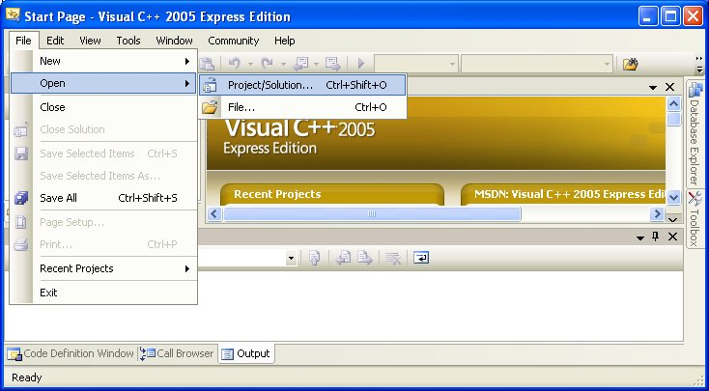
Build Clp with Visual C++ 2005 Express Edition
Notes:
Start Microsoft Visual C++ 2005 Express Edition
Select: File – Open – Project/Solution.

Slide 31
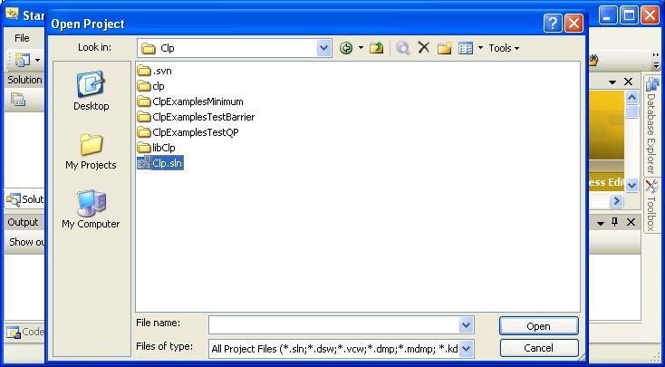
Build Clp with Visual C++ 2005 Express Edition
Notes:
In Open Project File selection dialog box, navigate to and open the file coin-Clp/MSVisualStudio/V8/Clp/Clp.sln

Slide 32
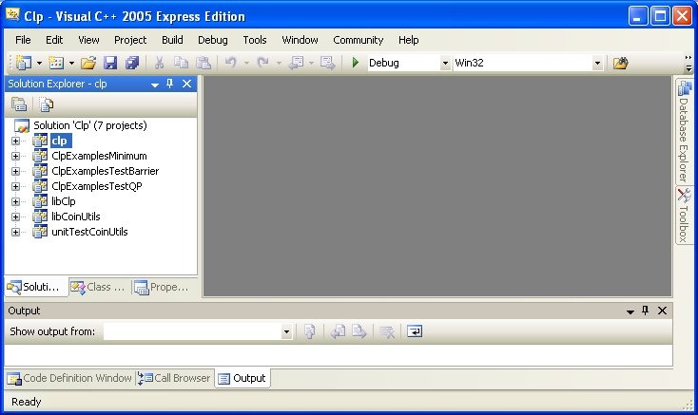
Build Clp with Visual C++ 2005 Express Edition
Notes:
Notice list of projects which have been opened: clp, clpExampesMinimum, clpExamplesTestBarrier, clpExamplesTestQp, libClp, libCoinUtils, unitTestCoinUtils

Slide 33
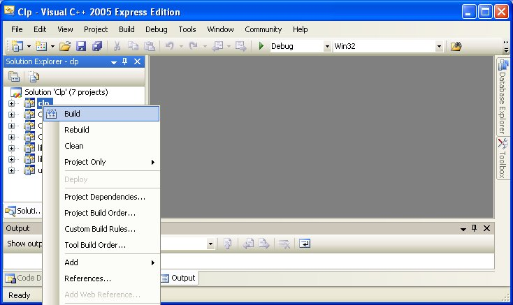
Build Clp with Visual C++ 2005 Express Edition
Notes:
Right click on the Clp project and select Build

Slide 34
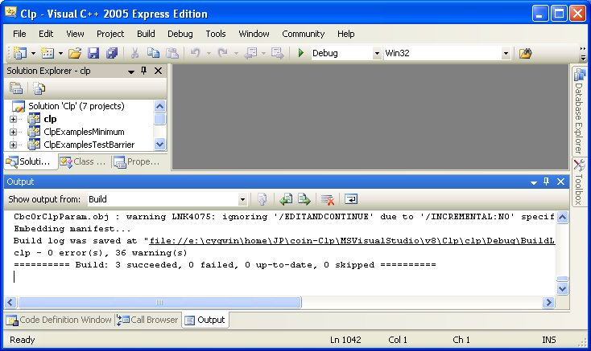
Build Clp with Visual C++ 2005 Express Edition
Notes:
Build completed. It built Clp and the projects it depends on (libClp and libCoinUtils).

Slide 35
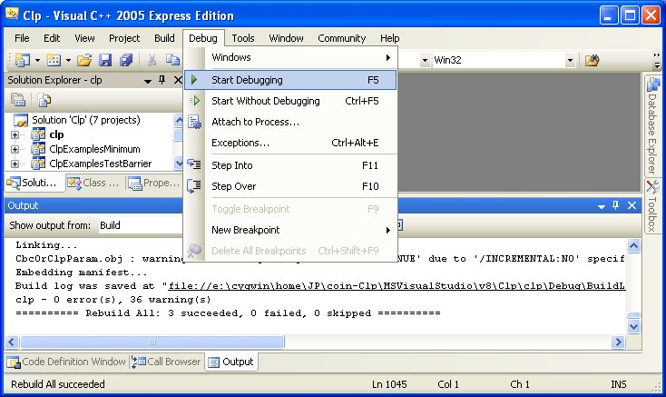
Build Clp with Visual C++ 2005 Express Edition
Notes:
To run clp
Select Debug – Start Debugging

Slide 36
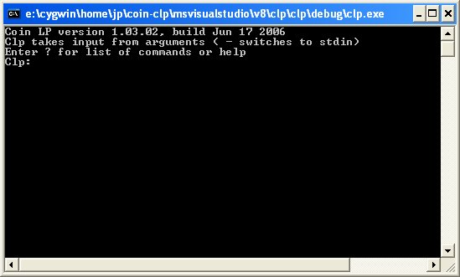
Build Clp with Visual C++ 2005 Express Edition
Notes:
Clp starts running as previously described on the UNIX build.

Slide 37
Building Examples
coin-Clp/Clp/examples/minimum.cpp
Windows
Notes:
mimimum.cpp is on of the simplest examples. There are many other more interesting examples.

Slide 38
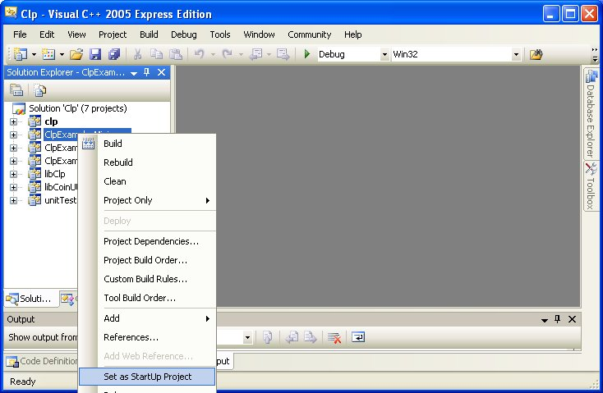
Build and run coin-Clp/Clp/examples/minimum.cpp
Notes:
Set ClpExamplesMinimum as the startup project. Right click on ClpExamplesMinimum and select “Set as StartUp Project”

Slide 39
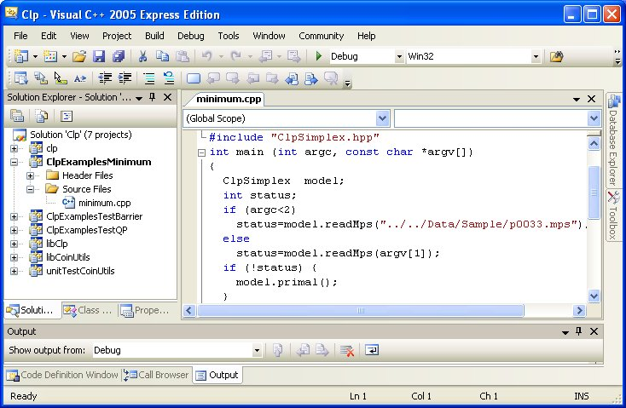
Build and run coin-Clp/Clp/examples/minimum.cpp
Notes:
View source by expanding project & source files folder, then double click on minimum.cpp.
Here one has a powerful development and debugging environment.

Slide 40
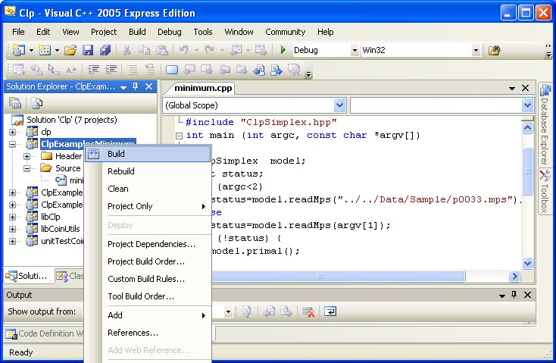
Build and run coin-Clp/Clp/examples/minimum.cpp
Notes:
Build by right clicking on ClpExamplesMinimum and selecting Build.

Slide 41
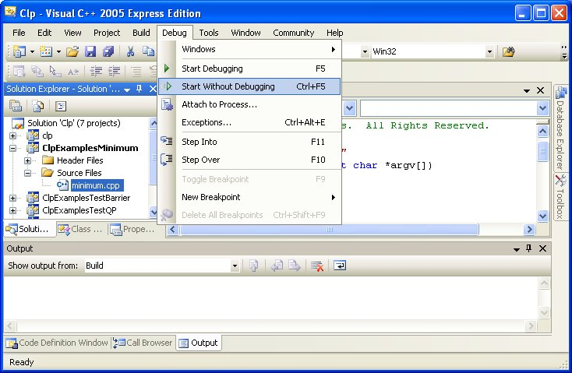
Build and run coin-Clp/Clp/examples/minimum.cpp
Notes:
Run by selecting “Debug” and “Start without Debugging”

Slide 42
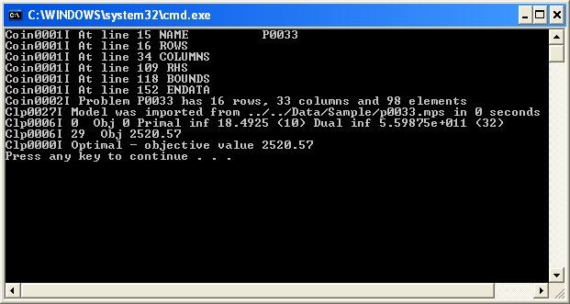
Build and run coin-Clp/Clp/examples/minimum.cpp
Notes:
minimum.cpp runs to completion

Slide 43
Windows: Alternatives to using Visual Studio IDE
On Windows the Unix build process can be used with Cygwin or MinGW.
  www.cygwin.com
  www.mingw.org
The gcc or Microsoft cl compiler can be used.
Notes:
IDE: Interactive Development Environment

Slide 44
Summary: www.coin-or.org
www.coin-or.org
  List of Projects
    Project Trac Pages
      Download
        Source: Subversion or tarballs
        Binaries
      Build code
        Unix
        Microsoft Visual Studio
      Documentation
      Tickets: Bugs/Enhancements/Features
      Wiki pages user community can update
  Mailing lists

Slide 45
Remaining Time:
www.coin-or.org
From list of projects, select project to build
Go to projects trac page
  Download source
  Build source

