Slide 1
Optimization Services Instance Language
(OSiL)
Robert Fourer
Jun Ma
Northwestern University
Kipp Martin
University of Chicago
Jun Ma
Northwestern University

Slide 2
Outline
1. Background and motivation for an instance standard
Why use XML for the instance standard
3. Optimization Services instance Language (OSiL) - this
replaces LPFML for the linear case and can be used to
represent a wide variety of optimization problems.
The OSiL schema
5. Real time data and user defined functions
6. Extensions

Slide 3
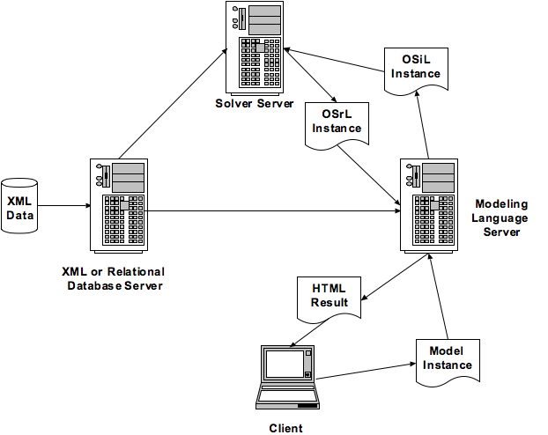
A Distributed Modeling Environment

Slide 4
A Distributed Modeling Environment
In a loosely coupled setting we have a separation
of the modeling language process and solver process.
Key idea: model versus instance
The solver wants an instance as opposed to a model

Slide 5
A MODEL
set PROD; # products
set DEP; # processing departments
param hours {DEP}; # time available in each department
param rate {DEP,PROD}; # hours used in each dept per product unit made
param profit {PROD}; # profit per unit of each product made
var Make {PROD} >= 0; # number of units of each product to be made
maximize TotalProfit:
sum {j in PROD} profit[j] * Make[j];
subject to HoursAvailable {i in DEP}:
sum {j in PROD} rate[i,j] * Make[j] <= hours[i];
This is a model. It is symbolic, general, concise,
and understandable (Fourer, 1983).

Slide 6
DATA
param: PROD: profit :=
std 10
del 9 ;
param: DEP: hours :=
cutanddye 630
sewing 600
finishing 708
inspectandpack 135 ;
param: rate: std del :=
cutanddye 0.7 1.0
sewing 0.5 0.8333
finishing 1.0 0.6667
inspectandpack 0.1 0.25 ;

Slide 7
MODEL + DATA = INSTANCE
maximize TotalProfit:
10*Make[‘std’] + 9*Make[‘del’];
subject to HoursAvailable[‘cutanddye’]:
0.7*Make[‘std’] + Make[‘del’] <= 630;
subject to HoursAvailable[‘sewing’]:
0.5*Make[‘std’] + 0.8333*Make[‘del’] <= 600;
subject to HoursAvailable[‘finishing’]:
Make[‘std’] + 0.6667*Make[‘del’] <= 708;
subject to HoursAvailable[‘inspectandpack’]:
0.1*Make[‘std’] + 0.25*Make[‘del’] <= 135;
Objective: represent a model instance using XML.

Slide 8
There is a proliferation of modeling languages
and solvers
AIMMS | CLP
AMPL | Impact
GAMS | GLPK
LINGO | LINDO
Mosel | MINOS
MPL | MOSEK
OSmL | Xpress-MP

Slide 9
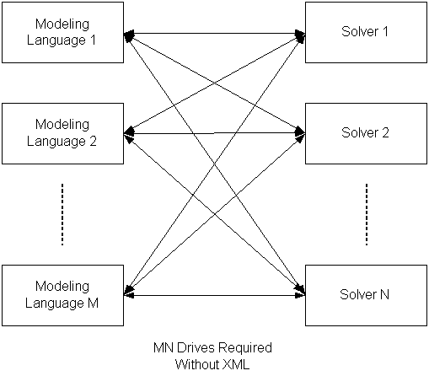
Consequence: a lot of drivers are need for every
modeling language to talk to every solver

Slide 10
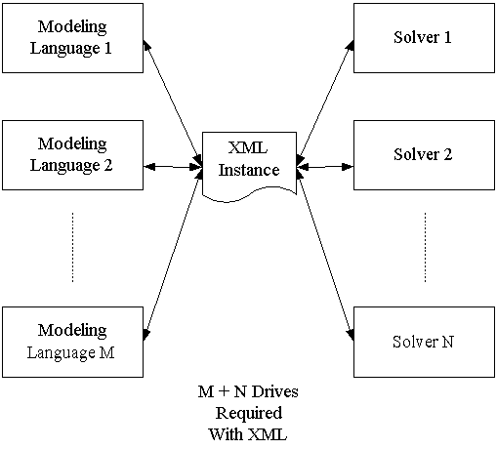
It would be nice to have an instance representation
language.

Slide 11
The Case for XML
1. Validation against a schema provides for error checking
2. Validation against a schema promotes stability of a standard
3. The schema can restrict data values to appropriate types, e.g. row
names to string, indices to integer, coefficients to double
4. The schema can define keys to insure, for example, no row or column
name is used more than once.
5. The schema can be extended to include new constraint types or
solver directives
6. There is a lot of open source software to make parsing easy.

Slide 12
XML and Optimization Systems
When instances are stored in XML format, optimization technology
solutions are more readily integrated into broader IT infrastructures
2. XML is used for Web Services – important for distributed computing
3. The XML format lends itself well to compression – more on this later
4. The XML format can be combined with other technologies, e.g.
XSLT to present results in human readable formats
Encryption standards are emerging for XML – possibly important
in a commercial setting.

Slide 13
XML Concepts
XML (Extensible Markup Language) – an XML file contains both data
and Markup (Elements (tags) and Attributes)
The tags are organized in a tree like structure. The closing tag of a
child element preceding the closing tag of its parent.
<constraints>
<con name=“cutanddye" ub="630"/>
<con name="sewing" ub="600"/>
<con name="finishing" ub="708"/>
<con name="inspectandpack" ub="135"/>
</constraints>
ATTRIBUTE
ELEMENT

Slide 14
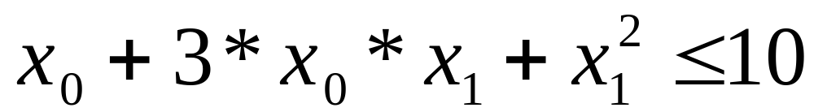
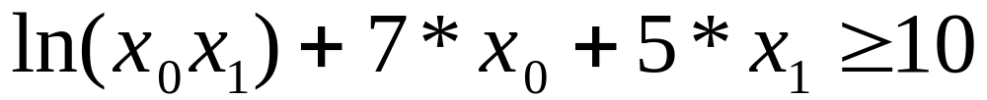
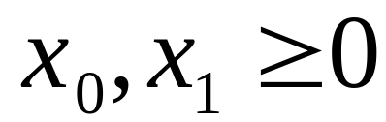
OSiL Instance Representation

Slide 15
OSiL Instance Representation
The variables:
<variables number="2">
<var lb="0" name="x0" type="C"/>
<var lb="0" name="x1" type="C"/>
</variables>
-OR-
<variables number="2">
<var lb="0" ub=“INF” name="x0" type="C"/>
<var lb="0" ub=“INF” name="x1" type="C"/>
</variables>

Slide 16
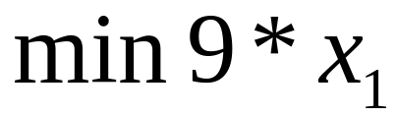
OSiL Instance Representation
The objective functions:
<objectives number="1">
<obj maxOrMin="min" name="minCost">]
<coef idx="1">9</coef>
</obj>
</objectives>

Slide 17


OSiL Instance Representation
The constraints:
<constraints number="2">
<con name=“row0” ub="10.0"/>
<con name=“row1” lb="10.0"/>
</constraints>

Slide 18
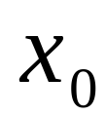
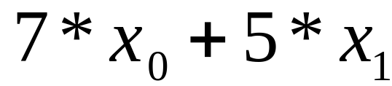
OSiL Instance Representation
The linear constraint terms:
<linearConstraintCoefficients>
<start>
<el>0</el><el>2</el><el>3</el>
</start>
<rowIdx>
<el>0</el><el>1</el><el>1</el>
</rowIdx>
<value>
<el>1.0</el><el>7.0</el><el>5.0</el>
</value>
</linearConstraintCoefficients>

Slide 19
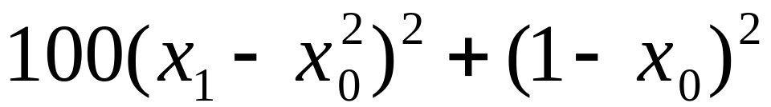
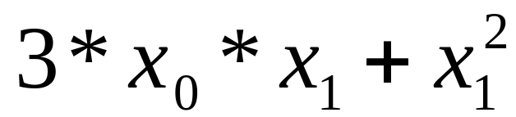
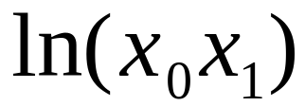
OSiL Instance Representation
The nonlinear terms:
<nl idx="1">
<ln>
<times>
<var idx="0"/>
<var idx="1"/>
</times>
</ln>
</nl>

Slide 20
OSiL Instance Representation
The nonlinear terms:
<nl idx="0">
<quadratic>
<qpTerm idxOne="0" idxTwo="1" coef="3"/>
<qpTerm idxOne="0" idxTwo=”0" coef=”1"/>
</quadratic>
</nl>
or
<quadraticCoefficients numberOfQPTerms=“2”>
<qpTerm idx=“0” idxOne="0" idxTwo="1" coef="3"/>
<qpTerm idx=“0” idxOne="0" idxTwo=”0" coef=”1"/>
</quadraticCoefficients >

Slide 21
XML Schema
Key idea – a schema. Similar to the concept of a class in
object orient programming. Critical for parsing!
Schema
Class
XML File
Object
We need a schema to represent an instance.

Slide 22
Schema – a Constraints Object
<constraints number="2">
<con name=“row0” ub="10.0"/>
<con name=“row1” lb="10.0"/>
</constraints>

Slide 23
Schema – a Constraints and Con Class
<xs:complexType name="constraints">
<xs:sequence>
<xs:element name="con" type="con" maxOccurs="unbounded"/>
</xs:sequence>
<xs:attribute name="number" type="xs:nonNegativeInteger" use="required"/>
</xs:complexType>
<xs:complexType name="con">
<xs:attribute name="name" type="xs:string" use="optional"/>
<xs:attribute name="lb" type="xs:double" use="optional" default="-INF"/>
<xs:attribute name="ub" type="xs:double" use="optional" default="INF"/>
<xs:attribute name="mult" type="xs:positiveInteger" use="optional" default="1"/>
</xs:complexType>

Slide 24
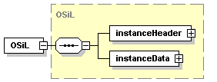

The OSiL Schema

Slide 25
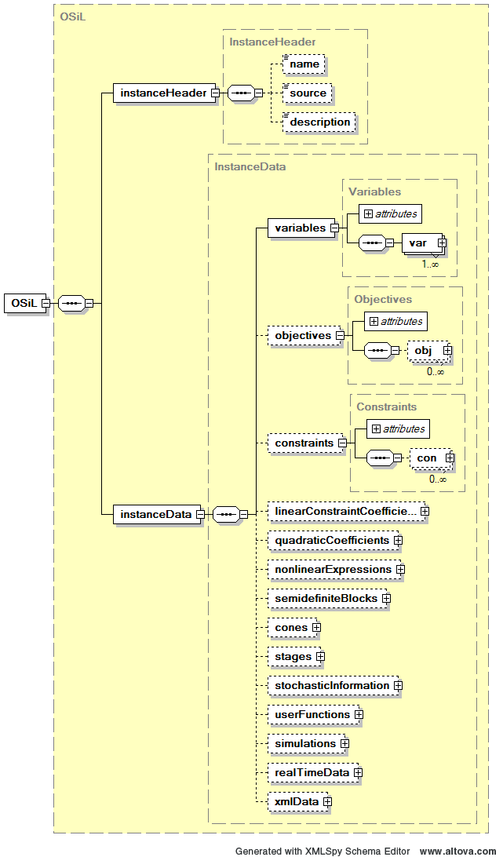
The OSiL Schema

Slide 26
Real Time Data
In many cases the instance generated by the solver
contains time sensitive data. For example, in many financial
models.
Before solving we can:
Repeat entire modeling process and have modeling
language generate a new model from scratch.
OR
2. Have the “reader” library update only the necessary
data before sending it to the solver.

Slide 27
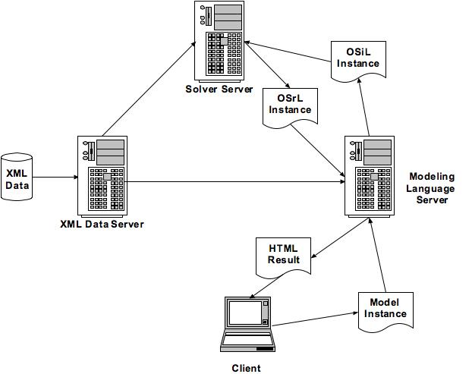
Real Time Data
Real time
data

Slide 28
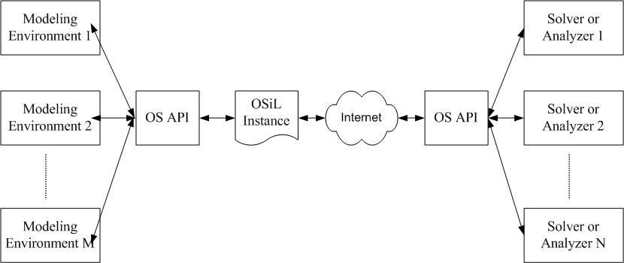
Real Time Data

Slide 29
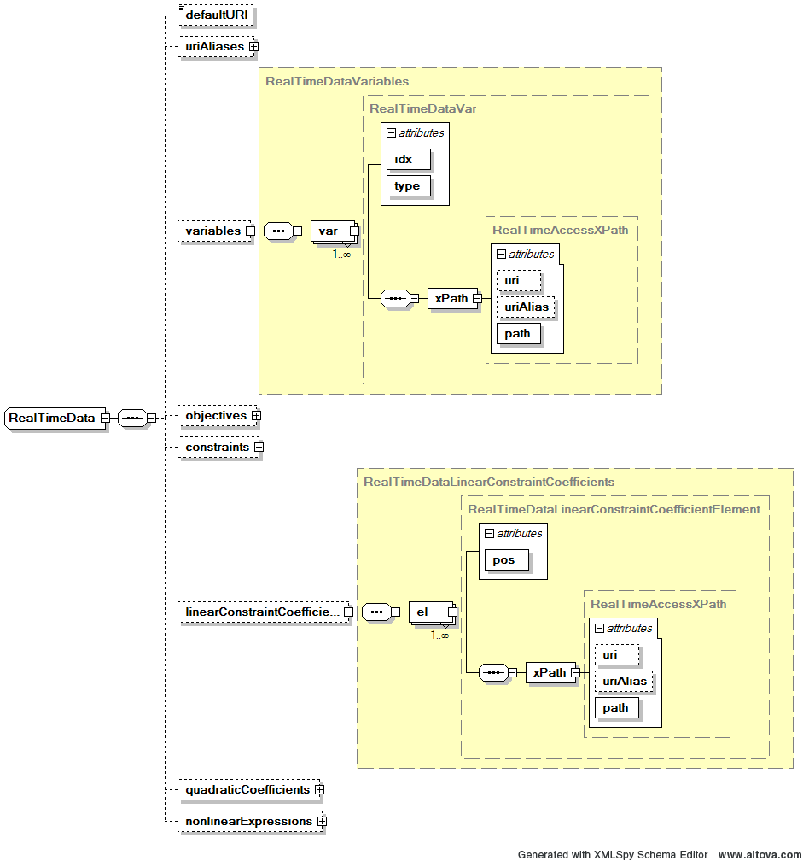
Real Time Data

Slide 30
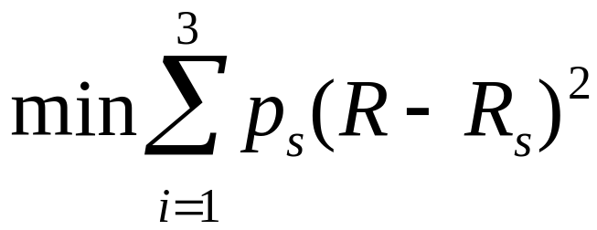

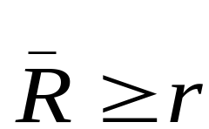
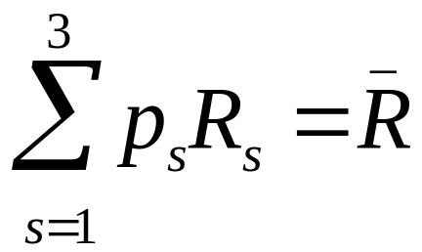

Markowitz Example

Slide 31
Markowitz and Real Time Data
<variables number="4">
<var name="msft" lb="0.0" ub=".75"/>
<var name="pg" lb="0.0" ub=".75"/>
<var name="ge" lb="0.0" ub=".75"/>
<var name="RBAR" lb=".05"/>
</variables>
<realTimeData>
<defaultURI>http://www.stockdata.com/stockdata.xml</defaultURI>
<variables>
<var idx="3" type="lb">
<xPath path="/xmlData/portfolioReturn/text()" />
</var>
</variables>
</realTimeData>

Slide 32
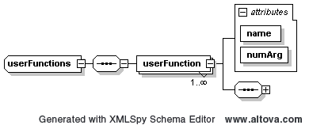
User Defined Functions
Many istances often:
Contain terms repeated many times, either verbatim or
With small systematic changes
2. Contain definitional variables

Slide 33
User Defined Functions
<userFunction name="stockRet" numArg="2">
<xPath path="//scenario[@id=$scenario]/stock[@name=$name]/@return">
<xPathIndex indexName="scenario">
<arg idx="0"/>
</xPathIndex>
<xPathIndex indexName="name">
<arg idx="1"/>
</xPathIndex>
</xPath>
</userFunction>
Idx=0 idx = 1

Slide 34
User Defined Functions
<userFunction name = "scenarioRet" numArg="1">
<sum>
<times>
<userF name="stockRet">
<arg idx="0"/>
<string value="msft"/>
</userF>
<var idx="0"/>
</times>
</sum>
</userFunction>

Slide 35
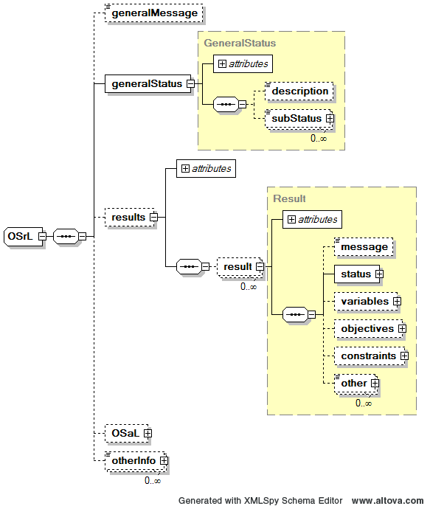
OSrL - Optimization Services result Language

Slide 36
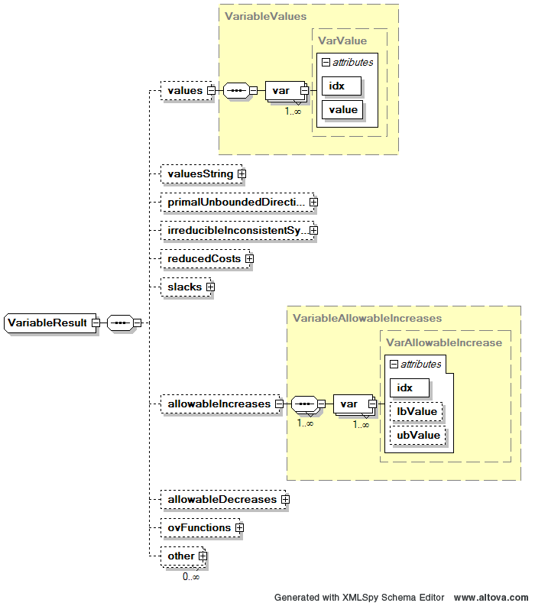
OSrL - Optimization Services result Language

Slide 37
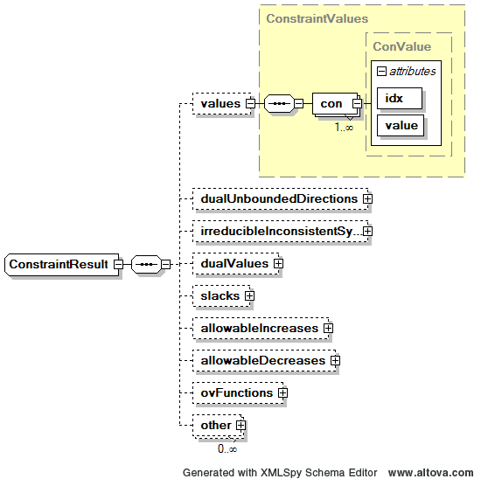
OSrL - Optimization Services result Language

Slide 38
Interested?
MB44 – Open Source Modeling Tools
  OS Library and Server
MC43 – Standards for Optimization Problem Representation
  OSiL (Fourer, Ma, Martin)
  OSiL stochastic extension (Gassmann, Fourer, Ma, Martin)
  Panel on standards
  etc
TC44 – Optimization Tools and Modeling Languages
  OSmL (Ma, Martin)
  Impact Solver Services (Huanyuan Sheng, Ma, Mehrotra)
  etc.
TD43 – Distributed Optimization Systems
  Optimization Services Framework (Fourer, Ma, Martin)
  etc.

Slide 39

QUESTIONS?

