Slide 1
Optimization Services
OS Server
and
OS Libraries
Robert Fourer
Jun Ma
Northwestern University
Kipp Martin
University of Chicago
Jun Ma
maj@northwestern.edu
Industrial Engineering and Management Sciences, Northwestern University
11/15/2005

Slide 2
Outline
Motivation
OS Framework
OS Library
OS Server
Conclusion/User Experience

Slide 3
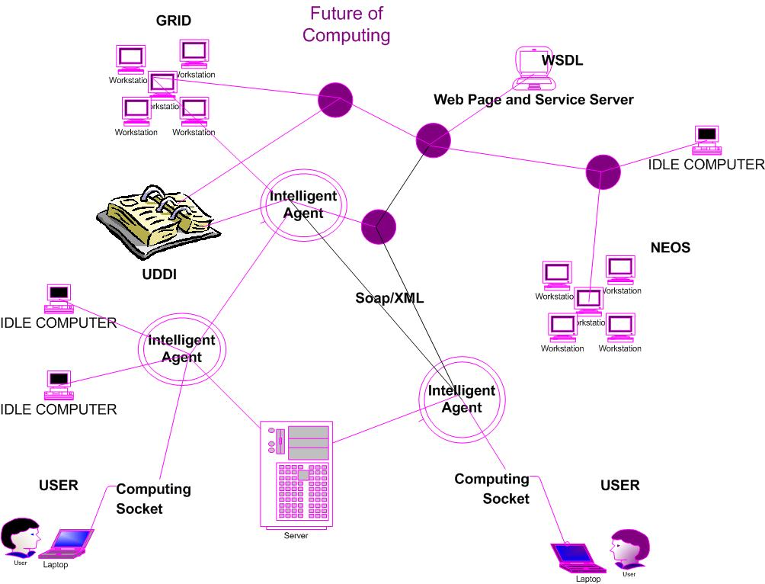
Motivation
Future of Computing

Slide 4
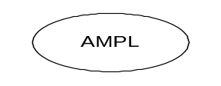


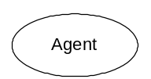




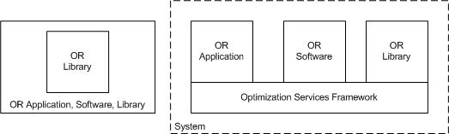
OS Framework
Optimization Services System
browser
Web address
http/html
Web page
html form
socket
CGI
location
OS
Server
Parse to OSiL
OSP/ OSxL
Web Server
OS Server
Database/ App Service
Google

Slide 5
OS Library
OSCommon
  representationParser
    OSiL Reader/Writer
    OSrL result
    OSoL option
    Etc.
  util
    data structure
    io
    xml
    etc
  communicationInterface
    OShL (hook up to solvers/analyzers: solve, send, retrieve)
    OScL (call to simulations)
    OSdL (discover in registries)
  localInterface
    OSInstance
    etc.
  nonlinear: defines all the nonlinear operator/operands/functions
OSiLReader reader = new OSiLReader();
reader.read(example.osil);
reader.getLinearConstraintCoefficients();
reader.calculateNonlinearFunction(5, x); //x is double[]

Slide 6
OS Library
OSAgent
  Solver agent
  Simulation agent
  Solver agent
OSSolver
  Utility and implementation of os-compatible solvers
OSSimulation
  Utility and implementation of os-compatible simulation.
OSRegistry
  Allows os developers to register their services
  Lets os users discover os services
  Let os users/developers validate instances
OSAnalyzer
  Utility and implementation of os-compatible analyzers.
OSScheduler
  Schedules optimization jobs over the distributed system
  Takes care of all the non-optimization related chores.
OSSolverAgent agent = new OSSolverAgent();
agent.solverAddress = “http://1.2.3.6/impactSolverService”;
String osrlResult = agent.solve(osilInstance, osolOption);

Slide 7
OS Framework
Optimization Services Protocol (OSP)
OSP
GET /xt/services/ColorRequest HTTP/1.0
Content Length: 442
Host: localhost
Content-type: text/xml; charset=utf-8
SOAPAction: "/getColor"
Application
Application
SOAP
Presentation
HTTP
Presentation
<soap:Envelope>
<soap:Body>
<soap:Body>
</soap:Envelope>
Session
Session
TCP
Transport
Transport
OSP – specifies soap content
Communication Interface Representation
e.g. hook (“<OSiL> … </OSiL>”)
Network
Network
IP
Link
Link
Ethernet
Physical
Physical
The 7-layer OSI Model
The 4-layer Internet model

Slide 8
OS Server
  Networking Protocols: HTTP, SOAP, OSP
  (OS server: Tomcat, Axis, OS library)
  OSServer =
impactSolverService
osp handler
soap parser
http parser

Slide 9
Conclusion/User Experience
Open Environment
Convenience just like Using Utility Services
No High Computing Power Needed
No Knowledge in Optimization Algorithms and Software (solvers, options, etc.)
Better and More Choices of Modeling Languages
More Solver Choices
Solve More Types of Problems
Automatic Optimization Services Discovery
Decentralized Optimization Services Development and Registration
More Types of Optimization Services Components Integrated (Analyzers/Preprocessors, Problem Providers, Bench Markers)
Smooth Flow and Coordination of Various Optimization Services Components.
A Universal, Scalable and Standard Infrastructure that promotes Collaboration and Other Related Researches
Concentration on Good Modeling

Slide 10

Interested?
MC43 – Standards for Optimization Problem Representation
  OSiL (Fourer, Ma, Martin)
  OSiL stochastic extension (Gassmann, Fourer, Ma, Martin)
  Panel on standards
  etc
TC44 – Optimization Tools and Modeling Languages
  OSmL (Ma, Martin)
  Impact Solver Services (Huanyuan Sheng, Ma, Mehrotra)
  etc.
TD43 – Distributed Optimization Systems
  Optimization Services Framework (Fourer, Ma, Martin)
  etc.

