Slide 1
A General and Unified Design and Framework for Distributed Optimization
Robert Fourer Jun Ma
12/12/2003
Industrial Engineering and Management Sciences

Slide 2
Outline
Abstract
Background
  A General Picture – The Future of Computing
  Our Positioning – The Hierarchy of Operations Research
  Some Terminologies (Parallel/Distributed/Grid Computing, XML, Web Services, etc.)
Motivation
  Motorola's VP Intelligent Optimization System
  AMPL-NEOS
The Design and Framework for Distributed Optimization (NSF Funded)
  Proposing and Defining Optimization Services (OS, OSXL)
  Design of Distributed Optimization Architecture (Centralized and Decentralized)
  Optimization Services Representation (OSTL, OSRL, OSOL, OSSL, OSAL)
  Optimization Services Communication (OSCL, OSDL, OSFL, OSEL)
  Optimization Services Inspection and Discovery (OSIL, OSPL, OSBL, OSQL)
Future Work and Conclusion

Slide 3
Abstract
There exist many heterogeneous implementations of optimization solvers (about 70)
There exist many formats to represent optimization problems (about 10)
There exist many mechanisms to communicate with solvers (about 10)
There are some initiatives to analyze and benchmark optimization (?)
Other Problems (All these possible reasons for recent NEOS leveling off, thus the motivation)
  Different Operating Systems (about 5)
  Different Programming Languages (about 5)
  Locating solvers (none)
  Reliability
  Scalability
  Security
We propose a general design and framework
We attempt to unify some of the popular means of solver communication, optimization analyses and model representations under the framework
This can also be regarded an initiative to start a wider level of cooperation to move toward a final standardization and facilitate a healthier development environment for research in the area of operations research

Slide 4
Outline
Abstract
Background
  A General Picture – The Future of Computing
  Our Positioning – The Hierarchy of Operations Research
  Some Terminologies (Parallel/Distributed/Grid Computing, XML, Web Services, etc.)
Motivation
  Motorola's VP Intelligent Optimization System
  AMPL-NEOS
The Design and Framework for Distributed Optimization (NSF Funded)
  Proposing and Defining Optimization Services (OS, OSXL)
  Design of Distributed Optimization Architecture (Centralized and Decentralized)
  Optimization Services Representation (OSTL, OSRL, OSOL, OSSL, OSAL)
  Optimization Services Communication (OSCL, OSDL, OSFL, OSEL)
  Optimization Services Inspection and Discovery (OSIL, OSPL, OSBL, OSQL)
Future Work and Conclusion

Slide 5
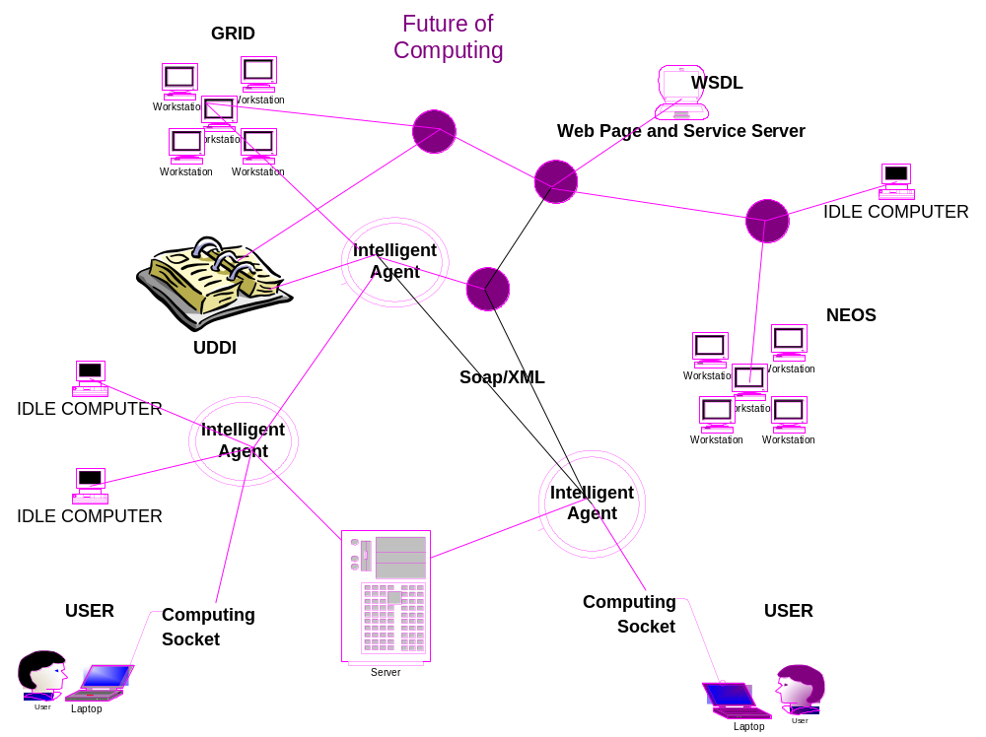
A General Picture

Slide 6
Our Positioning in
Industrial Engineering and Management Sciences
Modeling
Manufacturing
DoE
SCM
FE
Data mining/Machine Learning
Management
…
We are the bridge
-Standard
-Smooth,
-Scalable
-Simple
Communications, Modeling Languages and Systems etc.
Interface
Tools
Statistics
Optimization
Simulation
…
Foundation
Mathematics & Computing Theory

Slide 7
Literature Reviews
General Technologies
  Web Services–latest technology that we leverage On [W3C, T. Berners-Lee etc.]
  Open Grid Services Architecture [I. Foster, C. Kesselman]
  Optimization as an Internet Resource [R. Fourer, J.-P. Goux]
Modeling Systems
  Motorola Virtual Prototyping System [T. Tirpak etc.]
  NEOS – Network Enabled Optimization System [E.D. Dolan, R. Fourer, J.J. Moré, T.S. Munson, etc.]
Optimization Representations
  AMPL: A Modeling Language for Mathematical Programming [R. Fourer, D. Gay, B. Kernighan]
  A W3C XML Schema for Linear Programming [R. Fouer, L. Lopez, K. Martin]
  SMPS Standard [J. R. Birge, H. Gassmann, E. Gunn, A. King, and M. Dempster]
  No widely adopted nonlinear extensions to Mathematical Programming System (MPS)
Potential Applications and Collaborations
  Integrated DEsign Automation Laboratory (IDEAL) [W. Chen]
  COIN-OR project for publications [www-124.ib.com/developerworks/opensource/coin]
  Optimization Methods on Computational Grids [MetaNEOS Prject, J. Linderoth, Lehigh U.]
Other references throughout the presentation

Slide 8
Terminologies
– Parallel/Distributed/Grid Computing
Parallel Computing
  “Process by which a problem is solved using multiple resources working concurrently and collaboratively.” [Class Notes on Parallel Computing, P. Banerjee]
Distributed Computing
  “Computing on networked computers which is deeply concerned with problems such as reliability, security, and heterogeneity that are generally regarded as tangential in parallel computing.” [Designing and Building Parallel Programs, I. Foster]
Grid Computing
  ”An ambitious and exciting global effort to develop an environment in which individual users can access computers, databases and experimental facilities simply and transparently, without having to consider where those facilities are located.” [RealityGrid, Engineering & Physical Sciences Research Council, UK 2001]

Slide 9
XML
eXtensible Markup Language. A subset of SGML constituting a particular text markup language for interchange of structured data. It is a trademark of the World Wide Web Consortium.
MathML – a dialect of XML – more for presentation than for computation)
(X1+X2)²
___________
<?xml version="1.0" encoding="UTF-8"?>
<mml:math xmlns:mml="http://www.w3.org/1998/Math/MathML" xmlns="http://www.w3.org/1998/Math/MathML" xmlns:xsi="http://www.w3.org/2001/XMLSchema-instance"
xsi:schemaLocation ="http://www.w3.org/1998/Math/MathML
http ://www.w3.org/Math/XMLSchema/mathml2/mathml2.xsd">
<msup>
<mfenced>
<mi>X1</mi>
<mo>+</mo>
<mi>X2</mi>
</mfenced>
<mn>2</mn>
</msup>
</mml:math>
[NAMESPACE:]ELEMENtT
Overhead
Specify Schema for Validation – an ATTRIBUTE to ELEMENT <math>
Identifier
Attach a superscript to a base
operator
Surround content with a pair of fences
number

Slide 10
XML Schema
A database-inspired method for specifying constraints on XML documents using an XML-based language
MathML Schema for element <msup>
<xs:complexType name="msup.type">
<xs:group ref="Presentation-expr.class" minOccurs="2" maxOccurs="2" />
<xs:attributeGroup ref="msup.attlist" />
</xs:complexType>
<xs:element name="msup" type="msup.type" />
<msup>
<mfenced>
<mi>X1</mi> <mo>+</mo> <mi>X2</mi>
</mfenced>
<mn>2</mn>
</msup>

Slide 11
Other XML Technologies
XML authoring
  XML editors
  XML validators
XML transformation
  Tools for transforming XML into something that can be displayed in a browser or other rendering device.
  XSL, and its associated language XSLT, is the main tool here.
XML processing
      Xerces
      XT
XML Parsing Model
      DOM
      SAX
Xpath – for identifying subsets of a document, used in XSL , Xquery etc.
Xquery – language for querying XML
Xlink, Xpointer– for linking, referencing information within documents
XML Namespace – tagged in front of element name to avoid potential name conflict.

Slide 12
Web Services & Simple Object Access Protocol
Web Services – Platform and implementation independent components
  Described using a service description language
  Published to a registry of services
  Discovered through a standard mechanism (at runtime or design time)
  Invoked through a declared API, usually over a network
  Composed with other services
SOAP (1.2v, 24 June 2003 ) – first version that is a W3C recommendation
  Lightweight protocol and platform independent
  For exchange of information in a decentralized, distributed environment.
  XML based
    An envelope of message description and processing,
    Encoding rules for data types
    A convention for representing remote procedure calls and responses
    A binding convention for exchanging messages using an underlying protocol.

Slide 13
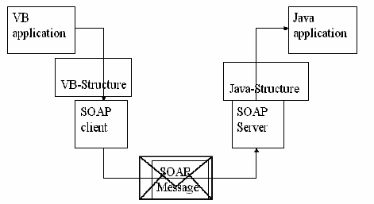
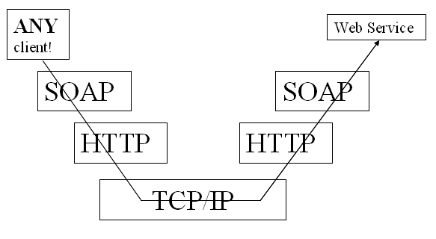
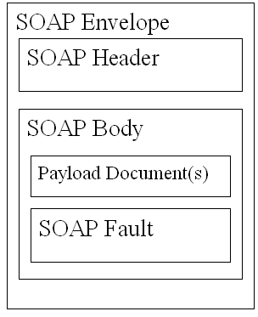
Web Services & Simple Object Access Protocol
Architecture View
Protocol View
Binary
Binary
Serialize
ASCII
Deserialize
POST /services/VersionRequest HTTP/1.0
Content Length: 123
Host: http://user.iems.nwu.edu/
Content-type: text/xml; charset=utf-8
<?xml version="1.0" encoding="UTF-8"?>
<soap:Envelope …>
<soap:Body>
<m:SolverVersionRequestMsg
xmlns:m="http://www.optimizationservices.org/soap-methods/">
<question xsi:type="xsd:string">
What is the version of the IMPACT MINLP solver?
</question >
</m: SolverVersionRequestMsg >
</soap:Body>
</soap:Envelope>
Envelope
Actual Message
Contains call and response information
d

Slide 14
Web Services & Web Service Definition Language
The standard format for describing a web service.
  Describes how to access a web service and what operations it will perform
  Can be provided through UDDI registries
  XML based
    PortType – Application Programming Interface
    Operation -- Methods/Function prototype
    Message – Parameters which can be input, output or fault message
    Types -- Actual data types in a message, e.g. array of integers
    Binding – Transport protocol and encoding protocol
    Port – Network address
    Service – A collection of ports

Slide 15
Web Services & Web Service Definition Language
<wsdl:definitions …>
<message name="favoriteSolverRequest">
<part name="question" type="xsd:string" />
</message>
<message name="favoriteSolverResponse">
<part name=“answer" type="xsd:string" />
</message>
<portType name="SimpleSolver">
<operation name="favoriteSolver" parameterOrder="question">
<input message="favoriteSolverRequest" …>
<output message="favoriteSolverResponse" …>
</operation>
</portType>
<binding name="SimpleSolverSoapBinding" type="intf:SimpleSolver">
<wsdlsoap:binding style="rpc" transport="http://schemas.xmlsoap.org/soap/http" />
…
</binding>
<service name="SimpleSolverService">
<port binding="intf:SimpleSolverSoapBinding" name="SimpleSolver">
<wsdlsoap:address location="http://localhost:8080/axis/SimpleSolver.jws" />
</port>
</service>
</wsdl:definitions>
Name of Program
Method
Interface
Input & Output
Protocol
Address
Where the Web Service is

Slide 16
Web Services, Web Service Inspection Language
& Universal Description Discovery and Integration
WSIL
  Specification for online web service registries (cf. web page search engines)
  Light weighted and complements UDDI
  XML based
    <inspection …>
    <abstract>Impact is an Integrated Mathematical Programming Advanced Computational Tool.</abstract>
    <service>
    <name>Impact Solver Service</name>
    <abstract>The version of the Impact service is 1.0. It solves many types of optimization problems.</abstract>
    <description
    referencedNamespace=http://schemas.xmlsoap.org/wsdl/
    location="http://www.optimizationservices.org/os/ossolver/ImpactSolverService?wsdl">
    </description>
    </service>
    <link location=" http://www.optimizationservices.org/os/ossolver/JunMaSolverService.wsil" >
    <abstract>JunMa Solver Service</abstract>
    </link>
    </inspection>
UDDI
  Heavyweight (think of yellow pages)
  Also specifies business models
  Provides a complete set of SOAP query APIs for searching web services

Slide 17
Open Grid Services Architecture & Web Services
OGSA (Globus Toolkit)
  - Protocol deficiencies
  - Mainly in scientific world
  - Missing functionality
  + Support transient services
  + Reliable and secure transport
  + Service creation
  + Global naming and references
  + Service management
  + Registration
  + Notification
  + Authorization
  + Concurrency
Web Service
  + Increasingly popular
  + Standards-based
Web services w/ grid – good idea
Becoming a topic at the super computing conferences
Will eventually converge till no distinction
  My feeling, and my hope
  Not a question of who wins
  Both provide something
Good for our Optimization Services

Slide 18
Outline
Abstract
Background
  A General Picture – The Future of Computing
  Our Positioning – The Hierarchy of Operations Research
  Some Terminologies (Parallel/Distributed/Grid Computing, XML, Web Services, etc.)
Motivation
  Motorola's VP Intelligent Optimization System
  AMPL-NEOS
The Design and Framework for Distributed Optimization (NSF Funded)
  Proposing and Defining Optimization Services (OS, OSXL)
  Design of Distributed Optimization Architecture (Centralized and Decentralized)
  Optimization Services Representation (OSTL, OSRL, OSOL, OSSL, OSAL)
  Optimization Services Communication (OSCL, OSDL, OSFL, OSEL)
  Optimization Services Inspection and Discovery (OSIL, OSPL, OSBL, OSQL)
Future Work and Conclusion

Slide 19
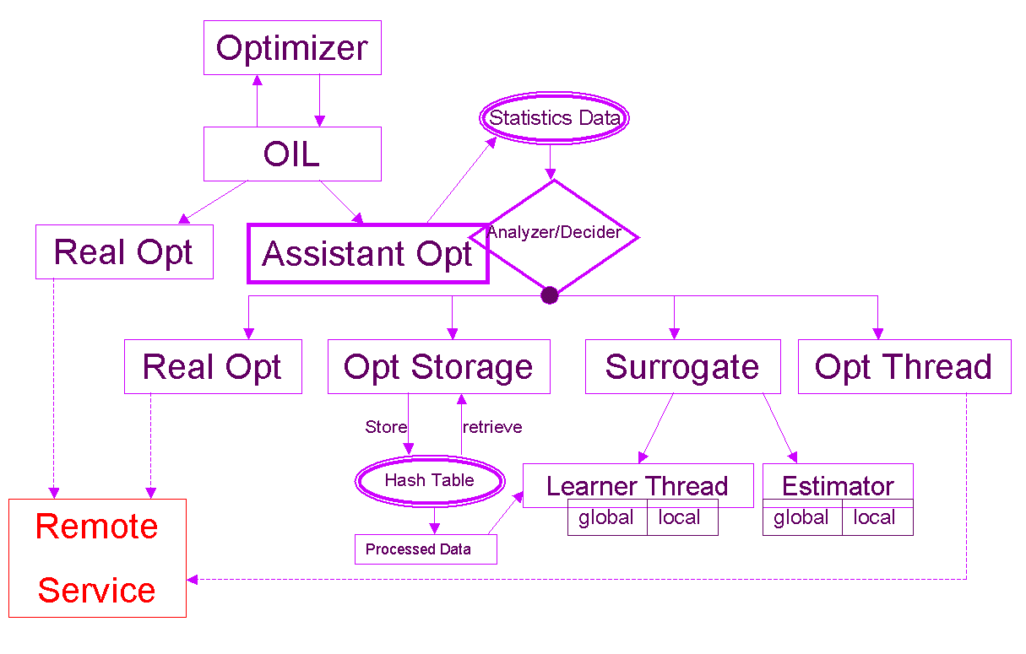
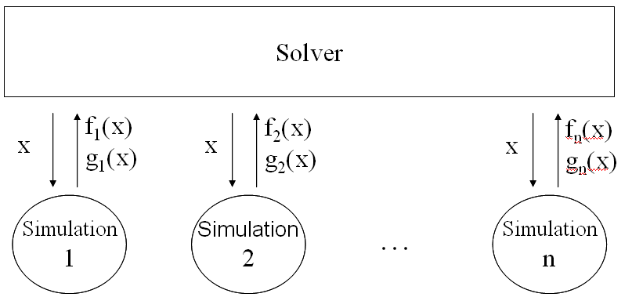
Motorola's VP Intelligent Optimization System
Architect and Procedures
Solver Architecture
Client
Model Constructor
Simulation Engine 2
…
Simulation Engine 1
Data Flow View

Slide 20
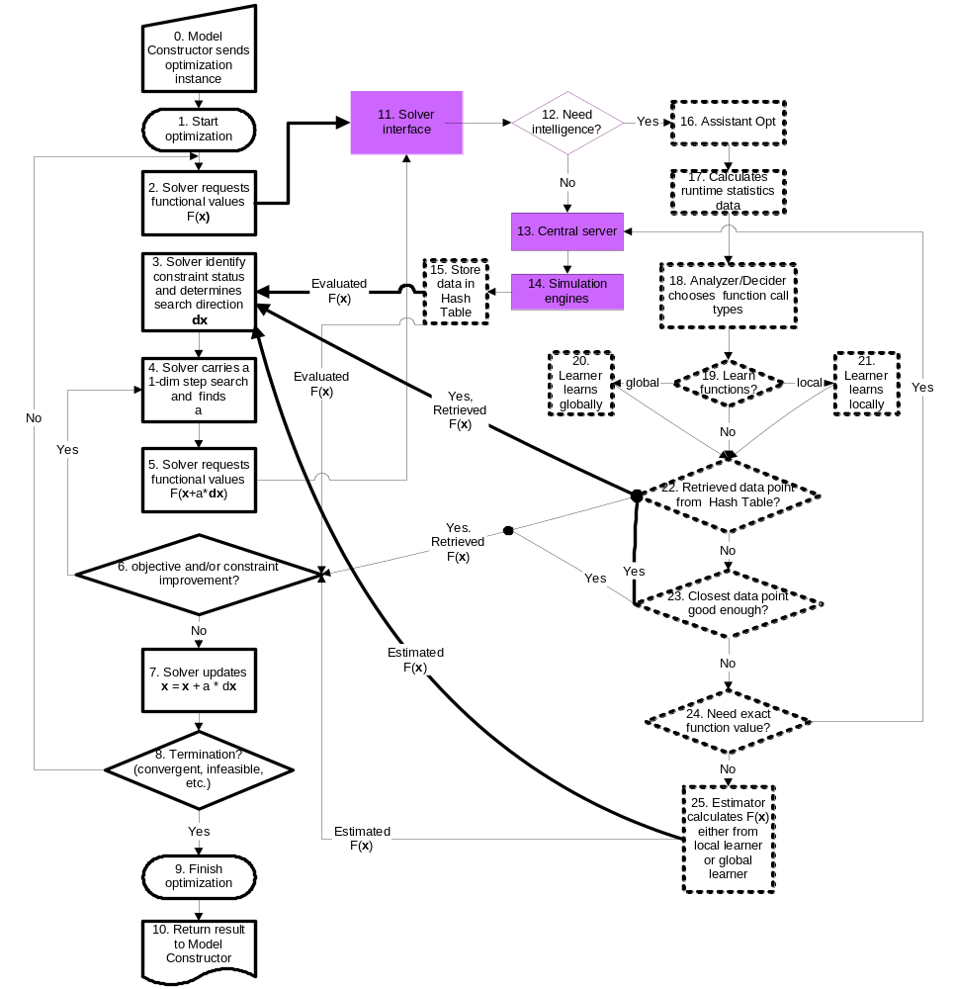

Slide 21
Motorola's VP Intelligent Optimization System
Service Requirement
+ System Architecting
+ Interfacing & Invocation
  Client & Server
  Model & Solver
  Solver & Simulation
+ Data Flow and Representation
+ Input Parsing and Output Generation
+ Variable/Objective/Constraint Construction
+ Service Location & Discovery (Not a problem in a centralized ASP)
? Common Variable Resolution (Can be included in OSFL)
? Simulation Service Flow (Can be included in OSFL)
? Metrics Interpretation (To a certain degree given naming standardization)
? Process Monitoring & Management (OSEL, OSPL)
? Job Queue Management (OSEL)
? Interdisciplinary Domain Knowledge Management (OSFL)
- Result Presentation/Mapping
- Intelligence Learning (Local Surrogate/Accelerator)
(“+” intended to solve in our framework; “?” Partially supported; “–” Not in our framework domain)

Slide 22
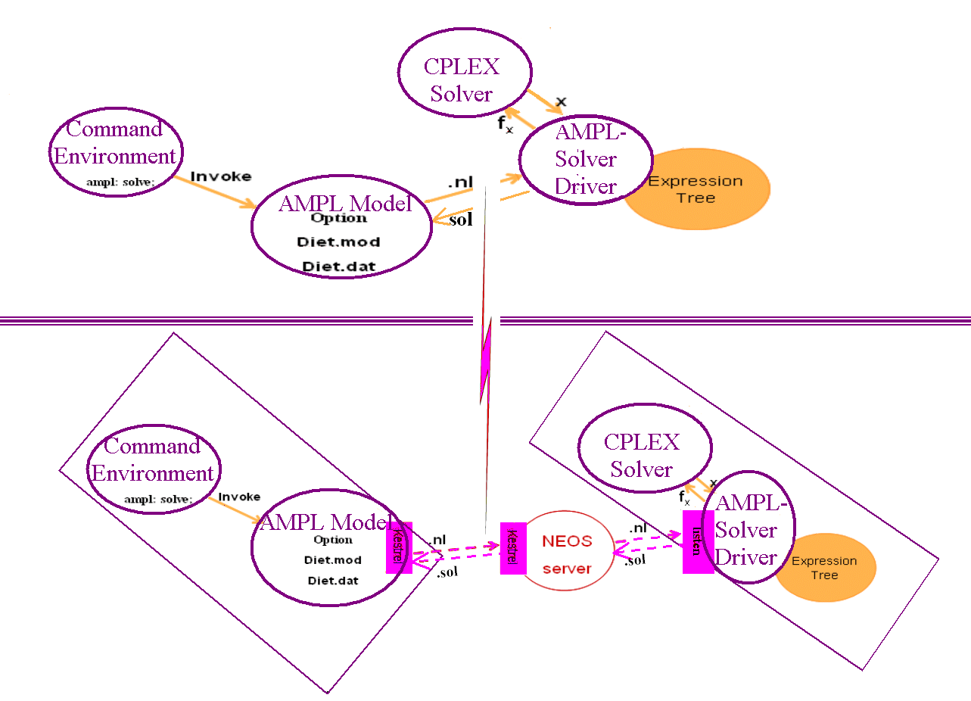
AMPL - NEOS

Slide 23
Outline
Abstract
Background
  A General Picture – The Future of Computing
  Our Positioning – The Hierarchy of Operations Research
  Some Terminologies (Parallel/Distributed/Grid Computing, XML, Web Services, etc.)
Motivation
  Motorola's VP Intelligent Optimization System
  AMPL-NEOS
The Design and Framework for Distributed Optimization (NSF Funded)
  Proposing and Defining Optimization Services (OS, OSXL)
  Design of Distributed Optimization Architecture (Centralized and Decentralized)
  Optimization Services Representation (OSTL, OSRL, OSOL, OSSL, OSAL)
  Optimization Services Communication (OSCL, OSDL, OSFL, OSEL)
  Optimization Services Inspection and Discovery (OSIL, OSPL, OSBL, OSQL)
Future Work and Conclusion

Slide 24
Proposing ”Optimization Services”
Optimization Services (temporary definition)
  SOAP based web services (potentially also leveraging on grid computing technologies) with specified interfaces and behaviors under the general framework of distributed optimization, including the following OSXL’s:
  for representing optimization instances,
    Optimization Services Template Language (OSTL)
    Optimization Services Result Language (OSRL)
    Optimization Services Option Language (OSOL)
    Optimization Services Simulation Language (OSSL)
    Optimization Services Analysis Language (OSAL)
  for controlling optimization accesses, flows and operations,
    Optimization Services Client Language (OSCL)
    Optimization Services Description Language (OSDL)
    Optimization Services Flow Language (OSFL)
    Optimization Services Endpoint Language (OSEL)
  for discovering and inspecting optimization services,
    Optimization Services Inspection Language (OSIL)
    Optimization Services Process Language (OSPL)
    Optimization Services Benchmark Language (OSBL)
    Optimization Services Query Language (OSQL)

Slide 25
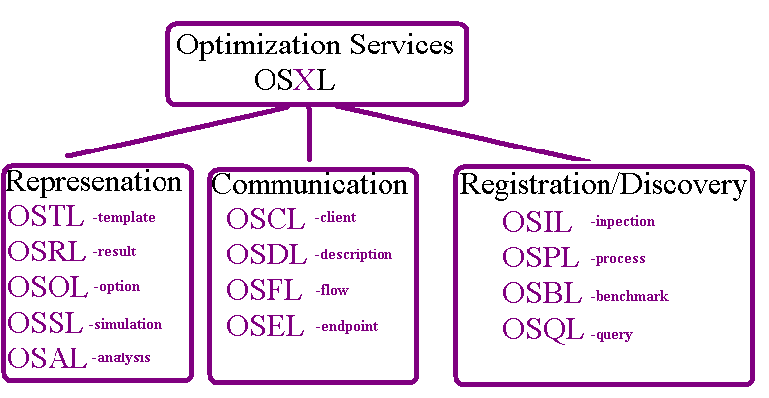
Proposing ”Optimization Services”

Slide 26
Outline
Abstract
Background
  A General Picture – The Future of Computing
  Our Positioning – The Hierarchy of Operations Research
  Some Terminologies (Parallel/Distributed/Grid Computing, XML, Web Services, etc.)
Motivation
  Motorola's VP Intelligent Optimization System
  AMPL-NEOS
The Design and Framework for Distributed Optimization (NSF Funded)
  Proposing and Defining Optimization Services (OS, OSXL)
  Design of Distributed Optimization Architecture (Centralized and Decentralized)
  Optimization Services Representation (OSTL, OSRL, OSOL, OSSL, OSAL)
  Optimization Services Communication (OSCL, OSDL, OSFL, OSEL)
  Optimization Services Inspection and Discovery (OSIL, OSPL, OSBL, OSQL)
Future Work and Conclusion

Slide 27
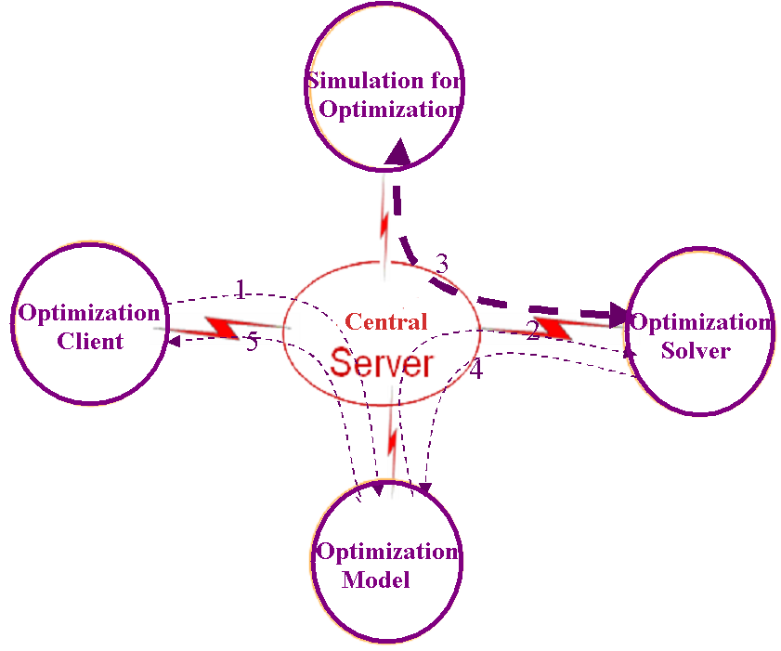
Design of Distributed Optimization Architect
Centralized

Slide 28
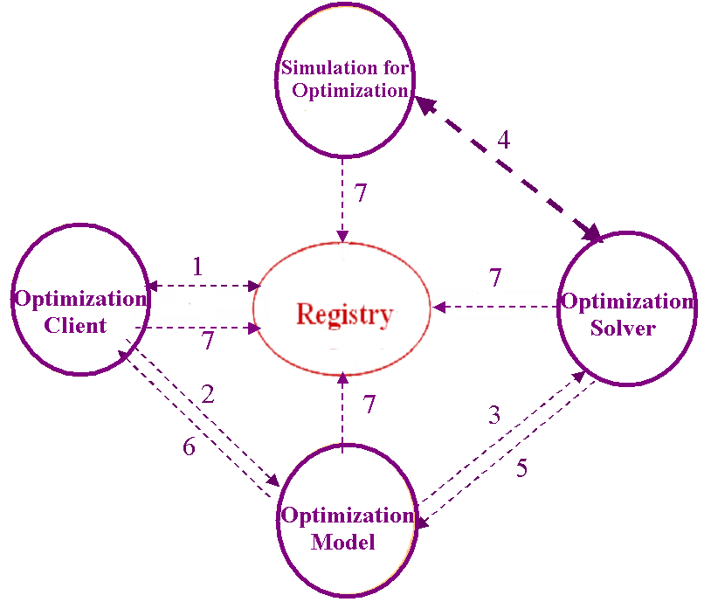
Design of Distributed Optimization Architect
Decentralized (Recommended)

Slide 29
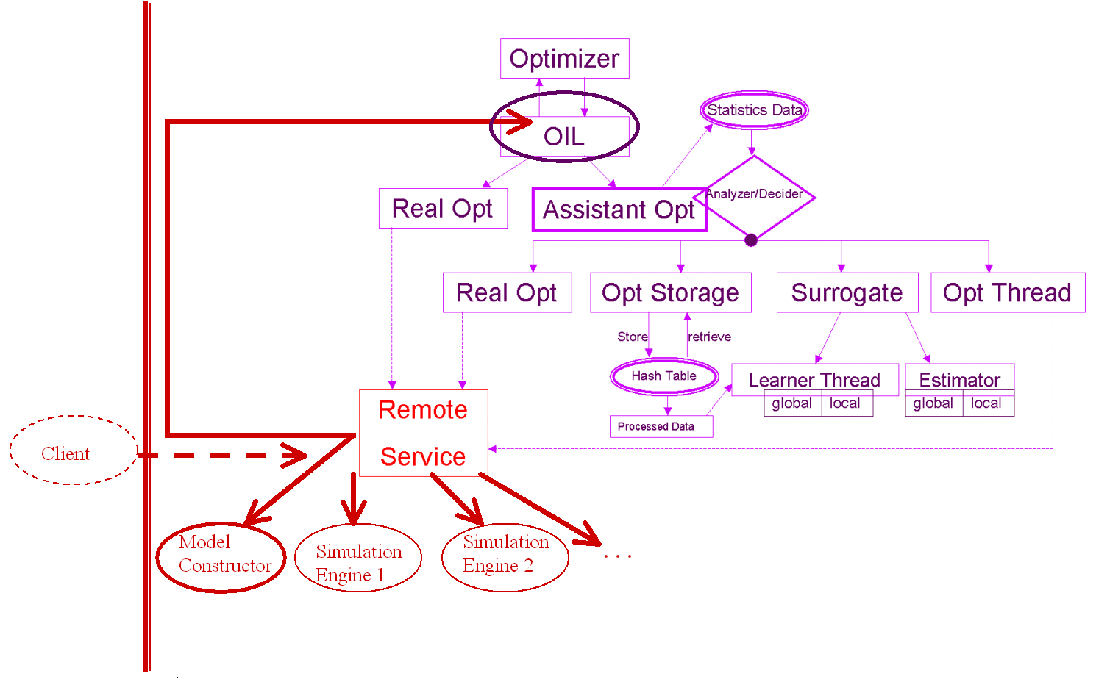
Application Service Provider Revisited

Slide 30
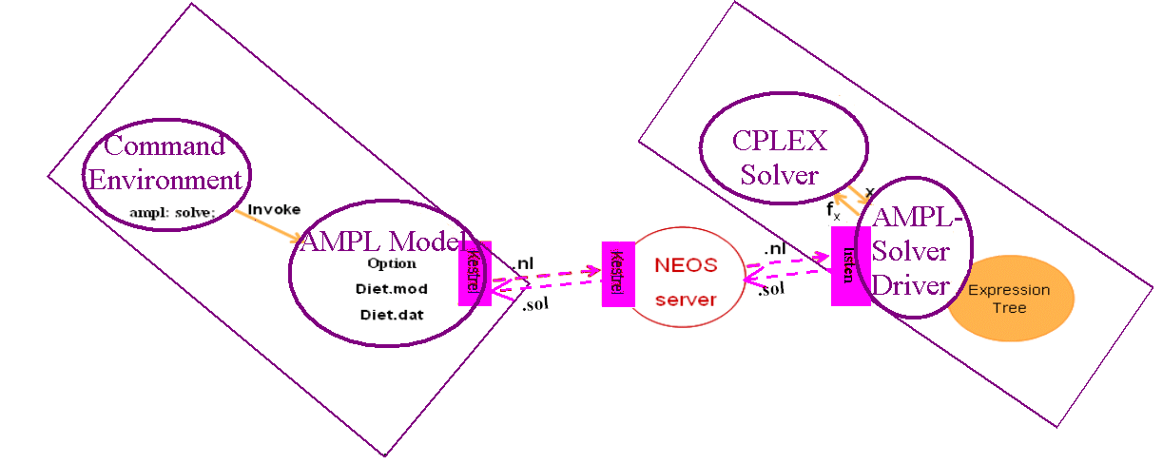
AMPL-NEOS Revisited
No More

Slide 31
Outline
Abstract
Background
  A General Picture – The Future of Computing
  Our Positioning – The Hierarchy of Operations Research
  Some Terminologies (Parallel/Distributed/Grid Computing, XML, Web Services, etc.)
Motivation
  Motorola's VP Intelligent Optimization System
  AMPL-NEOS
The Design and Framework for Distributed Optimization (NSF Funded)
  Proposing and Defining Optimization Services (OS, OSXL)
  Design of Distributed Optimization Architecture (Centralized and Decentralized)
  Optimization Services Representation (OSTL, OSRL, OSOL, OSSL, OSAL)
  Optimization Services Communication (OSCL, OSDL, OSFL, OSEL)
  Optimization Services Inspection and Discovery (OSIL, OSPL, OSBL, OSQL)
Future Work and Conclusion

Slide 32
High and Low Levels of
Optimization Representation
High Level Optimization Representation
  Example: AMPL, GAMS, LINGO, ILOG OPL etc.
  Abstract algebraic representation of a problem
  Separation between model and data
Optimization Services Representation
  Example: MPS – linear programming, SMPS – stochastic programming, .nl – used in AMPL, numerous proprietary formats used in commercial solvers
  Considered in our framework
  An optimization problem instance
  Generated by filling the model with corresponding data

Slide 33
Lower Level Optimization Representation
Optimization Services Template Language (OSTL)
It’s not “Optimization Services Modeling language.” It is “Optical Spectroscopy Markup Language” (The National Scientific Research Center – France)
“Modeling” may be confused with high level algebraic modeling languages.
A unified optimization instance representation – think of skeleton or simply template
Possible function type to be included (listed in terms of possibility)
  Existing standard linear representation in XML
  Simulation engine used for function evaluation through optimization
    Called through OSCL
    Represented through OSSL
  MathML for simple relation and nonlinear representation
  Existing standard linear representation in ASCII
  Binary expression or function calculation executable that takes OSSL as input and output
Constraints expressed as combination of individual constraints (mainly nonlinear or closed form) and constraint sets (mainly for linear form and matrices)
Can contain an optional section of optimization analysis represented by OSAL

Slide 34
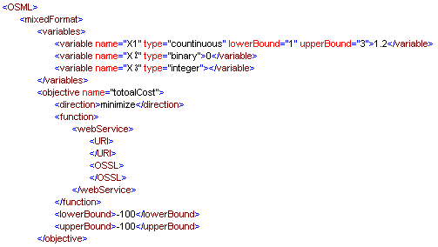

Lower Level Optimization Representation
Optimization Services Template Language (OSTL)
or

Slide 35
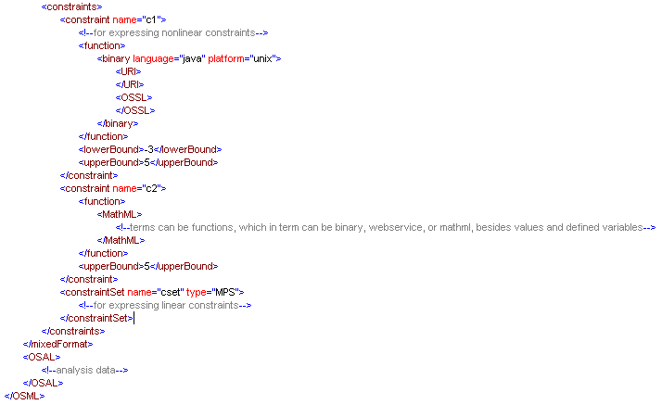
Lower Level Optimization Representation
Optimization Services Template Language (OSTL)

Slide 36
Lower Level Optimization Representation
Optimization Services Result Language (OSRL)
Contains 4 sections
  Status
  Variables
  Objective
  Constraints
  May contain extended contents
Names of different types of results associated with variables, the objective and constraints should be standardized (don’t necessarily have to be reported)
Think of AMPL suffixes

Slide 37
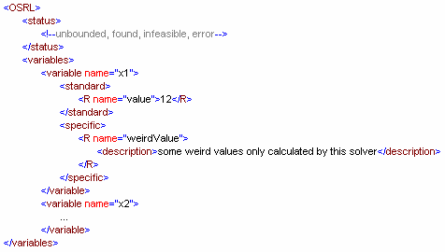
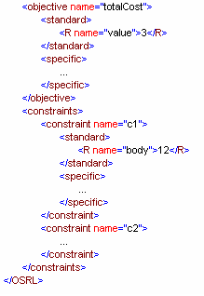
Lower Level Optimization Representation
Optimization Services Result Language (OSRL)

Slide 38
Lower Level Optimization Representation
Optimization Services Option Language (OSOL)
Separate from OSTL, because it is solver specific, rather than problem specific
Contains 2 sections
  Standard
    Common names of solver options
    Contains optional description (because it is standardized)
    Can be used for solver inspection and discovery
  Specific
    Solver specific
    Better contains a description for each option
    Option values are typeless (For simplification. Think of Python)

Slide 39
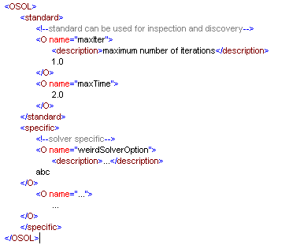
Lower Level Optimization Representation
Optimization Services Option Language (OSOL)

Slide 40
Lower Level Optimization Representation
Optimization Services Simulation Language (OSSL)
Used both for client initiating optimization model and solver calling simulation engines
Contains an input and/or an output section.
Input section contains two types of elements, both are typeless
  Variable
  Parameter
From perspective of simulation engine or function evaluator (binary executables), they are both input arguments
Reasoning for having two types of input argument
  Parameters are fixed, whereas variables change
  Iterative nature of optimization
  Network trafficking
  Variable matching between OSSL and OSML
  Different treatment for numerical analysis, e.g. variable be represented more accurately for calculating derivatives

Slide 41
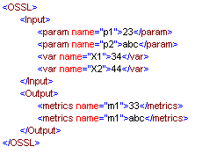
Lower Level Optimization Representation
Optimization Services Simulation Language (OSSL)

Slide 42
Lower Level Optimization Representation
Optimization Services Analysis Language (OSAL)
Separate from OSTL, because it is analyzer specific, as well as problem specific
AMPL .nl file does some analysis
Analyzer [H.J. GreenBerg]
MProbe [J.W. Chinneck, Carleton U.]
Convexity detection [D. Orban, NU]
Other solver recommendation projects [A. Neumeier, U. of Vienna]
Contains 2 sections
  Standard
    Common names and analyses from analyzers
    Contains optional description (because it is standardized)
  Specific
    Analyzer specific
    Better contains a description for each option
    Analysis values are typeless

Slide 43
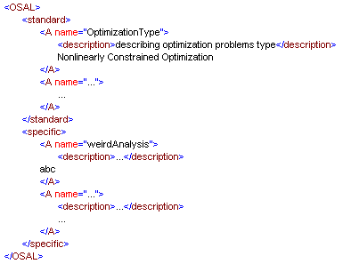
Lower Level Optimization Representation
Optimization Services Analysis Language (OSAL)

Slide 44
Outline
Abstract
Background
  A General Picture – The Future of Computing
  Our Positioning – The Hierarchy of Operations Research
  Some Terminologies (Parallel/Distributed/Grid Computing, XML, Web Services, etc.)
Motivation
  Motorola's VP Intelligent Optimization System
  AMPL-NEOS
The Design and Framework for Distributed Optimization (NSF Funded)
  Proposing and Defining Optimization Services (OS, OSXL)
  Design of Distributed Optimization Architecture (Centralized and Decentralized)
  Optimization Services Representation (OSTL, OSRL, OSOL, OSSL, OSAL)
  Optimization Services Communication (OSCL, OSDL, OSFL, OSEL)
  Optimization Services Inspection and Discovery (OSIL, OSPL, OSBL, OSQL)
Future Work and Conclusion

Slide 45
Lower Level Optimization Communication
Optimization Services Client Language (OSCL)
Specifies the following client interface for it to get function values
  String call (String input)
Both return value and input value should be of the XML form specified in OSSL
Default binding should be SOAP to HTTP
Used to call a standard web service used as a simulation for optimization
When solver needs a function value from a web service, the solver is considered a client
It should be a Remote Procedure Call
Port address (location of web service) should be specified

Slide 46
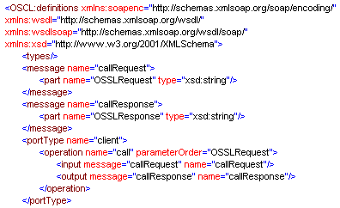
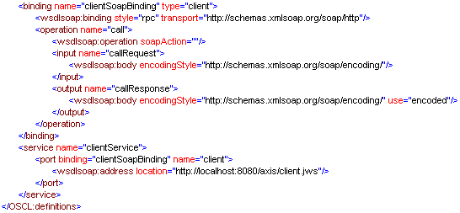
Lower Level Optimization Communication
Optimization Services Client Language (OSCL)

Slide 47
Lower Level Optimization Communication
Optimization Services Description Language (OSDL)
Mechanism similar to OSCL
Specifies the following 3 standard solver interfaces
  int solver (binary solve)
  Input specifies whether just checking status (false) or finally need to solve (true)
  Output reports solver status (possibly -1 if not ready, or a positive integer indicating job number for later retrieval)
  String set (String input)
  Both input and output should be of the XML format specified in OSOL
  Option values are set to empty if certain option input cannot be resolved
  String solve (String input)
  Input should be of the XML format specified in OSTL
  Output should be of the XML format specified in OSRL
Other interfaces are possible but solver/optimization specific
But probably don’t need a stop function (We may well leverage it as well as other similar “management” functions on grid computing technologies. So hope they will be merged with web services)

Slide 48
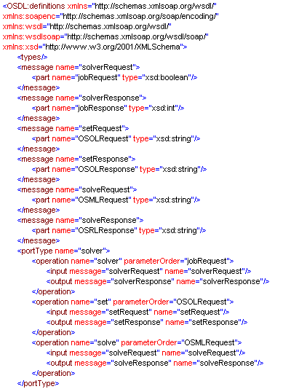
Lower Level Optimization Communication
Optimization Services Description Language (OSDL)

Slide 49
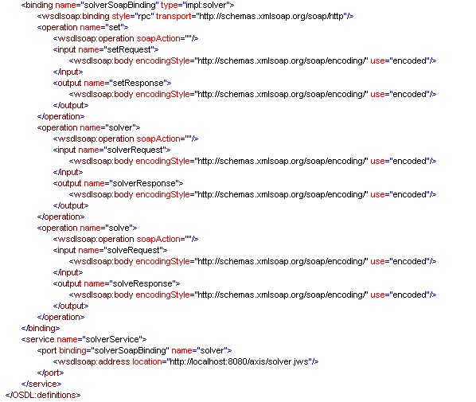
Lower Level Optimization Communication
Optimization Services Description Language (OSDL)

Slide 50
Lower Level Optimization Communication
Optimization Services Flow Language (OSFL)
Reserved for now
Exact purpose is clear and may be necessary. But don’t know of an appropriate design
Intention is to organize analyzers, solvers, optimization simulations and other Optimization Services components, orchestrate information (e.g. input and output), sequence optimization process, resolve common variables etc.
May prove to be especially useful in multi-objective, multi-start, multi-level, multi-disciplinary, Multi-processor optimization, Pareto-set optimization
It is likely that OSFL will highly leverage on the interfaces specified in OSDL.
May also need to collaborate with OSPL
OSFL will probably wait to see the success and popularity of other OSXL.

Slide 51
Lower Level Optimization Communication
Optimization Services Endpoint Language (OSEL)
Reserved for now
Exact purpose not clear (may overlap with grid computing, thus unnecessary to design it)
Intention is to be compatible with certain grid computing features
Mainly to describe non-functional characteristics of an Optimization service
  Quality of Service
  Privacy policy
  Auditing policy
Should not affect the core syntax of OSDL
May affect whether the solver requestor chooses to collaborate with a particular solver provider
Can be important for asynchronous message flows (that is not request and response model)
  Expected optimization time
  Possible duration estimates for interaction or number of acceptable retires.
  Basis on which solver requestor could establish time-out behavior, execute rollback or other interaction/compensation mechanism
  Certain other run time information (may need to collaborate with OSPL)

Slide 52
Outline
Abstract
Background
  A General Picture – The Future of Computing
  Our Positioning – The Hierarchy of Operations Research
  Some Terminologies (Parallel/Distributed/Grid Computing, XML, Web Services, etc.)
Motivation
  Motorola's VP Intelligent Optimization System
  AMPL-NEOS
The Design and Framework for Distributed Optimization (NSF Funded)
  Proposing and Defining Optimization Services (OS, OSXL)
  Design of Distributed Optimization Architecture (Centralized and Decentralized)
  Optimization Services Representation (OSTL, OSRL, OSOL, OSSL, OSAL)
  Optimization Services Communication (OSCL, OSDL, OSFL, OSEL)
  Optimization Services Inspection and Discovery (OSIL, OSPL, OSBL, OSQL)
Future Work and Conclusion

Slide 53
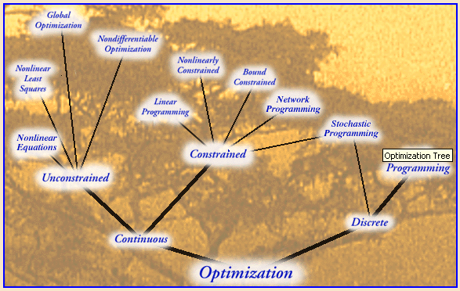
Lower Level Optimization Communication
Optimization Services Inspection Language (OSIL)
Think of optimization tree
Think of it as record in database, only that the record is in XML rather than a row, and likely to be queries by OSQL rather than SQL.
Describing keywords, abstract, description, etc.
Describes Functionalities
  OSOL
  OSBL
  Function type/format accepted
  NEOS ranking ☺
May also provide links to other solvers
This is the piece that probably most need the authorities:
  INFORMS
  OTC/NEOS
  W3C

Slide 54
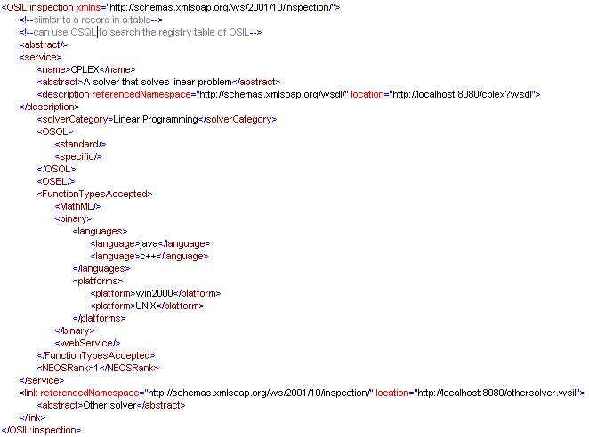
Lower Level Optimization Communication
Optimization Services Inspection Language (OSIL)

Slide 55
Lower Level Optimization Communication
Optimization Services Process Language (OSPL)
Runtime description of solvers
  Status
  Number of jobs in its queue
  Etc.
Contains 2 sections
  Standard
    Common names of solver process information
    Contains optional description (because it is standardized)
    Can be used for solver inspection and discovery
  Specific
    Solver specific
    Better contains a description for each option
    Process values are typeless

Slide 56
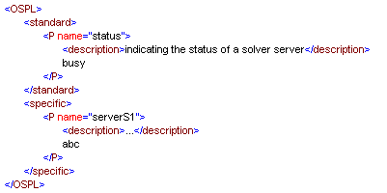
Lower Level Optimization Communication
Optimization Services Process Language (OSPL)

Slide 57
Lower Level Optimization Communication
Optimization Services Benchmark Language (OSBL)
Establishing industry standard for comparing solver algorithms and performances [w/ H. Mittelmann, U of Arizona]
Benchmarking Solver at NEOS
Probably doesn’t need to contain benchmarker specific information, since benchmarking is supposed to be carried out against one single authoritative benchmarker.
Not sure about exact design – will be designed by researchers who do benchmarking analysis.
Not sure where it fits and how it can incorporated in the entire framework (Maybe its separate)
Purpose is to make solver benchmark runs and make comparable results
Can be coupled with OSIL discovery and inspection

Slide 58
Lower Level Optimization Communication
Optimization Services Query Language (OSQL)
A language specification on query syntax
To facilitate discovery of optimization solvers
May just leverage on XMLQuery

Slide 59
Outline
Abstract
Background
  A General Picture – The Future of Computing
  Our Positioning – The Hierarchy of Operations Research
  Some Terminologies (Parallel/Distributed/Grid Computing, XML, Web Services, etc.)
Motivation
  Motorola's VP Intelligent Optimization System
  AMPL-NEOS
The Design and Framework for Distributed Optimization (NSF Funded)
  Proposing and Defining Optimization Services (OS, OSXL)
  Design of Distributed Optimization Architecture (Centralized and Decentralized)
  Optimization Services Representation (OSTL, OSRL, OSOL, OSSL, OSAL)
  Optimization Services Communication (OSCL, OSDL, OSFL, OSEL)
  Optimization Services Inspection and Discovery (OSIL, OSPL, OSBL, OSQL)
Future Work and Conclusion

Slide 60
Applications
Virtual Prototyping (T. Tirpak)
iNEOS (J. Nocedal)
IDEAL (W. Chen)
  Experimental Design, Response Surface Methodology, Metamodeling
  Multidisciplinary Optimization
  Multi-level Optimization
Stochastic Programming – Decomposition and Parallel Processing
Integer Programming – Branch and Bound
Optimization Via Simulation
Data Mining/Machine Learning

Slide 61
Possible Future Process
The W3C Model
“I wrote in 1990 a program called "WorlDwidEweb”…
The first three years were a phase of persuasion to get the Web adopted …
In 1992 academia, and in 1993 industry, was taking notice …
After much discussion I decided to form the World Wide Web Consortium in September 1994, with a base at MIT in the USA …”
T. Berners-Lee
The W3C Process Model:
Working Group Notes
Working Drafts
Candidate Recommendations
Proposed Edited Recommendations
Proposed Recommendations
Recommendations

Slide 62
Future Work
To be
  Smoother
  Simpler
  More scalable
  More systematic
Elaboration
Collaboration
Standardization
Finalization
To serve as a basis for other research

Slide 63
Conclusion
Distributed Optimization Design
  Centralized
  Decentralized
Optimization Services
  Representation
  (OSTL, OSRL, OSOL, OSSL, OSAL)
  Communication and Scheduling
  (OSCL, OSDL, OSFL, OSEL)
  Analyzing, Benchmarking and Categorizing
  (OSIL, OSPL, OSBL, OSQL)
OSXL
A B C D E F G
Analysis Benchmark Client Description Endpoint Flow
H I J K L M N
Inspection (Not to be used)
O P Q R S T
Option Process Query Result Simulation Template
U V W X Y Z
(*)

Slide 64
Acknowledgement
To Professor Fourer – for providing the vision and direction.
To Tom Tirpak – for providing the perfect environment, opportunity and motivation
To Professor John Birge and Professor Wei Chen – for serving on my committee
To My wife, Haiyan Xu, who is graduating this afternoon.
To all other OTC members for bring NEOS into being

Slide 65
Misc. Notes (ignore)
Tag, name description value (option), parameter (attribute or element)
Id and href and Soap message with attachment
Web service used locally (conforming to ossl)
Xml with binary attachment <pic xsi:type=“soap-end:base64>*&^KJfak</pic>
Use of ref or URI
Constraint programming
Complementarity problem
Primitive type, array/matrix
<obj> term and relation And closed form expression, name, can be web service choices <web service function> param, variable<>
Data provider and model provider
anyURI datatype usually a url
URIReference: abs or relative
<SOAP-ENC:uriReference>http://www.zvon.org</SOAP-ENC:uriReference>
<foo xsi:type="SOAP-ENC:uriReference">http://www.zvon.org</foo> <SOAP-ENC:uriReference>reference.xml</SOAP-ENC:uriReference>
<foo xsi:type="SOAP-ENC:uriReference">reference.xml</foo> <SOAP-ENC:uriReference>schema.xml#uriReference</SOAP-ENC:uriReference>
<foo xsi:type="SOAP-ENC:uriReference">schema.xml#uriReference</foo>

Slide 66
Using XSL
Client Side
XML
Servers
Web
Server
CGI
XSLT-enabled
Browser
XML
+ Stylesheet
http request
The
Internet
XML response
Server Side
XSLT-engine
HTML
http request
Regular
Browser
Web
Server
Servlet
The
Internet
HTML
XML response

