Slide 1




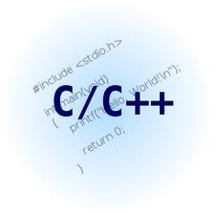
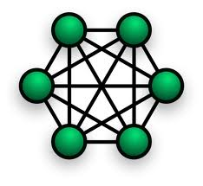
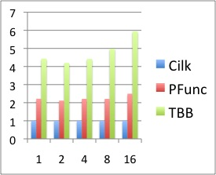
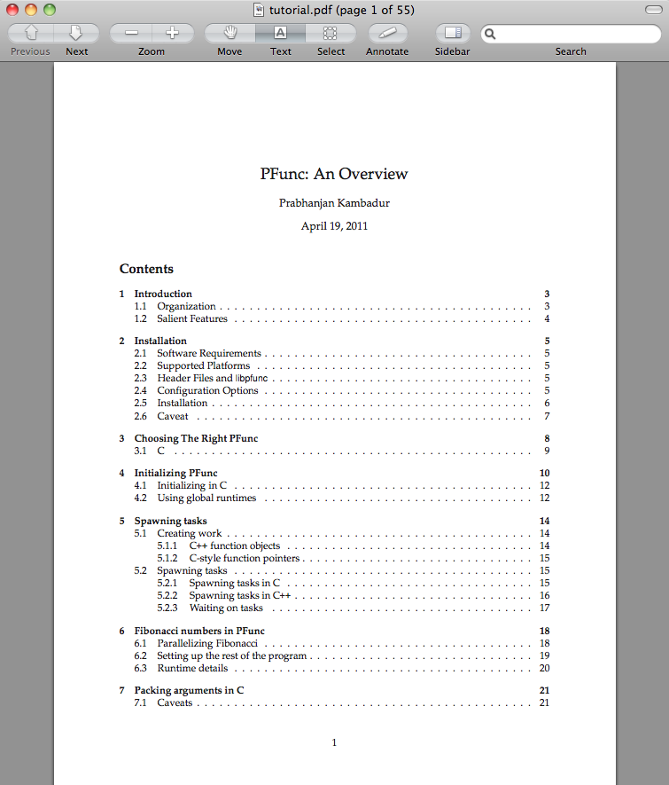


PFunc: A Tool For Teaching And Implementing Task Parallelism
Prabhanjan Kambadur¹, Anshul Gupta¹, Andrew Lumsdaine²
¹ IBM TJ Watson Research Center. ²Indiana University, Bloomington
number
Task Parallelism
Customizing at Compile-time
SPMD-style Parallelism
struct fibonacci {
fibonacci (const int& n):(n),answer(0){}
void operator () () {
if (0 == n || 1 == n) answer = n;
else {
task fib_task;
fibonacci fib_n_1 (n−1), fib_n_2 (n−2);
pfunc::spawn (fib_task, fib_n_1);
fib_n_2();
pfunc::wait (fib_task);
answer=fib_n_1.answer+fib_n_2.answer;
}
}
int answer;
const int n;
};
Fibonacci (n=37)
struct fibonacci;
typedef pfunc::generator <cilkS, /*Scheduling policy*/
pfunc::use_default, /*Compare*/
fibonacci> /*Functor*/ my_pfunc;
typedef my_pfunc::taskmgr taskmgr;
typedef my_pfunc::attribute attribute;
typedef my_pfunc::task task;
Mix task parallelism with SPMD-style programming.
Create groups of tasks; a task can be in only one group.
Tasks can communicate/sync using their group rank.
Barrier primitive on group allows collective syncs.
Scheduling Policy
Pedagogical and Research Aids
2× faster than TBB
2× slower than Cilk
Regular Predicate Pair
Portable, easy to install, and use.
Thorough documentation and tutorials.
Industry-strength exception handling.
PAPI integration for profiling performance.
Growing list of sample applications.
Online user-groups and support.
Task Queue Set
Waiting Predicate Pair
PFunc-specific Features for Task Parallelism
Group Predicate Pair
Spawn tasks on specific queues.
Select from work-stealing to work-sharing at runtime.
Tasks can have multiple parents; execute DAGs seamlessly!
Scheduling point
Loop Parallelism
Loop parallelism is simple, yet powerful.
Completely realized using task parallelism.
NO
Is thread’s own queue empty?
YES
Now Available: PFunc 1.0.
pfunc::parallel_for
Operating System | Processor
Windows XP | x86_32
Linux | ppc32, ppc64, x86_32, x86_64
AIX | ppc32, ppc64
OS X | x86_32, x86_64
Victim queue = own
Predicate = own
Victim queue = other
Predicate = steal
pfunc::parallel_while
pfunc::parallel_reduce
Get candidate tasks
Software Architecture
Select the best task using supplied predicate
Salient Features
User Applications and Libraries
New loop parallelism constructs.
New examples including matmult, scale, and accumulate.
Updated easy-to-use interface.
Updated atomics: compare-and-swap, fetch-and-add, etc.
NO
Found a task?
YES
Task Scheduler
End
PFunc
Perf Profiler
Thread Manager
number
Threads
Feature | Built-in | Default
Scheduling policy | cilkS, prioS, fifoS, lifoS | cilkS
Compare | N/A | std::less<int>
Functor | N/A | virtual_functor
References
https://projects.coin-or.org/PFunc
PFunc: Modern Task Parallelism For Modern High Performance Computing, Kambadur et al., SC 2009.
Demand-driven Execution Of Static Directed Acyclic Graphs Using Task Parallelism, Kambadur et al., HiPC, 2009.
Extending Task Parallelism For Frequent Pattern Mining, Kambadur et al, ParCO, 2009.
PAPI
OS
References:
Frequent Itemset Mining on Graphics Processors, Fang et al., DaMoN 2009.
Turbo-charging Vertical Mining of Large Databases, Shenoy et al., MOD 2000.
NVIDIA Tesla: A Unified Graphics and Computing Architecture, Lindholm et al., IEEE Micro 2008.
An Efficient Compression Scheme For Bitmap Indices, Wu et al., TR LBNL-49626, 2004.
Hardware

