Slide 1




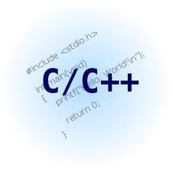
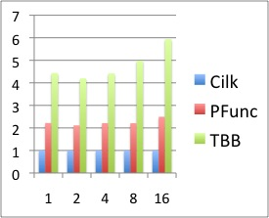
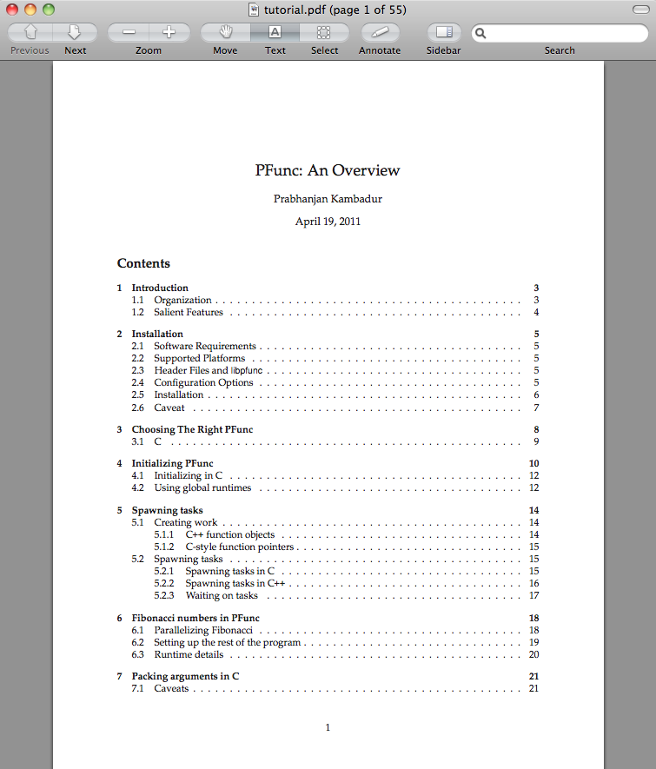
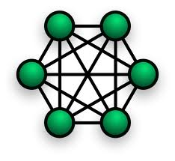


PFunc: A Tool For Teaching And Implementing Task Parallelism
https://projects.coin-or.org/PFunc
Prabhanjan Kambadur¹, Anshul Gupta¹, Andrew Lumsdaine²
¹ IBM TJ Watson Research Center. ²Indiana University, Bloomington
number
Task Parallelism
Customizing at Compile-time
Software Architecture
struct fibonacci {
fibonacci (const int& n):(n),answer(0){}
void operator () () {
if (0 == n || 1 == n) answer = n;
else {
task fib_task;
fibonacci fib_n_1 (n−1), fib_n_2 (n−2);
pfunc::spawn (fib_task, fib_n_1);
fib_n_2();
pfunc::wait (fib_task);
answer=fib_n_1.answer+fib_n_2.answer;
}
}
int answer;
const int n;
};
struct fibonacci;
typedef pfunc::generator <cilkS, /*Scheduling policy*/
pfunc::use_default, /*Compare*/
fibonacci> /*Functor*/ my_pfunc;
typedef my_pfunc::taskmgr taskmgr;
typedef my_pfunc::attribute attribute;
typedef my_pfunc::task task;
User Applications and Libraries
Fibonacci (n=37)
Task Scheduler
Scheduling Policy
PFunc
Perf Profiler
Thread Manager
Threads
Regular Predicate Pair
2× faster than TBB!
Task Queue Set
Waiting Predicate Pair
PAPI
OS
Group Predicate Pair
Hardware
Loop Parallelism
Scheduling point
Loop parallelism is simple, yet powerful.
Completely realized using task parallelism.
Is thread’s own queue empty?
Pedagogical Aids
pfunc::parallel_for
NO
YES
Portable, easy to install, and use.
Thorough documentation and tutorials.
Industry-strength exception handling.
PAPI integration for profiling performance.
Growing list of sample applications.
Online user-groups and support.
Growing list of examples.
Portable atomic operations.
Extensive customizability.
pfunc::parallel_while
pfunc::parallel_reduce
Victim queue = own
Predicate = own
Victim queue = other
Predicate = steal
Get candidate tasks
SPMD-style Parallelism
Mix task parallelism with SPMD-style programming.
Create group of tasks; a task can be in only one group.
Tasks can communicate/sync using their group rank.
Barrier primitive on a group allows collective syncs.
Select the best task using supplied predicate
NO
Found a task?
YES
End
Now Available: PFunc 1.0.
Feature | Built-in | Default
Scheduling policy | cilkS, prioS, fifoS, lifoS | cilkS
Compare | N/A | std::less<int>
Functor | N/A | virtual_functor
Research Aids
Operating System | Processor
Windows XP | x86_32
Linux | ppc32, ppc64, x86_32, x86_64
AIX | ppc32, ppc64
OS X | x86_32, x86_64
Customize task scheduling policy.
Customize task stealing policy.
Customize task priorities.
PAPI integration.
Spawn tasks on specific queues.
Bind threads to processors.*
Work-stealing to work-sharing.
Tasks can have multiple parents.

