Slide 1

Extending Task Parallelism For Frequent Pattern Mining.
Prabhanjan Kambadur, Amol Ghoting, Anshul Gupta and Andrew Lumsdaine.
International Conference on Parallel Computing (ParCO),2009

Slide 2
Overview
Introduce Frequent Pattern Mining (FPM).
  Formal definition.
  Apriori algorithm for FPM.
  Task-parallel implementation of Apriori.
    Requirements for efficient parallelization.
Cilk-style task scheduling
  Shortcomings w.r.t Apriori
Clustered task scheduling policy
Results

Slide 3
FPM: A Formal Definition
Let I = {i₁, i₂, … in} be a set of n items.
Let D = { T₁, T₂ …, Tm} be a set of m transactions such that Ti ⊆ Ι.
  A set i ⊆ I of size k is called k-itemset
Support of k-itemset is ∑j =1, m (1: i ⊆ Τj)
  The number of transactions in D having i as a subset.
“Frequent Pattern Mining problem aims to find all i ∈D that have a support are ≥ to a user supplied value”.

Slide 4
Apriori Algorithm for FPM
TID | Item | Item | Item | Item
1 | A | B | C | E
2 | B | C | A | F
3 | G | H | A | C
4 | A | D | B | H
5 | E | D | A | B
6 | A | B | C | D
7 | B | D | A | G
8 | A | C | D | B
Transaction Database

Slide 5









Apriori Algorithm
A
1 | 2 | 3 | 4 | 5 | 6 | 7 | 8
TID | Item | Item | Item | Item
1 | A | B | C | E
2 | B | C | A | F
3 | G | H | A | C
4 | A | D | B | H
5 | E | D | A | B
6 | A | B | C | D
7 | B | D | A | G
8 | A | C | D | B
B
1 | 2 | 4 | 5 | 6 | 7 | 8
C
1 | 2 | 3 | 6 | 8
D
4 | 5 | 6 | 7 | 8
E
1 | 2
F
2
TID List
G
3 | 7
Transaction Database
H
3

Slide 6






Apriori Algorithm for FPM
A
1 | 2 | 3 | 4 | 5 | 6 | 7 | 8
B
1 | 2 | 4 | 5 | 6 | 7 | 8
Join
AB
1 | 2 | 4 | 5 | 6 | 7 | 8
C
1 | 2 | 3 | 6 | 8
Support (AB) = 87.5%
D
4 | 5 | 6 | 7 | 8
Support (CD) = 25%
Join
CD
6 | 8

Slide 7




















Apriori Algorithm for FPM
Transaction Database
A
B
C
D
Support = 37.5% (3/8)
E
F
G
H
E
F
G
H
Spawn
A
B
C
D
Wait All
AB
AC
AD
BC
BD
CD
ABC
ABD
Notes:
One can say that this is OpenMP parallel for loop. But, each task is not the same duration and we have the same affinity issues as Cilk even here.

Slide 8











Cilk-style parallelization
Order of completion
1 Thread
Order of discovery
11
1
n
5
2
10
n-1
n-2
7
3
n-2
3
n-3
4
n-3
6
n-4
9
6
8
9
1
n-3
n-4
2
7
n-5
n-6
8
4
5
10
11
Depth-first discovery, post-order finish
Notes:
In theory, the DFS execution is slightly altered because of the fact that all the children of a node are put on the queue and then other empty threads are given a chance to actually steal work from them. Note that this is not how its depicted here in this picture.

Slide 9











Cilk-style parallelization
Thread-local Deques
n
Thd 1 | Thd 2
n
Thd 1 | Thd 2
n-2 | n-1
n
Thd 1 | Thd 2
n | n-4
 | n-3
 | n-2
 | n-1
Thd 1 | Thd 2
n-2
n-1
n
Thd 1 | Thd 2
n-3 | n-4
n | n-2
 | n-1
1. Breadth-first theft.
2. Steal one task at a time.
3. Stealing is expensive.
n-1
n-2
n-2
n-3
n-3
n-4
n-3
n-4
n-5
n-6
Steal (n-3)
Steal (n-1)
Notes:
What is labeled is the order of completion
The table shows the tasks in the queue. A will complete last, but is taken off the queue regardless.

Slide 10









Efficient Parallelization of FPM
AB
AC
AD
A
ABC
ABD
AB
Shortcomings of Cilk-style w.r.t FPM:
1. Exploits data locality only b/w parent-child tasks.
2.Stealing does not consider data locality.
3. Tasks are stolen one at a time.
Tasks with overlapping memory accesses:
1. Executed by the same thread.
2. Stolen together by the same thread.

Slide 11






Clustered Scheduling Policy
Cluster k-itemset based on common (k-1) prefix
Hash Table
Hash(A)
AB
AC
AD
Hash(A) xor Hash(B)
ABC
ABD
1. Hash Table - std::hash_map.
2. Hash - std::hash.
Thread-local deque
Thread-local hash table

Slide 12





Clustered Scheduling Policy
Thd 1 Hash Table
Hash(A)
AB
AC
AD
Hash(A) xor Hash(B)
ABC
ABD
Thd 2 Hash Table

Slide 13


Clustered Scheduling Policy
Thd 1 Hash Table
Hash(A)
AB
AC
AD
Thd 2 Hash Table
Hash(A) xor Hash(B)
ABC
ABD
Steal an entire bucket of tasks.
Notes:
1. Tasks are always sorted and are unique. This is important as XOR will produce same hash key for both AB and BA. In our case, it does not really matter.

Slide 14
Where does PFunc fit in?
Customizable task scheduling and priorities.
  Cilk-style, LIFO, FIFO, Priority-based scheduling built-in.
  Custom scheduling policies are simple to implement.
    Eg.,Clustered scheduling policy.
    Chosen at compile time.
    Much like STL (Eg., stl::vector<T>).
namespace pfunc {
struct hashS: public schedS{};
template <typename T>
struct scheduler <hashS, T> { … };
} // namespace pfunc

Slide 15



So, how does it work?
Hash Table-Based
Select Scheduling Policy and priority
Reference to itemset
GetPriority (T) - ABC
Task T;
SetPriority (T, ref (ABD));
Spawn (T);
Generate Hash Key
Hash(A) xor Hash(B)
BCD
BCE
ABC
ABD
Program
Place task
Task Queue
Scheduler

Slide 16
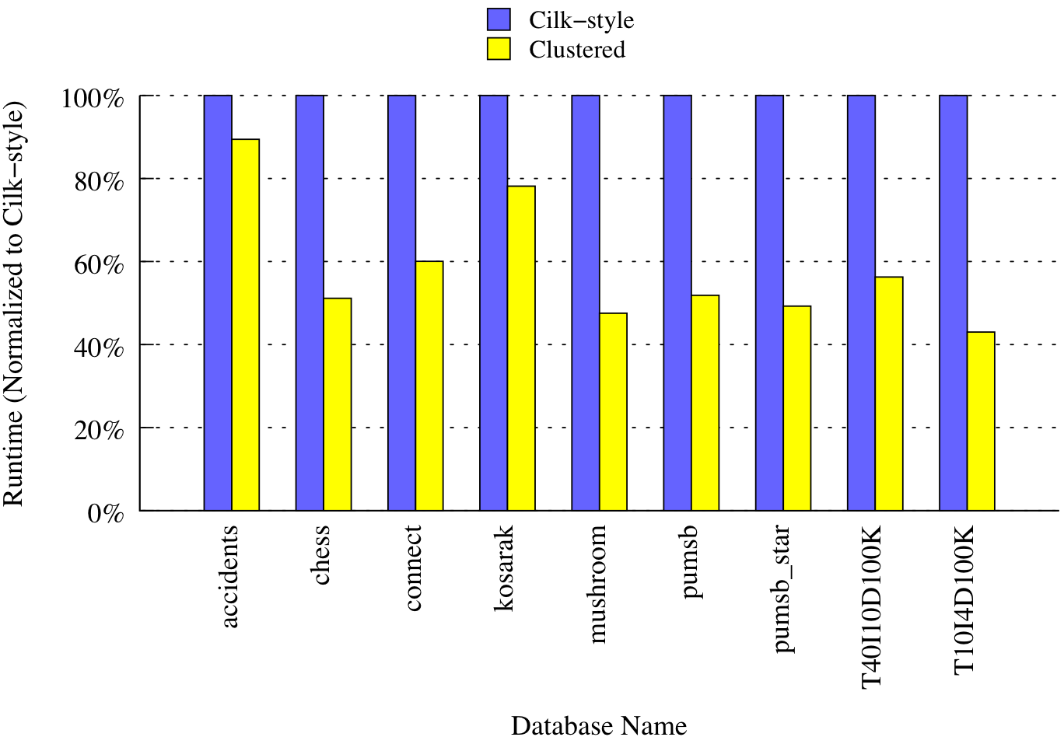
Performance Analysis
8 Threads
Dual AMD 8356, Linux 2.6.24, GCC 4.3.2

Slide 17
Performance Analysis - IPC
Dataset | Support | IPC(Cilk) | IPC(Clustered)
accidents | 0.25 | 0.595 | 0.604
chess | 0.6 | 0.560 | 0.669
connect | 0.8 | 0.543 | 0.809
kosark | 0.0013 | 0.692 | 0.717
pumsb | 0.75 | 0.494 | 0.719
pumsb_star | 0.3 | 0.527 | 0.698
mushroom | 0.10 | 0.570 | 0.705
T40I10D100K | 0.005 | 0.627 | 0.727
T10I4D100K | 0.00006 | 0.556 | 0.716
8 Threads
Higher the better!
Dual AMD 8356, Linux 2.6.24, GCC 4.3.2

Slide 18
Performance Analysis – L1 DTLB Misses
Dataset | Support | Cilk DTLB L1M/L2H | Clustered DTLB L1M/L2H
accidents | 0.25 | 0.000048 | 0.000046
chess | 0.6 | 0.000797 | 0.000242
connect | 0.8 | 0.000249 | 0.000112
kosark | 0.0013 | 0.000400 | 0.000185
pumsb | 0.75 | 0.000230 | 0.000114
pumsb_star | 0.3 | 0.000315 | 0.000145
mushroom | 0.10 | 0.000477 | 0.000267
T40I10D100K | 0.005 | 0.000368 | 0.000305
T10I4D100K | 0.00006 | 0.000218 | 0.000144
8 Threads
Lower the better!
Dual AMD 8356, Linux 2.6.24, GCC 4.3.2

Slide 19
Performance Analysis – L2 DTLB Misses
Dataset | Support | Cilk DTLB L1M/L2M | Clustered DTLB L1M/L2M
accidents | 0.25 | 0.000161 | 0.000110
chess | 0.6 | 0.001006 | 0.000032
connect | 0.8 | 0.001204 | 0.000141
kosark | 0.0013 | 0.000659 | 0.000123
pumsb | 0.75 | 0.001276 | 0.000126
pumsb_star | 0.3 | 0.001082 | 0.000114
mushroom | 0.10 | 0.000950 | 0.000022
T40I10D100K | 0.005 | 0.000900 | 0.000021
T10I4D100K | 0.00006 | 0.000876 | 0.000044
8 Threads
Lower the better!
Dual AMD 8356, Linux 2.6.24, GCC 4.3.2

Slide 20
Conclusions
For task parallel FPM.
  Clustered scheduling outperforms Cilk-style.
    Exploits data locality.
    Better work-stealing policy.
PFunc provides support for facile customizations.
  Task scheduling policy, task priorities, etc.
  Being released under COIN-OR.
    Eclipse Public License version 1.0.
Future work.
  Task queues based on multi-dimensional index structures.
    K-d trees.

Slide 21
Fibonacci 37
Threads | Cilk (secs) | PFunc/Cilk | TBB/Cilk | PFunc/TBB
1 | 2.17 | 2.2718 | 4.431 | 0.5004
2 | 1.15 | 2.1135 | 4.1924 | 0.5041
4 | 0.55 | 2.2131 | 4.4183 | 0.5009
8 | 0.28 | 2.2114 | 4.9839 | 0.4437
16 | 0.15 | 2.4944 | 5.9370 | 0.4201
2x faster than TBB
2x slower than Cilk.
  But provides more flexibility.
  Fibonacci is the worst case behavior!

