Slide 1




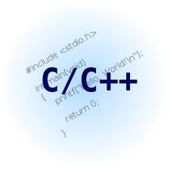
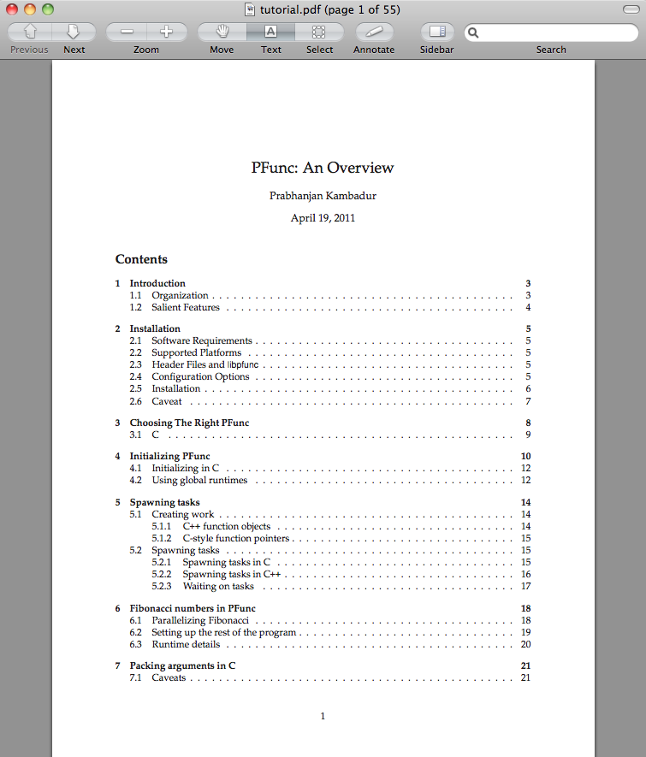
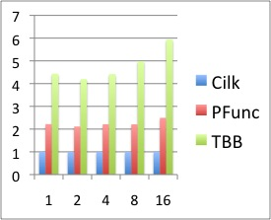


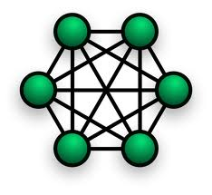
PFunc: A Tool For Teaching And Implementing Task Parallelism
https://projects.coin-or.org/PFunc
Prabhanjan Kambadur¹, Anshul Gupta¹, Andrew Lumsdaine²
¹ IBM TJ Watson Research Center. ²Indiana University, Bloomington
number
Task Parallelism
Customizing at Compile-time
Pedagogical Aids
struct fibonacci {
fibonacci (const int& n):(n),answer(0){}
void operator () () {
if (0 == n || 1 == n) answer = n;
else {
task fib_task;
fibonacci fib_n_1 (n−1), fib_n_2 (n−2);
pfunc::spawn (fib_task, fib_n_1);
fib_n_2();
pfunc::wait (fib_task);
answer=fib_n_1.answer+fib_n_2.answer;
}
}
int answer;
const int n;
};
struct fibonacci;
typedef pfunc::generator <cilkS, /*Scheduling policy*/
pfunc::use_default, /*Compare*/
fibonacci> /*Functor*/ my_pfunc;
typedef my_pfunc::taskmgr taskmgr;
typedef my_pfunc::attribute attribute;
typedef my_pfunc::task task;
Portable, easy to install, and use.
Thorough documentation and tutorials.
Industry-strength exception handling.
PAPI integration for profiling performance.
Growing list of sample applications.
Online user-groups and support.
Growing list of examples.
Portable atomic operations.
Fibonacci (n=37)
Scheduling Policy
Regular Predicate Pair
2× faster than TBB!
Task Queue Set
Waiting Predicate Pair
Group Predicate Pair
Loop Parallelism
Scheduling point
Software Architecture
Loop parallelism is simple, yet powerful.
Completely realized using task parallelism.
User Applications and Libraries
NO
Is thread’s own queue empty?
YES
pfunc::parallel_for
Task Scheduler
pfunc::parallel_reduce
Victim queue = own
Predicate = own
Victim queue = other
Predicate = steal
PFunc
Perf Profiler
Thread Manager
pfunc::parallel_while
Threads
Get candidate tasks
PAPI
OS
SPMD-style Parallelism
Select the best task using supplied predicate
Mix task parallelism with SPMD-style programming.
Create group of tasks; a task can be in only one group.
Tasks can communicate/sync using their group rank.
Barrier primitive on a group allows collective syncs.
Hardware
NO
Found a task?
YES
End
Feature | Built-in | Default
Scheduling policy | cilkS, prioS, fifoS, lifoS | cilkS
Compare | N/A | std::less<int>
Functor | N/A | virtual_functor
Now Available: PFunc 1.0.
Research Aspects
Operating System | Processor
Windows XP | x86_32
Linux | ppc32, ppc64, x86_32, x86_64
AIX | ppc32, ppc64
OS X | x86_32, x86_64
Customize task scheduling policy.
Customize task stealing policy.
Customize task priorities.
PAPI integration.
Spawn tasks on specific queues.
Bind threads to processors.
Work-stealing to work-sharing.
Tasks can have multiple parents.

