Slide 1

Open Source In Optimisation
The
University
of Auckland
  Dr. Stuart Mitchell
  Department of Engineering Science
  University of Auckland
  New Zealand
  s.mitchell@auckland.ac.nz

Slide 2
Contents of presentation
What is Open Source
The open source future for OR
PuLP
Genrating a Yield Frontier with PuLP
Traveling tournement problem with PuLP
Further PuLP examples

Slide 3
What is open source
A term used to describe software distributed in source under licenses guaranteeing anybody rights to freely use, modify, and redistribute the code.
Examples of Open Source software include:
  The Linux Kernel
  The Apache Web Server
  The R Project for Statistical Computing
  Open Cmiss

Slide 4
Statistical software nets technology award
Otago Daily Times 11 Nov 2008
Ross Ihaka has won New Zealand's top award for technology achievements, the 2008 Pickering Medal.
Dr Ihaka, of Auckland University, gained his honour for a package of computer programmes.
The medal was one of series awarded by the national science academy, the Royal Society, before 380 of the nation's senior scientists at Te Papa in Wellington,
Dr Ihaka's software for statisticians, called R, can be downloaded free and has had huge uptake by universities, industry and government.
Readily customised for different applications, it has proved invaluable for major "data crunching" tasks such as processing genomic information.

Slide 5
Statistical software nets technology award
The package and the paper introducing it have been cited over 1700 times in research papers: the highest 'hit-rate' for publications in the mathematical sciences over the past 10 years, worldwide, and it is now disseminated from over 75 internet sites in 30 countries.

Slide 6
The open source future for OR
Presently the Computational OR tools used, taught within this department, are closed source.
  Excel /Storm
  AMPL, GAMS
  CPLEX, EXPRESS, ZIP
Students can not afford commercial licences of this software
Students cannot see how this software works.

Slide 7
The open source future for OR
These tools follow the 'Cathedral' style of development.
  ... software .. built like cathedrals, carefully crafted by individual wizards or small bands of mages working in splendid isolation, with no beta to be released before its time
  Eric S. Raymond
They are also typically expensive for non- academic use

Slide 8
The open source future for OR
Open source tools, for instance the Linux Kernel, can follow a 'Bazaar' development model
  a great babbling bazaar of differing agendas and approaches out of which a coherent and stable system could seemingly emerge only by a succession of miracles
  Eric S Raymond

Slide 9
The open source future for OR
What are the attributes of the Bazaar?
  Publicly available code that is released and updated often
  The ability for anyone to make improvements
  A community that pushes for constant improvement and code quality

Slide 10
The open source future for OR
What are the attributes of the Bazaar?
  Publication:
    Publicly available code that is released and updated often
  Collaboration
    The ability for anyone to make improvements
  Peer Review:
    A community that pushes for constant improvement and code quality

Slide 11
The open source future for OR
Open source therefore naturally complements the research and publication process.
From the Coin-OR website
Why for OR? Consider the following scenario. You read about an optimization algorithm in the literature and you get an idea on how to improve it. Today, testing your new idea typically requires re-implementing (and re-debugging and re-testing) the original algorithm. Often, clever implementation details aren't published. It can be difficult to replicate reported performance. Now imagine the scenario if the original algorithm was publicly available in a community repository. Weeks of re-implementing would no longer be required. You would simply check out a copy of it for yourself and modify it. Imagine the productivity gains from software reuse!

Slide 12
The open source future for OR
Outcomes for students
  Ability to access free (no cost) software to implement their own solutions once they graduate
  Ability to access free (open) source code to see how the algorithms are implemented.
    Imagine the difference to 391??
  The ability to improve the software they use.

Slide 13
PuLP
PuLP is a python module that allows the easy expression of Mathematical Programs
PuLP is built to interface with separate solvers
PuLP is similar in style to:
  AMPL
  GAMS
  OPL
  LINGO
  FLOPC++ etc.

Slide 14
PuLP
Why Python?
  Core Python syntax leads to the concise statement of MP's
  Python is a scripting language so no compilation is needed and the code is platform independent
  Python interfaces easily with external solvers that do the heavy lifting
  Python comes with 'batteries included'
    The Python standard library is huge

Slide 15
PuLP
Written initially by J. S. Roy
Now maintained by S. A. Mitchell
It is available at
http://pulp-or.google-code.com
Now available for Windows and Linux

Slide 16
Generating a Yield Frontier
Total Volume of Pulp logs
40m³
Lines joining extreme points represent the Yield Frontier
Total Volume of Saw logs
20m³

Slide 17
Generating a Yield Frontier
Using pulp we formulate the bucking problem (with a single objective) as a set packing problem by log section.

Slide 18
lp = LpProblem("Bucking Model", LpMaximize)
#set up the logvolume variables
logvol=LpVariable.dicts("LogVolume(\"%s\")",logtypes,0)
#objective
lp+=lpSum([l.price * logvol[l] for l in logtypes]), "Revenue“
#setup the arc variables
x=LpVariable.dict("x(%s)",f_logs,0,1,LpInteger)
#set up a section set partitioning problem
count = 0
for s in stems:
slogs = fs_logs[s]
for i,sec in enumerate(s.sections):
lp +=( lpSum((x[log] for log in slogs
if log.startl <= sec.start
if log.endl > sec.start)) <= 1
, "Stem_Section(\"%s\",%i)" % (str(s),i))
count += 1
#add the constraints that link the log volumes
for lt in logtypes:
lp +=( lpSum((log.volume*x[log]
for log in fl_logs[lt])) - logvol[lt] == 0
, "Logtype_volume(\"%s\")" % str(lt))

Slide 19
Generating a Yield Frontier Using Pulp
We then iteratively solve the problem to find all extreme supported solutions on the Yield Frontier
Equivalent to projecting the problem into the log volume space
I added a module to PuLP that implements projection using Iterative Hull Methods (Lassez, Lassez 1992)
>>> pprob, ppoints = polytope.project(lp, totalvars)

Slide 20
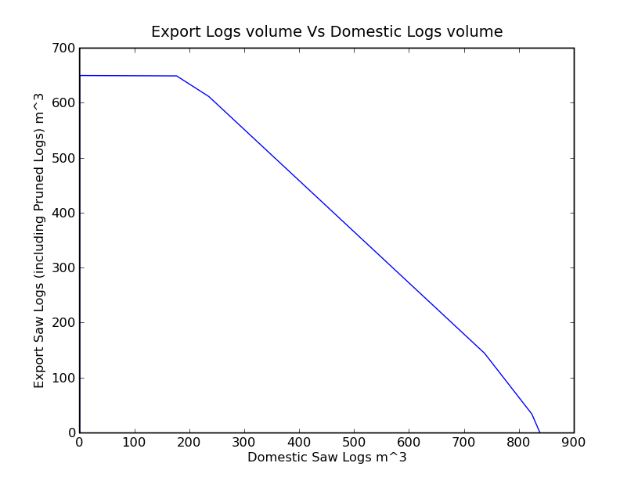
Find Yield Frontier for the Dataset
(176, 649)
(0, 650)
(235, 611)
(737,145)
(0, 0)
(823, 35)
(838, 0)

Slide 21
Find Yield Frontier for a Single Stem
\* Total projected *\
Minimize
OBJ: __dummy
Subject To
_C1: DomSaw + 1.11154598826 ex <= 2669.27592955
_C2: DomSaw + 1.34653465347 ex <= 3118.57425743
_C3: 1.00863930886 DomSaw + ex <= 2522.60691145
Bounds
__dummy = 0
End

Slide 22
Travelling tournament problem with PuLP
This problem models the allocation of teams to Home and Away games in a tournament
A full problem description and datasets are found at Michael Trick's page
http://mat.tepper.cmu.edu/TOURN/

Slide 23
Travelling tournament problem with PuLP
At IFORS 2008 M. Trick presented an approach to finding lower bounds to this problem using combinatorial benders cuts
That evening I implemented his algorithm using PuLP
Along the way I also added Powerset, Combination and Permutation operators to PuLP

Slide 24
lp = LpProblem("Travelling tournement Master", LpMinimize)
#create variables
triplist = [Trip(t1,p) for t1 in teams
for p in
allpermutations([t for t in
teams if t !=t1] ,k)
if p[0] <= p[-1]]
tripvars = LpVariable.dict("mastervar ",triplist,0,1,LpInteger)
#objective
lp += lpSum([t.cost()*tripvars[t]
for t in triplist])
#construct constraints to ensure that all teams visit each other
for t1 in teams:
for t2 in teams:
if t1 != t2:
lp += lpSum([tripvars[t] for t in triplist
if t.team == t1
if t2 in a.awayteams]) == 1, \
"Team_%s_Visits_%s"%(t1,t2)

Slide 25
Further examples
The 392 course has been converted from AMPL to PuLP
http://130.216.209.237/engsci392/pulp/OptimisationWithPuLP
There you can see a number of different ways to construct problems
Note that new language features can be added very easily only needing approval from the BDFL

